Slide 1
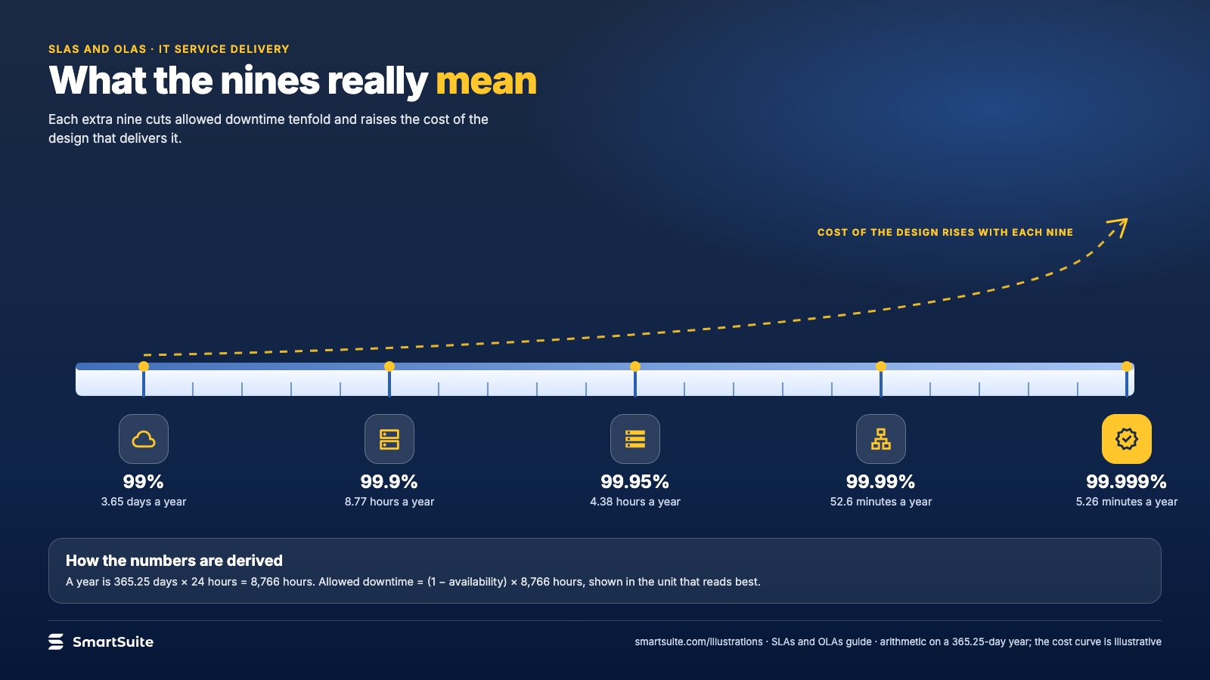
Notes:
What the nines really mean
Allowed downtime per year at each level of availability, and the cost curve that goes with it.
Source: Arithmetic on 365.25 days · From: SLAs and OLAs
Credit: Source: SmartSuite, smartsuite.com/illustrations

Slide 2
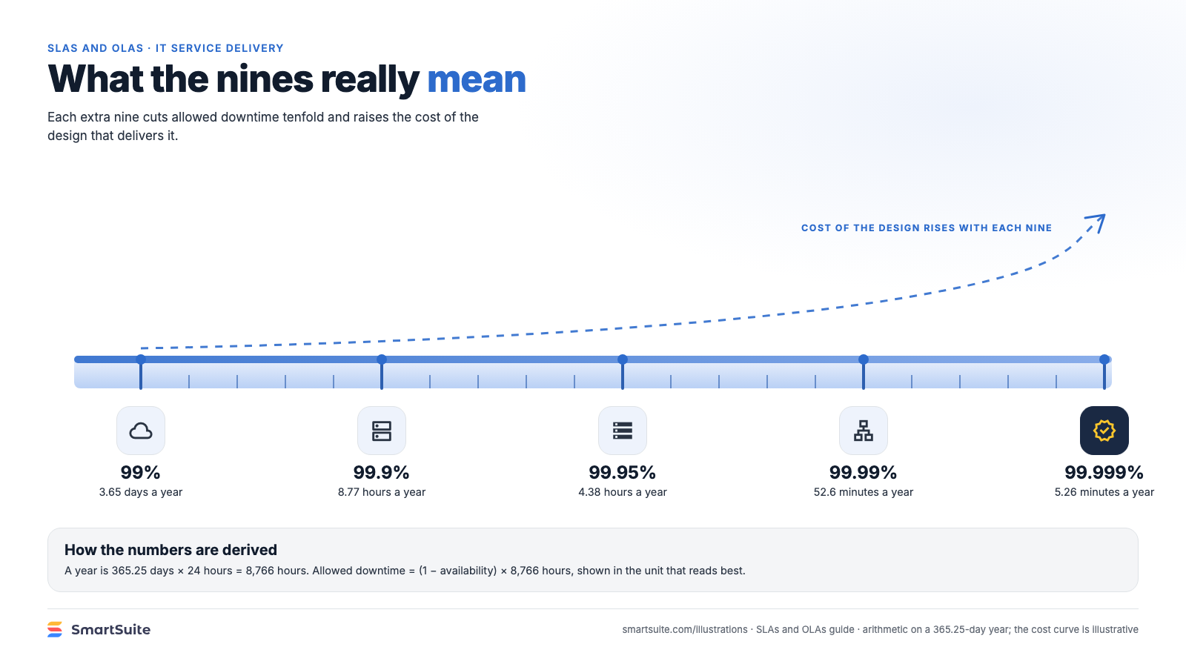
Notes:
What the nines really mean
Allowed downtime per year at each level of availability, and the cost curve that goes with it.
Source: Arithmetic on 365.25 days · From: SLAs and OLAs
Credit: Source: SmartSuite, smartsuite.com/illustrations

