Slide 1
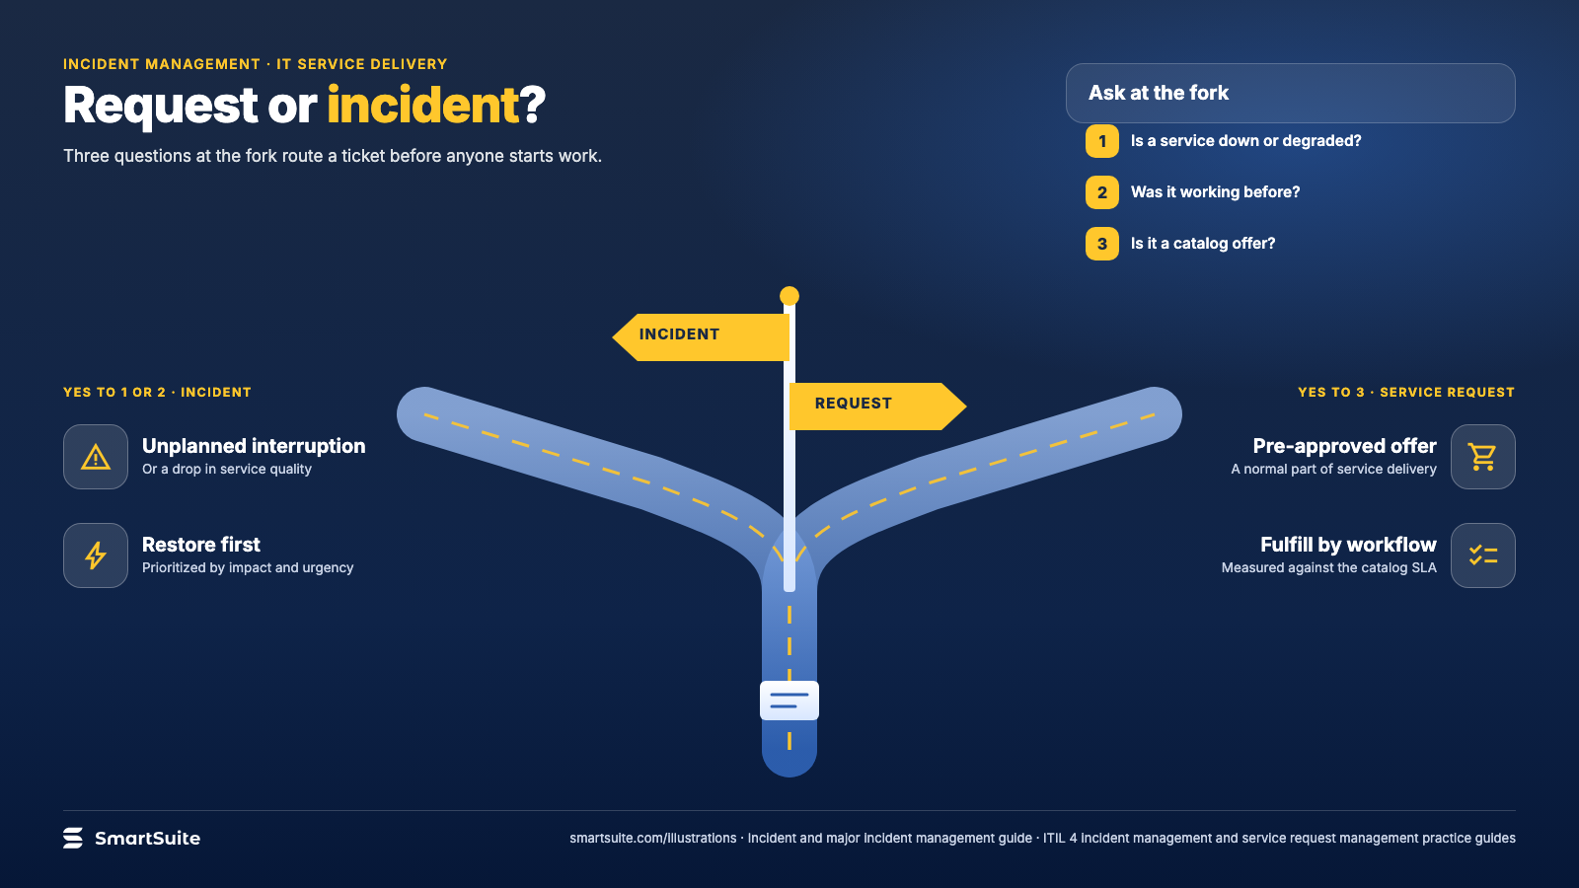
Notes:
Request or incident?
Something is broken, or someone needs something: the three questions that route a ticket correctly.
Source: ITIL 4 Incident Management and Service Request Management practice guides · From: Incident and major incident management
Credit: Source: SmartSuite, smartsuite.com/illustrations

Slide 2
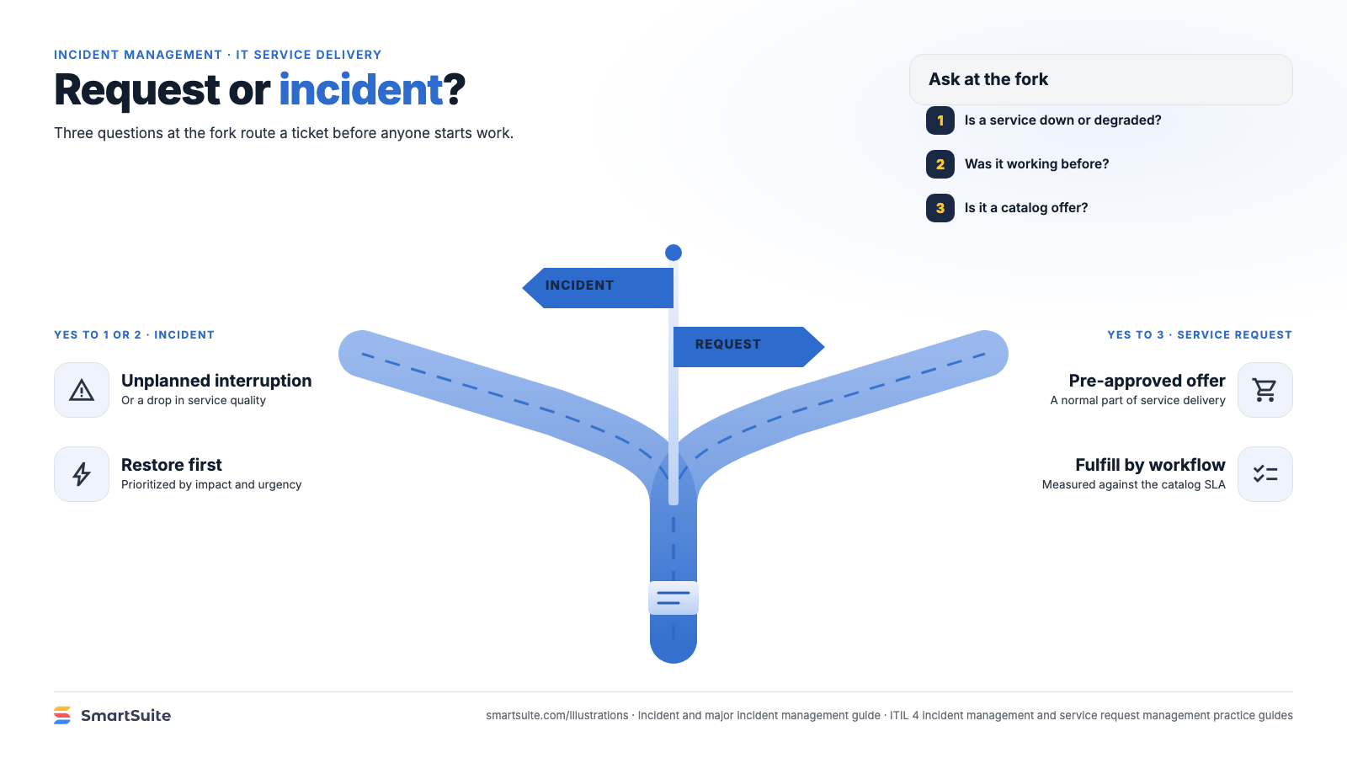
Notes:
Request or incident?
Something is broken, or someone needs something: the three questions that route a ticket correctly.
Source: ITIL 4 Incident Management and Service Request Management practice guides · From: Incident and major incident management
Credit: Source: SmartSuite, smartsuite.com/illustrations

