Slide 1
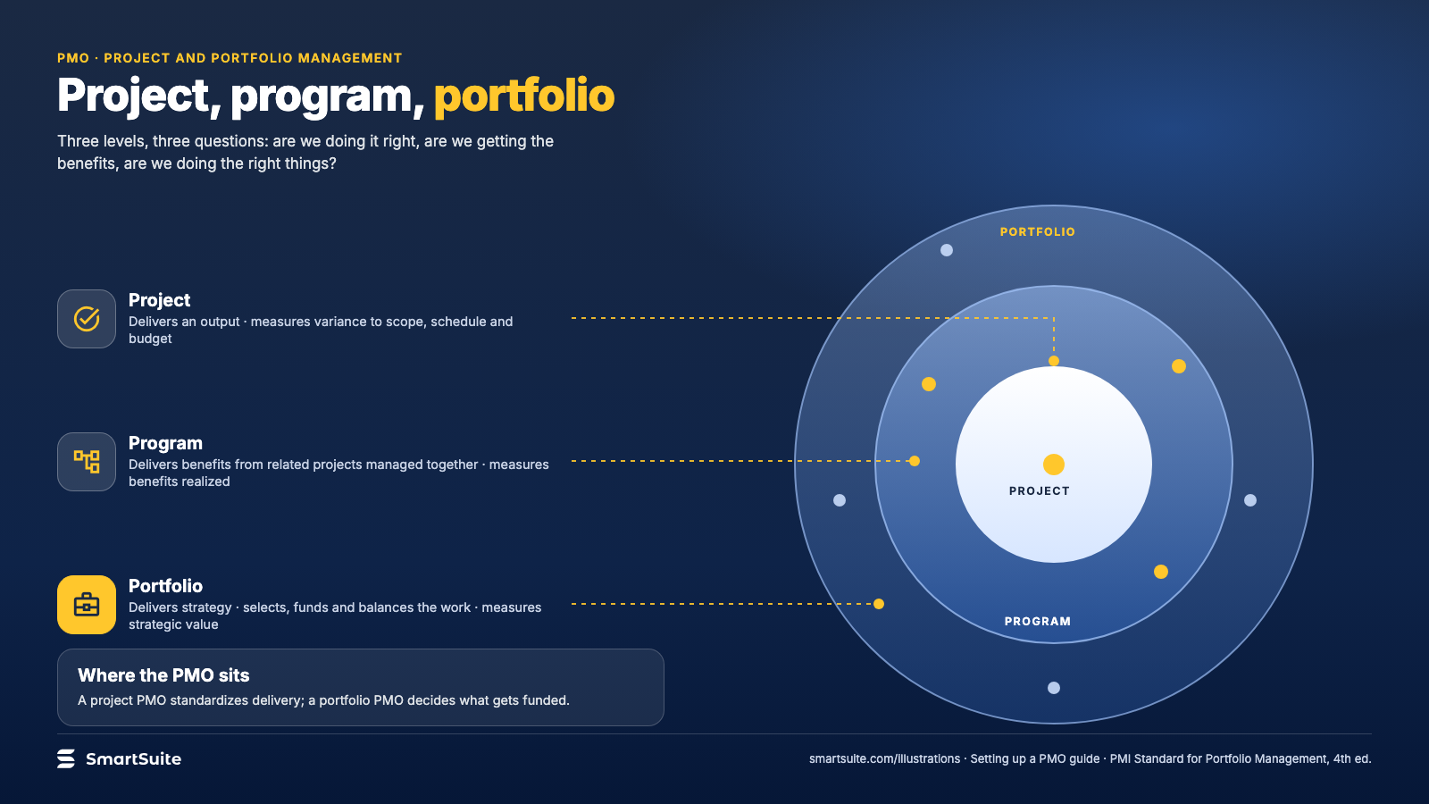
Notes:
Project, program, portfolio
Delivering an output, delivering benefits, delivering strategy: what each level decides and measures.
Source: PMI Standard for Portfolio Management (4th ed.) · From: Setting up a PMO
Credit: Source: SmartSuite, smartsuite.com/illustrations

Slide 2
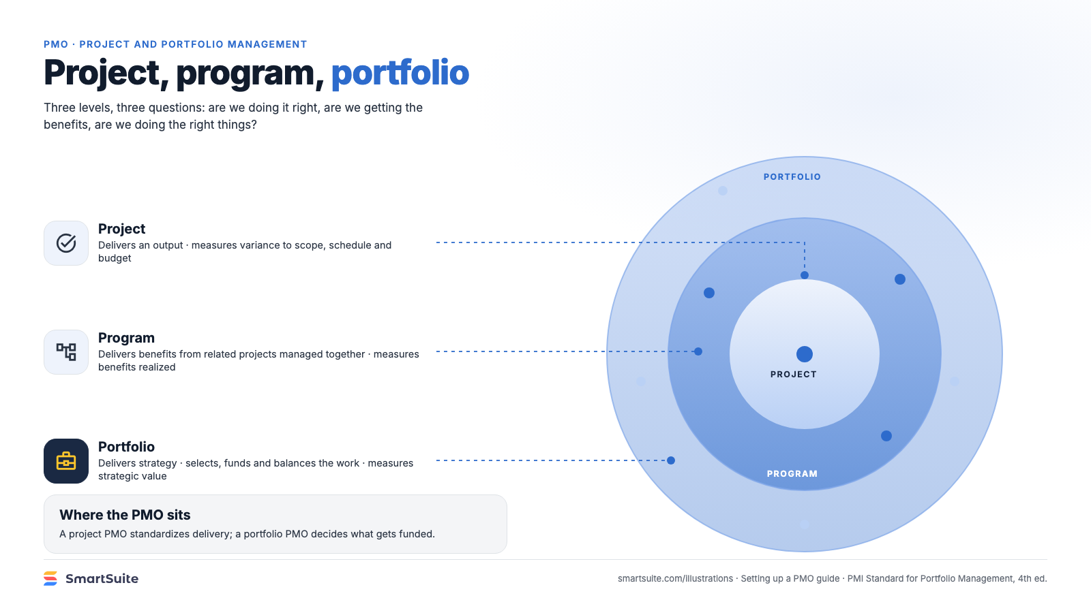
Notes:
Project, program, portfolio
Delivering an output, delivering benefits, delivering strategy: what each level decides and measures.
Source: PMI Standard for Portfolio Management (4th ed.) · From: Setting up a PMO
Credit: Source: SmartSuite, smartsuite.com/illustrations

