Slide 1
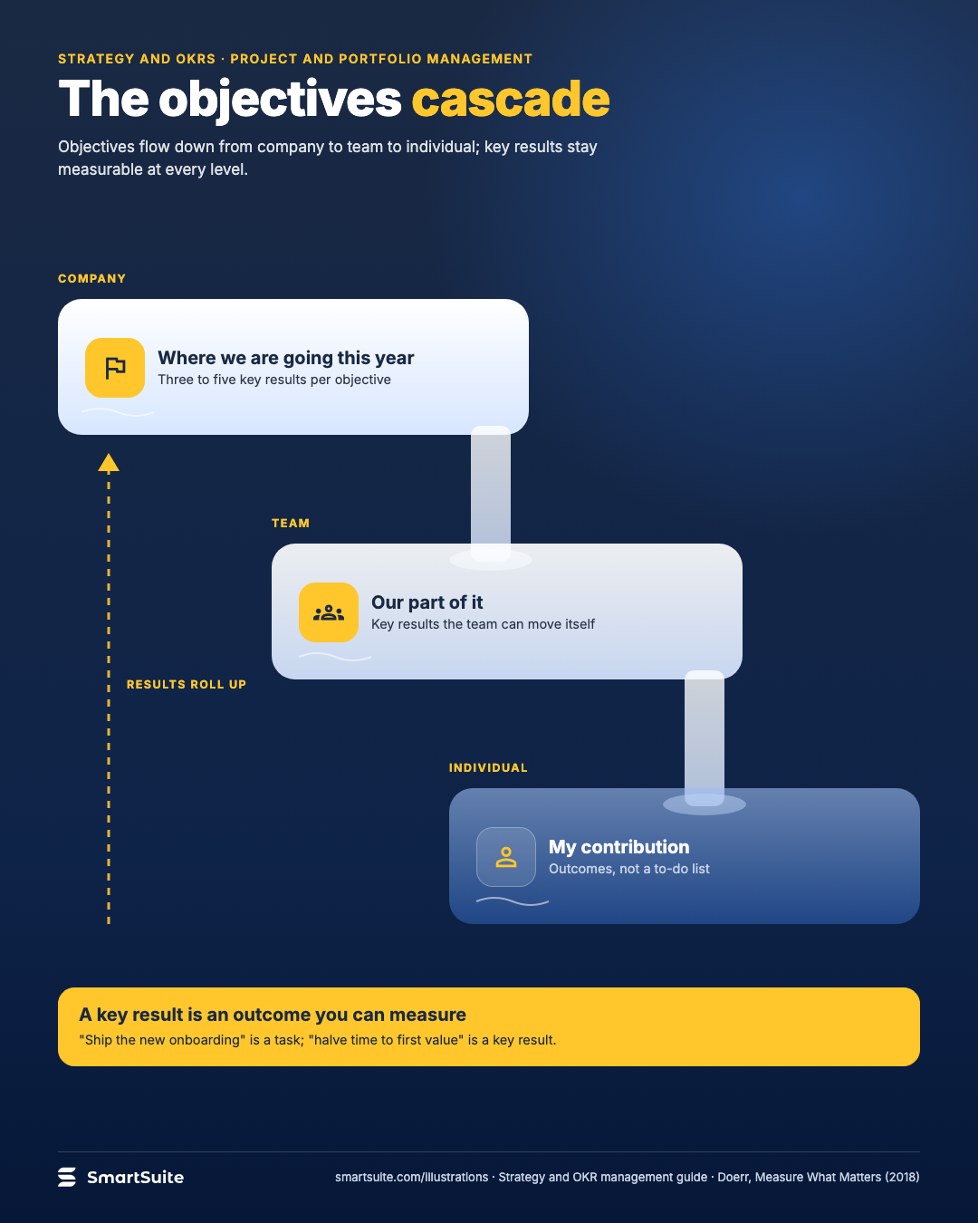
The objectives cascade
Company, team and individual objectives, each with measurable key results that roll up without becoming to-do lists.
Source: Doerr, Measure What Matters (2018); PMI Pulse 2023
Notes:
The objectives cascade
Company, team and individual objectives, each with measurable key results that roll up without becoming to-do lists.
Source: Doerr, Measure What Matters (2018); PMI Pulse 2023 · From: Strategy and OKR management
Credit: Source: SmartSuite, smartsuite.com/illustrations

Slide 2
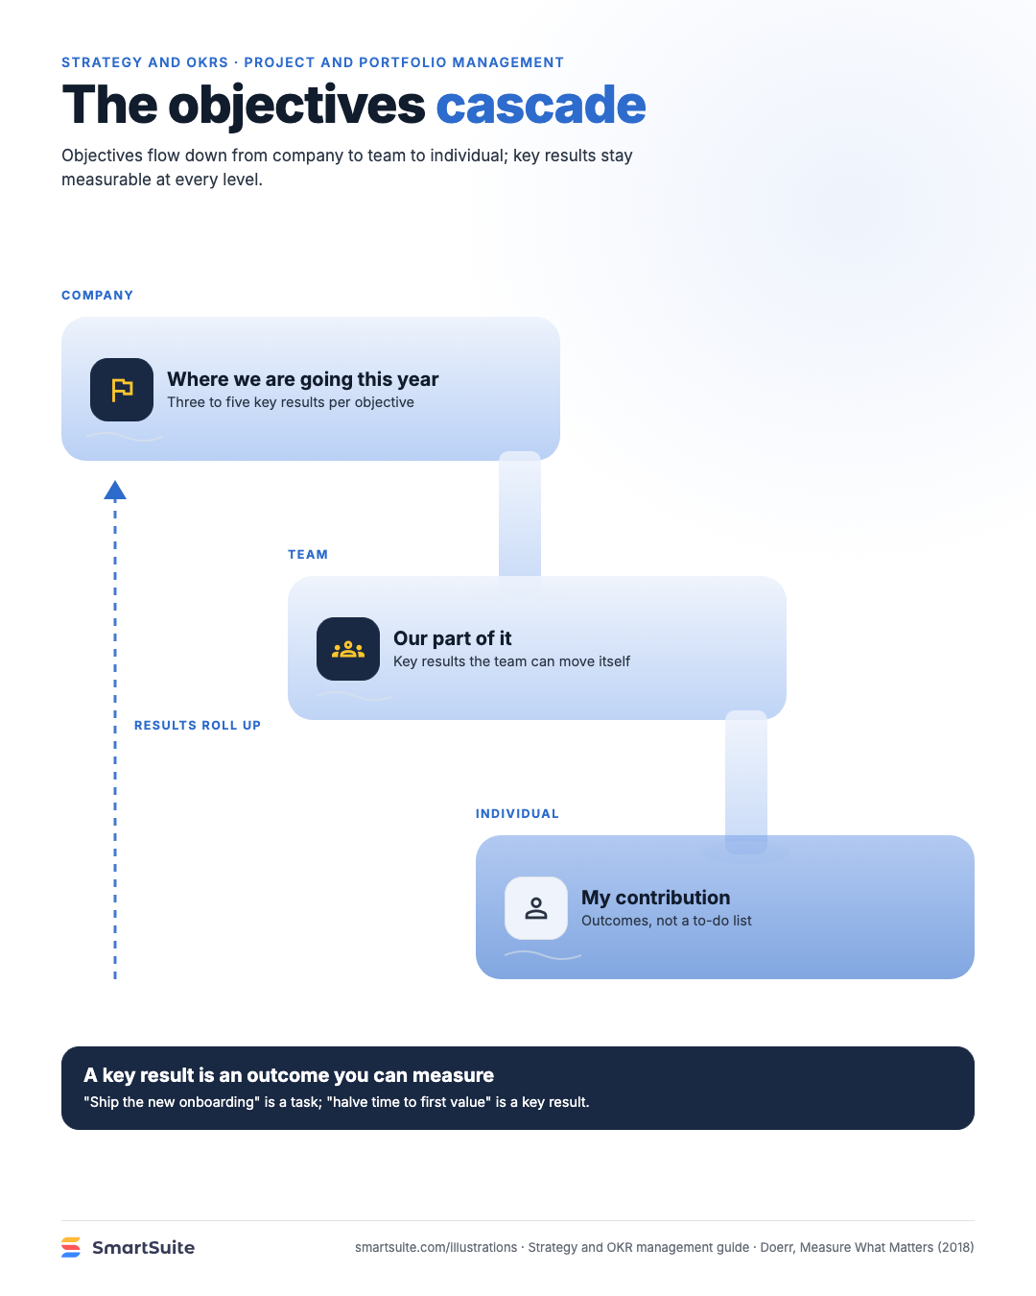
The objectives cascade
Company, team and individual objectives, each with measurable key results that roll up without becoming to-do lists.
Source: Doerr, Measure What Matters (2018); PMI Pulse 2023
Notes:
The objectives cascade
Company, team and individual objectives, each with measurable key results that roll up without becoming to-do lists.
Source: Doerr, Measure What Matters (2018); PMI Pulse 2023 · From: Strategy and OKR management
Credit: Source: SmartSuite, smartsuite.com/illustrations

