Slide 1
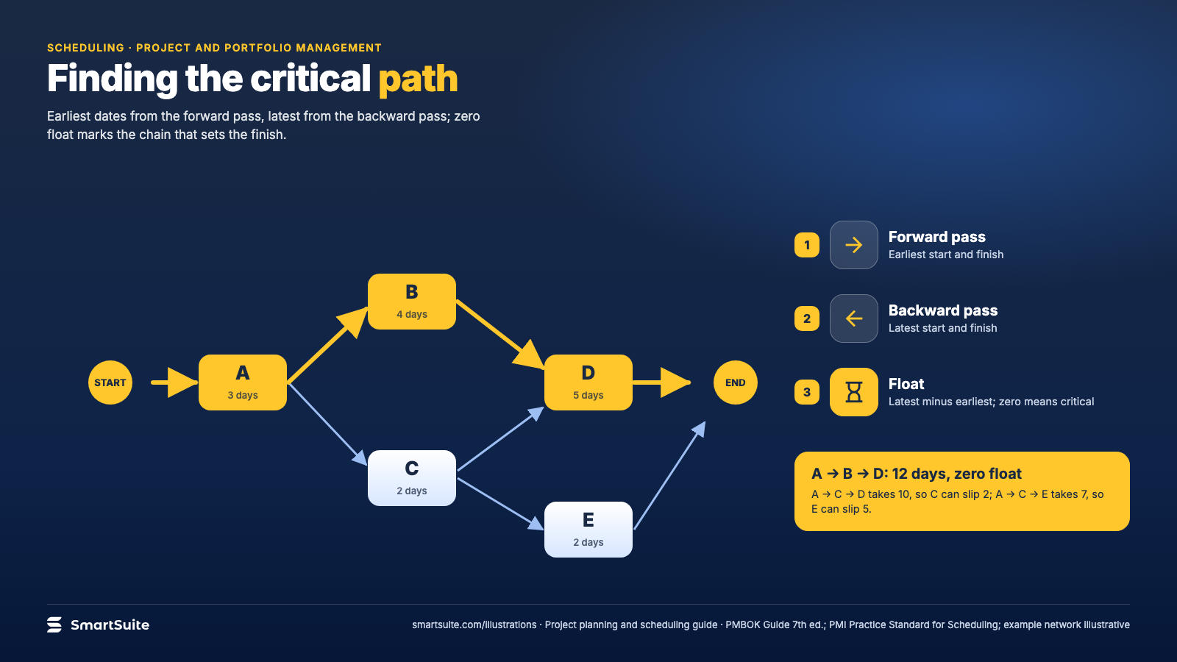
Notes:
Finding the critical path
Forward pass, backward pass, float: the chain of tasks that sets the finish date.
Source: PMBOK Guide 7th ed.; PMI Practice Standard for Scheduling · From: Project planning and scheduling
Credit: Source: SmartSuite, smartsuite.com/illustrations

Slide 2
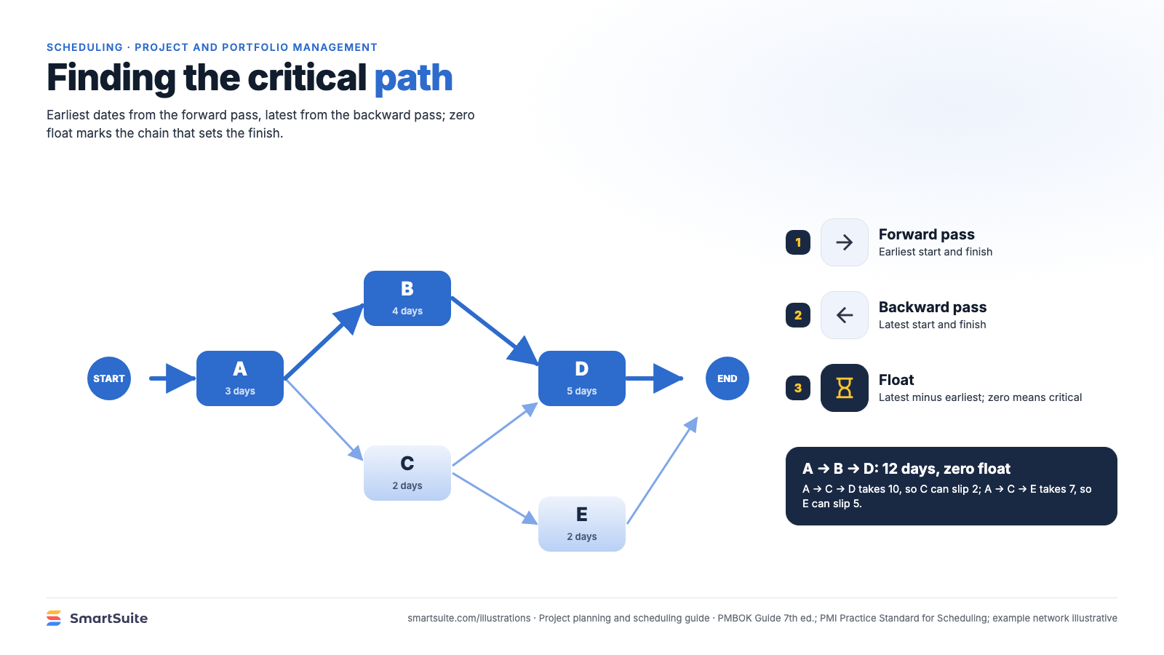
Notes:
Finding the critical path
Forward pass, backward pass, float: the chain of tasks that sets the finish date.
Source: PMBOK Guide 7th ed.; PMI Practice Standard for Scheduling · From: Project planning and scheduling
Credit: Source: SmartSuite, smartsuite.com/illustrations

