Slide 1
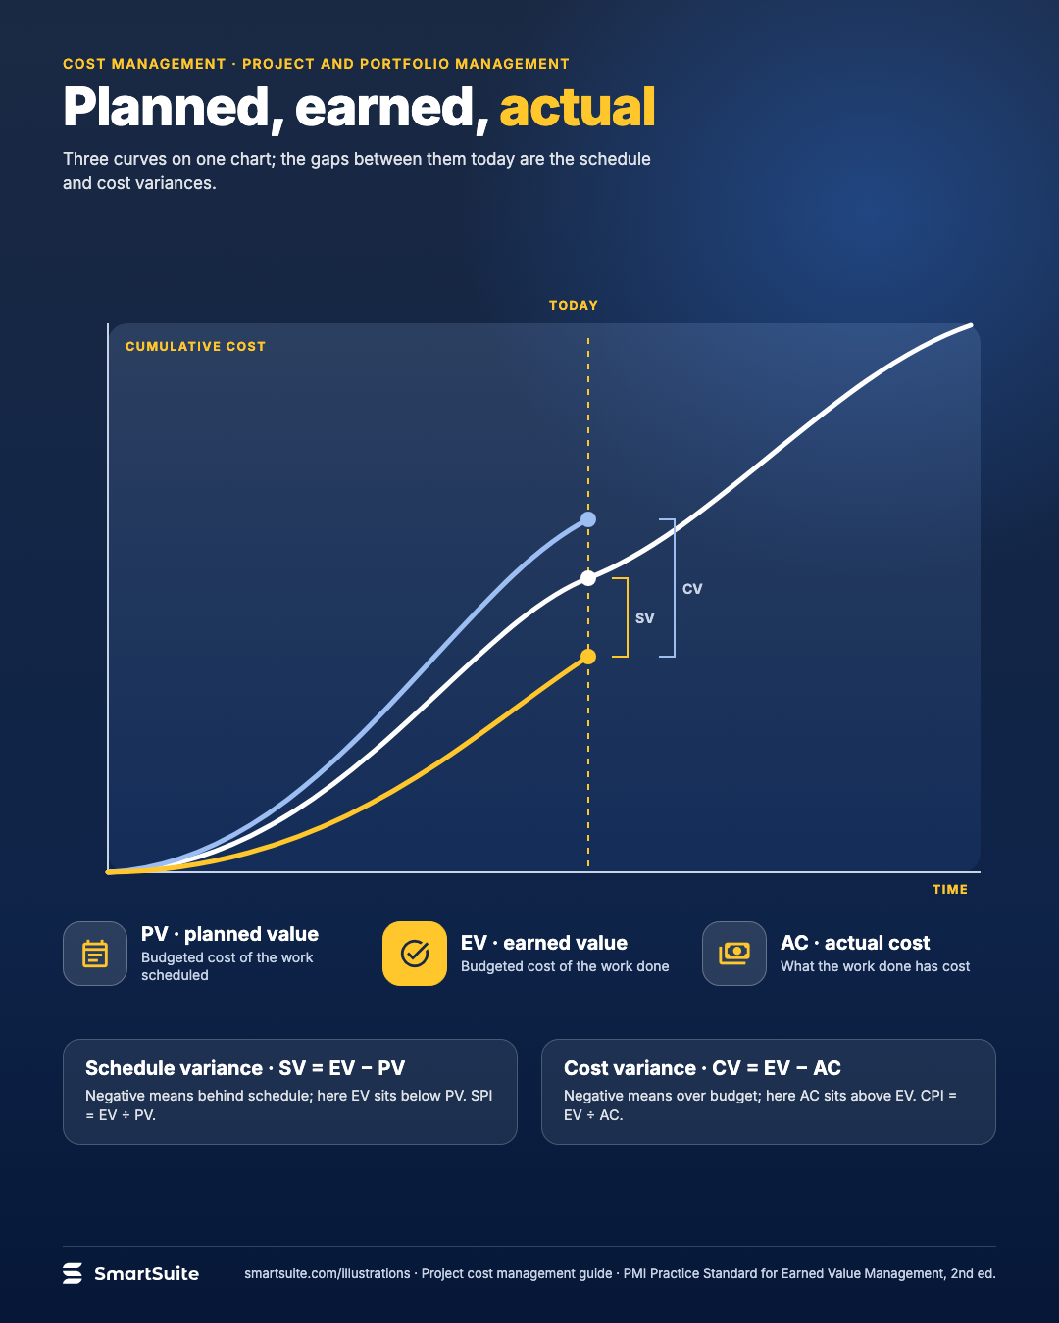
Planned, earned, actual
PV, EV and AC, and how schedule and cost variance fall out of the gaps between them.
Source: PMI Practice Standard for Earned Value Management (2nd ed.)
Notes:
Planned, earned, actual
PV, EV and AC, and how schedule and cost variance fall out of the gaps between them.
Source: PMI Practice Standard for Earned Value Management (2nd ed.) · From: Project cost management
Credit: Source: SmartSuite, smartsuite.com/illustrations

Slide 2
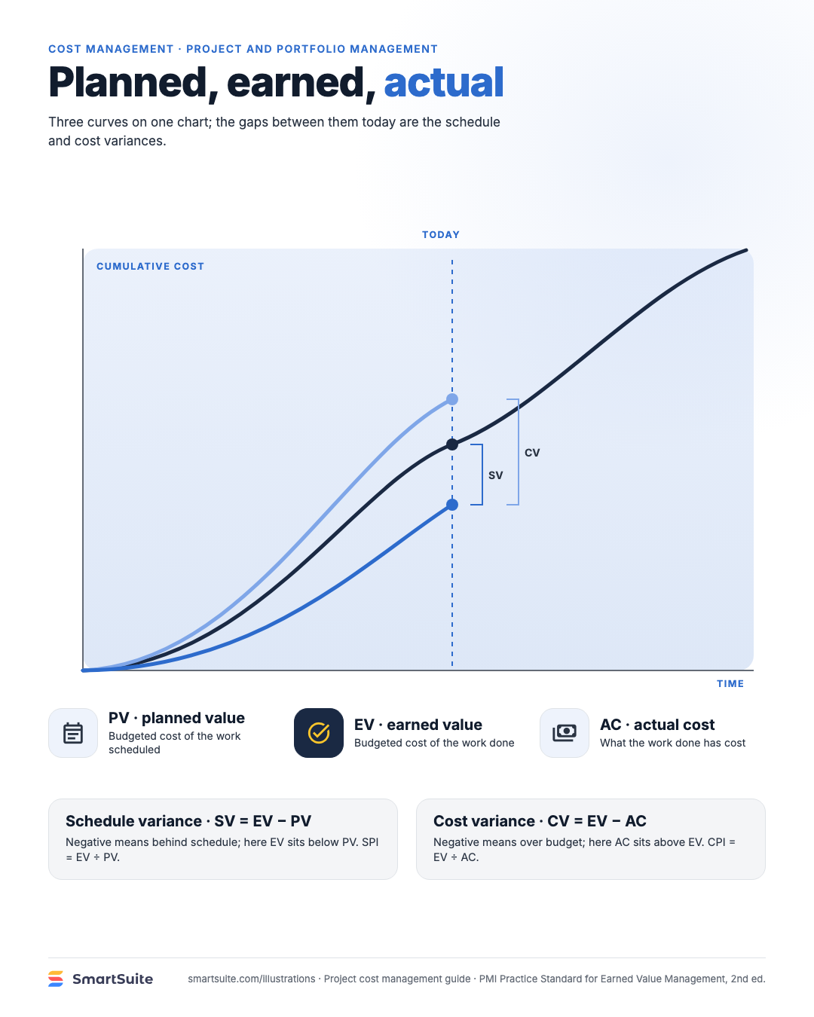
Planned, earned, actual
PV, EV and AC, and how schedule and cost variance fall out of the gaps between them.
Source: PMI Practice Standard for Earned Value Management (2nd ed.)
Notes:
Planned, earned, actual
PV, EV and AC, and how schedule and cost variance fall out of the gaps between them.
Source: PMI Practice Standard for Earned Value Management (2nd ed.) · From: Project cost management
Credit: Source: SmartSuite, smartsuite.com/illustrations

