Slide 1
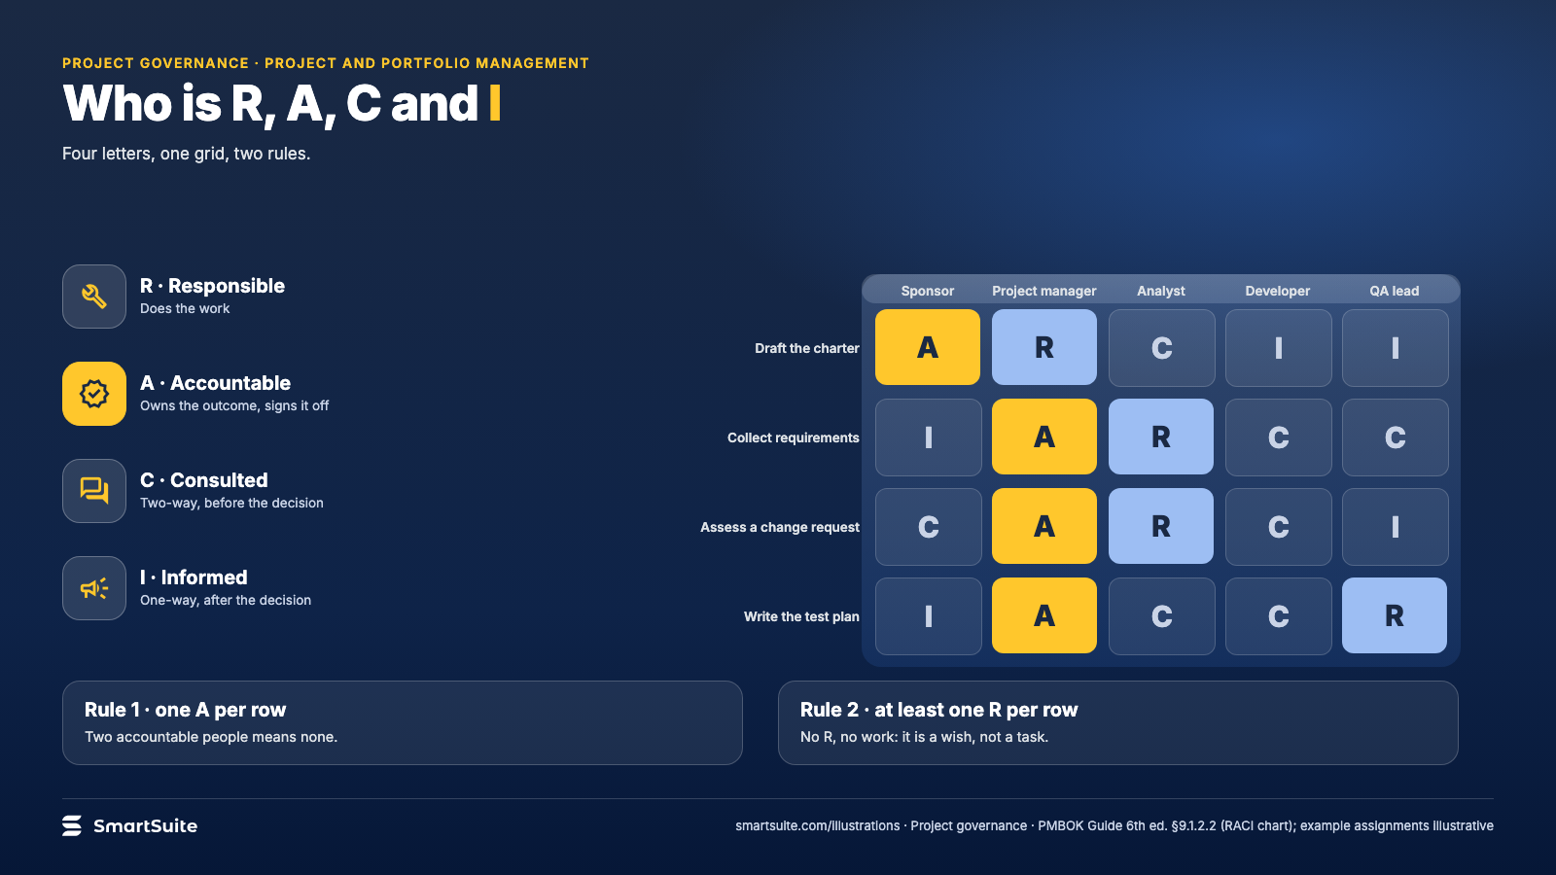
Notes:
Who is R, A, C and I
Responsible, accountable, consulted, informed, and the two rules that keep the matrix honest.
Source: PMBOK Guide 6th ed. §9.1.2.2 · From: Project governance
Credit: Source: SmartSuite, smartsuite.com/illustrations

Slide 2
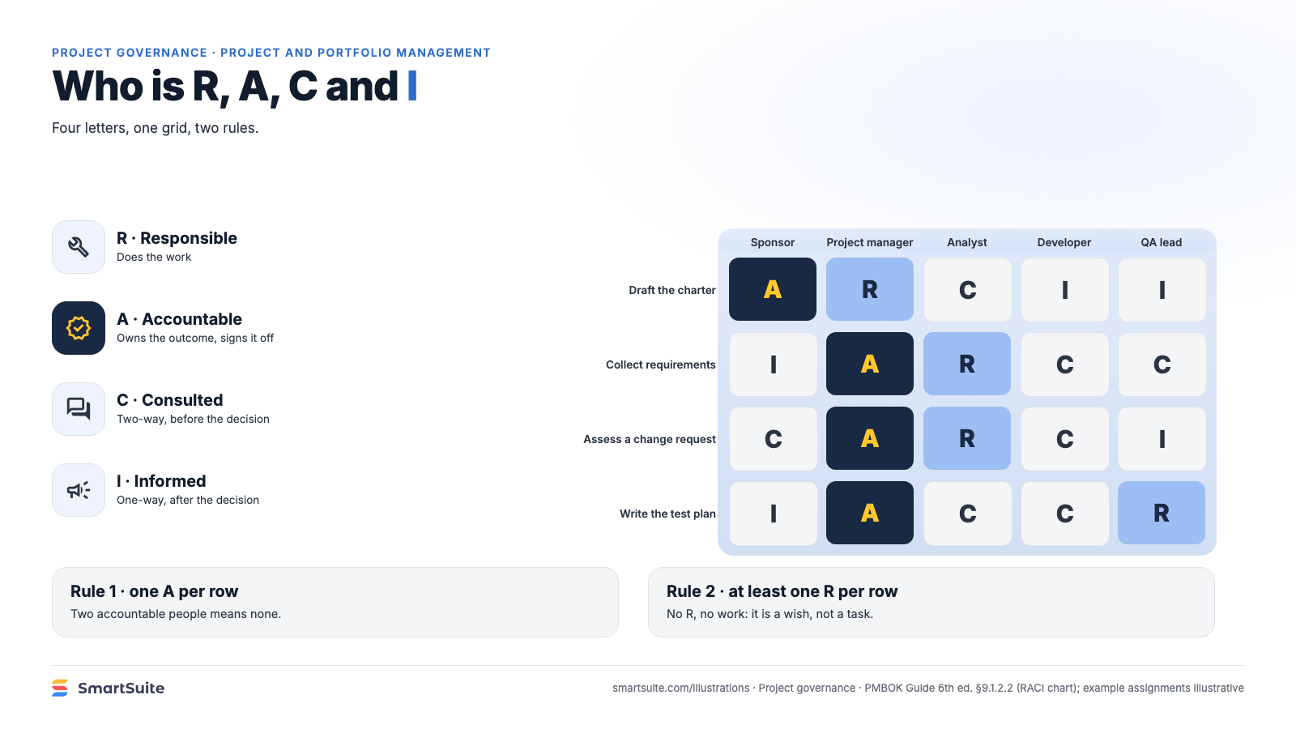
Notes:
Who is R, A, C and I
Responsible, accountable, consulted, informed, and the two rules that keep the matrix honest.
Source: PMBOK Guide 6th ed. §9.1.2.2 · From: Project governance
Credit: Source: SmartSuite, smartsuite.com/illustrations

