Slide 1
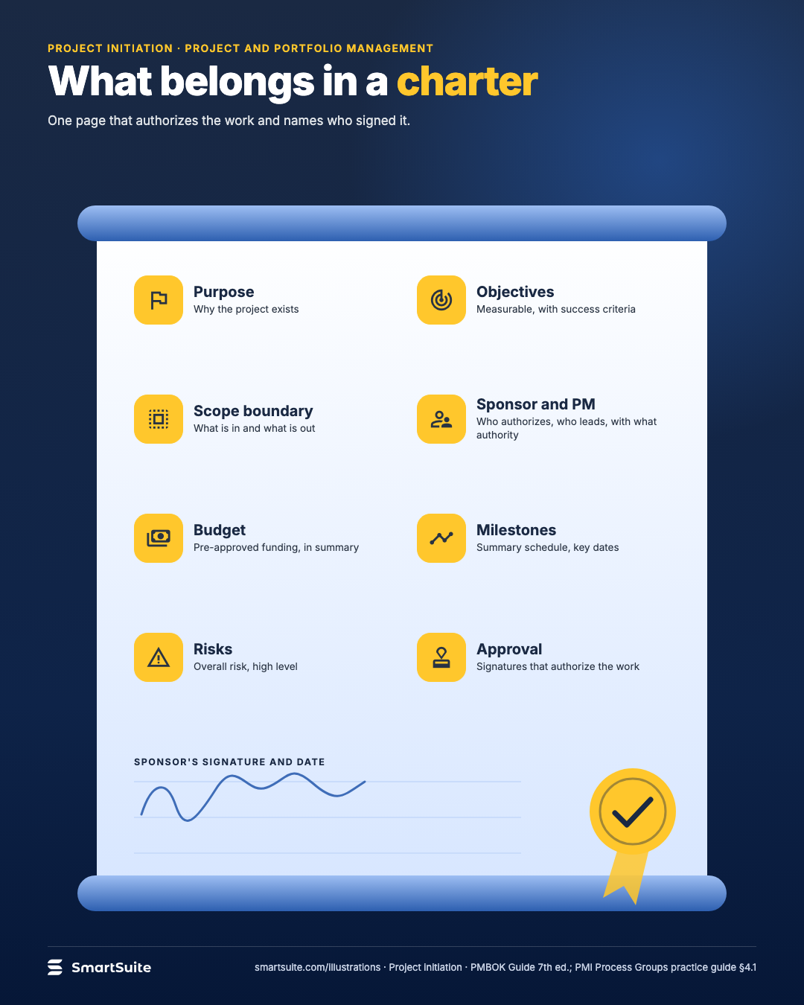
What belongs in a charter
Purpose, objectives, scope boundary, sponsor, budget, milestones, risks and approval: the page that authorizes the work.
Source: PMBOK Guide 7th ed.; PMI Process Groups practice guide §4.1
Notes:
What belongs in a charter
Purpose, objectives, scope boundary, sponsor, budget, milestones, risks and approval: the page that authorizes the work.
Source: PMBOK Guide 7th ed.; PMI Process Groups practice guide §4.1 · From: Project initiation
Credit: Source: SmartSuite, smartsuite.com/illustrations

Slide 2
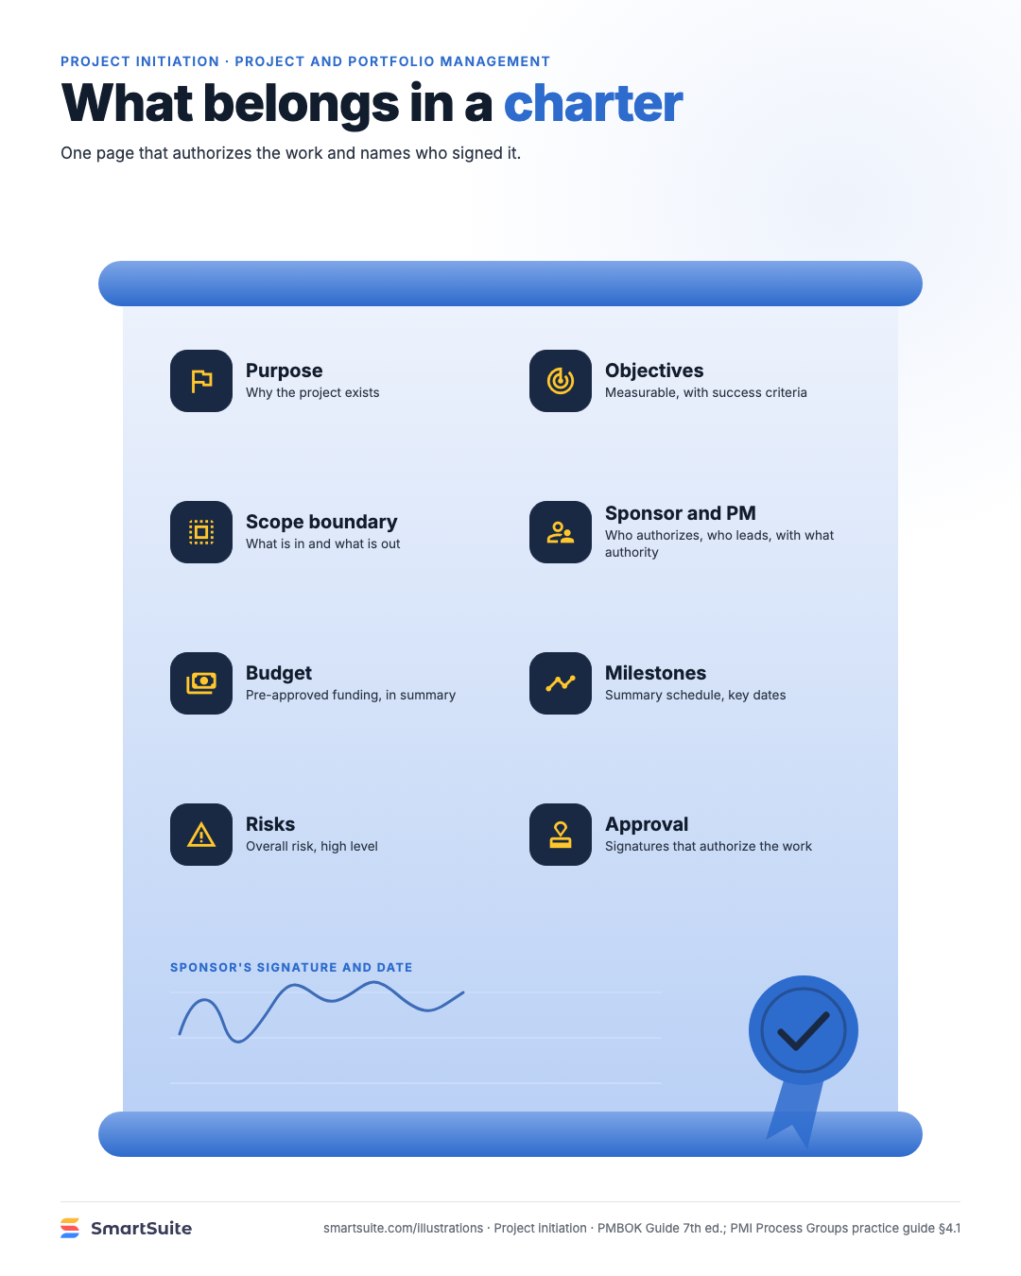
What belongs in a charter
Purpose, objectives, scope boundary, sponsor, budget, milestones, risks and approval: the page that authorizes the work.
Source: PMBOK Guide 7th ed.; PMI Process Groups practice guide §4.1
Notes:
What belongs in a charter
Purpose, objectives, scope boundary, sponsor, budget, milestones, risks and approval: the page that authorizes the work.
Source: PMBOK Guide 7th ed.; PMI Process Groups practice guide §4.1 · From: Project initiation
Credit: Source: SmartSuite, smartsuite.com/illustrations

