Slide 1
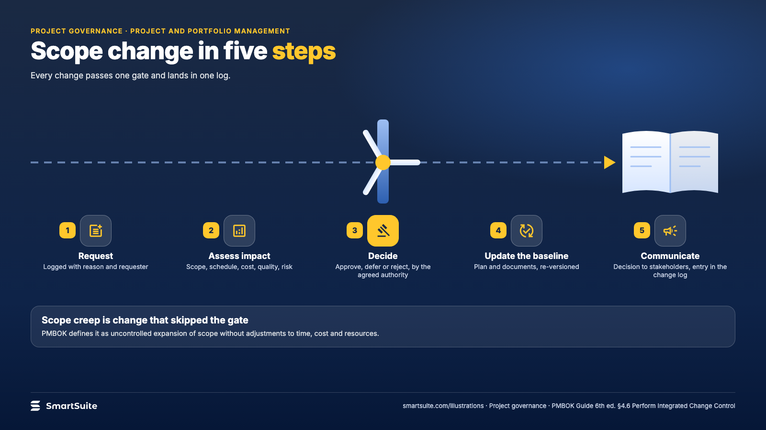
Notes:
Scope change in five steps
Request, assess impact, decide, update the baseline, communicate: why unlogged change is the usual cause of overrun.
Source: PMBOK Guide 6th ed. §4.6 · From: Project governance
Credit: Source: SmartSuite, smartsuite.com/illustrations

Slide 2
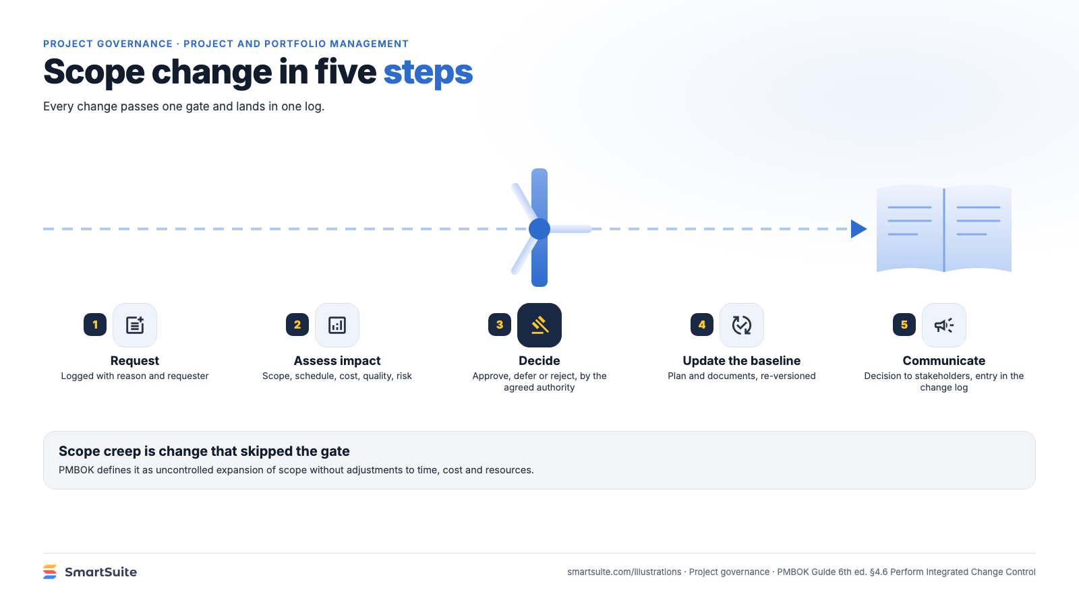
Notes:
Scope change in five steps
Request, assess impact, decide, update the baseline, communicate: why unlogged change is the usual cause of overrun.
Source: PMBOK Guide 6th ed. §4.6 · From: Project governance
Credit: Source: SmartSuite, smartsuite.com/illustrations

