Slide 1
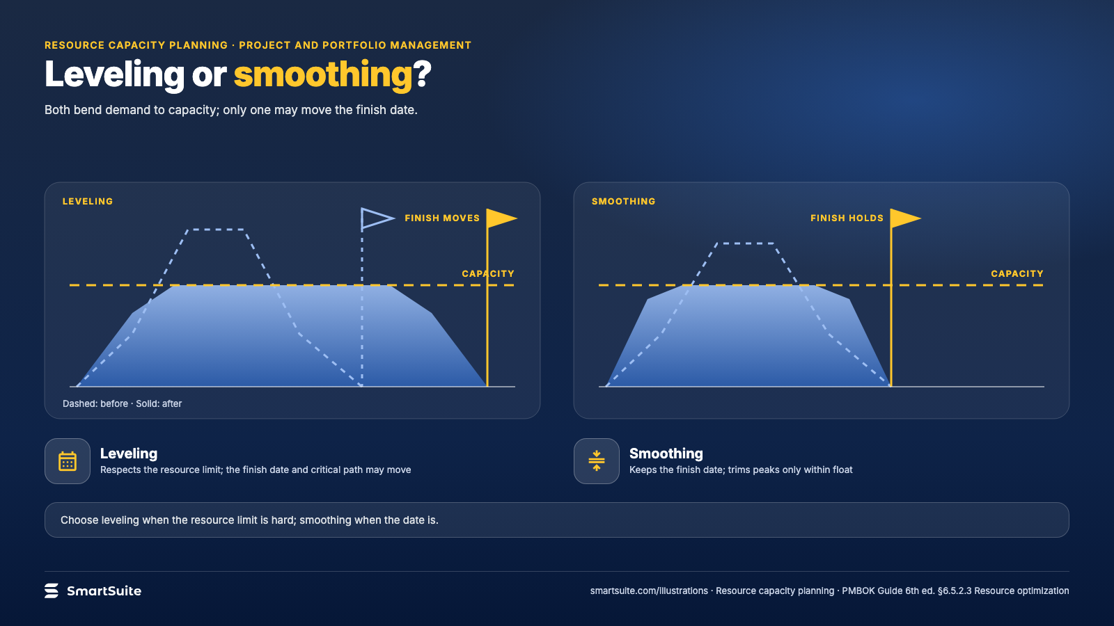
Notes:
Leveling or smoothing?
Leveling moves the finish date to respect capacity; smoothing keeps the date and flattens the peaks.
Source: PMBOK Guide 6th ed. §6.5.2.3 · From: Resource capacity planning
Credit: Source: SmartSuite, smartsuite.com/illustrations

Slide 2
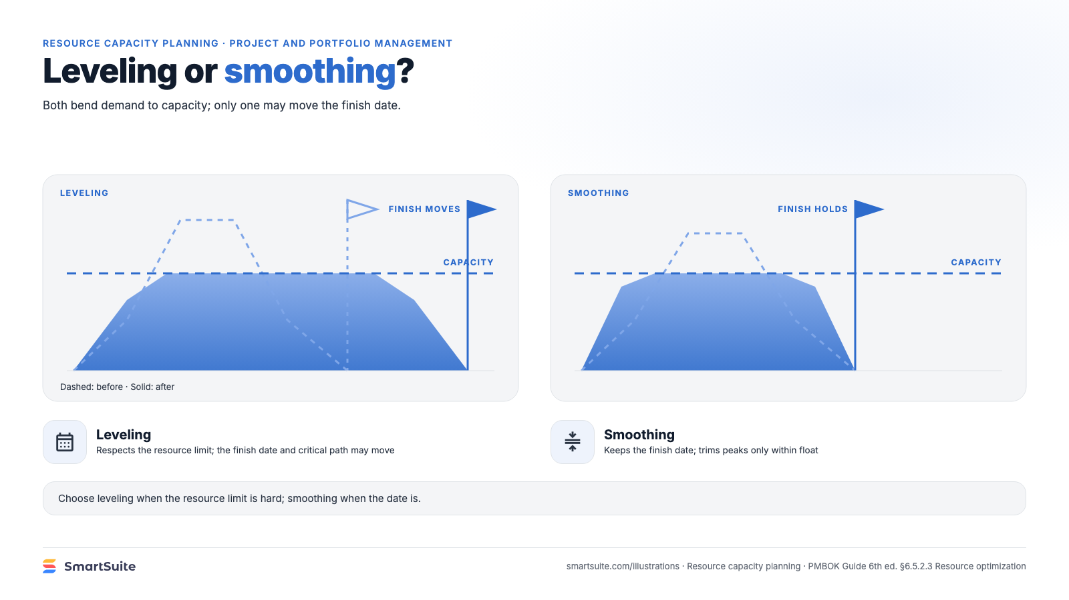
Notes:
Leveling or smoothing?
Leveling moves the finish date to respect capacity; smoothing keeps the date and flattens the peaks.
Source: PMBOK Guide 6th ed. §6.5.2.3 · From: Resource capacity planning
Credit: Source: SmartSuite, smartsuite.com/illustrations

