Slide 1
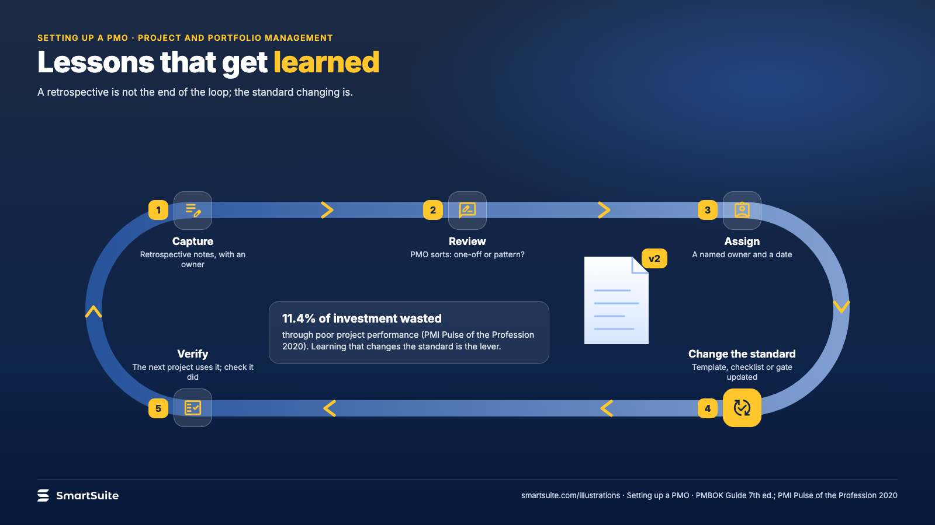
Notes:
Lessons that get learned
Capture, review, assign, change the standard, verify: the four steps between a retrospective and an improved method.
Source: PMBOK Guide 7th ed. §2.8; PMI Pulse 2020 · From: Setting up a PMO
Credit: Source: SmartSuite, smartsuite.com/illustrations

Slide 2
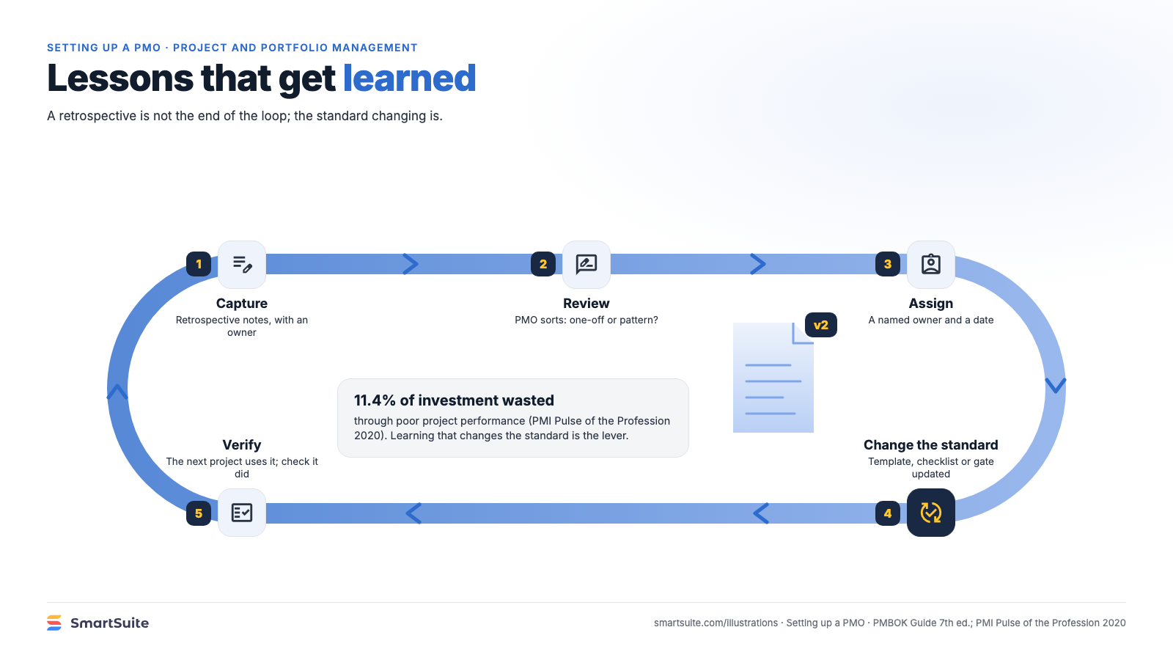
Notes:
Lessons that get learned
Capture, review, assign, change the standard, verify: the four steps between a retrospective and an improved method.
Source: PMBOK Guide 7th ed. §2.8; PMI Pulse 2020 · From: Setting up a PMO
Credit: Source: SmartSuite, smartsuite.com/illustrations

