Slide 1
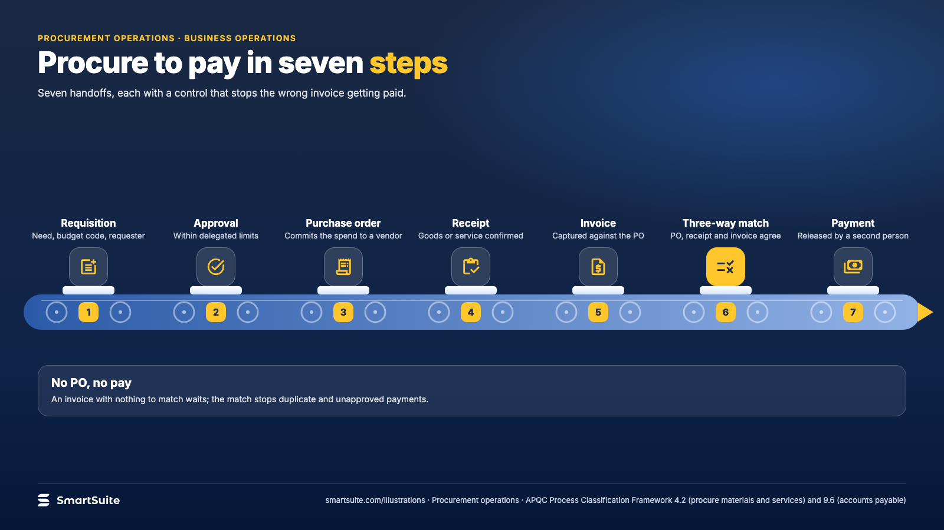
Notes:
Procure to pay in seven steps
Requisition, approval, purchase order, receipt, invoice, three-way match, payment: the controls at each handoff.
Source: APQC Process Classification Framework 4.2 (procure-to-pay) · From: Procurement operations
Credit: Source: SmartSuite, smartsuite.com/illustrations

Slide 2
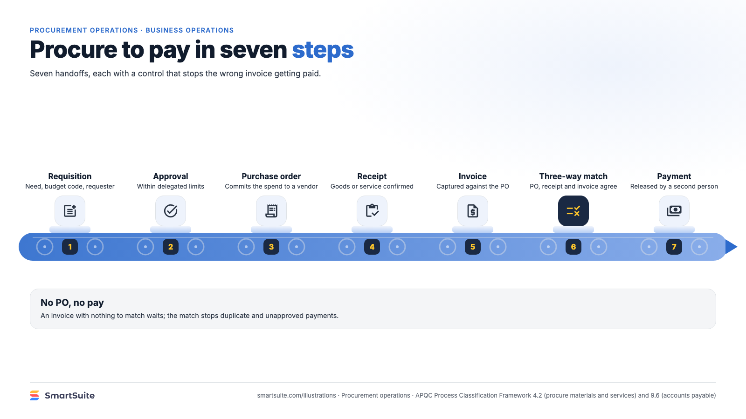
Notes:
Procure to pay in seven steps
Requisition, approval, purchase order, receipt, invoice, three-way match, payment: the controls at each handoff.
Source: APQC Process Classification Framework 4.2 (procure-to-pay) · From: Procurement operations
Credit: Source: SmartSuite, smartsuite.com/illustrations

