Slide 1
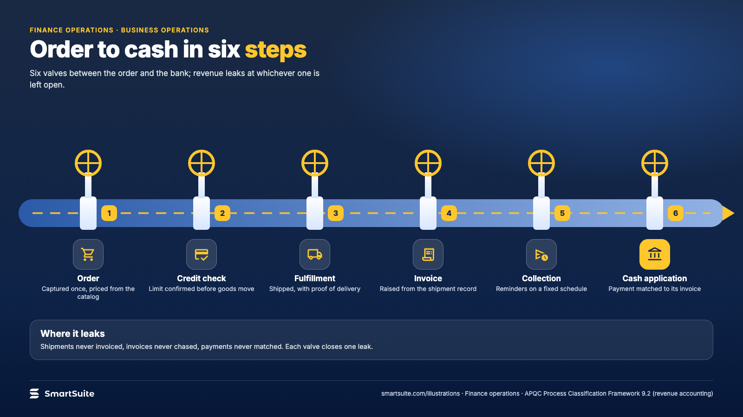
Notes:
Order to cash in six steps
Order, credit check, fulfillment, invoice, collection, cash application: where revenue leaks and where it is caught.
Source: APQC PCF 9.2 (order-to-cash) · From: Finance operations
Credit: Source: SmartSuite, smartsuite.com/illustrations

Slide 2
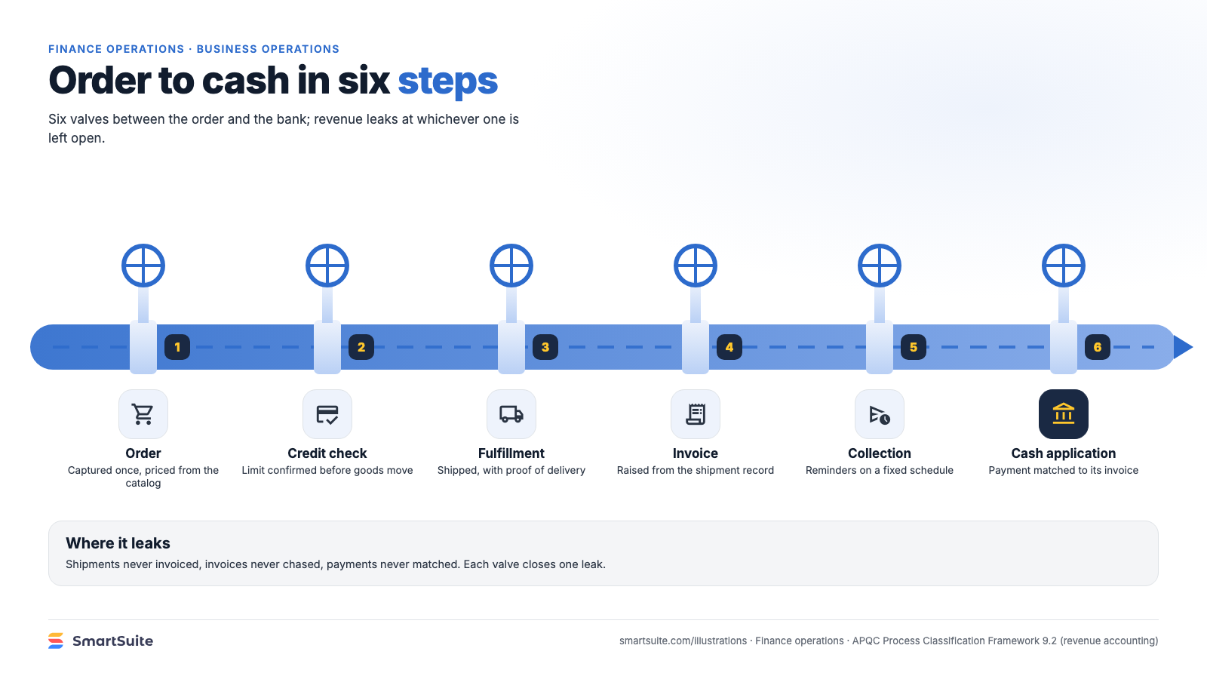
Notes:
Order to cash in six steps
Order, credit check, fulfillment, invoice, collection, cash application: where revenue leaks and where it is caught.
Source: APQC PCF 9.2 (order-to-cash) · From: Finance operations
Credit: Source: SmartSuite, smartsuite.com/illustrations

