Slide 1
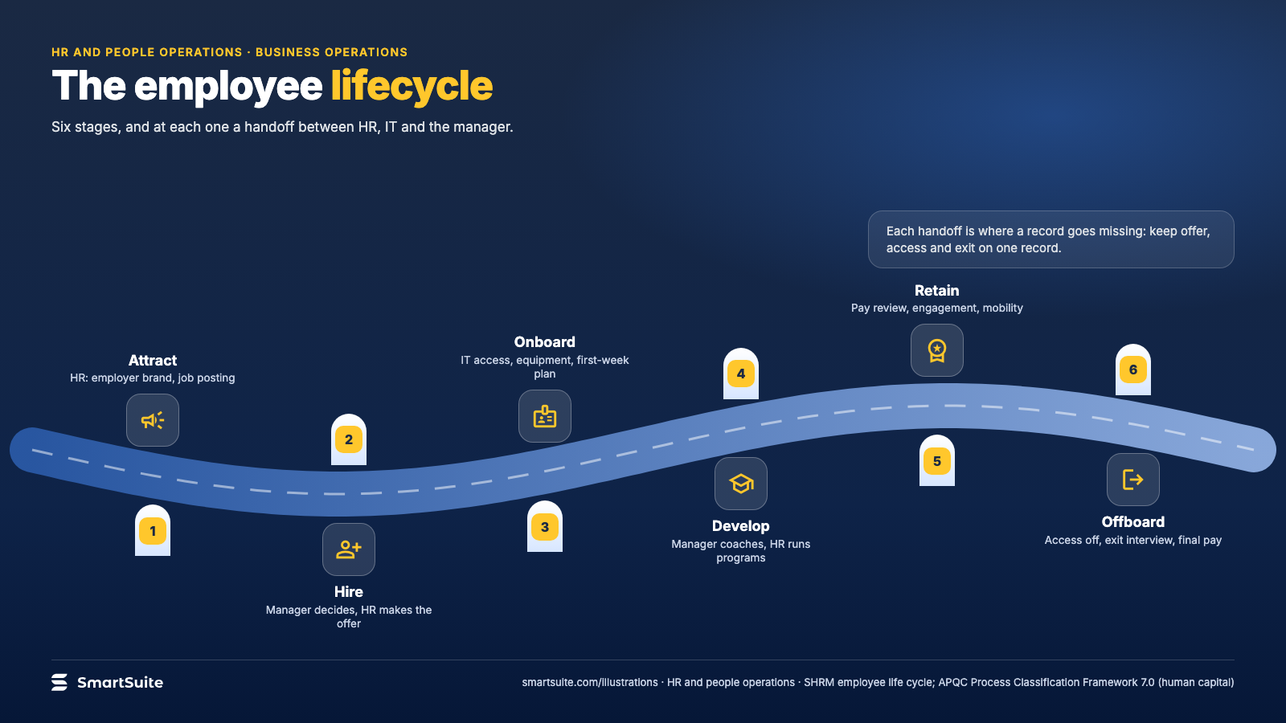
Notes:
The employee lifecycle
Attract, hire, onboard, develop, retain, offboard: the handoffs between HR, IT and the manager at each stage.
Source: SHRM employee life cycle; APQC PCF 7.0 · From: HR and people operations
Credit: Source: SmartSuite, smartsuite.com/illustrations

Slide 2
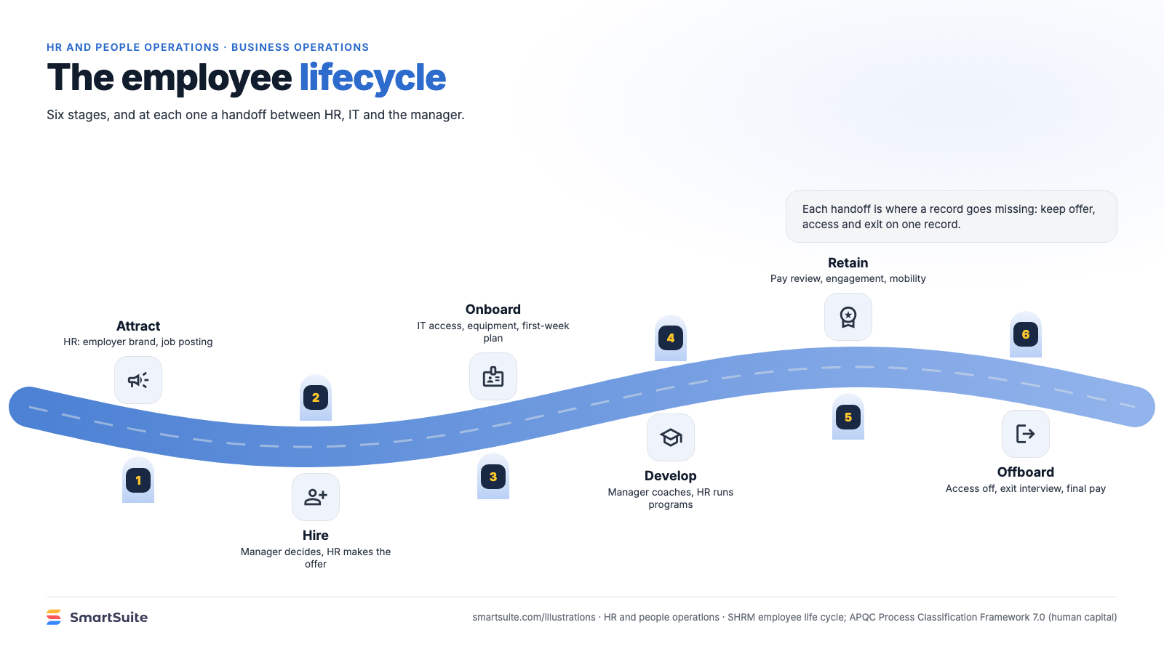
Notes:
The employee lifecycle
Attract, hire, onboard, develop, retain, offboard: the handoffs between HR, IT and the manager at each stage.
Source: SHRM employee life cycle; APQC PCF 7.0 · From: HR and people operations
Credit: Source: SmartSuite, smartsuite.com/illustrations

