Slide 1
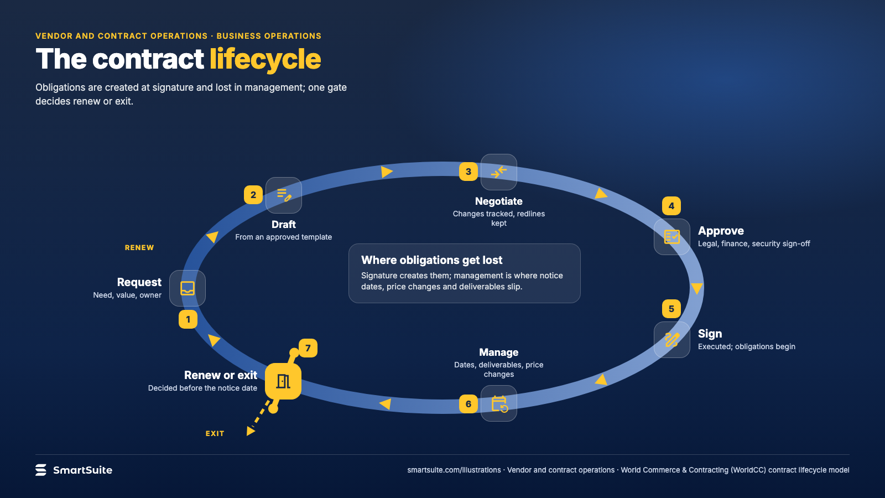
Notes:
The contract lifecycle
Request, draft, negotiate, approve, sign, manage, renew or exit: where obligations are created and where they are lost.
Source: World Commerce & Contracting (WorldCC) CLM model · From: Vendor and contract operations
Credit: Source: SmartSuite, smartsuite.com/illustrations

Slide 2
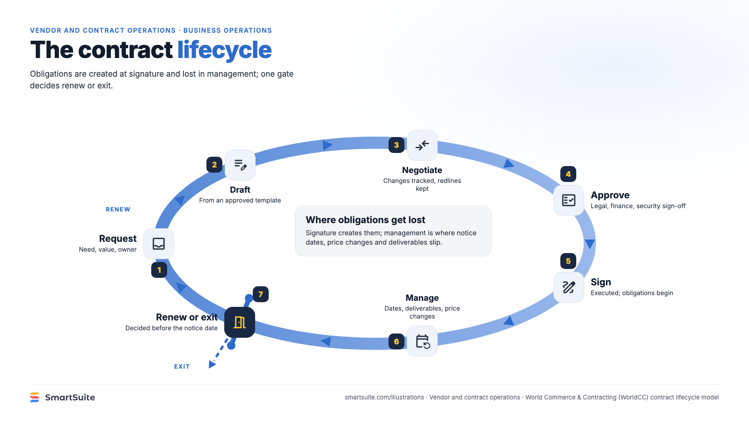
Notes:
The contract lifecycle
Request, draft, negotiate, approve, sign, manage, renew or exit: where obligations are created and where they are lost.
Source: World Commerce & Contracting (WorldCC) CLM model · From: Vendor and contract operations
Credit: Source: SmartSuite, smartsuite.com/illustrations

