Slide 1
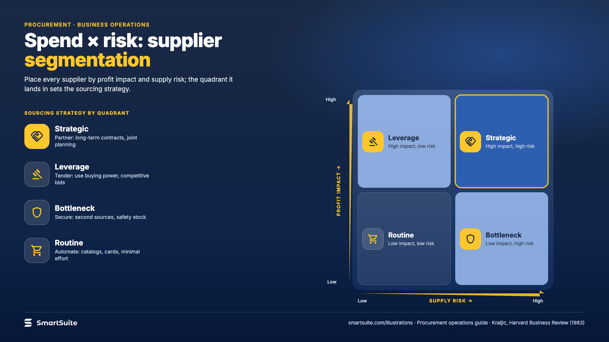
Notes:
Spend × risk: supplier segmentation
Strategic, leverage, bottleneck and routine suppliers, and the sourcing strategy for each quadrant.
Source: Kraljic, Harvard Business Review (1983) · From: Procurement operations
Credit: Source: SmartSuite, smartsuite.com/illustrations

Slide 2
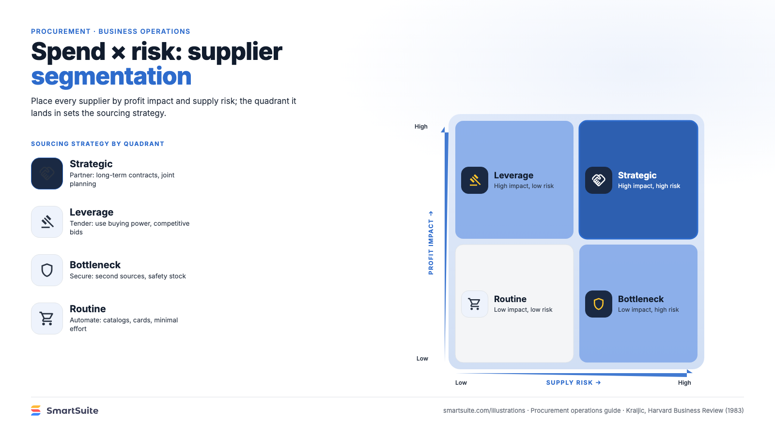
Notes:
Spend × risk: supplier segmentation
Strategic, leverage, bottleneck and routine suppliers, and the sourcing strategy for each quadrant.
Source: Kraljic, Harvard Business Review (1983) · From: Procurement operations
Credit: Source: SmartSuite, smartsuite.com/illustrations

