Slide 1
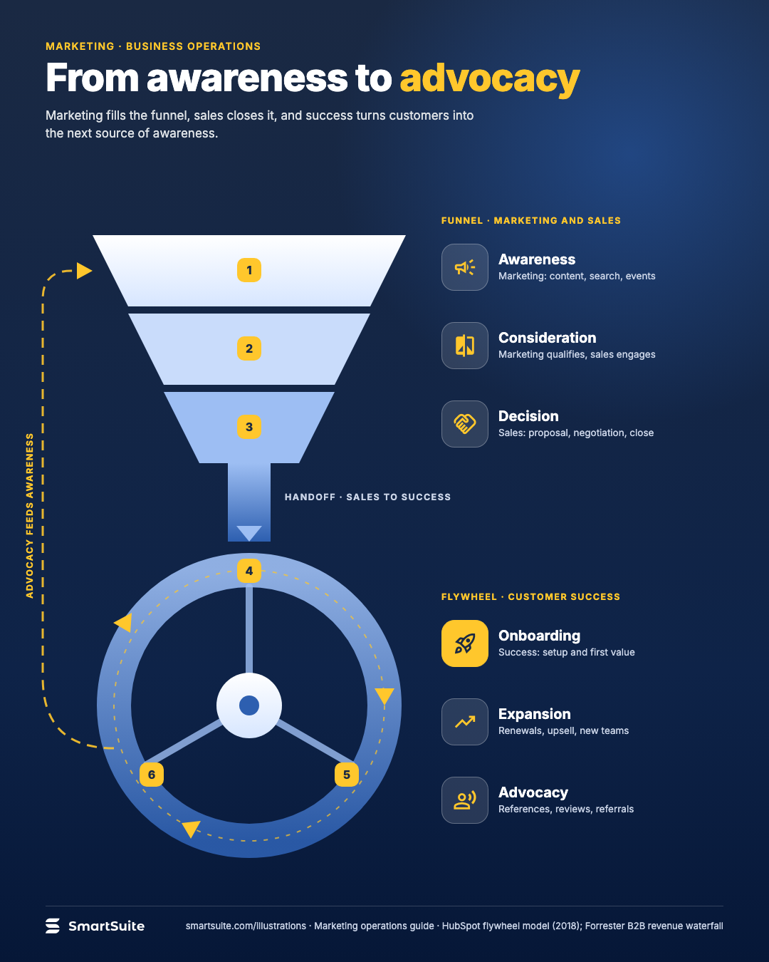
From awareness to advocacy
Awareness, consideration, decision, onboarding, expansion, advocacy: the stages marketing, sales and success hand off.
Source: HubSpot flywheel model (2018); Forrester B2B revenue waterfall
Notes:
From awareness to advocacy
Awareness, consideration, decision, onboarding, expansion, advocacy: the stages marketing, sales and success hand off.
Source: HubSpot flywheel model (2018); Forrester B2B revenue waterfall · From: Marketing operations
Credit: Source: SmartSuite, smartsuite.com/illustrations

Slide 2
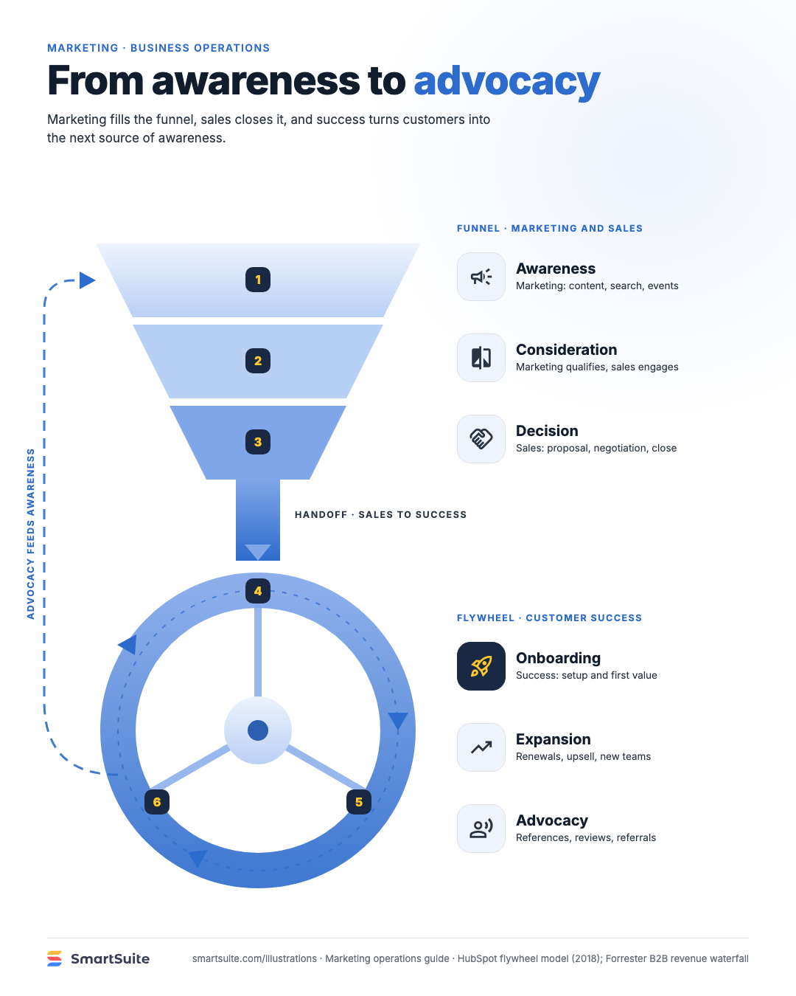
From awareness to advocacy
Awareness, consideration, decision, onboarding, expansion, advocacy: the stages marketing, sales and success hand off.
Source: HubSpot flywheel model (2018); Forrester B2B revenue waterfall
Notes:
From awareness to advocacy
Awareness, consideration, decision, onboarding, expansion, advocacy: the stages marketing, sales and success hand off.
Source: HubSpot flywheel model (2018); Forrester B2B revenue waterfall · From: Marketing operations
Credit: Source: SmartSuite, smartsuite.com/illustrations

