Slide 1
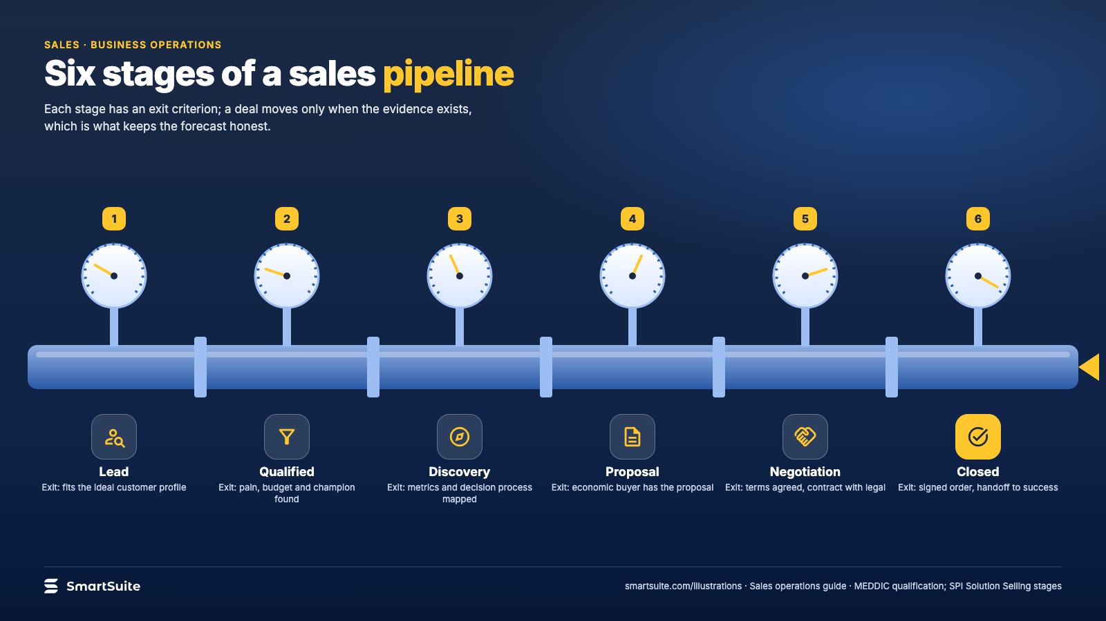
Notes:
Six stages of a sales pipeline
Lead, qualified, discovery, proposal, negotiation, closed: the exit criteria that keep a forecast honest.
Source: MEDDIC qualification; SPI Solution Selling stages · From: Sales operations
Credit: Source: SmartSuite, smartsuite.com/illustrations

Slide 2
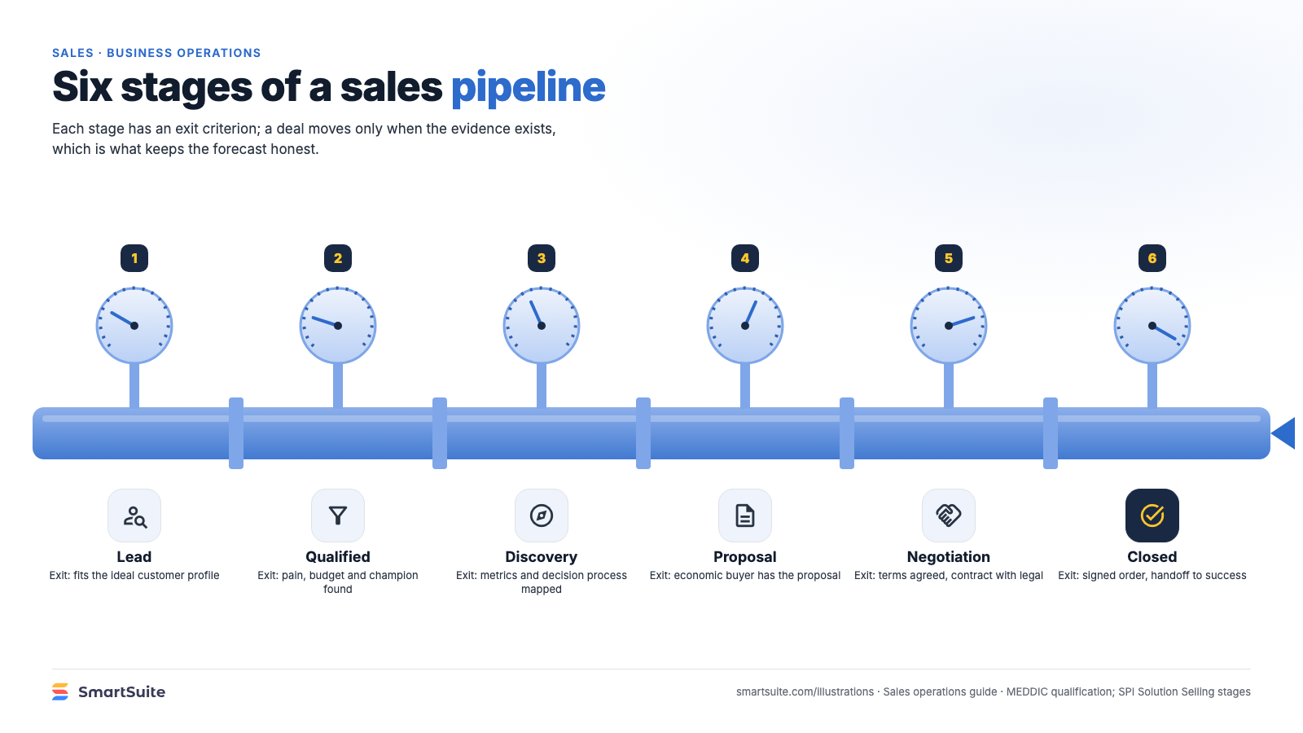
Notes:
Six stages of a sales pipeline
Lead, qualified, discovery, proposal, negotiation, closed: the exit criteria that keep a forecast honest.
Source: MEDDIC qualification; SPI Solution Selling stages · From: Sales operations
Credit: Source: SmartSuite, smartsuite.com/illustrations

