Slide 1
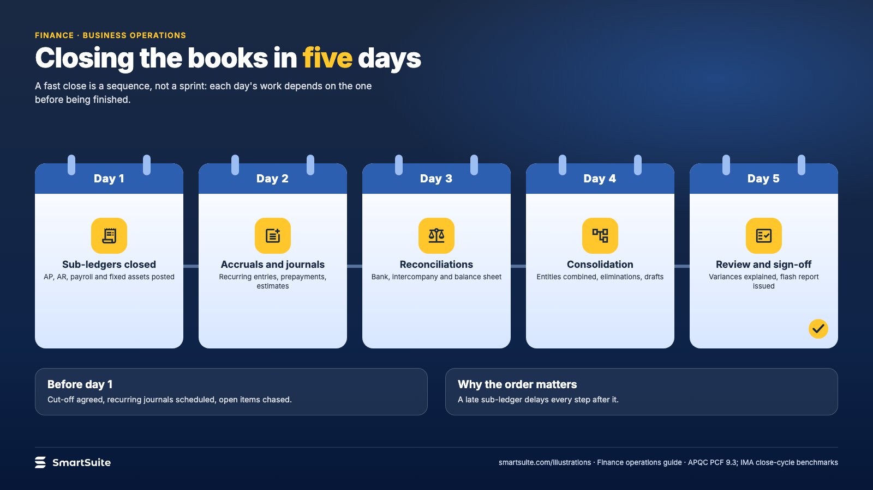
Notes:
Closing the books in five days
Sub-ledgers, accruals, reconciliations, consolidation, review: the sequence that makes a fast close possible.
Source: APQC PCF 9.3; IMA close-cycle benchmarks · From: Finance operations
Credit: Source: SmartSuite, smartsuite.com/illustrations

Slide 2
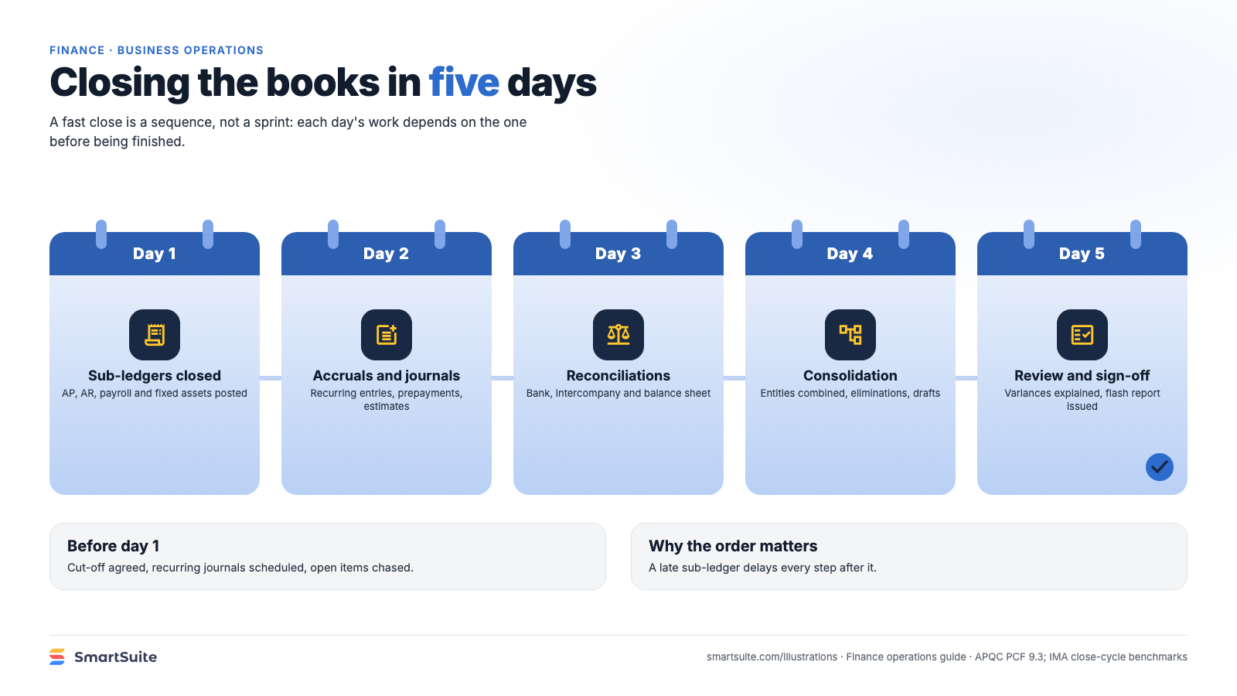
Notes:
Closing the books in five days
Sub-ledgers, accruals, reconciliations, consolidation, review: the sequence that makes a fast close possible.
Source: APQC PCF 9.3; IMA close-cycle benchmarks · From: Finance operations
Credit: Source: SmartSuite, smartsuite.com/illustrations

