Slide 1

Work in progress, limited
Why capping the work in each column shortens the time everything takes, with the arithmetic behind it.
Source: Anderson, Kanban (2010); Little's law
Notes:
Work in progress, limited
Why capping the work in each column shortens the time everything takes, with the arithmetic behind it.
Source: Anderson, Kanban (2010); Little's law · From: Business operations
Credit: Source: SmartSuite, smartsuite.com/illustrations

Slide 2
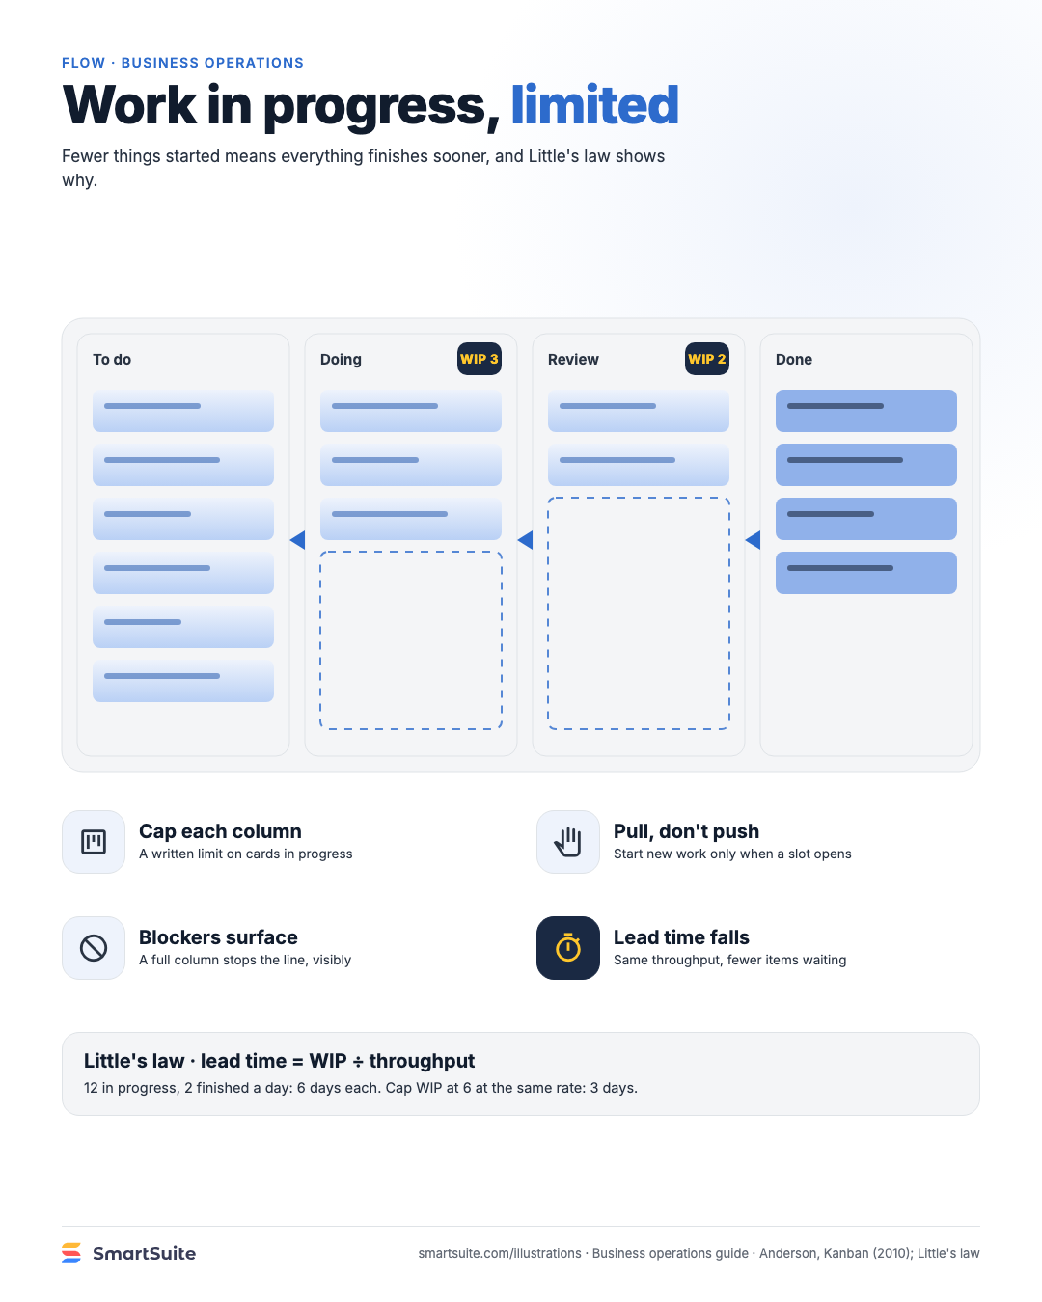
Work in progress, limited
Why capping the work in each column shortens the time everything takes, with the arithmetic behind it.
Source: Anderson, Kanban (2010); Little's law
Notes:
Work in progress, limited
Why capping the work in each column shortens the time everything takes, with the arithmetic behind it.
Source: Anderson, Kanban (2010); Little's law · From: Business operations
Credit: Source: SmartSuite, smartsuite.com/illustrations

