Slide 1
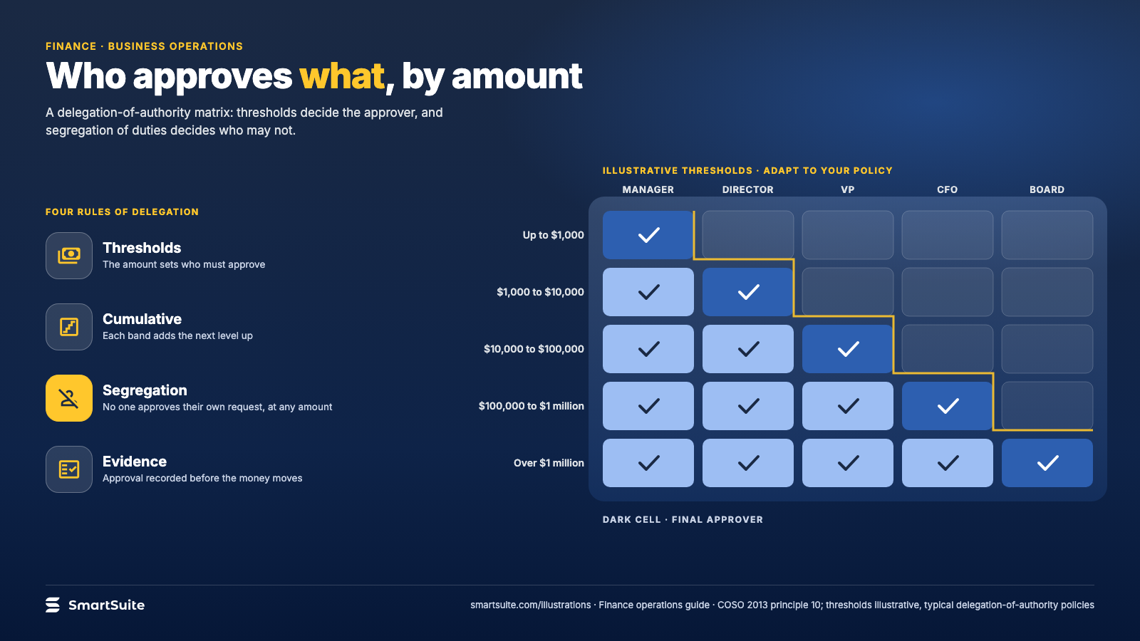
Notes:
Who approves what, by amount
A delegation-of-authority matrix: thresholds, roles and the segregation rule that no one approves their own request.
Source: COSO 2013 principle 10; typical delegation-of-authority policies · From: Finance operations
Credit: Source: SmartSuite, smartsuite.com/illustrations

Slide 2
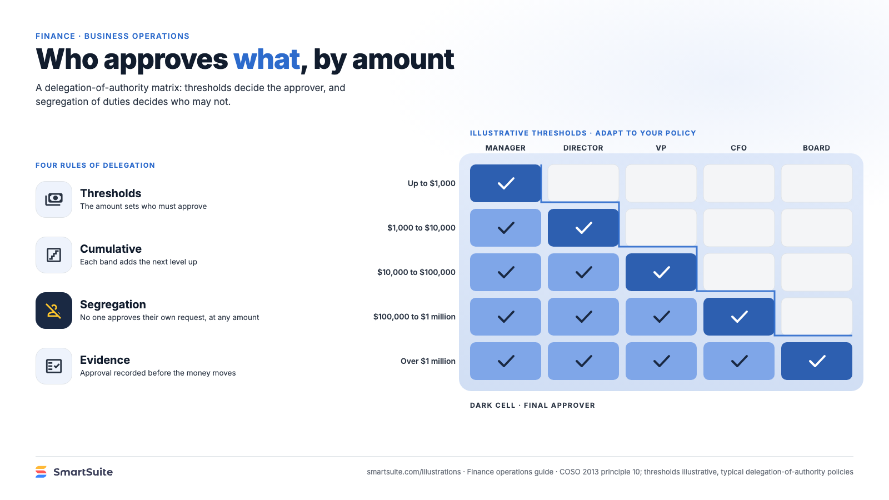
Notes:
Who approves what, by amount
A delegation-of-authority matrix: thresholds, roles and the segregation rule that no one approves their own request.
Source: COSO 2013 principle 10; typical delegation-of-authority policies · From: Finance operations
Credit: Source: SmartSuite, smartsuite.com/illustrations

