Slide 1
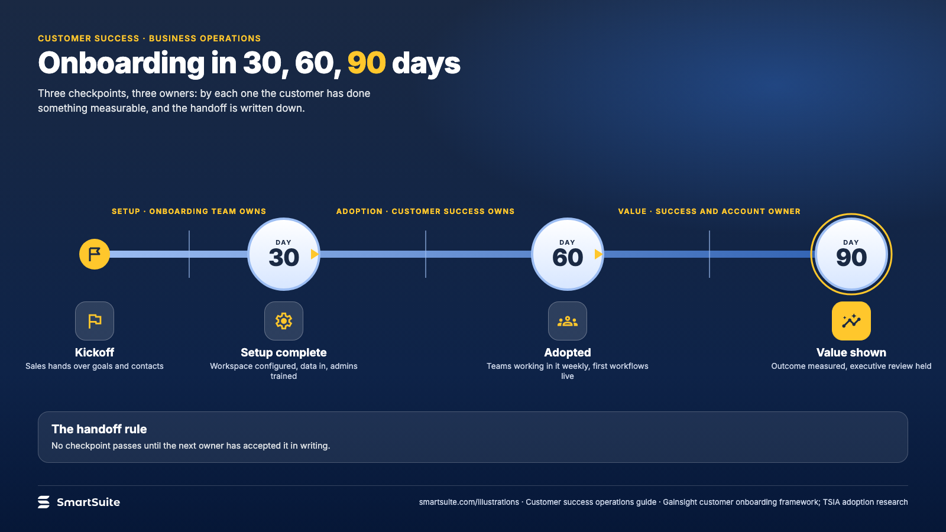
Notes:
Onboarding in 30, 60, 90 days
Setup, adoption, value: what the customer should have done by each checkpoint and who owns the handoff.
Source: Gainsight customer onboarding framework; TSIA adoption research · From: Customer success operations
Credit: Source: SmartSuite, smartsuite.com/illustrations

Slide 2
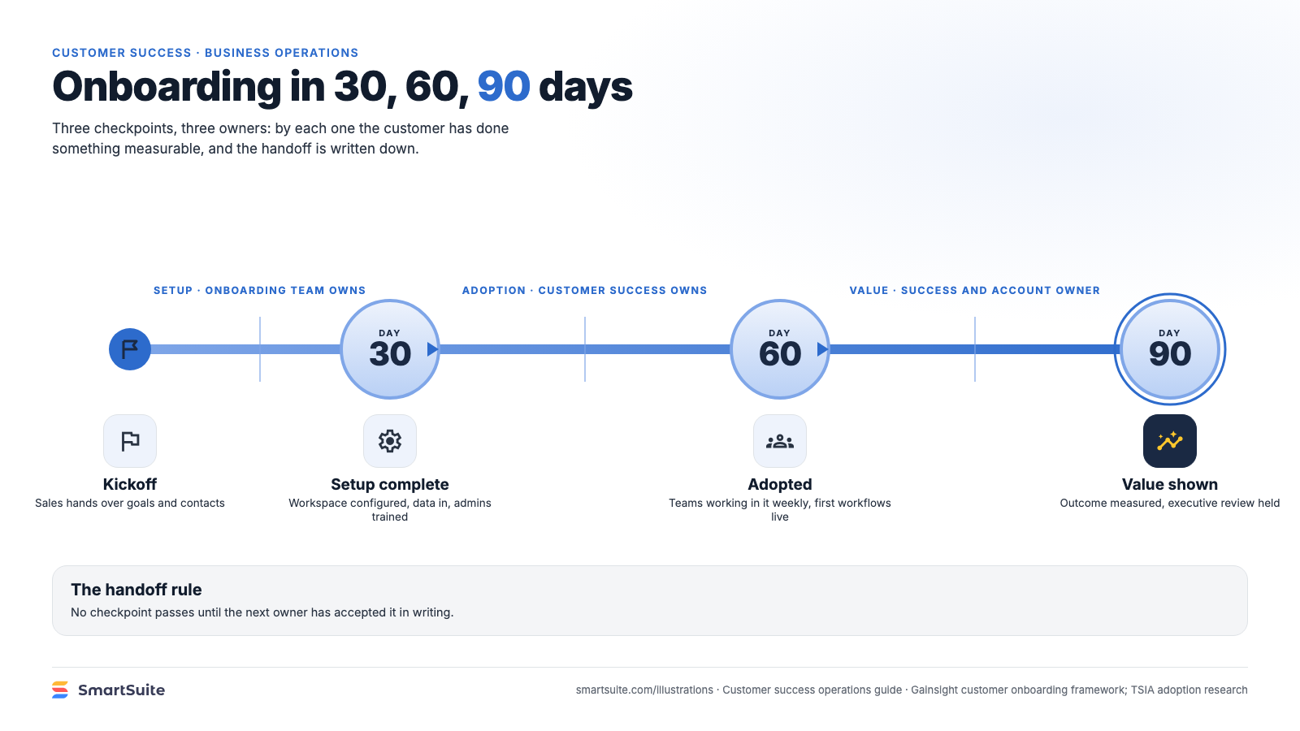
Notes:
Onboarding in 30, 60, 90 days
Setup, adoption, value: what the customer should have done by each checkpoint and who owns the handoff.
Source: Gainsight customer onboarding framework; TSIA adoption research · From: Customer success operations
Credit: Source: SmartSuite, smartsuite.com/illustrations

