Slide 1
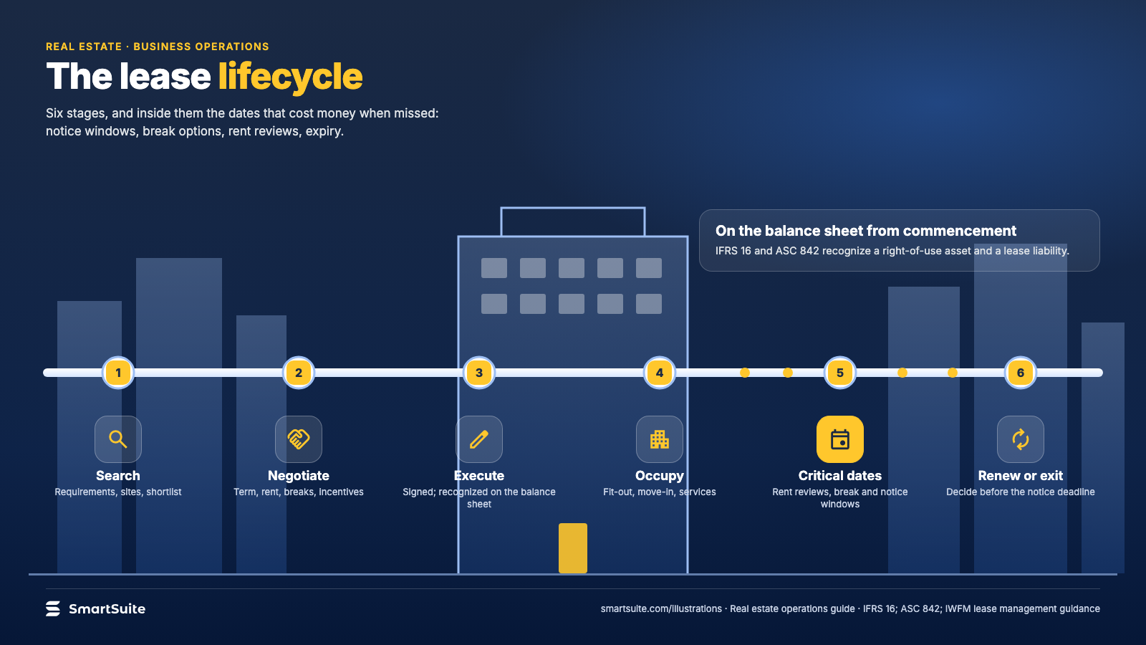
Notes:
The lease lifecycle
Search, negotiate, execute, occupy, critical dates, renew or exit: the dates that cost money when missed.
Source: IFRS 16; ASC 842; IWFM lease management guidance · From: Real estate operations
Credit: Source: SmartSuite, smartsuite.com/illustrations

Slide 2
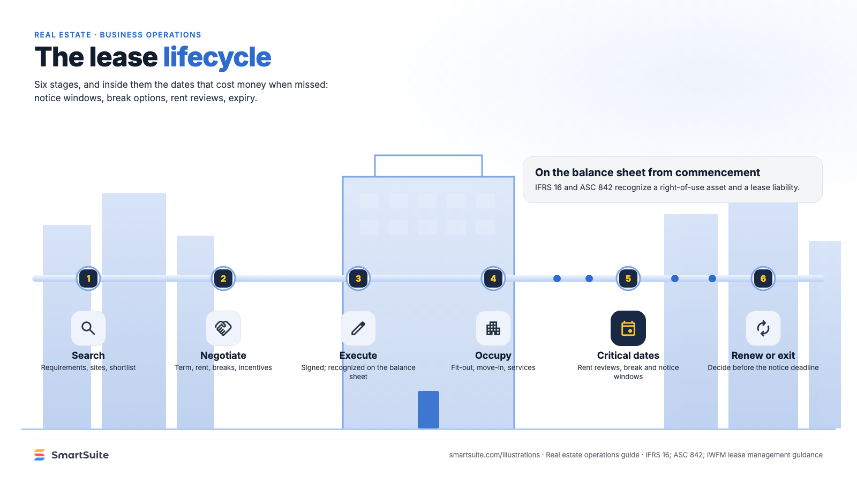
Notes:
The lease lifecycle
Search, negotiate, execute, occupy, critical dates, renew or exit: the dates that cost money when missed.
Source: IFRS 16; ASC 842; IWFM lease management guidance · From: Real estate operations
Credit: Source: SmartSuite, smartsuite.com/illustrations

