Slide 1
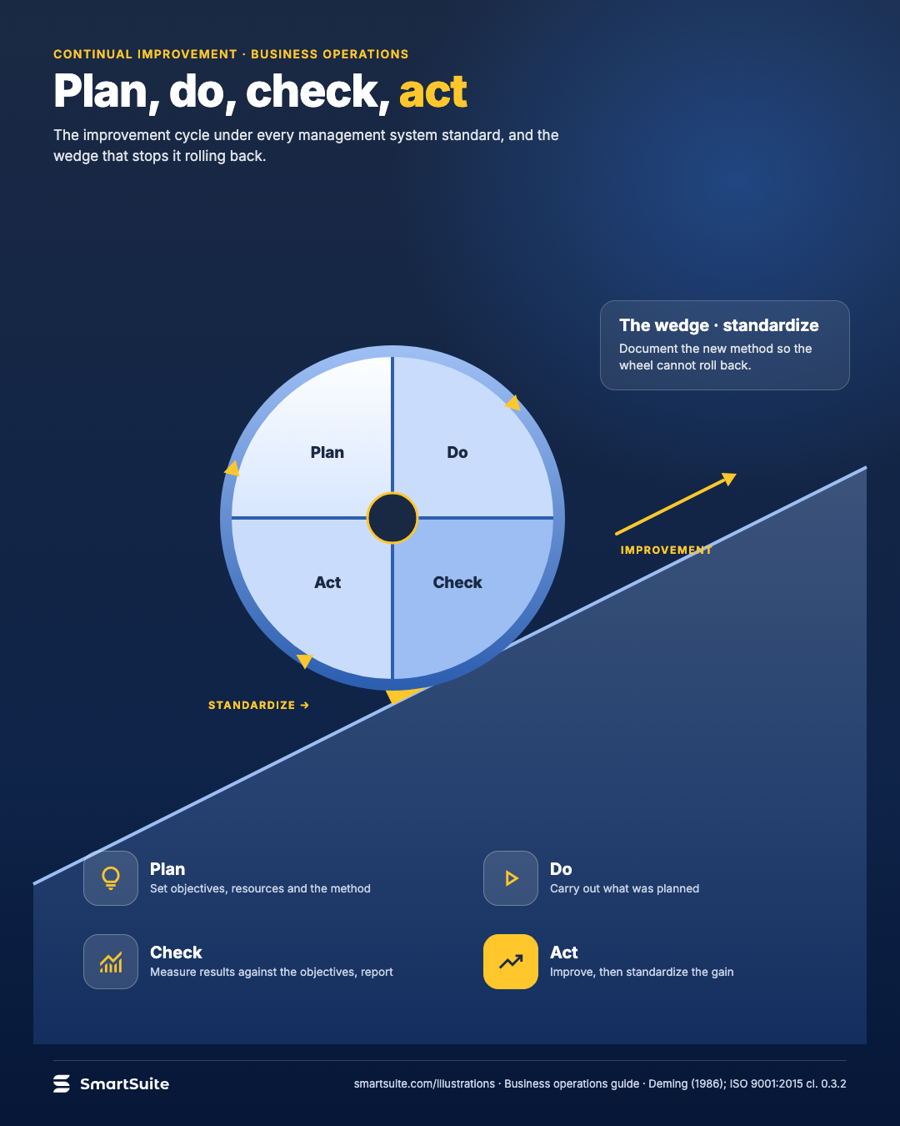
Plan, do, check, act
The improvement cycle every management system standard is built on, and the wedge that stops it rolling back.
Source: Deming (1986); ISO 9001:2015 cl. 0.3.2
Notes:
Plan, do, check, act
The improvement cycle every management system standard is built on, and the wedge that stops it rolling back.
Source: Deming (1986); ISO 9001:2015 cl. 0.3.2 · From: Business operations
Credit: Source: SmartSuite, smartsuite.com/illustrations

Slide 2
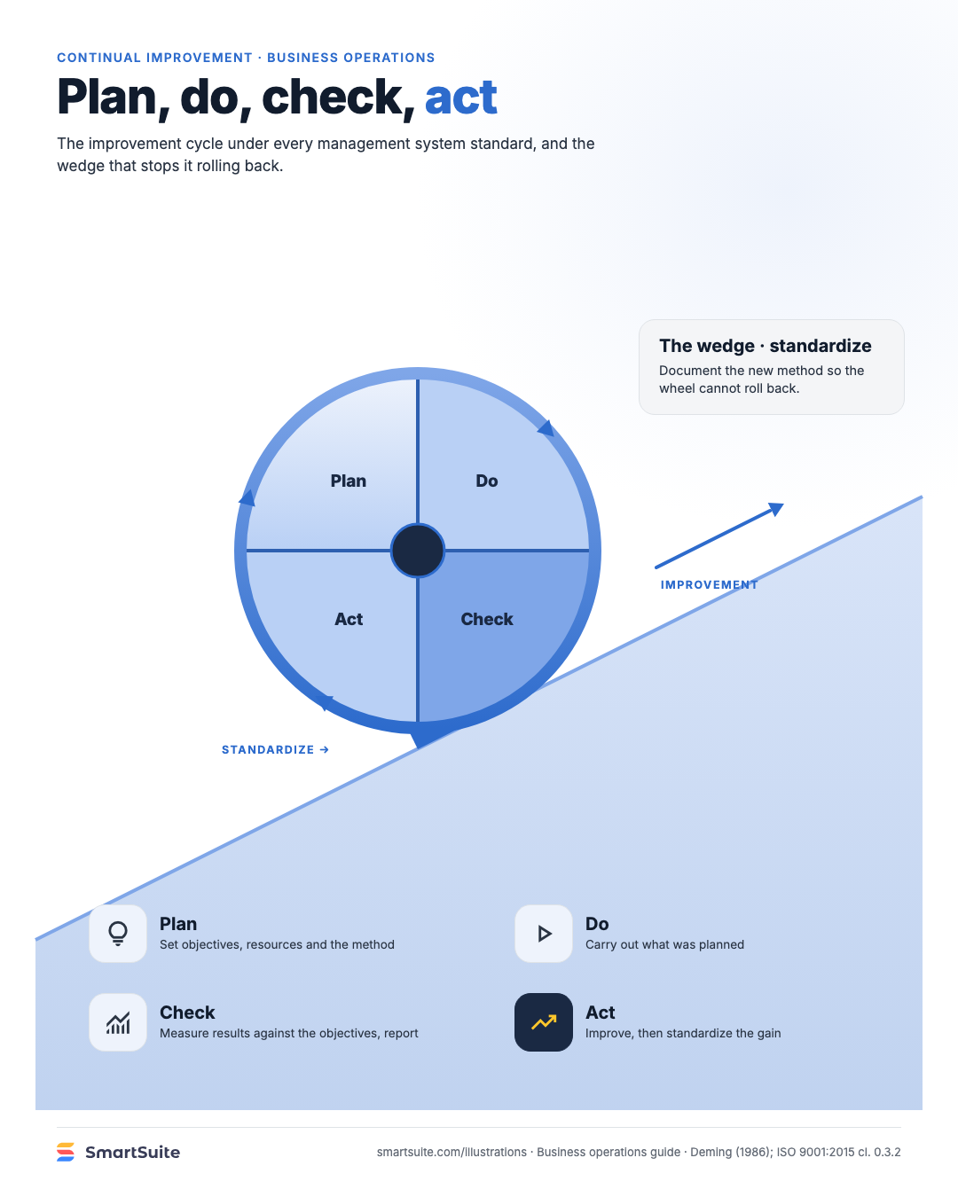
Plan, do, check, act
The improvement cycle every management system standard is built on, and the wedge that stops it rolling back.
Source: Deming (1986); ISO 9001:2015 cl. 0.3.2
Notes:
Plan, do, check, act
The improvement cycle every management system standard is built on, and the wedge that stops it rolling back.
Source: Deming (1986); ISO 9001:2015 cl. 0.3.2 · From: Business operations
Credit: Source: SmartSuite, smartsuite.com/illustrations

