Slide 1
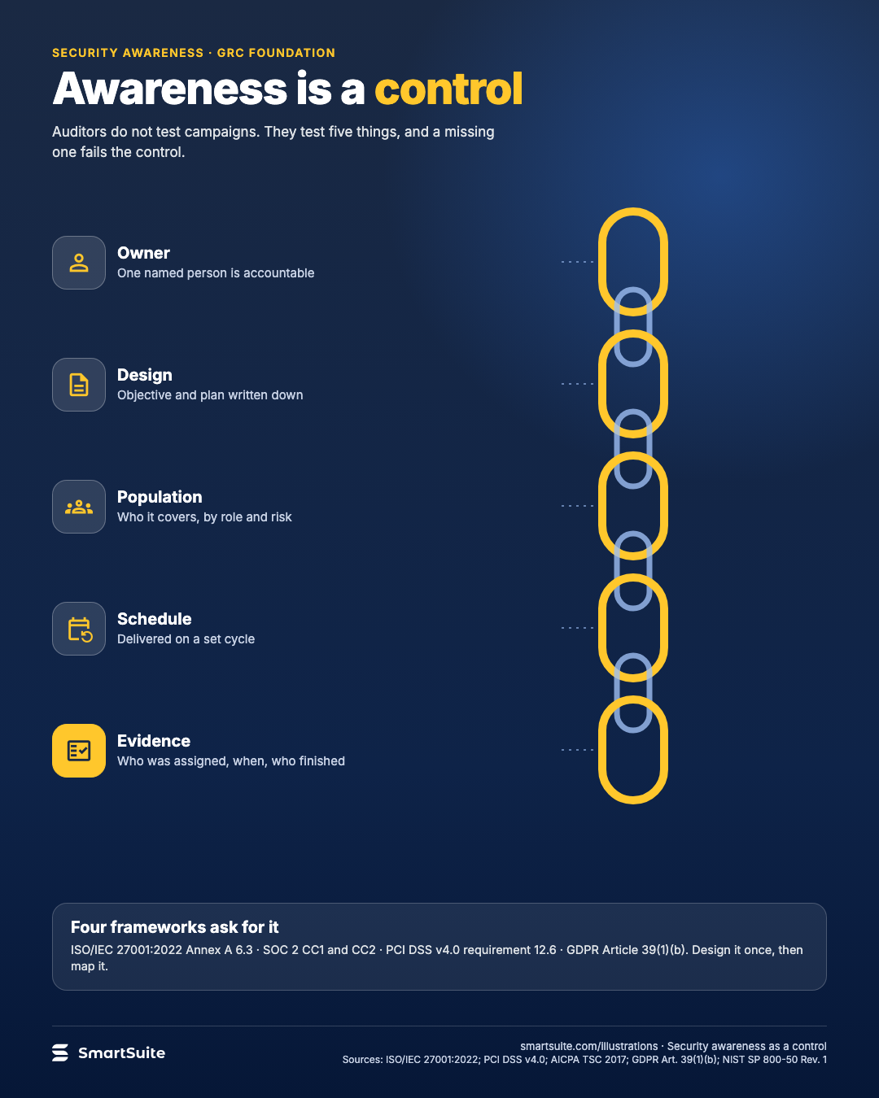
Awareness is a control
The five things auditors test in a security awareness program: owner, design, population, schedule and evidence.
Source: ISO/IEC 27001:2022 Annex A 6.3; PCI DSS v4.0 req. 12.6; AICPA Trust Services Criteria 2017 CC1, CC2; GDPR Art. 39(1)(b); NIST SP 800-50 Rev. 1
Notes:
Awareness is a control
The five things auditors test in a security awareness program: owner, design, population, schedule and evidence.
Source: ISO/IEC 27001:2022 Annex A 6.3; PCI DSS v4.0 req. 12.6; AICPA Trust Services Criteria 2017 CC1, CC2; GDPR Art. 39(1)(b); NIST SP 800-50 Rev. 1 · From: Security awareness as a control (GRC Foundation article)
Credit: Source: SmartSuite, smartsuite.com/illustrations

Slide 2
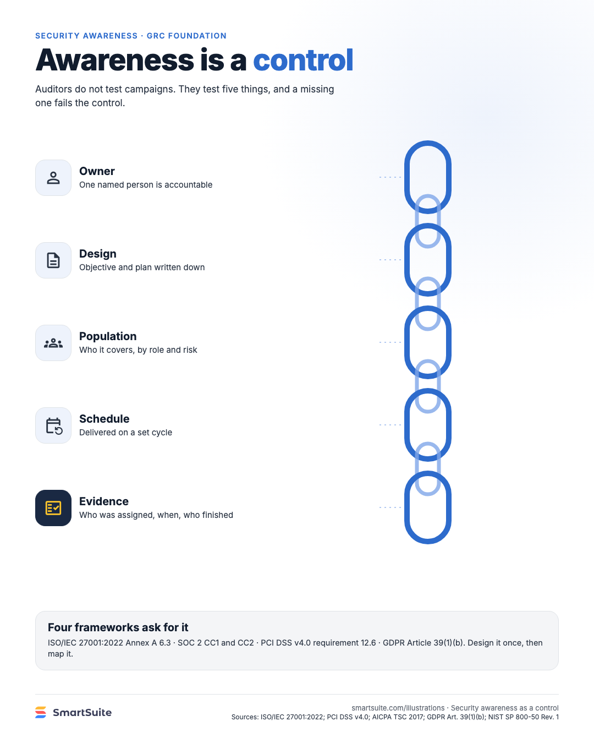
Awareness is a control
The five things auditors test in a security awareness program: owner, design, population, schedule and evidence.
Source: ISO/IEC 27001:2022 Annex A 6.3; PCI DSS v4.0 req. 12.6; AICPA Trust Services Criteria 2017 CC1, CC2; GDPR Art. 39(1)(b); NIST SP 800-50 Rev. 1
Notes:
Awareness is a control
The five things auditors test in a security awareness program: owner, design, population, schedule and evidence.
Source: ISO/IEC 27001:2022 Annex A 6.3; PCI DSS v4.0 req. 12.6; AICPA Trust Services Criteria 2017 CC1, CC2; GDPR Art. 39(1)(b); NIST SP 800-50 Rev. 1 · From: Security awareness as a control (GRC Foundation article)
Credit: Source: SmartSuite, smartsuite.com/illustrations

