Slide 1
Bill Shillito
Title: Teaching Axiomatic Proof through Combinatorial Games
Program: Mathematics - Doctoral
College: College of Arts and Sciences
Advisor: Dr. Draga Vidakovic

Slide 2
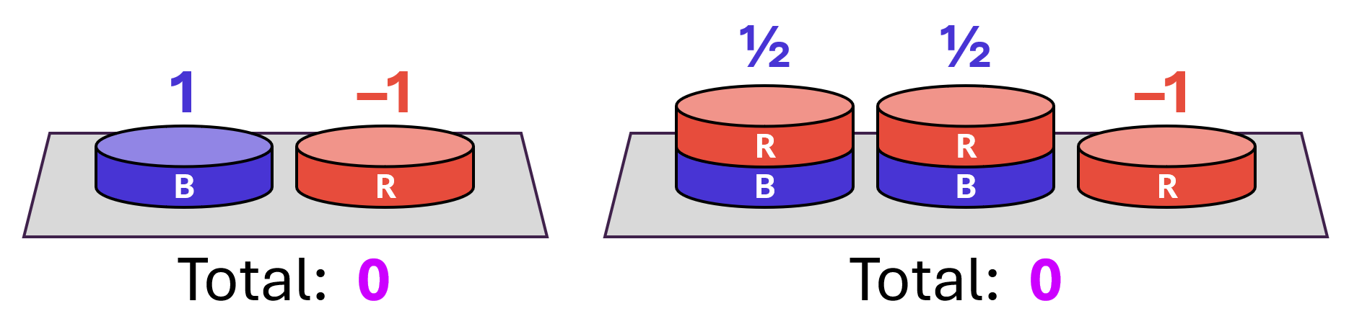
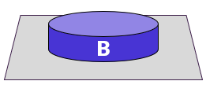
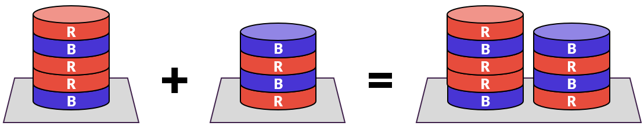
Who wins?
B
R
R
B
B
R
B
R
B
R
Axioms
Examples
P2
=
0
=
1
Research Questions
How do students reason
about winning strategies?
How do students prove
the values of positions?
x
y
x + y

