Slide 1
Online facilitation
What’s going on, and how do we prepare best?

Slide 2




Katrine Hald Kjeldsen
Consultant & Trainer
20+ years of experience as a facilitator
60+ online trainings
20+ webinars
I train, coach and develop facilitators

Slide 3

Katrine Hald Kjeldsen
Consultant & Trainer
20+ years of experience as a facilitator
60+ online trainings
20+ webinars
I train, coach and develop facilitators
I struggle with online formats

Slide 4
After this presentation,
You will understand
why you too (probably) struggle with online engagement
1
2
why it is not your fault
3
what you can do to counteract it and create more real connection

Slide 5
Content
1
Why we must learn this
2
The altered physics of the online space
3
Behavioral, mental and cognitive effects
4
5 design laws for the online space

Slide 6
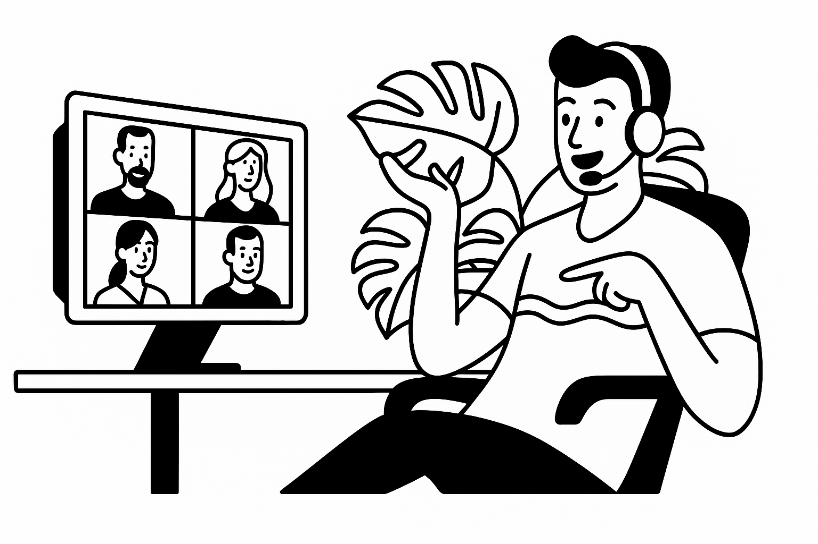
Online collaboration IS the new normal
Notes:
Selvom der er mange der “kalder folk tilbage på kontoret”, så sidder vi alligevel i online møder dagen lang

Slide 7
Online collaboration IS the new normal
Work is distributed
Teams, customers and partners are no longer in the same room or the same country
Notes:
This particularly goes for you
Companies are becoming international
Sales are international
We have to renew our ways of working to match this reality
And we are not quite there yet

Slide 8
Online collaboration IS the new normal
Flexibility
Hybrid and remote work are the new norm – not at temporary trend
Work is distributed
Teams, customers and partners are no longer in the same room or the same country
Notes:
Even though far too many companies are forcing people back to the office
The irony is that we then attend online meetings. From our desk

Slide 9
Online collaboration IS the new normal
Speed
Work moves faster than travel or physical meetings allow
Flexibility
Hybrid and remote work are the new norm – not at temporary trend
Work is distributed
Teams, customers and partners are no longer in the same room or the same country
Notes:
We collaborate more often / and with more people

Slide 10
Online collaboration IS the new normal
Speed
Work moves faster than travel or physical meetings allow
Flexibility
Hybrid and remote work are the new norm – not at temporary trend
Responsibility
Online formats lower barriers to participation and reduce business travel
Work is distributed
Teams, customers and partners are no longer in the same room or the same country
Notes:
Social responsibility:
Make it possible for people who might not have the budget, the travel flexibility, or the physical access to join
Environmental responsibility. Less business travel. Less time spent on travel, more on working

Slide 11
Online collaboration IS the new normal
Speed
Work moves faster than travel or physical meetings allow
Flexibility
Hybrid and remote work are the new norm – not at temporary trend
Responsibility
Online formats lower barriers to participation and reduce business travel
Work is distributed
Teams, customers and partners are no longer in the same room or the same country
Resilience
We are less vulnerable to crisis and disaster if we are strong online collaborators
Notes:
Online collaboration keeps us operational
Global disruptions can happen anytime

Slide 12
TAKEAWAY 1
F2F engagement remains valuable, but it should not be our operating norm
MASTERING ONLINE
COLLABORATION
IS NOW BUSINESS CRITICAL

Slide 13

Still, we kinda suck at it…
Notes:
We don’t lean into learning this as a business critical skill

Slide 14
The “altered physics” of the digitally mediated space
Notes:
Because it is hard. There are some structural/natural constraints that demand more from us, both as facilitators and participants

Slide 15

The “altered physics” of the digitally mediated space
Distance
Physical separation
- breaks shared presence
SPACE
Notes:
The “we” is weaker.
Hard to build group energy – it doesn’t build naturally.
Harder to read the room
Harder to trust others
Group cohesion is fragile
Harder to feel the group or intuit energy shifts

Slide 16

The “altered physics” of the digitally mediated space
Distance
Distraction
Physical separation
- breaks shared presence
Competing stimuli
- weaken focus
SPACE
ENVIRON-MENT
Notes:
Competing input both from our home environment and from other work. Especially the latter
Peoples focus is not bounded by the physical room – it can go anywhere
Attention is no longer granted by presence. We can no longer monitor and micro/counteract a decrease in attention
Group attention dissolves fast
Momentum is harder to sustain

Slide 17

The “altered physics” of the digitally mediated space
Distance
Distraction
Delay
Physical separation
- breaks shared presence
Competing stimuli
- weaken focus
Transmission lag, micro-delays
- makes interaction less fluid
SPACE
ENVIRON-MENT
TIME
Notes:
Awkward timing makes speaking up riskier
Afraid to interrupt / to be misheard
Turn-taking breaks down
Lack of rhythm can break trust and momentum.
A lot of social processes such as laughter and empathy depend on synchronicity – which is oftentimes broken

Slide 18

The “altered physics” of the digitally mediated space
Distance
Distraction
Delay
Dis-connection
Physical separation
- breaks shared presence
Competing stimuli
- weaken focus
Transmission lag, micro-delays
- makes interaction less fluid
Decrease of social/ emotional bond
- weakened sense
of belonging
SPACE
ENVIRON-MENT
TIME
FEELING
Notes:
It is easier to be passive, invisible or emotionally absent
People may participate technically but not emotionally
Harder to feel as part of the team.
Easier to disengage.

Slide 19
The “altered physics” of the digitally mediated space
Distance
Distraction
Delay
Dis-connection
Disem-bodiment
Physical separation
- breaks shared presence
Competing stimuli
- weaken focus
Transmission lag, micro-delays
- makes interaction less fluid
Decrease of social/ emotional bond
- weakened sense
of belonging
Loss of body language
- harder to enterpret and make sense
SPACE
ENVIRON-MENT
TIME
FEELING
SENSORY INPUT
Notes:
We lose the emotional bandwidth of F2F interactions
No body language, eye contact, micro-reactions
Tone and intention are harder to decode
Greater risk of misunderstanding, emotional nuance gets blunted

Slide 20
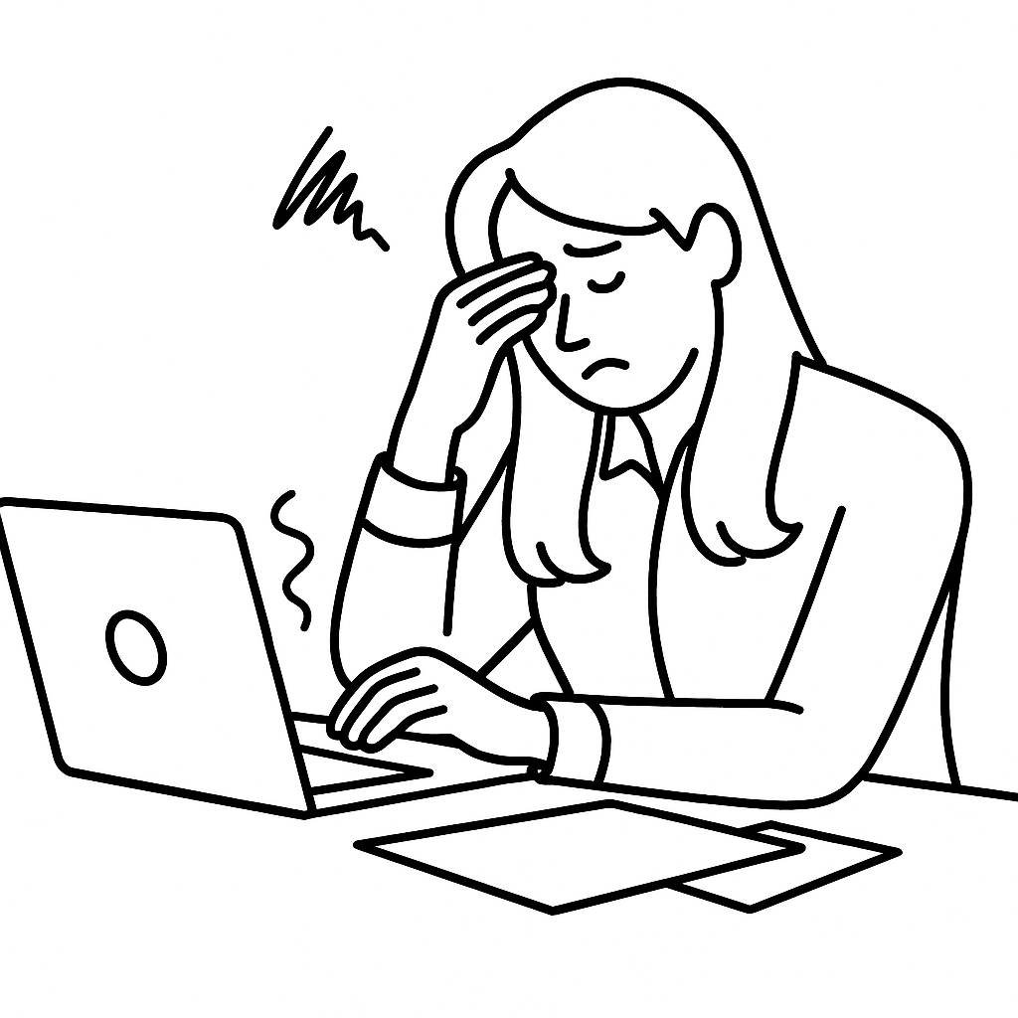
Behavioral, emotional and cognitive effects

Slide 21
Behavioral, emotional and cognitive effects
Fatigue
Your brain works overtime trying to follow – and it wears you out fast
Notes:
COGNITIVE EFFECT
Brain works overtime to keep up, follow the thread, and decode what is going on – especially when the context is unstructured or overloaded with information
People burn out faster, lose focus and fall back into autopilot
This is why we do not recommend online activities that last a whole day

Slide 22
Behavioral, emotional and cognitive effects
Passivity
It feels easier to lean back and stay quiet than just jump in
Fatigue
Your brain works overtime trying to follow – and it wears you out fast
Notes:
BEHAVIORAL EFFECT
Shows up in behavior – or rather the absence of it
When it feels riskier or more draining to contribute than stay silent, people withdraw
Not a lack of knowledge or interest but a calculation that silence is the safest option
The group loses out on voices, perspectives, and diversity of thought

Slide 23
Behavioral, emotional and cognitive effects
Mental drifting
You start drifting – checking your email, your phone, or just mentally checking out
Passivity
It feels easier to lean back and stay quiet than just jump in
Fatigue
Your brain works overtime trying to follow – and it wears you out fast
Notes:
COGNITIVE/BEHAVIORAL EFFECT
Happens when the brain seeks an easier reward or less cognitive load:
Checking emails
Picking up the phone
Diving into the ServiceNow
Classic escape when engagement drops
Physically present but mentally checked out

Slide 24
Behavioral, emotional and cognitive effects
Mental drifting
You start drifting – checking your email, your phone, or just mentally checking out
Confusion
You are never quite sure when to speak or what’s expected, so you hesitate
Passivity
It feels easier to lean back and stay quiet than just jump in
Fatigue
Your brain works overtime trying to follow – and it wears you out fast
Notes:
COGNITIVE/EMOTIONAL EFFECT
More than “not understanding”
Constant hesitation:
When to speak?
What is expected?
What should my contribution be?
How do I fit in?
What is going on?
Where are we in the agenda?
Keeps people on the sidelines rather than in the game

Slide 25
Behavioral, emotional and cognitive effects
Mental drifting
You start drifting – checking your email, your phone, or just mentally checking out
Confusion
You are never quite sure when to speak or what’s expected, so you hesitate
Passivity
It feels easier to lean back and stay quiet than just jump in
Low psychological safety
You worry that if you say something, it will land wrong – or land nowhere at all
Fatigue
Your brain works overtime trying to follow – and it wears you out fast
Notes:
EMOTIONAL EFFECT
May be the most paralyzing and overarching effect.
People are constantly calculating the risk of speaking up. This is even more prevalent in online settings.

Slide 26
TAKEAWAY 2
The struggles we feel online are not personal failures
THE PREDICTABLE EFFECTS
OF THE PHYSICS
OF THE ONLINE SPACE

Slide 27

So, what can we do??
Notes:
We don’t lean into learning this as a business critical skill

Slide 28

Five design laws for the online space
Notes:
Selvom der er mange der “kalder folk tilbage på kontoret”, så sidder vi alligevel i online møder dagen lang

Slide 29
#1
Purpose before format
#2
Refresh every 10 minutes
#3
Design for contribution
#4
Lower the barriers of participation
#5
Evoke emotion, use narratives

Slide 30
Purpose before format
#1
In the online space, put purpose in the front seat, or technology will take the wheel
Notes:
Technology is not neutral
Tools can dictate how you meet and collaborate
Technology creates constraints
Suddenly you are designing around what Miro and Teams can rather than what the group actually needs

Slide 31

Purpose before format
#1
In the online space, put purpose in the front seat, or technology will take the wheel
Confusion
Fatigue

Slide 32

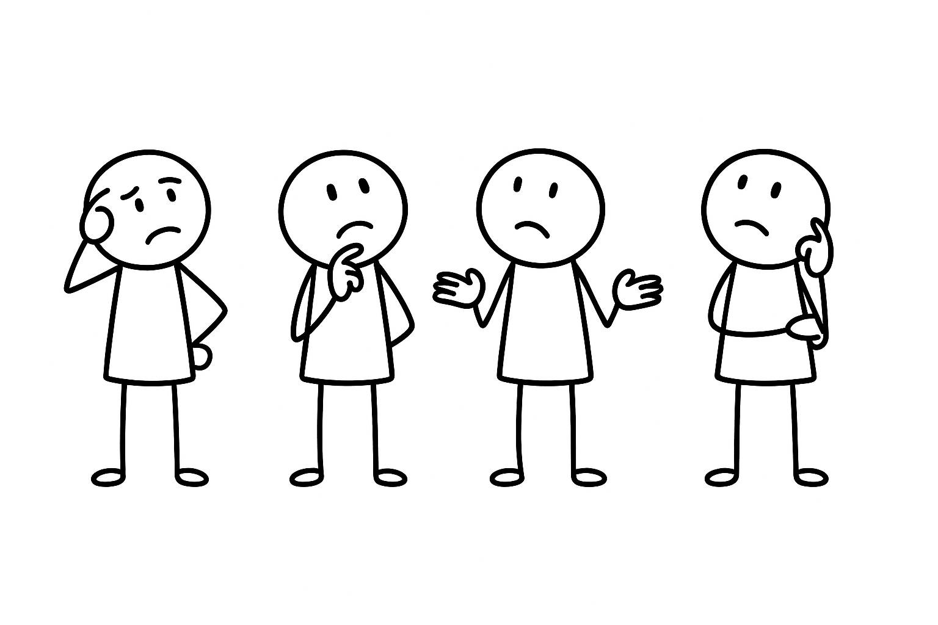
Purpose before format
#1
In the online space, put purpose in the front seat, or technology will take the wheel
Confusion
Fatigue
“Let’s try the whiteboard. Now let’s do polls! Now, let’s… what are we doing again?”
“He said that he wanted deep dialogue, no? So, what’s up with the anonymous multiple-choice poll?”
“We wanted fast ideas – but spent 20 minutes teaching everyone how to log on to the whiteboard”

Slide 33

Purpose before format
#1
In the online space, put purpose in the front seat, or technology will take the wheel
Confusion
Fatigue
“Let’s try the whiteboard. Now let’s do polls! Now, let’s… what are we doing again?”
“He said that he wanted deep dialogue, no? So, what’s up with the anonymous multiple-choice poll?”
“We wanted fast ideas – but spent 20 minutes teaching everyone how to log on to the whiteboard”
LET PURPOSE RULE YOUR DESIGN
BE GOLDILOCKS WHEN YOU CHOOSE TOOLS
DECLARE PURPOSE AND EXPECTATIONS
First consider desired outcomes:
Mindset change? Decisions?
Then consider relevant participant behaviors
Then choose interaction tools
Don’t stack too many features or platforms
Don’t settle for passive formats – be brave, try stuff out, invest!
Tell people both WHY they’re here and HOW they are expected to engage

Slide 34
Refresh every 10 minutes
#2
In the online space, you must refresh rhythm often, or attention will decay
Notes:
Like we have already established: attention works differently
People don’t drift after hours but potentially after minutes
Research shows that our brains can only hold focus in a virtual setting for short bursts before it seeks stimulation elsewhere
This is why it is very important to aim at refreshing the scenery every 10 min
Not gimmicks or constant icebreakers
Introducing a shift in energy, perspective or activity
Varying the rhythm

Slide 35
Refresh every 10 minutes
#2
In the online space, you must refresh rhythm often, or attention will decay
Mental drifting

Slide 36
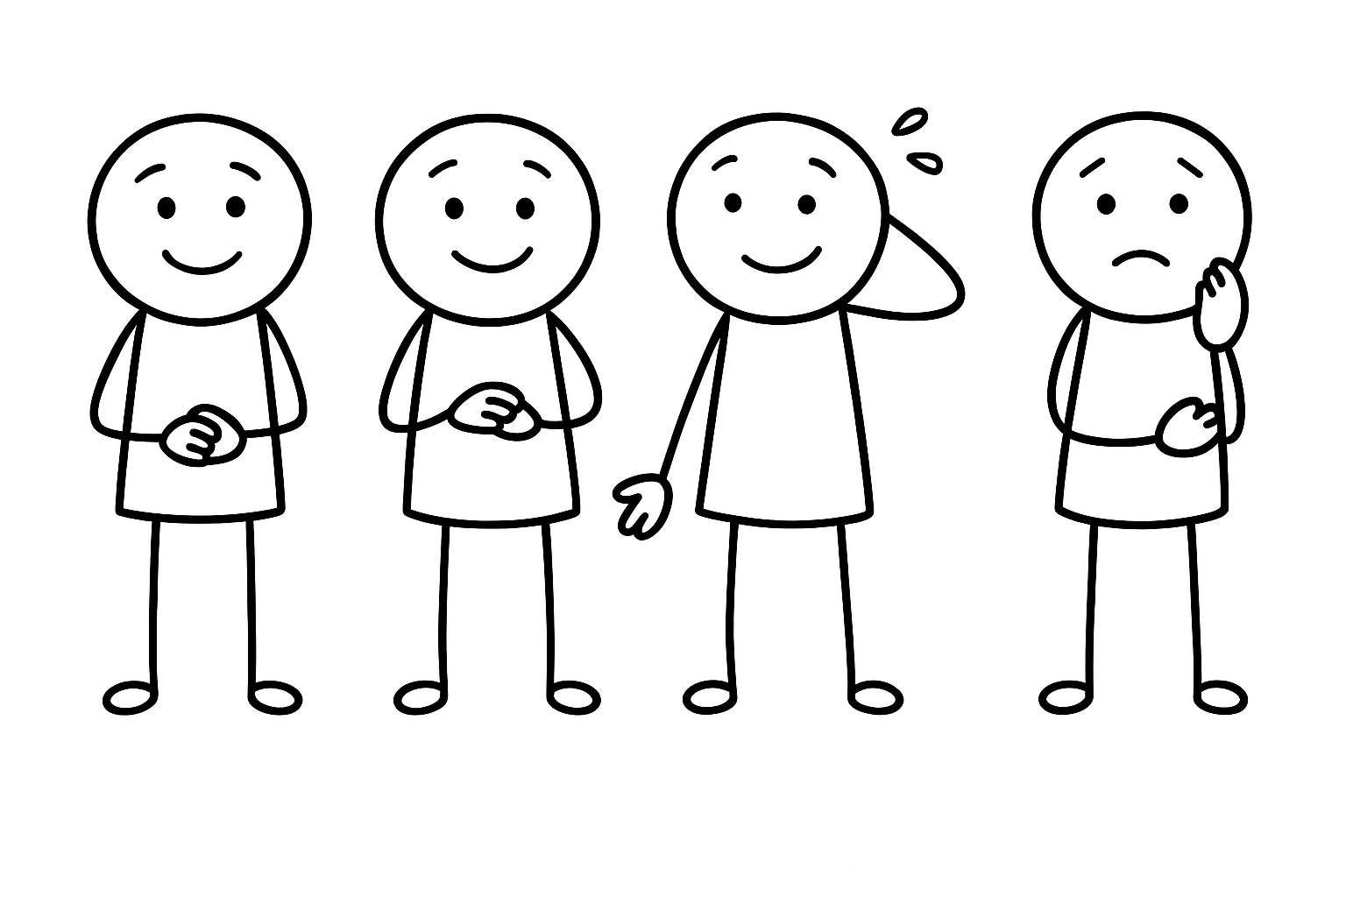
Refresh every 10 minutes
#2
In the online space, you must refresh rhythm often, or attention will decay
Mental drifting
“The meeting agenda 60 minutes of download – interaction is if time allows”
“What started as a check-in turned into Donnas 25-minute hobby horse parade”
“We have been in this breakout for… how long??”

Slide 37
Refresh every 10 minutes
#2
In the online space, you must refresh rhythm often, or attention will decay
Mental drifting
“The meeting agenda 60 minutes of download – interaction is if time allows”
“What started as a check-in turned into Donnas 25-minute hobby horse parade”
“We have been in this breakout for… how long??”
REVIEW YOUR MEETING DESIGN
BALANCE ACTIVE AND PASSIVE MOMENTS
REMEMBER BREAKS
Make sure there are changes of scene every 5-10 min
Think in energy shifts
New task → new mode (chat, poll, discussion, breakout)
Alternate between listening, doing and sharing
Include a break every hour
Think of micro breaks – even 30 seconds of stretching or pausing resets focus

Slide 38
Design for contribution
#3
In the online space, if you don’t design for contribution, you invite to passivity
Notes:
Passivity is the default – ASSUME THIS
So if you don’t intentionally design for contribution, youre really designing for silence
It is not enough to prompt verbally – this only works for the most confident voices
Instead you have to structure activities, so everyone has a natural way in

Slide 39
Design for contribution
#3
In the online space, if you don’t design for contribution, you invite to passivity
Mental drifting
Passivity

Slide 40
Design for contribution
#3
In the online space, if you don’t design for contribution, you invite to passivity
Mental drifting
Passivity
“Any questions or ideas? No?
Ok, moving on then!”
“I am sending you into breakouts – just talk about whatever inspired you”
“We would really like your feedback. Please raise your hand at any point in time”

Slide 41
Design for contribution
#3
In the online space, if you don’t design for contribution, you invite to passivity
Mental drifting
Passivity
“Any questions or ideas? No?
Ok, moving on then!”
“I am sending you into breakouts – just talk about whatever inspired you”
“We would really like your feedback. Please raise your hand at any point in time”
DESIGN PARTICIPATION INTO THE STRUCTURE
NORMALIZE EARLY CONTRIBUTION
PROVIDE CLEAR INSTRUCTIONS
Make contribution the expected path, not a random bi-product
Active elements => passive ones
Establish participants as contributors as the first thing
Shift the power balance
Keep the exchange going!
Clear prompts, small asks
Make clear what the expected output is and what happens next

Slide 42
Lower the barriers of participation
#4
In the online space, participation is best secured through a series of small, safe elements of interaction
Notes:
This is connected to law #3
It has to do with HOW you create easy safe entry points
HOW EASY IS IT TO STEP IN?
Participation is best secured not by one big leap, but by a series of small, cumulative acts

Slide 43
Lower the barriers of participation
#4
In the online space, participation is best secured through a series of small, safe elements of interaction
Low psych safety
Passivity

Slide 44
Lower the barriers of participation
#4
In the online space, participation is best secured through a series of small, safe elements of interaction
Low psych safety
Passivity
“Any questions or ideas? No?
Ok, moving on then!”
“Any volunteers?
….
Donna?”
“So now the CEO has set the scene. Let’s get the debate going!
Who would like to start?”

Slide 45
Lower the barriers of participation
#4
In the online space, participation is best secured through a series of small, safe elements of interaction
Low psych safety
Passivity
“Any questions or ideas? No?
Ok, moving on then!”
“Any volunteers?
….
Donna?”
“So now the CEO has set the scene. Let’s get the debate going! Who would like to start?”
START WITH SAFE, LOW-STAKES ACTIVITIES
OFFER PARTICIPATION VARIATION
BUILD MOMENTUM GRADUALLY
Anonymous polls, simple chat entries, reactions
Humorous icebreakers, not too personal
Eg both verbal and written modes of expression
Choice between working alone, in pairs or in a group
Anonymous first, public second
Small, then large
Written, then oral contributions

Slide 46
Evoke emotion, use narratives
#5
In the online space, facts fade — but feelings and stories stay
Notes:
We often fall into the trap of thinking that more data, more slides, or more bullet points will convince people.
But the reality is: the more you stack facts, the faster people disengage
Stories and emotions anchor information.

Slide 47
Evoke emotion, use narratives
#5
In the online space, facts fade — but feelings and stories stay
Mental drifting
Psych safety
Confusion

Slide 48

Evoke emotion, use narratives
#5
In the online space, facts fade — but feelings and stories stay
Mental drifting
Psych safety
Confusion
“We are not here to sit in a circle – let’s be efficient!
“No need to talk about the big picture — let’s just get through the action items”
“As you can see from these 72 data points... Wait, let me just read them aloud, so you understand”

Slide 49
Evoke emotion, use narratives
#5
In the online space, facts fade — but feelings and stories stay
Mental drifting
Psych safety
Confusion
“We are not here to sit in a circle – let’s be efficient!
“No need to talk about the big picture — let’s just get through the action items”
“As you can see from these 72 data points... Wait, let me just read them aloud, so you understand”
TELL TINY STORIES, NOT JUST FACTS
GLUE FACTS TO FEELINGS
BE A REAL HUMAN, NOT A PERFECT HOST
Facts slide of, stories stick
Stories anchor information naturally
If they don’t feel it, they won’t file it
Create verbal emotional spikes:
“This is important”
Relate the topic to participant’s experience
Share tiny doubts, delights, surprises
Let them connect to you, not just the subject matter

Slide 50
TAKEAWAY 3
Yes, creating more online engagement and real connection requires
empathizing and preparation
BUT IT IS SO
WORTH IT!

