Slide 1




with

Slide 2
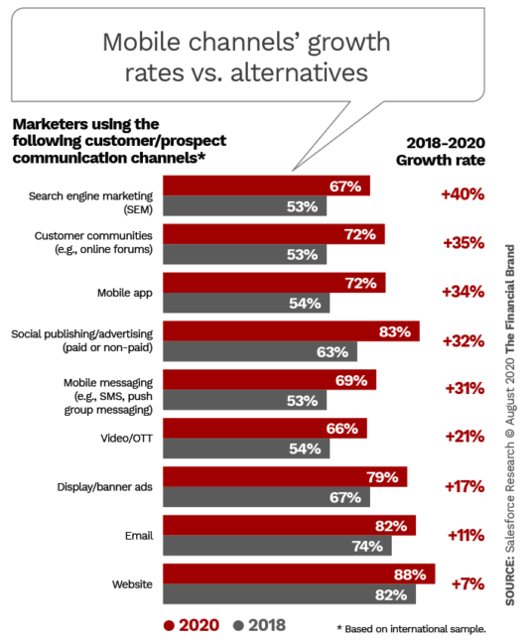
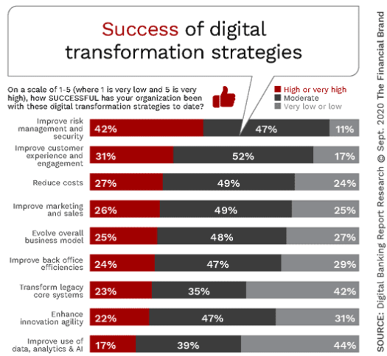
What is Going On?
Notes:
By now, we are all aware: The world has moved to digital. While there may be some correction, we can all agree that your primary channels are digital. No longer will the bulk of your members walk into a branch or call. The challenge now is how do we use these “impressions” to serve, delight and engage moving forward? If differentiator is dedication to the community member, how do we do community in digital channels? How do we demonstrate that we know the member better than wells fargo, chase or paypal? The key is data. The challenge is how to use data in digital channels. Today, we address that concern with DeepTarget’s Digital Experience Platform.

Slide 3
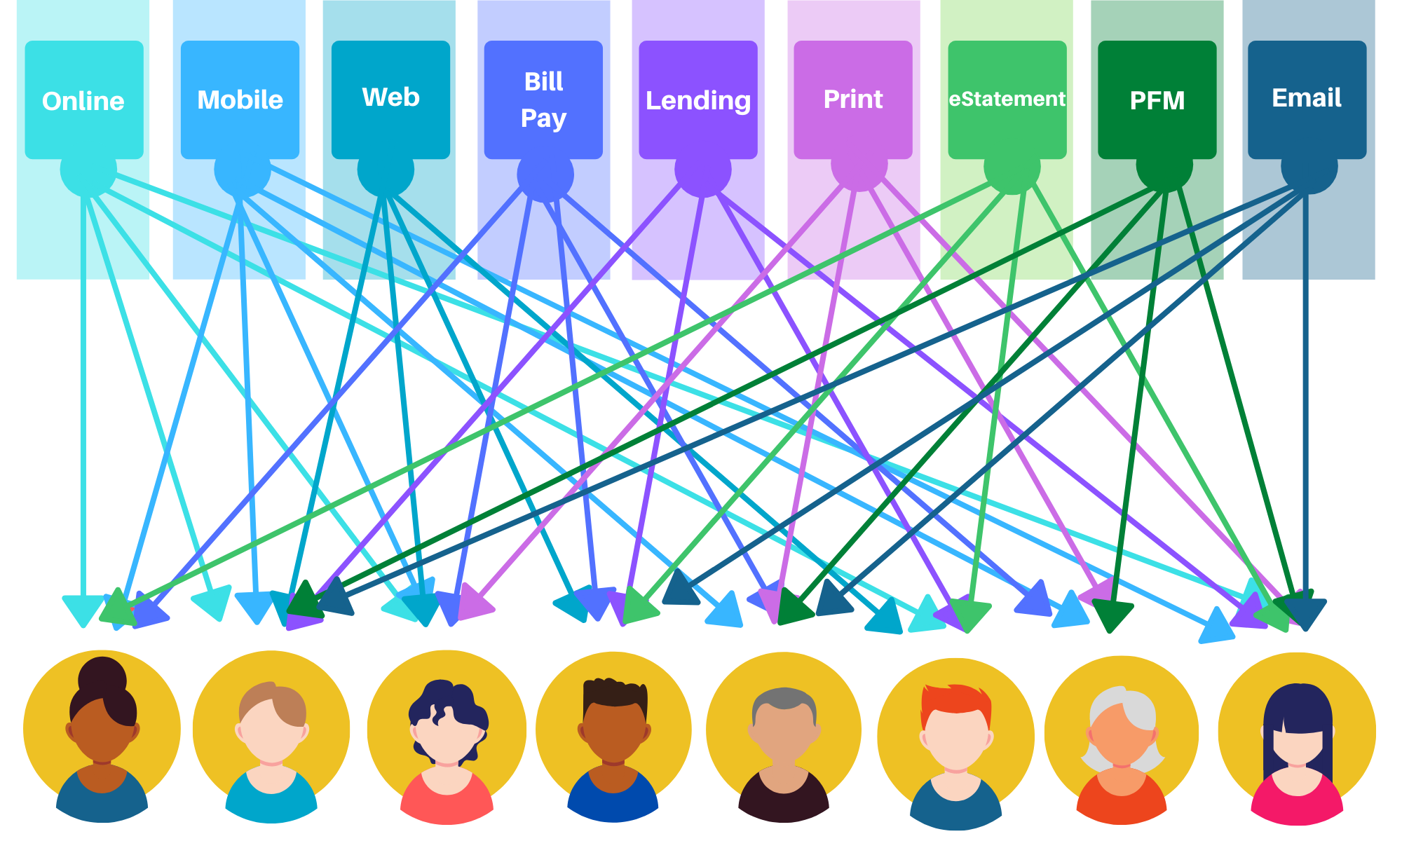
FI Landscape - Communication and Campaign Silos
Notes:
DeepTarget addresses a growing problem that has been recognized but unaddressed as other priorities have been distracting. Silos by channels have persisted. Marketing has been challenged in coordinating a comprehensive message to membership. This is only getting worse. Moreover, the idea of “community” and “we know you” continues to erode and suffer. This slide depicts why.

Slide 4
Enter DeepTarget
Huntsville Alabama
Over 200 Financial Institution Clients
Recognized Need in 2008
Renamed to the DXP
3D StoryTeller
Machine Learning/Predictive Analytics
Notes:
This is why deep target is in business. We have implemented in over 200 financial institutions and we are already implemented in your technology stack.

Slide 5
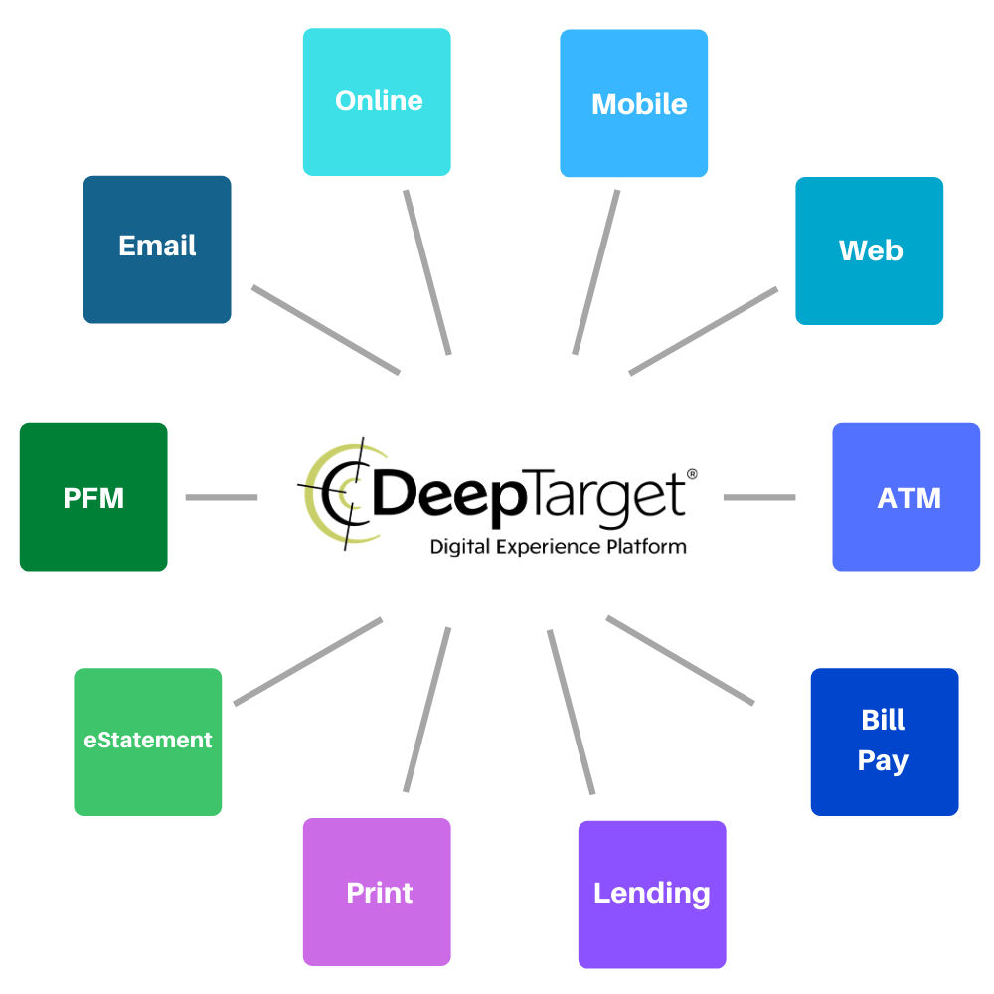
Design Once, Engage Everywhere
Digital Experience Platform
DeepTarget automates and elevates customer experiences digitally to yield new loans, deposits & customer loyalty for credit unions and banks.
Notes:
What DeepTarget does is insert our technology between your data and your delivery. In this way, we coordinate your messaging across all empowered channels. Perhaps we should stop there. That is profound and something you’ve never been able to do before. You can personalize, on a one-on-one basis, your message to each member. You can make a market of x number of members, x markets of one member. We should probably stop right there. But wait, there’s more! For the first time, we can measure marketing effectiveness and create marketing best practices for your credit union. You can, for the first time, apply science to the art of marketing.

Slide 6
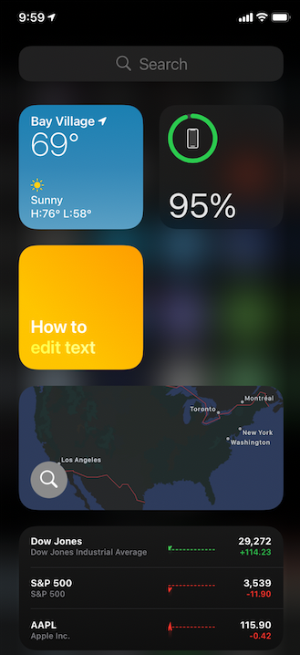
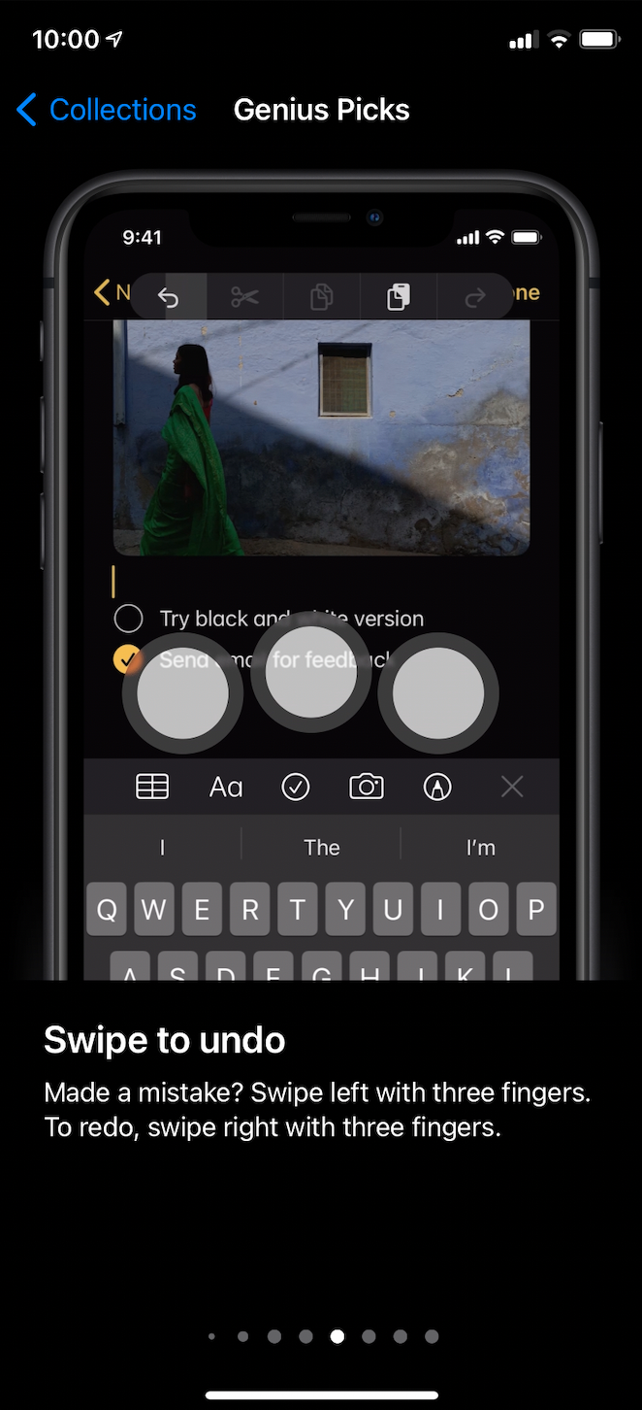
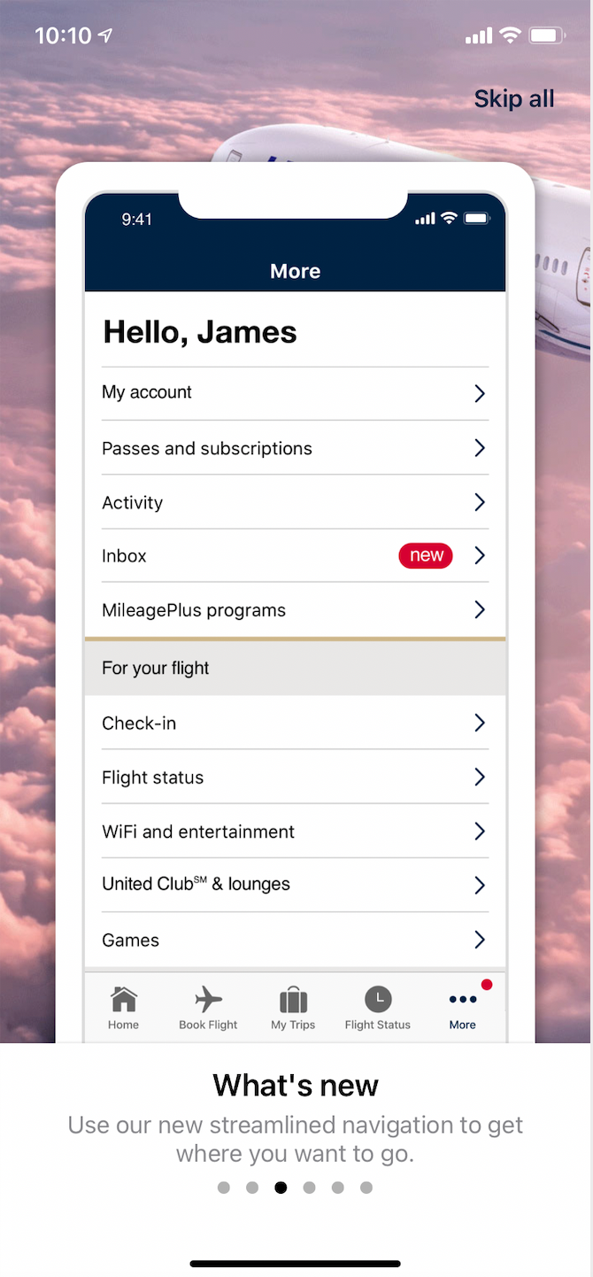
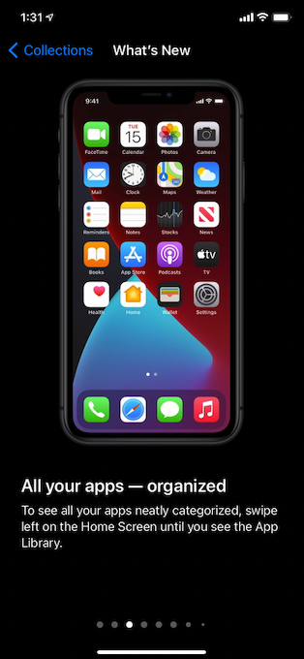
Apple
iOS
United
Airlines
Notes:
Several studies tell us that the deeper engagement you can create, the more opportunity you have. Years ago, banks sold ”totally free checking” as a lost leader because they knew it was the path to financial partnership. The checking account was the way to create and establish affinity which led to even more affinity. Here we see the latest releases of Apple iOS (14) and United Airlines where they are purposely trying to get users to more actively engage. With the onset of the pandemic, many members are looking to expand their understanding of what is offered over digital channels. Others may see a feature on TV from a competitor and change alliances because they didn’t’ know you had the same feature…you just didn’t tell them.

Slide 7
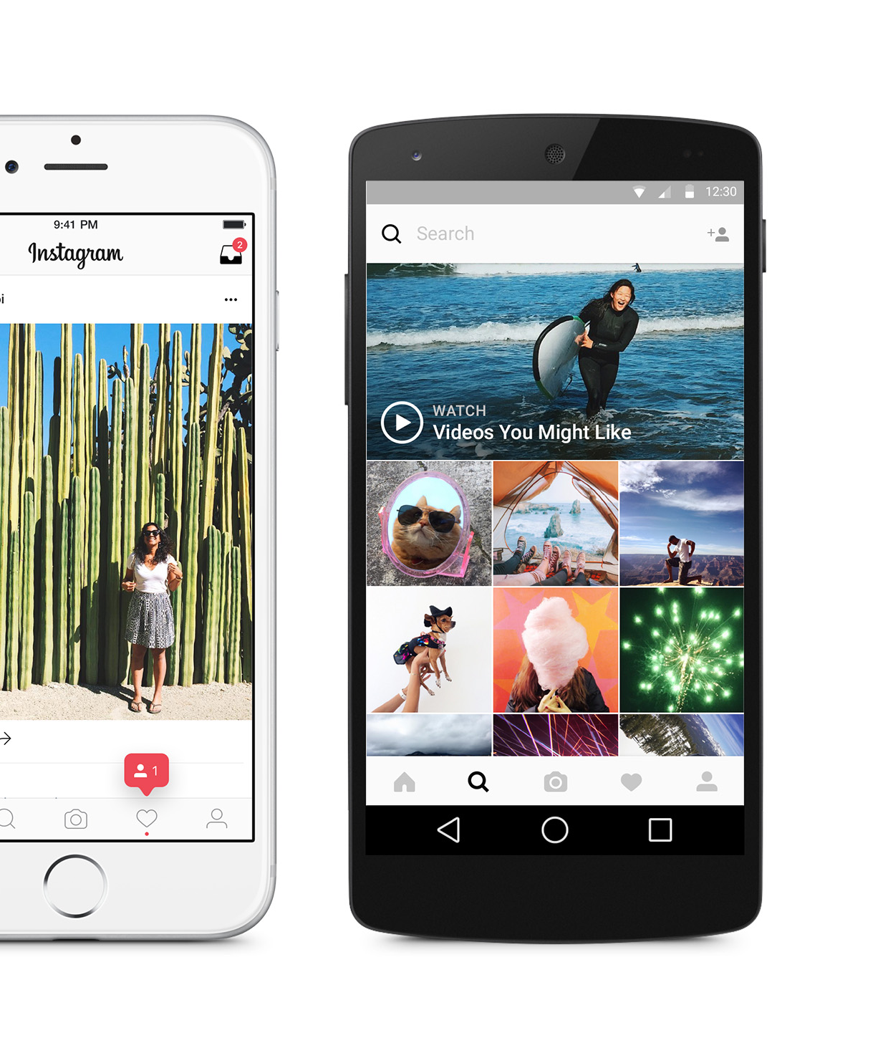
Stories:
The game-changer for Instagram
Over 1 Billion Monthly Active Users
1/3 Most-Viewed Stories are from Businesses
And in 2019 -
  Stories became a pervasive App Experience (Instagram, Facebook, Messenger, WhatsApp)
Notes:
You may be asking, “with all of these features, how do I help the member with their financial journey?” Social media has utilized a technic they call “Stories”. In fact, LinkedIn just introduce “stories” this fall. This is a way to categorize what will resonate for that member, their story, as opposed to every other member’s story. So an older member’s story may be retirement planning, savings plans for grandchildren, plans to help college-bound kids, etc. A younger member may be interested in first time home financing, debt consolidation, auto loans, etc. There is a lot that can be done with Stories.

Slide 8
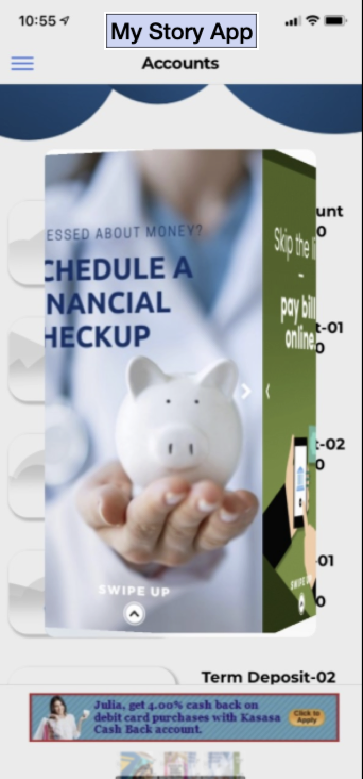
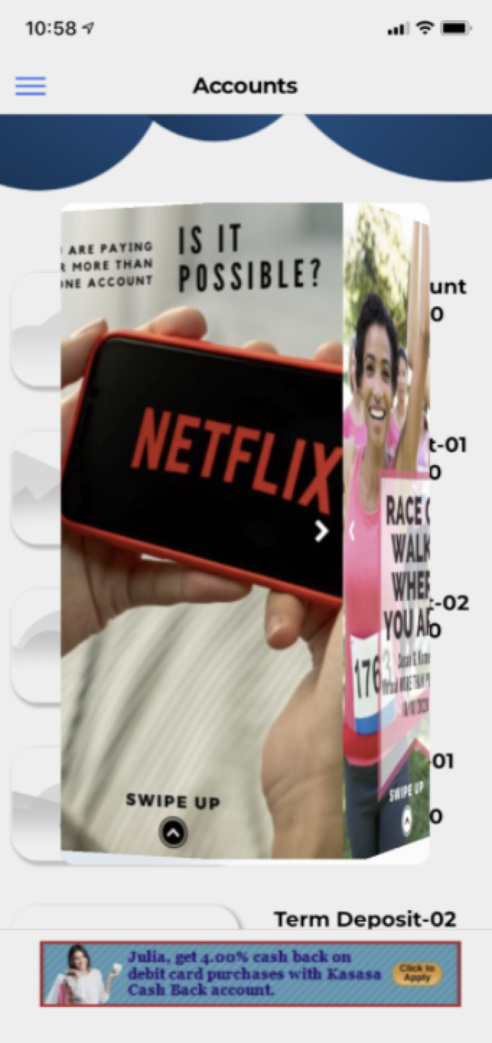
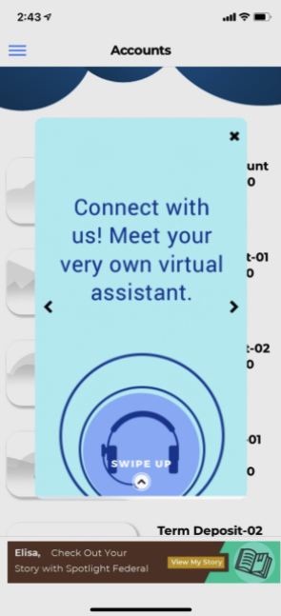

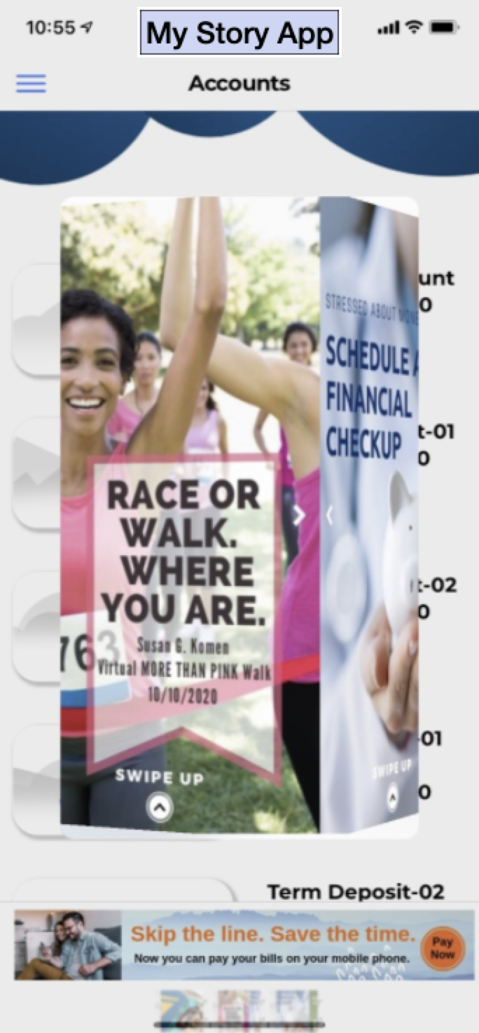
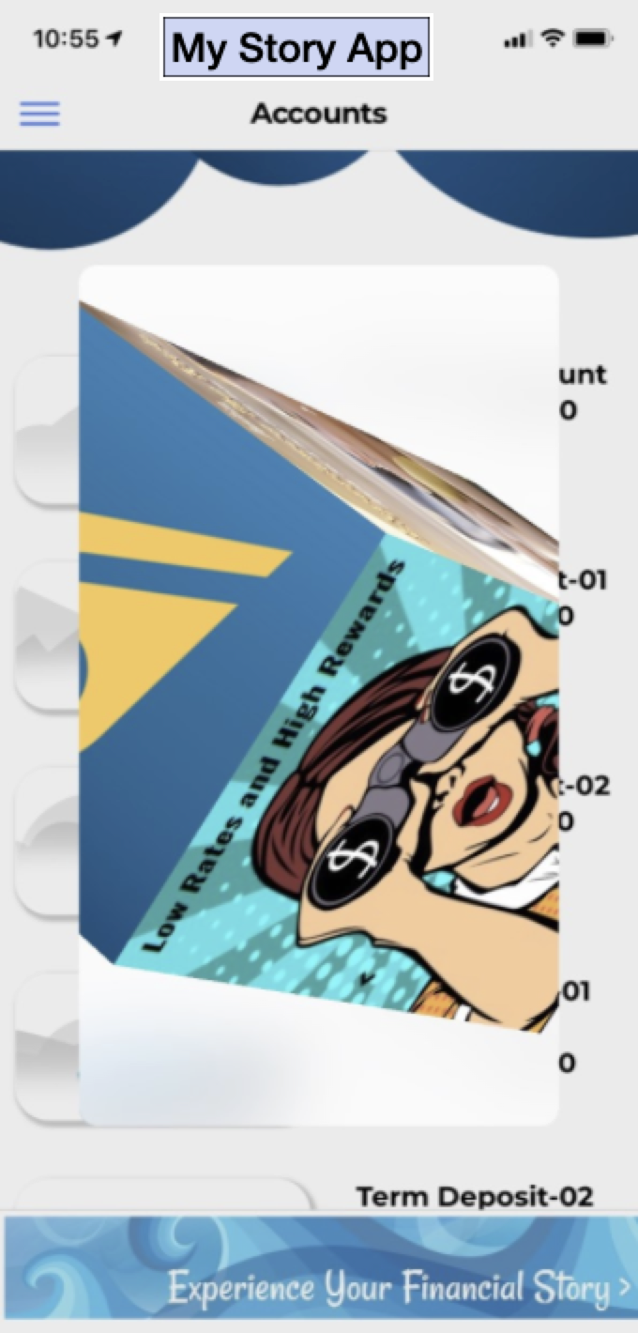
Messaging Types
Affinity
  Personalized
  Community
  Charity
Drive Engagement
  Make More Sticky
  Drive Brand
  Increase impressions
  End User Education
Cross Sell and Up Sell
Notes:
Best practices suggests that the first message is discoverable and highly personalized. By this we mean points status or something specific to that user. We also populate with several categories, Personalized messaging for statuses and engagement. Affinity messages to underscore your and their commitment to community. Engagement to drive users to use more features than they have before: billpay, remote deposit capture, PFM or, targeting millennials against PayPal or Venmo, Zelle. Status alerts to notify the user of operational updates like a change in contact center hours, branch notes, or other house-keeping messages. Cross Sell and Up Sell to serve the customer better and increase wallet share.

