Slide 1
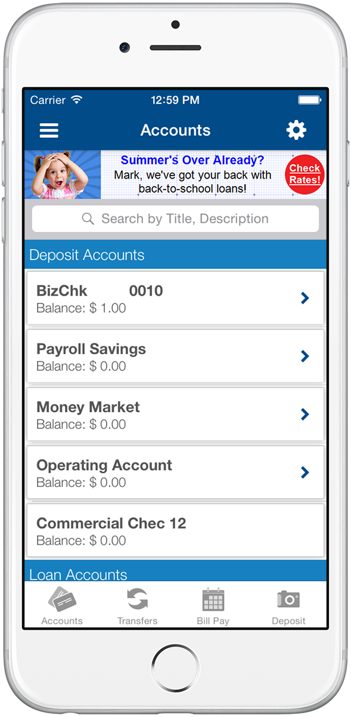




Digital Engagement: From Data to Delivery
Design Once, Engage Everywhere
Personalized
Messages
Realtime
Analytics
Intelligent Targeting
The Master Stack
CSV Lists, Rules, Predictive (Machine Learning)
“My” Financial Story
My Stack
User ID, Campaign 1, Campaign 2…Campaign n
Client Apps
Multiple campaigns, multiple channels
Notes:
That’s great. So now you may be thinking “that sounds great, but how does this all work?” First, DeepTarget and MDT will help you assess your data availability. We assess the data available from all sources and decide what data should be exposed to the DeepTarget system. We then create feeds to the DeepTarget servers which are in the cloud. We can then run rules against that data. For example, you can assign a campaign against everyone who owns a home, has a mortgage, is in a variable rate tool, is located in certain zip codes and has had this mortgage for over a year. You can also send DeepTarget lists. So, you can calculate the savings a mortgage refinance will create for a member, then show them the results in a personalized offer with name and benefit right inside the offer. We can also apply machine learning so the system will apply offers to members, without human intervention, to become more efficient and effective. Once done, we then create a pocket or “Story” for each member. That story is the compilation of messages and offers assigned to that member’s “financial story” with your credit union. Once presented, the system adjusts in real time. If the member swipes up to a linked page, that is tracked and the offer can be changed. Or, for example, we can limit to offer to five times or within a certain timeframe. In any case, everything is tracked and reported upon. It is important that I explained this slide clearly. Do you have any questions about this?

Slide 2
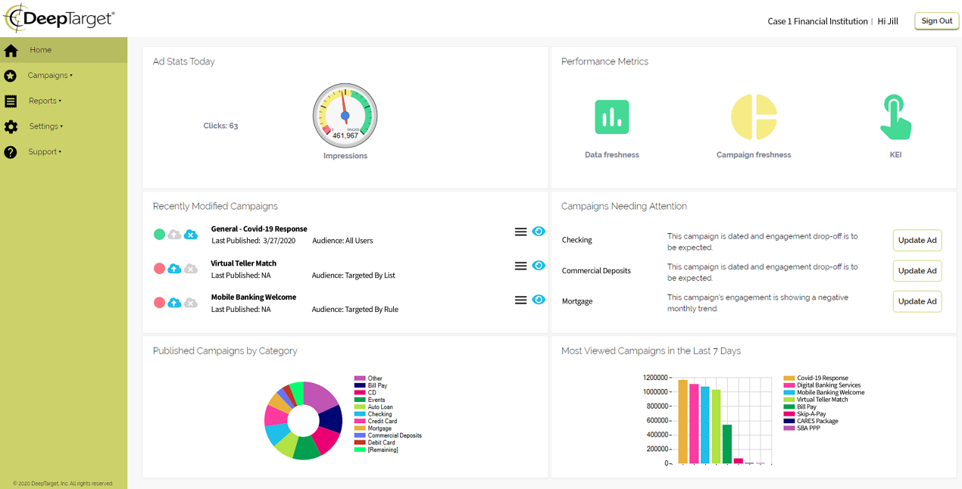

DeepTarget's Digital Experience Platform (DXP)
Realtime Performance Analytics
Campaign Monitoring
Data Monitoring
Impression Management
Notes:
Here is where the data is tracked and we turn art to science. Peter Drucker is credited with saying ““If you can’t measure it, you can’t improve it.” Marketing has always been some what of an art form which has proven to be a challenge to measure. Here you can see a) real time measurements (upper left) b) tracking effectiveness against expectations in the form of KPIs (upper right) c) eyes on upcoming or recently changed campaigns (middle left) d) eyes-on campaigns needed attention (middle right) e) Campaigns by Category (lower left) f) Most viewed campaigns (lower right). You’ve never had this kind of control or measurement before and that is huge. But lets look a little closer at the lower left and right. Here, for the first time, you can divvy out impressions to align with strategic objectives. If you are light on loans, make sure various lending campaigns are highlighted. If you are light on deposits, adjust your portfolio of campaigns to align with increasing deposits.

Slide 3
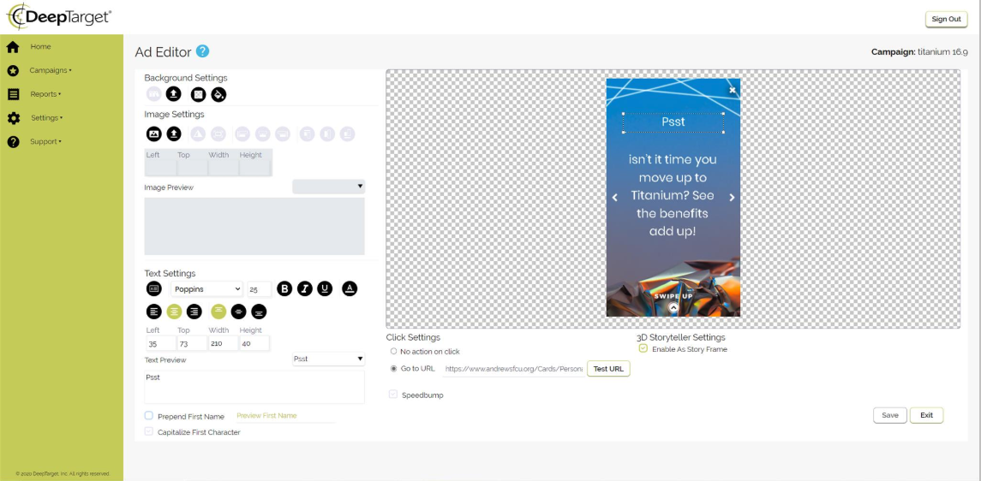
Targeted Messaging
Channel Sensitivity
Channel Context
Deep Linking
Simplicity
Notes:
We’ve shown that the swing to digital is necessitating the need to establish “community” and understanding over digital channels. We established how DeepTarget imbeds that into your digital channels by using their Digital Experience Platform via rules, lists and machine learning. Then we showed how the Command and Control Center provides science to art in managing impressions strategically across the credit union. All of those concepts are game changers. Here, I want to give you a taste as to how to create and modify campaigns. Above is the Ed Editor. Here you can create or download an image suitable for the channel you are targeting. Then, on the left, you can add the text (including font and colors). Circled, I am showing how you paste a URL into the offer so that the member can swipe up to get more information or take advantage of the offer. I then test it and attach it to that offer. There is more to it, but this gives you an idea as to how easy it is to create or change an offer.

Slide 4
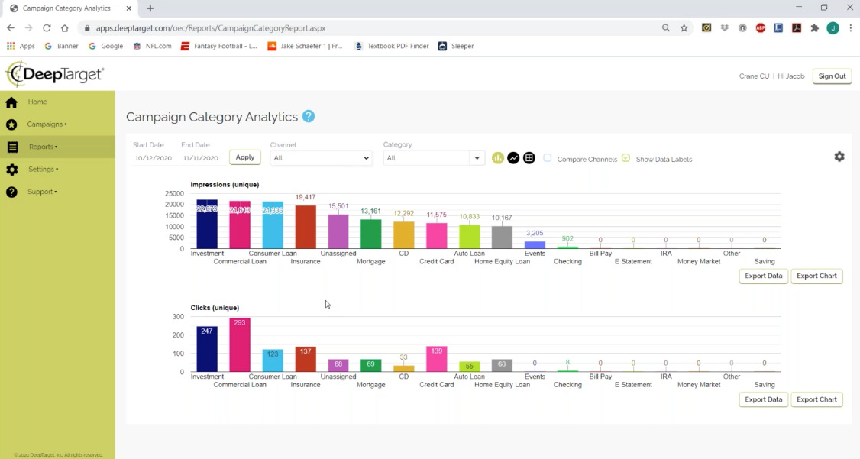
Notes:
Should you want more performance data from the main dashboard that I showed earlier, here are some examples of reports. This report shows the number of impressions and clicks by campaign. The manager can click on bars in this graph to drill down and see what members viewed and clicked that campaign. So the manager can see what member did what. That is powerful!

Slide 5
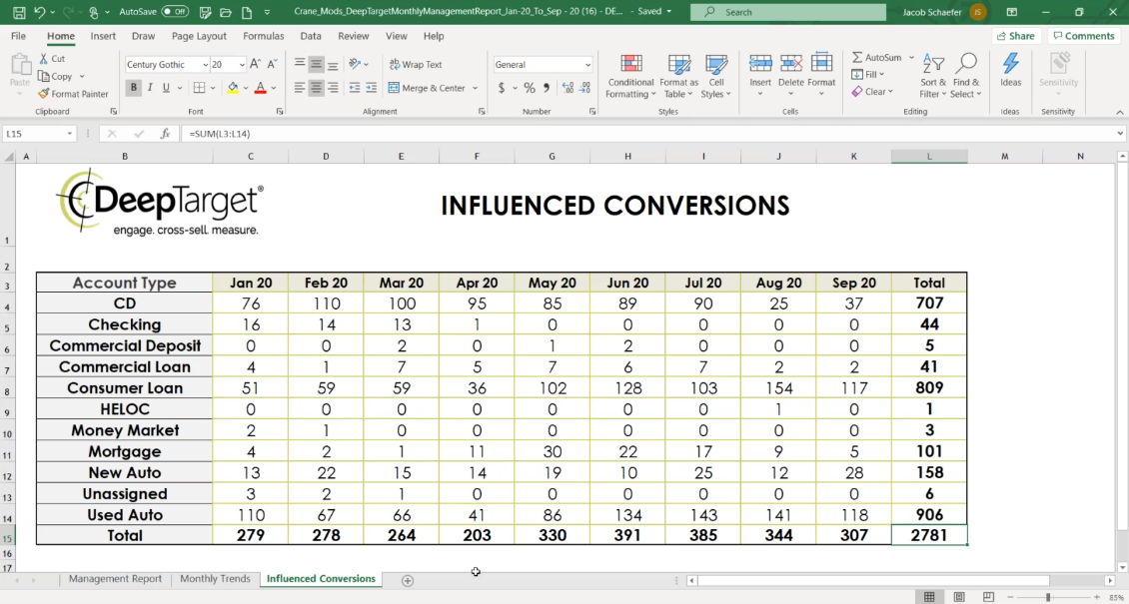
Notes:
This is an example of a management report to apply science to art. Here we are tracking conversions that have been influenced as a result of an impression. This is a great area to emphasize the ability to create measurable best practices so we optimize our effectiveness rather than simply shot-gunning offers without any idea what is happening in your marketplace. This report shows who opened a new account or service after being presented an offer within the last several months. Incidentally, this is a great ongoing ROI tool.

Slide 6
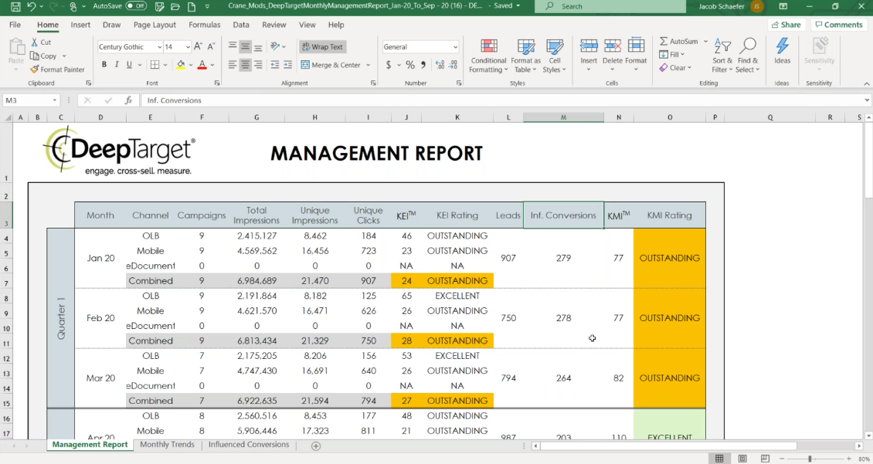
Notes:
And here is a management tool to let the senior team know if strategic initiatives are exceeding, meeting or underperforming against goals. ……….I don’t have an example, but we also have a tool that allows you to load leads into a lead management tool like Salesforce.com or Hubspot. What we do is take any member who showed interest in an offer, but didn’t finalize the process, and feed that to your lead management tool. This can be used as a ore targeted follow-up in the form of a phone call or email to see if that member needs assistance to take advantage of that offer. This is a VERY valuable tool for your lending team.

