Slide 1
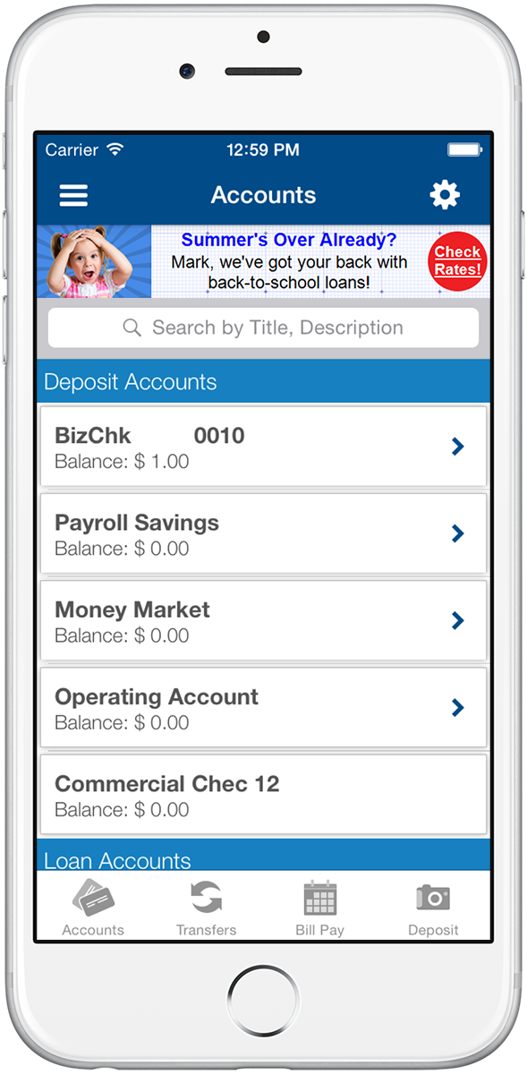
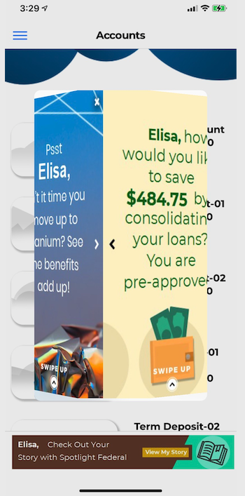
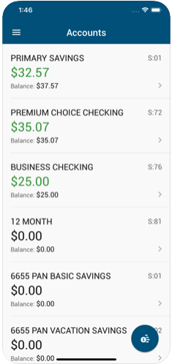
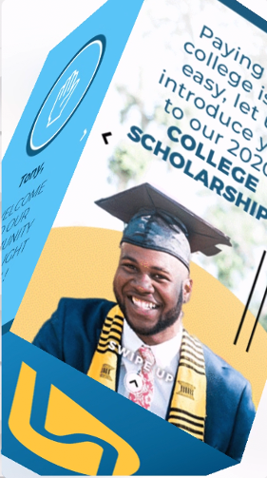
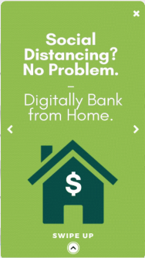
With 3D StoryTeller
From This
To This

Slide 2
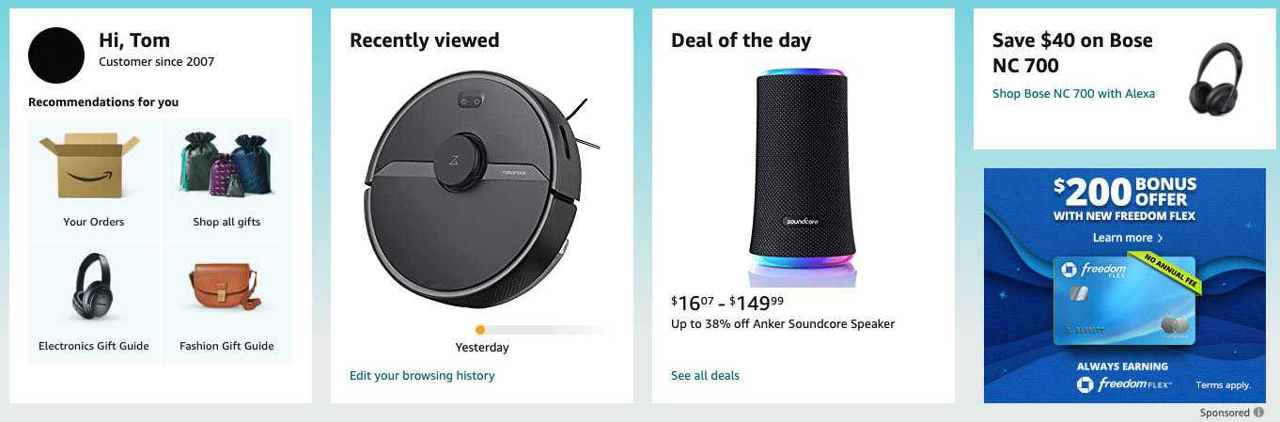
Notes:
Amazon: Recommendations, recently reviewed, deals of the day and sponsored content.

Slide 3
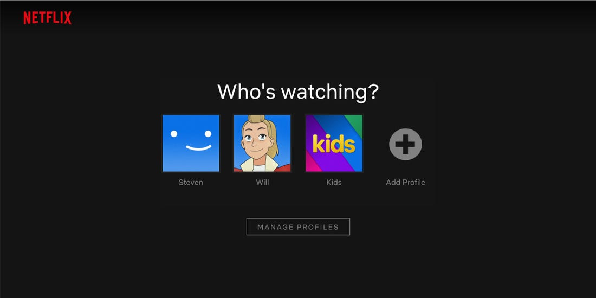
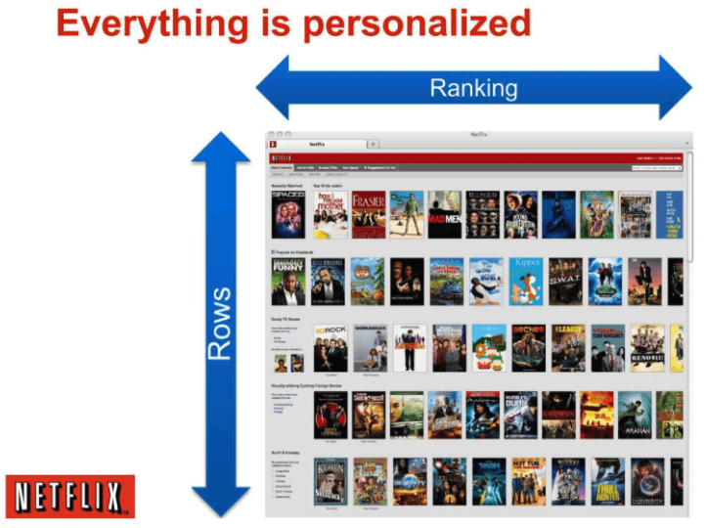
Over 75% of What is
Watched Is the Result
of an ML Recommendation
Source: InfoQ

Slide 4


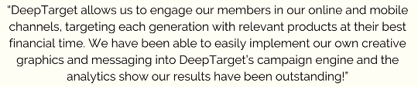
Results
Drive the Dream Campaign – “tripled the traffic to our Loan Center”
Traditionalist Generation – 175 Investment Accounts in 3 Months
Military Savings Week – $69m in New Deposits
Four MAC Awards in 2020
Notes:
Success stories: Loans tripled, 175 new accounts in three months, $69m in new deposits, Four MAC awards for small community-based CUs.

Slide 5
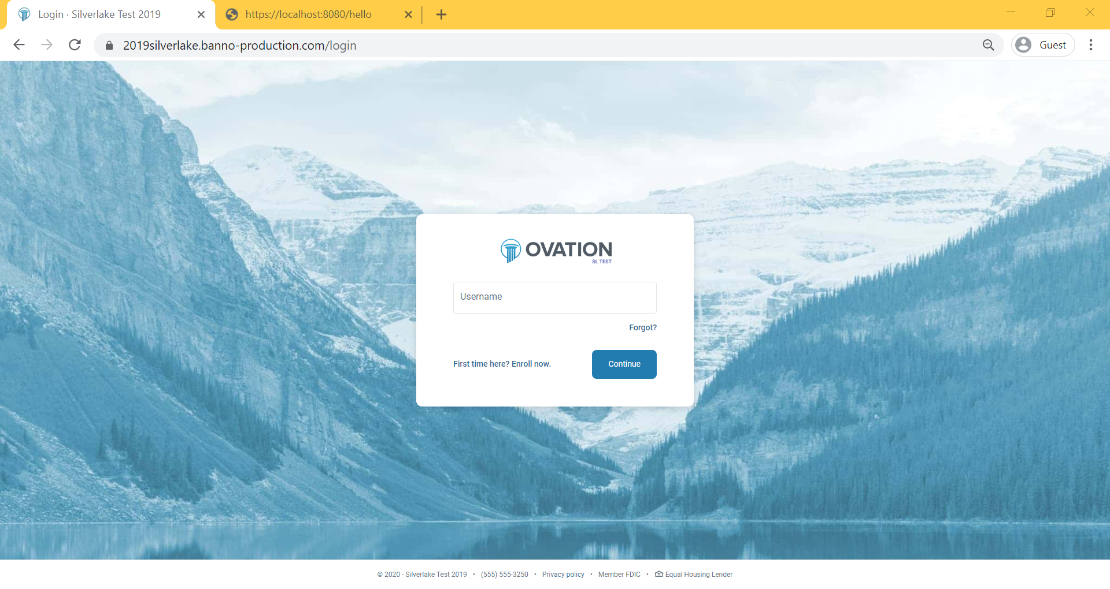
Notes:
Banno Online Banking Sign On Screen

Slide 6
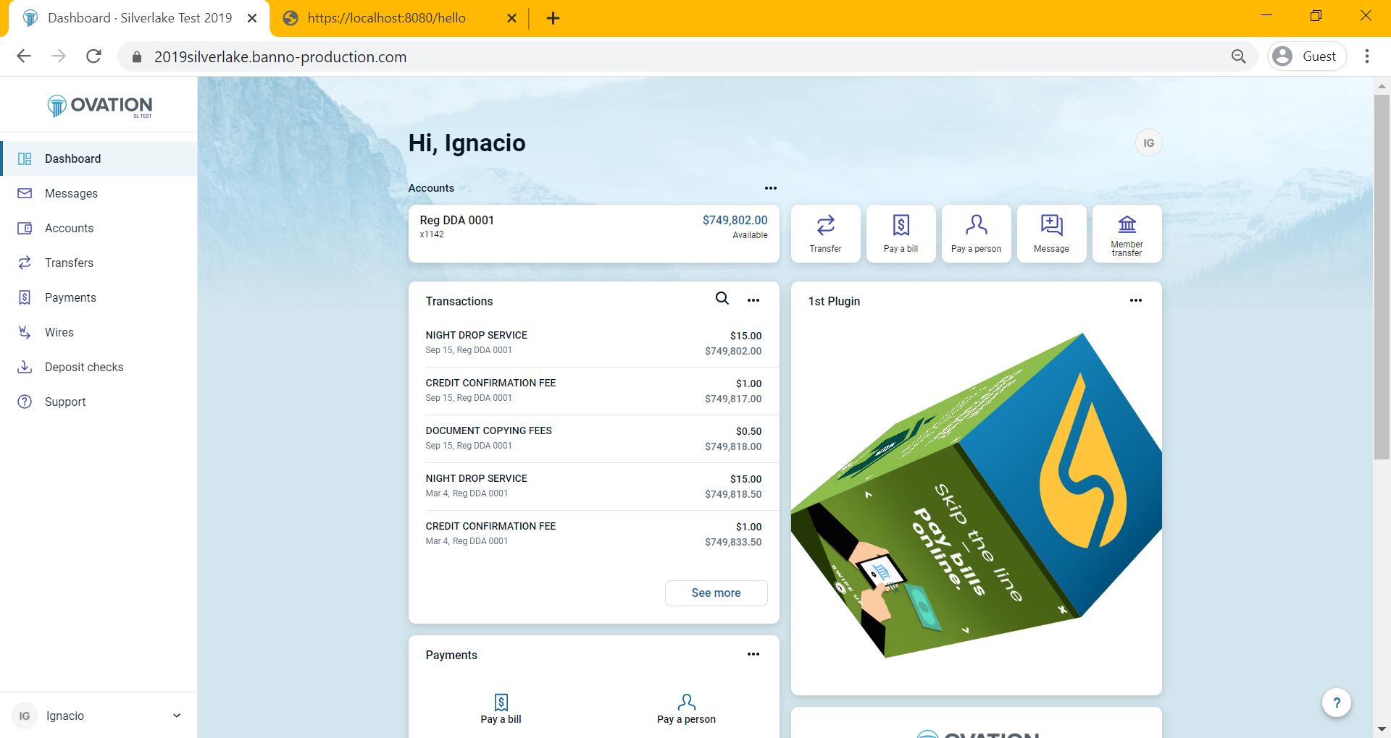
Hi, Frank
Notes:
Here, our analytics shows that Frank isn’t using Billpay so we have a panel offering to escort him over to bilpay within the Banno offer.

Slide 7
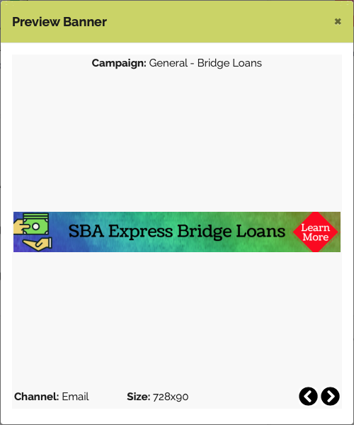
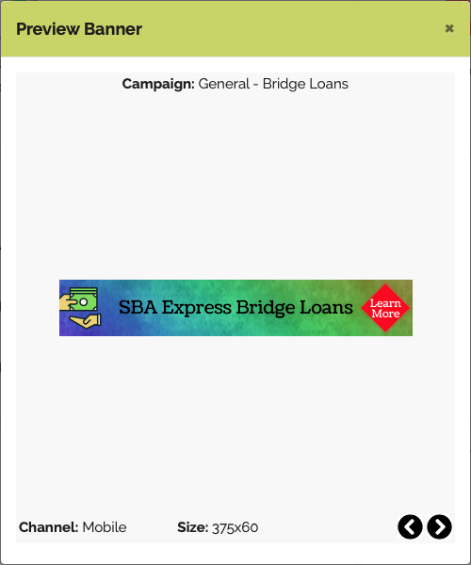
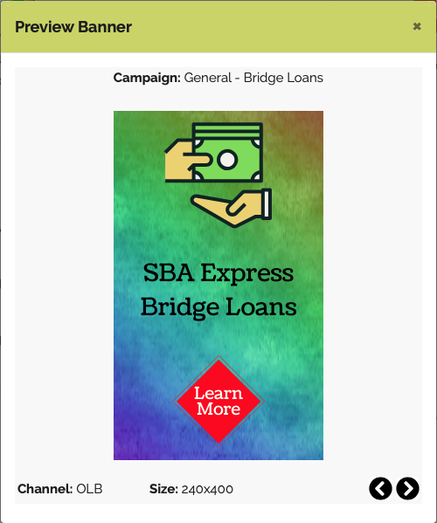

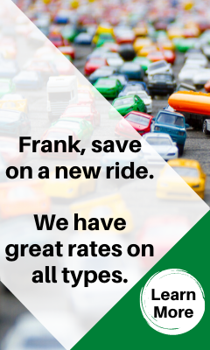


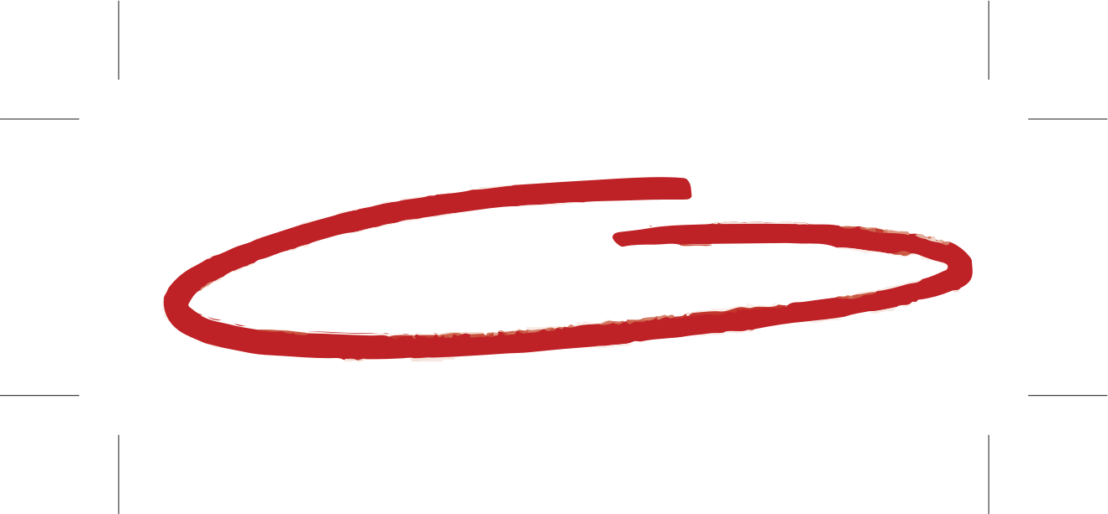
Design Once, Engage Everywhere
One Campaign
Extended Across the Member/Customer Journey
Notes:
Here is an example of a single campaign for auto loans deployed in email, mobile and Online Banking. You can make sure the user sees it, how many times they see it, and you can turn on or shut off these messages at any time; even in an automated fashion. For example, once a user sees it five times or if they action on it, switch to a different banner. You don't want to be selling something they already bought. It really flies in the face of the community financial institution: We KNOW you!

Slide 8
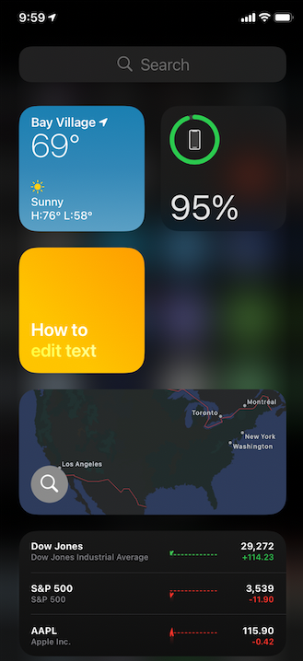
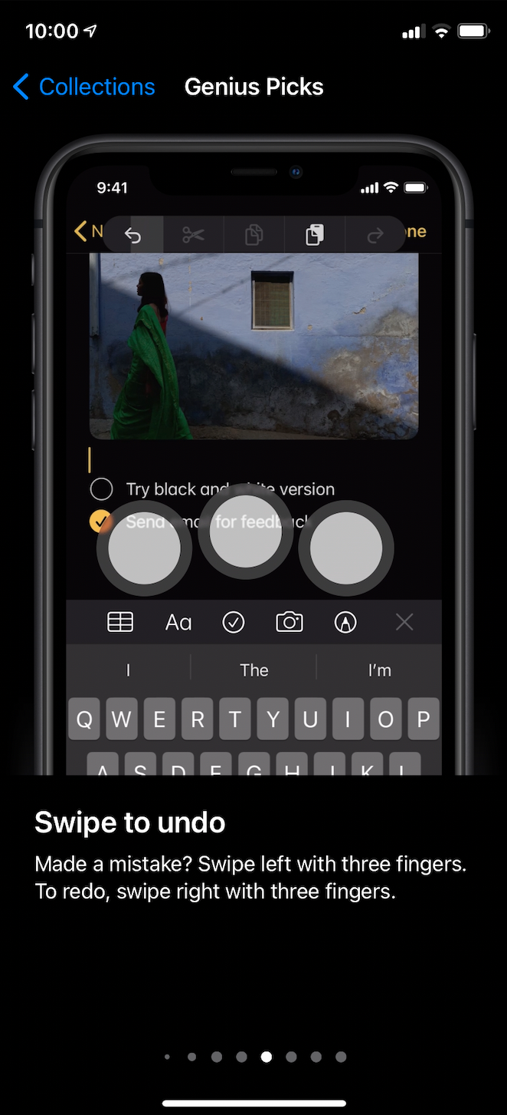
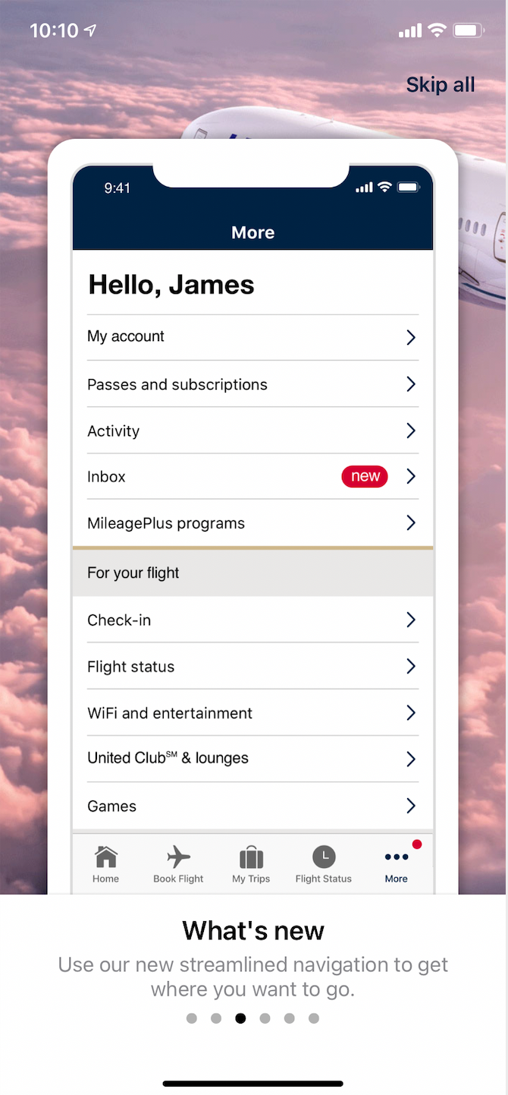
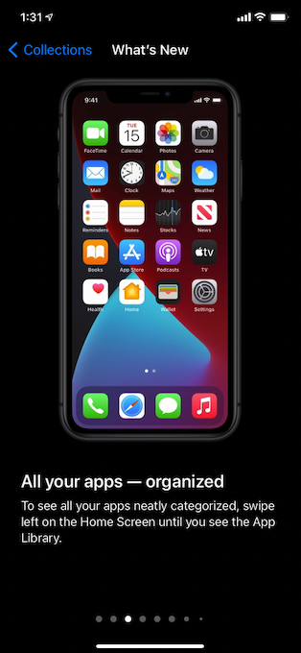
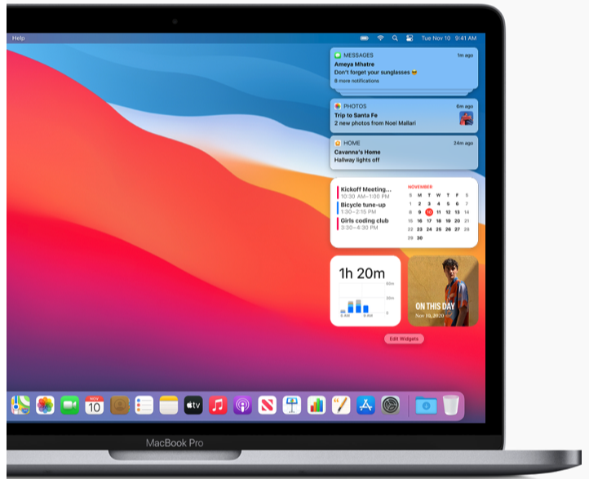
United
iOS 14
MacOS Big Sur
Notes:
More examples of driving deeper end user engagement. Apple iPhone iOS, MacOS and United.

