Slide 1

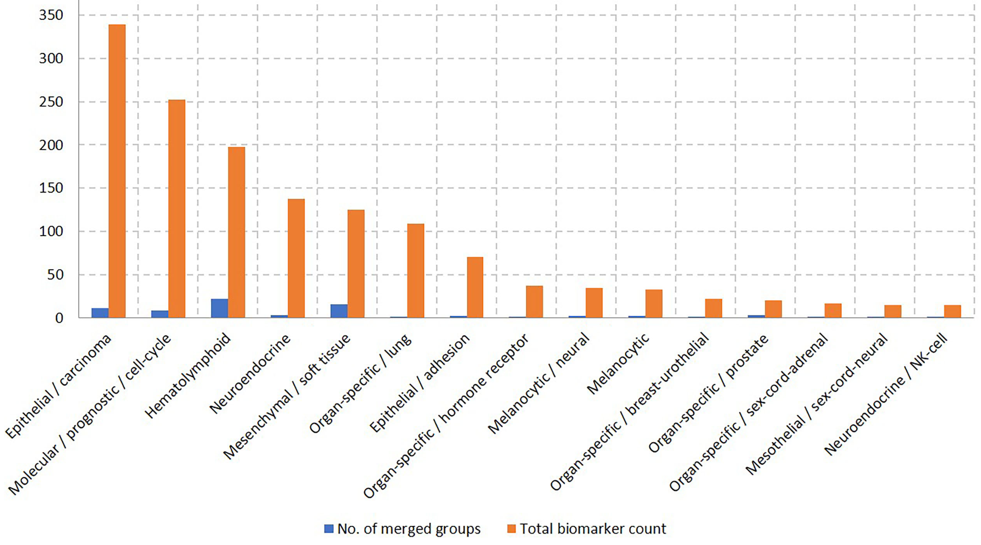
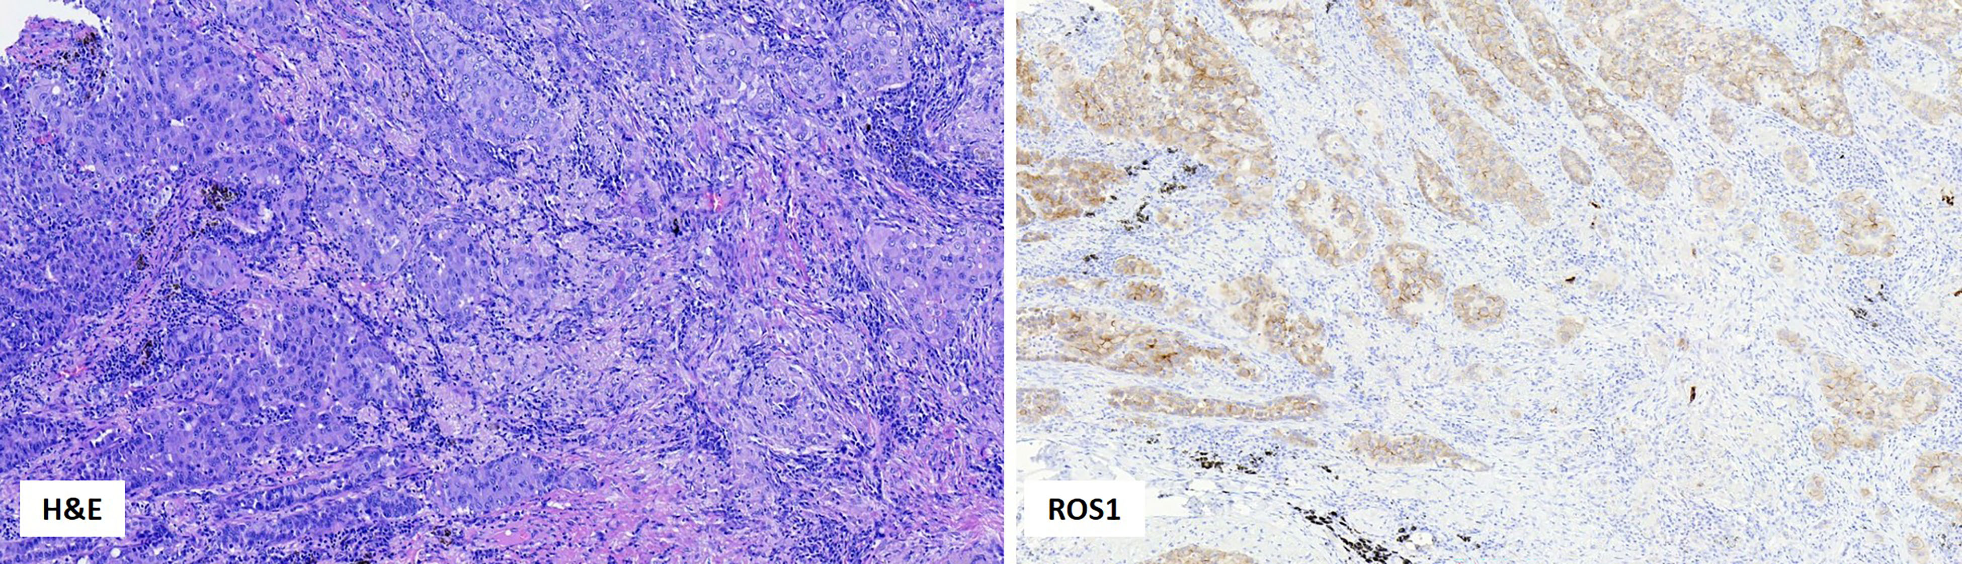
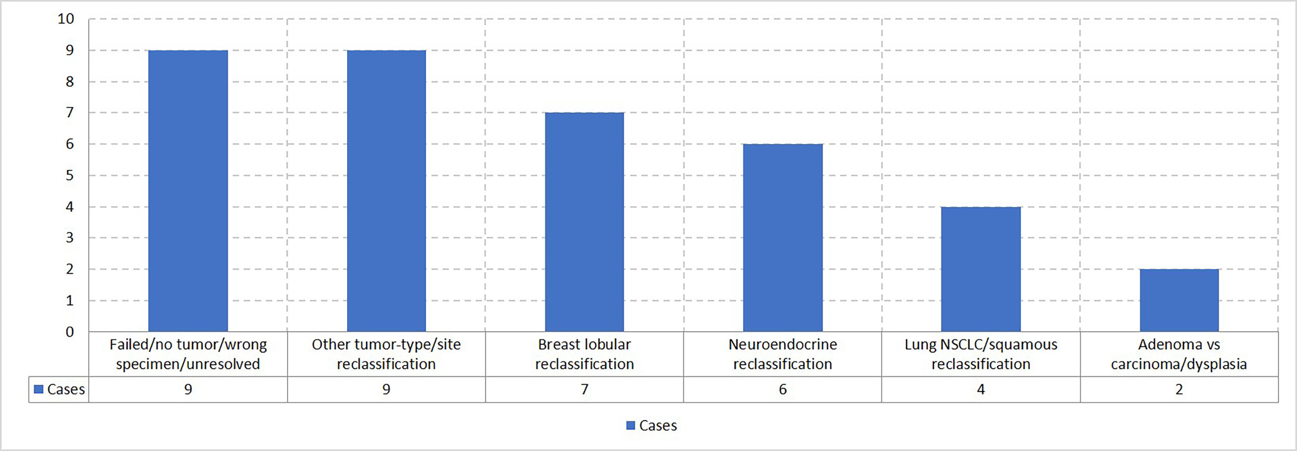

Recommendations for Quality and Organizational Improvements to Support a Diverse Use of Bio-banked Samples (#65)
Add your logos here
Zoran Gatalica^{1*}, Inga Rose¹, Nataliya Kuzmova¹, Aaron Schlum¹, Faruk Skenderi^{2,3}, Semir Vranić⁴
¹ Reference Medicine, Pathology, Phoenix, Arizona, United States of America; ² Sarajevo School of Science and Technology, Medical School, Sarajevo, Bosnia and Herzegovina; ³ Precision Diagnostics, Pathology, Sarajevo, Bosnia and Herzegovina; ⁴ Qatar University College of Medicine, Pathology, Doha, Qatar
INTRODUCTION
methodS
Research and development of novel clinical assays are highly dependent on the availability and quality of collected biological samples. Sample quality is affected not just by pre-analytical conditions (collection, transport, storage, and distribution), but also by data associated with the collected samples, including patients’ and sample characteristics. Post-analytical data sharing supports inter-laboratory collaborations and multiple, diverse uses of individual samples.
Clinical, pathologic, and molecular/genomic data from 8,871 patients, along with associated biospecimens stored at the Reference Medicine biorepository and laboratory in Phoenix, Arizona, were reviewed and analyzed. Selected cases underwent further characterization by immunohistochemistry (IHC) and next-generation sequencing (NGS).
RESULTS
Biorepository’s pre-analytical quality control (QC) includes pathologists’ microscopic review of all submitted tissue samples and assessment of DNA quality extracted from them.
The QC measures were shared with collection sites and have improved sample quality, reducing the initial 22.6% failure rate (7.4% histology and 15.2% DNA) to the current 11.9% (5.4% histology and 6.5% DNA).
2.9% of cases were submitted to immunohistochemical (IHC) confirmation of the original diagnoses (Figures 1-3). This resulted in the refinement of the original diagnosis in 0.1% of cases (Figure 3).
Digital imaging of IHC-characterized tissues enabled end-users to virtually analyze samples even when the original blocks were exhausted (e.g., the development of deep learning methods for PD-L1 assessment in non-small cell lung cancer, ref. Biomol Biomed. 2025;26:79-90).
Tissue microarrays were generated from cases with adequate tumor volumes, allowing many samples to be screened simultaneously for various predictive biomarkers, which were then confirmed in individual tissue samples using sequencing methods (e.g., ROS1 and rare gene fusions, Figure 4).
Data generated by diverse research/clinical partners of the biorepository allowed for additional shared research (e.g., risk stratification of breast cancer patients).
Figure 1. Overview of different diagnostic IHC biomarkers used for the confirmation of the final diagnosis.
Biomarkers Listed in Order of Use Frequency
Figure 2. Overview of the utilized biomarkers by type.
Figure 4. Morphologic features of a high-grade pulmonary adenocarcinoma (H&E, 20x); ROS1 protein expression (clone #3287, Cell Signaling) was observed in >90% of cancer cells (20x). NGS analysis confirmed the EZR:ROS1 fusion.
Figure 3. Overview of the main discrepancy themes.
CONCLUSION
CONTACT INFORMATION
Sharing data from biorepository quality-control measures with collection sites improves local procedures and the quality of collected samples.
Disagreement between pathology diagnoses highlights a need for an appropriate work-up in cases with diagnostic ambiguity.
Better characterization of stored samples reduces misinterpretations at the end-user’s site. Generating virtual slide images enables multiple users to work on various projects with limited sample data.
Finally, data exchanges can lead to novel research ideas and clinical applications.
For more information contact:
Zoran Gatalica, M.D., D.Sc.
Reference Medicine
Phoenix, AZ, USA
zoran@referencemedicine.com
www.ReferenceMedicine.com
The authors declare no conflict of interest.

