Slide 1



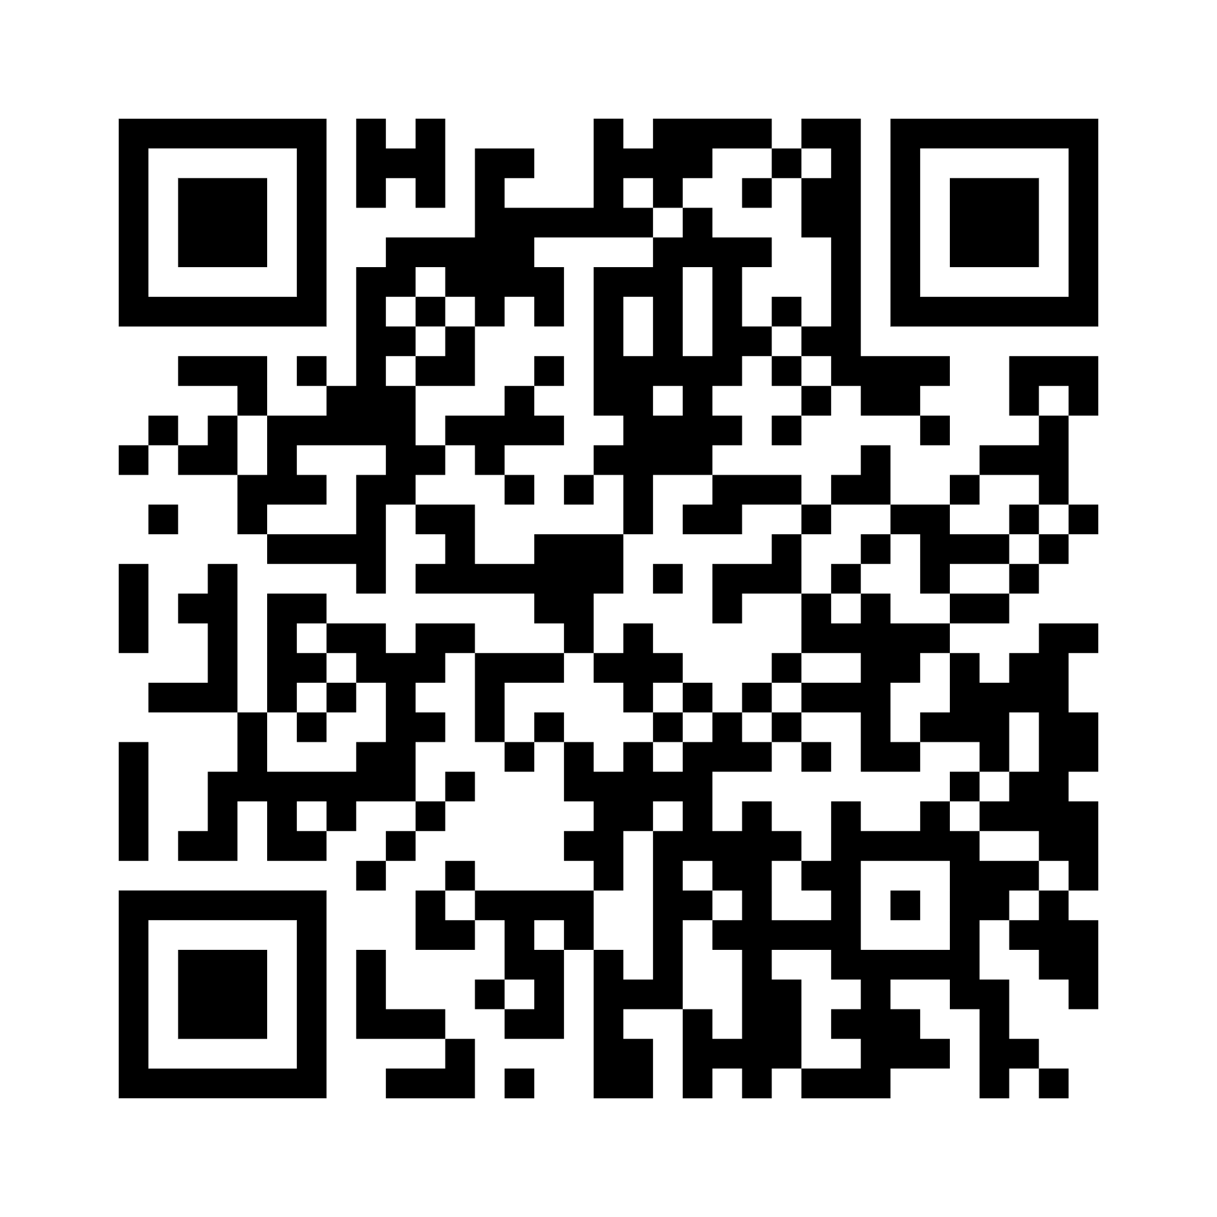
Your faith is part of your life.
It can be part of your banking, too.
The ELCA Federal Credit Union (ELCA FCU) brings together the financial services you need and the values you share. As a member-owned financial cooperative, we offer competitive rates, low fees and personal service to support your everyday needs and future plans.
For today’s needs and tomorrow’s goals
Checking and savings accounts
Certificates of deposit
Auto and home loans
Personal loans and credit cards
Credit building options
Scan or visit elcafcu.org/new-membership to explore ELCA FCU membership.
ELCA FEDERAL CREDIT UNION

Slide 2

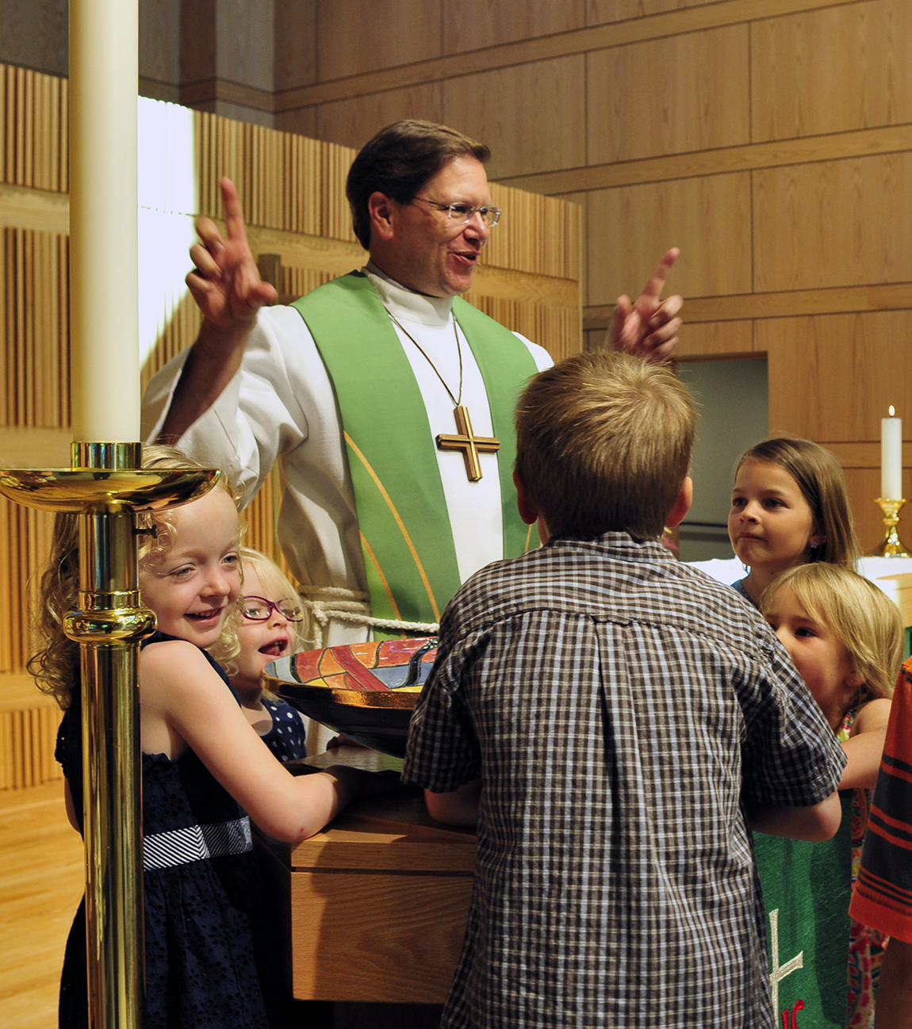

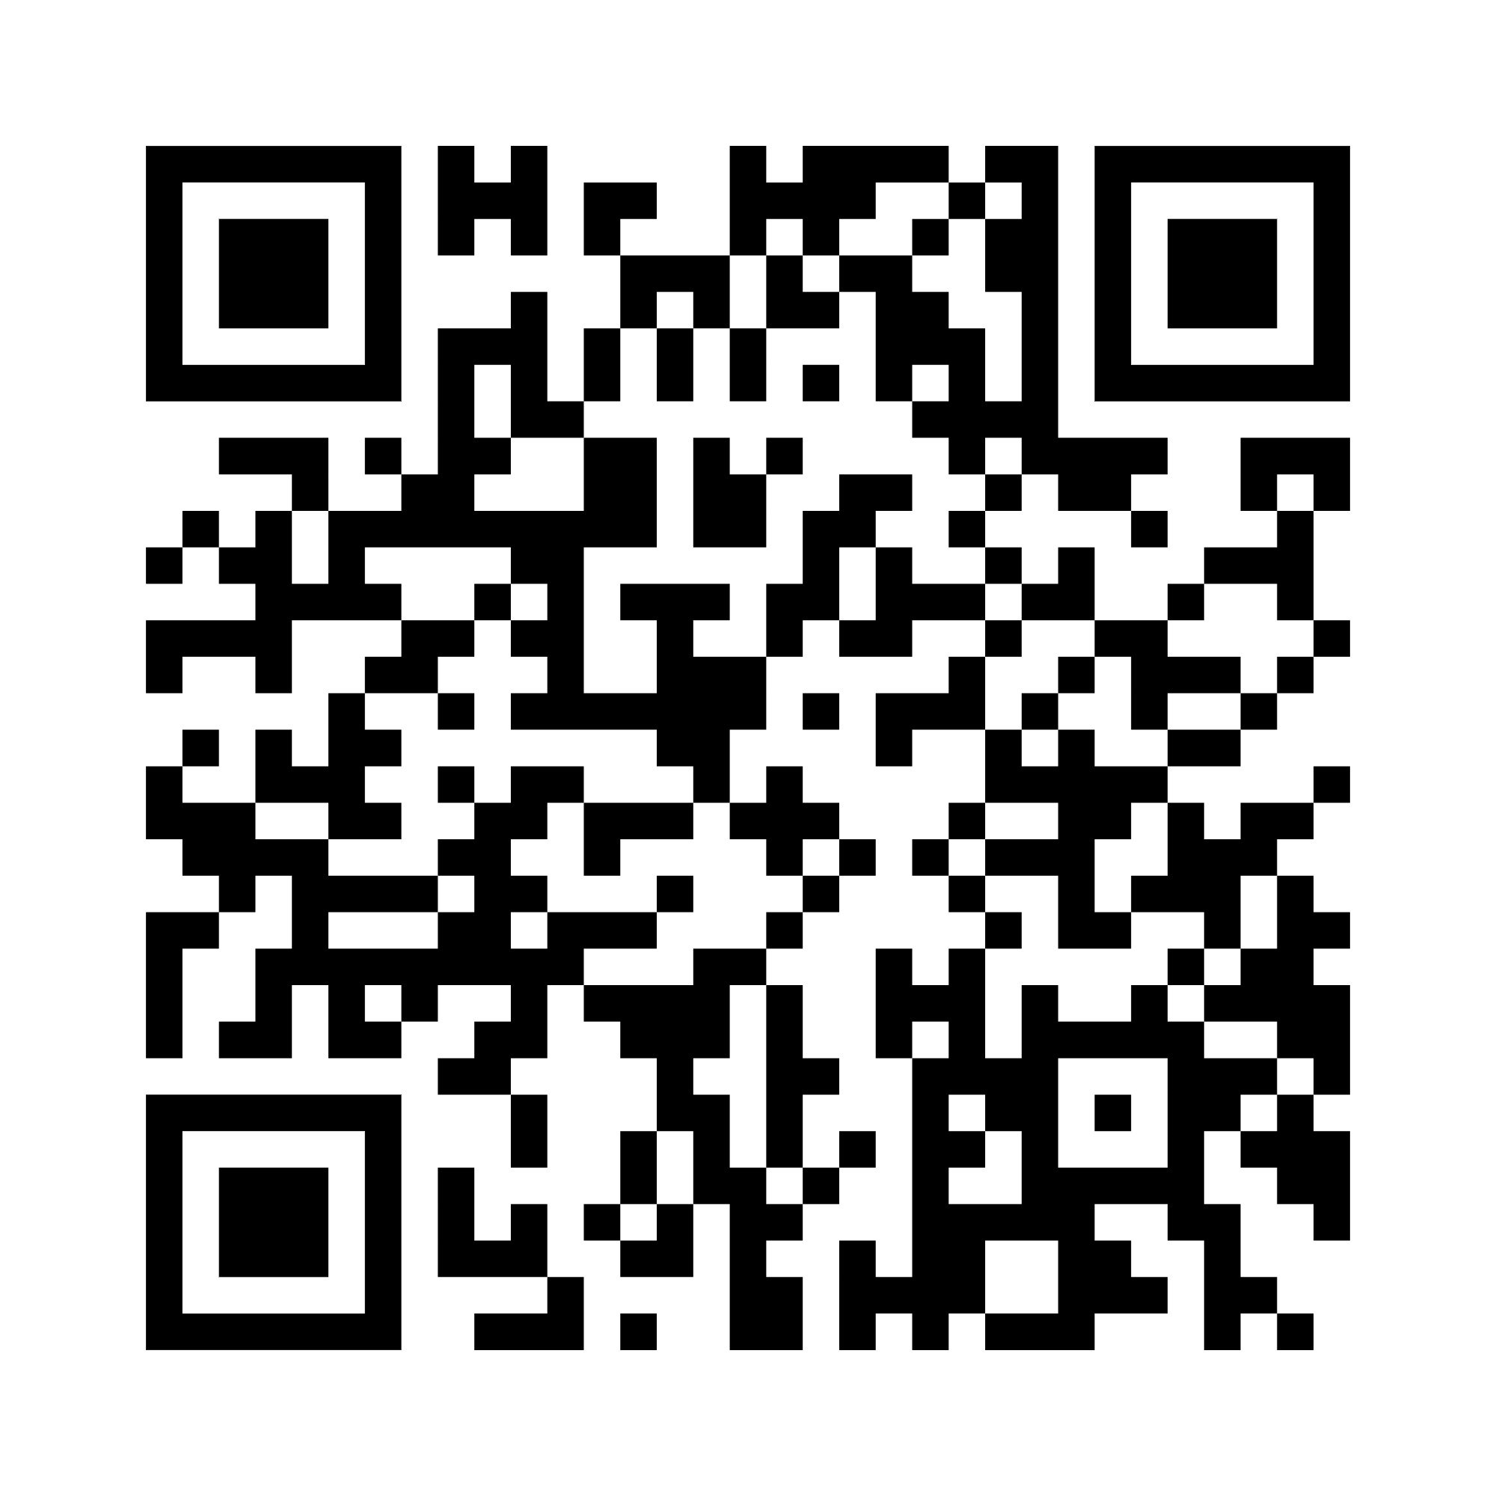
Invest in your future.
Help build something meaningful.
Your financial goals matter. With the Mission Investment Fund (MIF), your investments also help fund loans for ELCA congregations and ministries, supporting the places where people worship, find community and receive care.
Investments that fit your plans
Choose from Fixed-Term and Demand Investments, with convenient access through MIF Online and MIF Mobile.
Scan or visit mif.elca.org/personal-investments to explore MIF investments.
MISSION INVESTMENT FUND

