Slide 1


TRACXN GEO ANNUAL REPORT
INDIA TECH - 2025

Slide 2
Contents
Snapshot
Investments
Investors
Exits
New Unicorns
Citywise Trends
Women Co-Founded Trends
News
Funded Deadpooled Companies
Appendix

Slide 3
Contents
Snapshot |  | Snapshot
Investments
Investors
Exits
New Unicorns
Citywise Trends
Women Co-Founded Trends
News
Funded Deadpooled Companies
Appendix

Slide 4
Tracxn Insights (1/5)
India is the 3rd highest funded country in 2025 ahead of China and Germany at positions 4th and 5th respectively. The only 2 countries that saw more funding than India are the United States and United Kingdom.
A total of $10.5B was raised in 2025, a drop of 17% compared to $12.7B raised in 2024, and a drop of 4% compared to $11.0B raised in 2023.
  Seed Stage saw a total funding of $1.1B in 2025, a drop of 30% compared to $1.5B raised in 2024, and a drop of 25% compared to $1.4B raised in 2023.
  Early Stage saw a total funding of $3.9B in 2025, a rise of 7% compared to $3.7B raised in 2024, and a rise of 11% compared to $3.5B raised in 2023.
  Late Stage witnessed a total funding of $5.5B in 2025, a drop of 26% compared to $7.5B raised in 2024, and a drop of 8% compared to $6.0B raised in 2023.

Slide 5
Tracxn Insights (2/5)
2025 has witnessed 14 $100M+ funding rounds when compared to 19 such rounds in 2024 and 16 such rounds in 2023.
Companies like Erisha E Mobility, Zepto, GreenLine have managed to raise funds above $100M in this period.
  Erisha E Mobility has raised a total of $1.0B in a Series D round.
  Zepto has raised a total of $300M in a Series H round.
  GreenLine has raised a total of $275M in a Series A round.
A major part of these $100M+ funding rounds are from Transportation and Logistics Tech, Environment Tech, and Auto Tech.
Enterprise Applications, Retail, and FinTech were the top-performing sectors in 2025 in this space.

Slide 6
Tracxn Insights (3/5)
  Enterprise Applications sector saw a total funding of $2.6B in 2025 which is a decrease of 17% when compared to $3.2B raised in 2024 and a decrease of 12% when compared to $3.0B raised in 2023.
  Retail sector saw a total funding of $2.4B in 2025 which is a decrease of 17% when compared to $2.9B raised in 2024 and a decrease of 21% when compared to $3.1B raised in 2023.
  FinTech sector saw a total funding of $2.2B in 2025 which is a decrease of 5% when compared to $2.3B raised in 2024 and a decrease of 9% when compared to $2.4B raised in 2023.
India Tech recorded 42 IPOs in 2025, up 17% from 36 in 2024, and up by 62% from 26 in 2023.
  Meesho, Aequs and Ravel are some of the companies that went public in 2025.
There were 5 unicorns created in 2025, same as compared to 2024, and a rise of 150% compared to 2 in 2023.

Slide 7
Tracxn Insights (4/5)
Tech companies in India saw 136 acquisitions in 2025, which is a rise of 7% as compared to 127 acquisitions in 2024 and a drop of 11% compared to 153 acquisitions in 2023.
  Resulticks was acquired by Diginex at a price of $2.0B.
    This becomes the highest valued acquisition in 2025 followed by the acquisition of Magma General Insurance acquired by DS Group, Patanjali Ayurved at a price of $516M.
Bengaluru based tech firms accounted for 32% of all funding seen by tech companies across India. Mumbai came next, with 18% of the total funding.
Inflection Point Ventures, Venture Catalysts and Antler were the top seed stage investors in India Tech ecosystem for 2025.
Peak XV Partners, Accel and Elevation Capital were the top early stage investors in India Tech ecosystem for 2025.

Slide 8
Tracxn Insights (5/5)
Sofina, SoftBank Vision Fund and Mars Growth Capital were the top late stage investors in India Tech ecosystem for 2025.

Slide 9












India Tech Snapshot - 2025
India Tech All time Stats
Summary
All Companies | 172,183
Funded Companies | 17,431
Total Funding | $173B
Funding in last 24 months | $23.2B
Cumulative Valuation of all Unicorns | $192B
$10.5B (vs $12.7B,▼17%)
1,518 (vs 2,493,▼39%)
516 (vs 727,▼29%)
433 (vs 675,▼35%)
$ Funding
# Funding rounds
Series A+ rounds
First Time Funded Companies
118 (vs 231,▼48%)
5 (vs 5)
136 (vs 127,▲7%)
42 (vs 36,▲17%)
New additions to Soonicorn Club
New Unicorns
Acquisitions
IPOs
Exits
Acquisitions | 1,378
IPOs | 543
Companies Covered
Unicorns | 84
Soonicorns | 297
Minicorns | 1,489
Editor’s Pick | 6,617
Series A+ | 2,087
Series C+ | 382
Acqui-Hires | 581
Deadpooled | 53,911
Top Funding Rounds
Company | Round Details
Erisha E Mobility (2022, Delhi) | $1.0B - Series D
Zepto (2021, Bengaluru) | $300M - Series H
GreenLine (2021, Mumbai) | $275M - Series A
Uniphore (2008, Chennai) | $260M - Series F
Infra.Market (2016, Thane) | $222M - Series F
Top Feeds
Feed | $Funding
Electric Vehicles | $1.5B
B2B E-Commerce | $838M
Online Grocery | $777M
Alternative Lending | $763M
Investment Tech | $658M
Top Cities
City | $Funding
Bengaluru | $3.4B
Mumbai | $1.8B
Delhi | $1.5B
Gurugram | $1.0B
Chennai | $655M
Top Cities | Bengaluru ($77.4B)
 | Gurugram ($28.2B)
*Data from 01-Jan-2025 to 15-Dec-2025 is considered in report
Note: Numbers in bracket indicate the values of 2024
‹#›

Slide 10











India Tech vs. Major Geos Performance - 2025
Metric | India | Global | US | Europe | China | SEA
$ Funding | $10.5B | $344B | $244B | $48.6B | $7.3B | $5.0B
% of global funding (# Country Rank) | 3%(#3) | 100% | 71%(#1) | 14% | 2%(#4) | 1%
# Funding rounds | 1,518 | 12,598 | 5,287 | 2,815 | 251 | 230
First Time Funded Companies | 433 | 4,727 | 1,650 | 1,091 | 79 | 90
Series A+ rounds | 516 | 6,401 | 3,215 | 1,340 | 192 | 108
New Unicorns | 5 | 111 | 74 | 20 | 2 | 2
Acquisitions | 136 | 3,618 | 1,597 | 1,290 | 19 | 54
IPOs | 42 | 253 | 60 | 23 | 38 | 14
Top Countries by 2025 Funding
United States | $244B
United Kingdom | $15.2B
India | $10.5B
China | $7.3B
Germany | $7.0B
Canada | $6.3B
France | $6.2B
Singapore | $4.5B
Israel | $4.2B
Switzerland | $3.5B
‹#›

Slide 11
Contents
Snapshot
Investments |  | Y-o-Y Funding Trends
Investors |  | Y-o-Y Stage-wise Funding Trends
Exits |  | Top Funding Rounds in 2025
New Unicorns |  | Top Funded Business Models in 2025
Citywise Trends
Women Co-Founded Trends
News
Funded Deadpooled Companies
Appendix

Slide 12
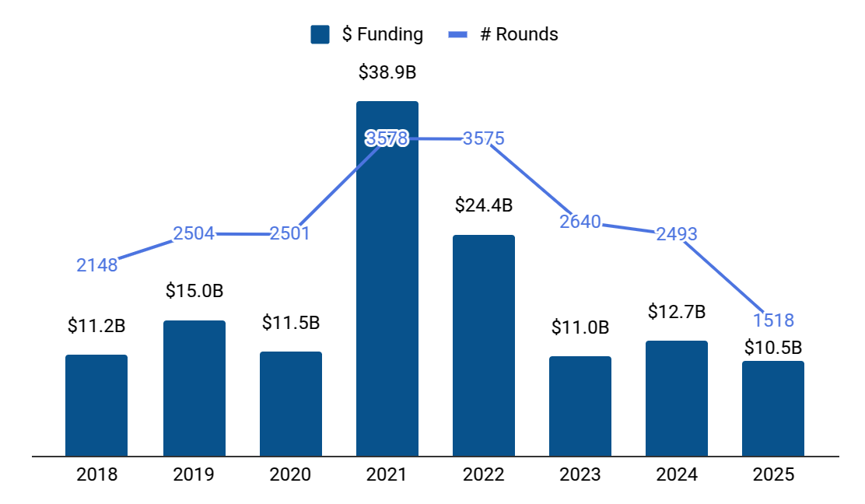






Y-o-Y Funding Trends
Top Funding Rounds in last 8 years
Company |  | Funding Round
 | Flipkart (2007, Bengaluru) | $3.6B - Series J
 | OYO (2012, Gurugram) | $1.5B - Series F
 | Swiggy (2014, Bengaluru) | $1.3B - Series J
 | OYO (2012, Gurugram) | $1.0B - Series E
 | Erisha E Mobility (2022, Delhi) | $1.0B - Series D
 | Swiggy (2014, Bengaluru) | $1.0B - Series H
 | Dream Sports (2008, Mumbai) | $840M - Series F
 | VerSe (2007, Bengaluru) | $805M - Series J
 | BYJU'S (2011, Bengaluru) | $800M - Series F
 | Swiggy (2014, Bengaluru) | $700M - Series K
$ Funding (3y) CAGR = -1%
$ Funding (5y) CAGR = -2%
Note: Funding includes only Equity Funding. It excludes Debt, Grant, Post-IPO and ICO funding.
Notes:
Add in one box

Slide 13
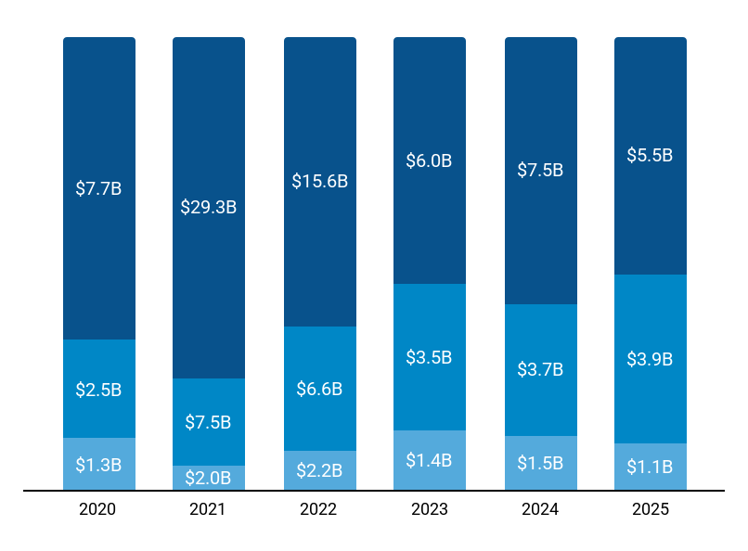
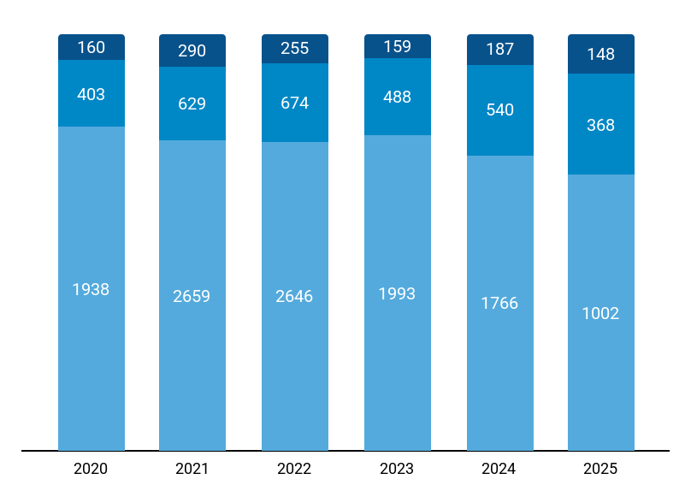
Y-o-Y Stage-wise Funding Trends
Stage-wise $ Invested
Stage-wise Number of Rounds
$11.5B
$38.9B
$24.4B
$11.0B
$12.7B
$10.5B
2501
3578
3575
2640
2493
1518
Seed
Early Stage
Late Stage
Total Funding
Seed
Early Stage
Late Stage
Total Rounds
Note: Seed includes Seed, Angel rounds. Early Stage includes Series A,B rounds. Late Stage includes Series C+, PE, Pre-IPO rounds.
‹#›
Notes:
Add Legend for Totals

Slide 14









Top Funding Rounds in 2025 (1/2)
Company |  | $ Amount | Round | Date | Investors
 | Erisha E Mobility (2022, Delhi, $1.0B) | $1.0B | Series D | Mar 2025 | -
 | Zepto (2021, Bengaluru, $2.3B) | $300M | Series H | Oct 2025 | Glade Brook Capital, Avenir Growth Capital, General .., +4 more
 | GreenLine (2021, Mumbai, $293M) | $275M | Series A | Apr 2025 | -
 | Uniphore (2008, Chennai, $987M) | $260M | Series F | Oct 2025 | Nvidia, Snowflake, March Capital, +6 more
 | Infra.Market (2016, Thane, $763M) | $222M | Series F | Jan 2025 | Tiger Global Management, Nuvama, Trifecta Capital, +16 more
 | Access Healthcare (2011, Chennai, $215M) | $211M | PE | Jan 2025 | New Mountain Capital
 | Groww (2016, Bengaluru, $596M) | $202M | Series F | Jun 2025 | GIC, Iconiq Capital
 | Meril (2006, Vapi, $410M) | $200M | Series D | Jul 2025 | ADIA
 | Weaver (2024, Mumbai, $170M) | $170M | Unattributed | Aug 2025 | Premji Invest, Gaja Capital, Lightspeed Venture Partners
 | Spinny (2015, Gurugram, $687M) | $131M | Series F | Mar 2025 | WestBridge Capital, Tiger Global Management, Elevati.., +6 more
 | Jumbotail (2015, Bengaluru, $279M) | $120M | Series D | Jun 2025 | SC Ventures, Artal Asia
 | Raise (2021, Mumbai, $146M) | $120M | Series B | Oct 2025 | Hornbill Capital, JM Financial, MUFG, +1 more
Notes:
Confine to 4 Slides

Slide 15








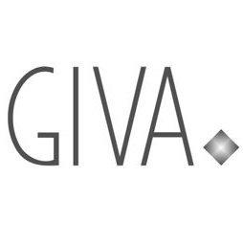



Top Funding Rounds in 2025 (2/2)
Company |  | $ Amount | Round | Date | Investors
 | Snapmint (2015, Mumbai, $180M) | $115M | Series B | Oct 2025 | General Atlantic, Kae Capital, Elev8, +1 more
 | Raphe mPhibr (2017, Noida, $154M) | $100M | Series B | Jun 2025 | Think Investments, General Catalyst, Ashra Family Tr.., +1 more
 | Zetwerk (2018, Bengaluru, $859M) | $76M | Series F | Jul 2025 | -
 | Udaan (2016, Bengaluru, $2.0B) | $75M | Series G | Feb 2025 | M&G, Lightspeed Venture Partners
 | CRED (2018, Bengaluru, $942M) | $75M | Series G | May 2025 | GIC, Sofina, Lathe Investment, +2 more
 | Euler Motors (2018, Delhi, $206M) | $75M | Series D | May 2025 | Athera, Hero MotoCorp, British International Investm.., +3 more
 | InsuranceDekho (2016, Gurugram, $398M) | $70M | Series C | Mar 2025 | Beams Fintech Fund, MUFG, BNP Paribas Cardif, +1 more
 | Truemeds (2019, Mumbai, $114M) | $65M | Series C | Mar 2025 | WestBridge Capital, Peak XV Partners, MMPL Trust, +3 more
 | GIVA (2019, Bengaluru, $131M) | $62M | Series C | Jun 2025 | Premji Invest, Epiq Capital Advisors, Creaegis, +2 more
 | Gupshup (2004, Mumbai, $546M) | $60M | Series F | Jul 2025 | Globespan Capital Partners, EvolutionX
 | MoEngage (2014, Bengaluru, $242M) | $60M | Series F | Nov 2025 | Goldman Sachs, A91 Partners
 | EKA (2019, Pune, $179M) | $57M | Series A | Oct 2025 | India Japan Fund
Full list of 1,518 Key Funding Rounds is available on Tracxn Platform
Notes:
Confine to 4 Slides

Slide 16



Top Funded Business Models in 2025
Rank |  | Business Model | $ Funding | # Rounds | Top Funding Round
1 | ▲2 | Electric Vehicle Manufacturers | $1.3B | 26 | Erisha E Mobility $1.0B - Series D
2 | – | Online Lenders | $651M | 51 | Weaver $170M - Unattributed
3 | ▼2 | Grocery Ecommerce | $595M | 67 | Zepto $300M - Series H
4 | -- | Digital Trading Platforms | $472M | 25 | Groww $202M - Series F
5 | -- | Cognitive Process Automation | $369M | 6 | Uniphore $260M - Series F
6 | ▲4 | Construction Project Management | $362M | 13 | Infra.Market $222M - Series F
7 | -- | Emission Control Systems | $311M | 4 | GreenLine $275M - Series A
8 | ▲4 | B2B Building Materials Marketplace | $295M | 7 | Infra.Market $222M - Series F
9 | -- | Internet First Consumer Payments | $190M | 12 | CRED $75.0M - Series G
10 | -- | C4ISR Systems | $181M | 15 | Raphe mPhibr $100M - Series B
* Rank is based on $Invested in last 1 year in the Business Model. ▲- Indicates change in Rank from previous year.
‹#›

Slide 17
Contents
Snapshot
Investments
Investors |  | Y-o-Y Investors
Exits |  | Y-o-Y International Investors
New Unicorns |  | Most Active Investors
Citywise Trends
Women Co-Founded Trends
News
Funded Deadpooled Companies
Appendix

Slide 18
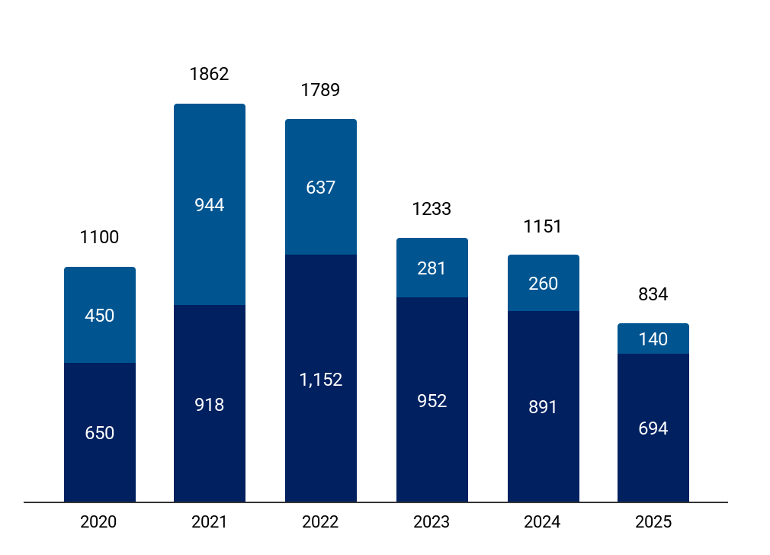









Y-o-Y Investors
Y-o-Y # of unique Institutional Investors in India Tech
Top Institutional Investors in 2025
Stage | Investor name | # Investments in 2025
Seed Stage | Inflection Point Ventures | 32 (▼24%)
 | Venture Catalysts | 23 (▼34%)
 | Antler | 20 (▲5%)
Early Stage | Peak XV Partners | 16 (▲33%)
 | Accel | 12 (▼8%)
 | Elevation Capital | 10 ( – )
Late Stage | Sofina | 3 ( -- )
 | SoftBank Vision Fund | 1 (▼50%)
 | Mars Growth Capital | 1 (▼50%)
# First Time Investors (2Y) CAGR = -29%
# First Time Investors (4Y) CAGR = -38%
First-time Investors
Existing Investors
Note: First-time investors and Existing Investors are calculated from the available Equity Funding Rounds on Tracxn Platform. 1.The numbers in bracket correspond to the change from 2024.
Notes:
Includes the analysis on the investors spread across the World (US + Non US)

Slide 19
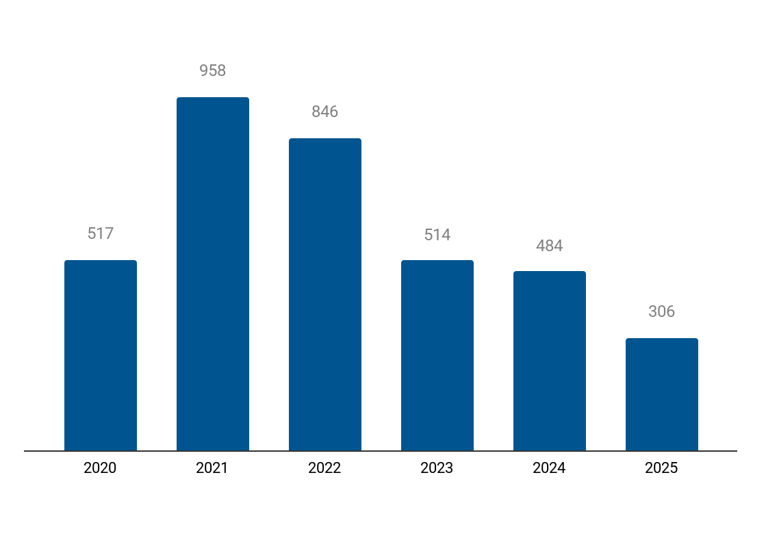



Y-o-Y International Investors
Y-o-Y # of unique International Institutional Investors in India Tech
Top International Institutional Investors in 2025
Stage | Investor name | # Investments in 2025
Seed Stage | Antler | 20 (▲5%)
 | Better Capital | 8 (▲100%)
Early Stage | Accel | 12 (▼8%)
 | Lightspeed Venture Partners | 7 ( – )
 | Bessemer Venture Partners | 6 (▲100%)
Late Stage | Sofina | 3 ( -- )
 | SoftBank Vision Fund | 1 (▼50%)
 | Mars Growth Capital | 1 (▼50%)
International Investors
Note: International Investors are the investors who are based outside of the Geo mentioned in the report. 1.The numbers in bracket correspond to the change from 2024.
‹#›
Notes:
Includes the analysis on the investors spread across the World (US + Non US)

Slide 20










Most Active Investors: Accelerators & Incubators
# | Investor Name | Country | # Overall investments | # Investments in Geo* - 2025 | Notable Investments in Geo*
1 | Rainmatter | India | 156 | 19 | CRED ($942M), M2P Fintech ($188M), Jupiter ($182M)
2 | Real Time Accelerator Fund | India | 72 | 14 | HouseEazy ($25.4M), Pantherun ($19.6M), Ambak ($18.0M)
3 | IIMA Ventures | India | 356 | 13 | Jai Kisan ($88.6M), AgniKul ($72.8M), Kaleidofin ($44.5M)
4 | We Founder Circle | India | 131 | 13 | Zypp Electric ($76.5M), Garuda Aerospace ($49.5M), Pandorum ($46.8M)
5 | India Accelerator | India | 258 | 11 | Droom ($344M), Purple Style Labs ($72.5M), HouseEazy ($25.4M)
6 | IvyCap Ventures Advisors | India | 70 | 9 | Miko Technologies ($102M), Celcius ($54.0M), SNITCH ($53.3M)
7 | JITO Incubation & Innovation Foundation | India | 124 | 8 | AjnaLens ($13.8M), NOTO ($9.1M), HairOriginals ($8.2M)
8 | Turbostart | India | 68 | 7 | Meolaa ($10.4M), Ykrita Life Sciences ($6.5M), Neuralzome ($2.7M)
9 | Fundamentum | India | 19 | 7 | Spinny ($687M), Kuku FM ($122M), FlexiLoans ($97.3M)
10 | 100Unicorns | India | 174 | 6 | Zetwerk ($859M), Vedantu ($337M), Snapmint ($180M)
Note: *Geo = India Tech. The number in bracket refers to the total funding raised by the company.
Notes:
# Investments In Geo and Notable Investments in Geo should be based on the last 1 year or till date?

Slide 21





Most Active Investors: VC - Seed
# | Investor Name | Country | # Overall investments | # Investments in Geo* - 2025 | Notable Investments in Geo*
1 | Inflection Point Ventures | India | 291 | 32 | Vested Finance ($25.8M), Kazam ($20.1M), Fabheads ($13.4M)
2 | Venture Catalysts | India | 376 | 23 | Vedantu ($337M), Pepperfry ($307M), CityMall ($153M)
3 | Antler | Singapore | 1,448 | 20 | BetterPlace ($96.7M), HouseEazy ($25.4M), InspeCity ($7.2M)
4 | Blume Venture | India | 330 | 14 | Spinny ($687M), Euler Motors ($206M), Servify ($165M)
5 | Firstport Capital | India | 105 | 11 | Recur Club ($15.3M), Fabheads ($13.4M), NOTO ($9.1M)
6 | DeVC | India | 63 | 11 | Ambak ($18.0M), Lucio ($7.7M), Cybrilla ($7.3M)
7 | Unicorn India Ventures | India | 62 | 10 | Olyv ($46.7M), Netrasemi ($14.6M), Kluisz.ai ($9.7M)
8 | Info Edge Ventures | India | 98 | 9 | Truemeds ($114M), Geniemode ($87.7M), ShopKirana ($59.2M)
9 | Better Capital | United States | 286 | 8 | M2P Fintech ($188M), Jupiter ($182M), Yulu ($135M)
10 | Fireside Ventures | India | 80 | 8 | Cult.fit ($667M), HomeLane ($194M), Ripplr ($123M)
Note: *Geo = India Tech. The number in bracket refers to the total funding raised by the company.
Notes:
# Investments In Geo and Notable Investments in Geo should be based on the last 1 year or till date?

Slide 22





Most Active Investors: VC - Early Stage
# | Investor Name | Country | # Overall investments | # Investments in Geo* - 2025 | Notable Investments in Geo*
1 | Peak XV Partners | India | 417 | 16 | Meesho ($1.4B), CRED ($942M), Zetwerk ($859M)
2 | Accel | United States | 1,160 | 12 | Zetwerk ($859M), Infra.Market ($763M), Spinny ($687M)
3 | Elevation Capital | India | 218 | 10 | Meesho ($1.4B), Spinny ($687M), ACKO ($598M)
4 | Vertex Ventures | India | 143 | 8 | Kuku FM ($122M), Kapiva ($78.5M), Pilgrim ($50.0M)
5 | Alteria Capital | India | 238 | 7 | Zepto ($2.3B), Infra.Market ($763M), Spinny ($687M)
6 | Lightspeed Venture Partners | United States | 951 | 7 | Zepto ($2.3B), Udaan ($2.0B), Zetwerk ($859M)
7 | Trifecta Capital | India | 213 | 6 | Zepto ($2.3B), Udaan ($2.0B), Meesho ($1.4B)
8 | Bessemer Venture Partners | United States | 905 | 6 | Vedantu ($337M), Innoviti ($141M), Seekho ($42.3M)
9 | Alpha Wave Global | United States | 168 | 4 | CRED ($942M), OfBusiness ($776M), Stanza Living ($231M)
10 | Bertelsmann India Investments | Netherlands | 35 | 4 | Pepperfry ($307M), Lendingkart ($260M), Agrostar ($191M)
Note: *Geo = India Tech. The number in bracket refers to the total funding raised by the company.
Notes:
# Investments In Geo and Notable Investments in Geo should be based on the last 1 year or till date?

Slide 23


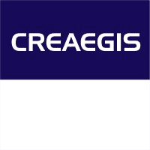
Most Active Investors: VC - Late Stage
# | Investor Name | Country | # Overall investments | # Investments in Geo* - 2025 | Notable Investments in Geo*
1 | Sofina | Belgium | 101 | 3 | CRED ($942M), MedGenome ($264M), The Whole Truth Foods ($37.6M)
2 | SoftBank Vision Fund | United Kingdom | 344 | 1 | Meesho ($1.4B), OfBusiness ($776M), Zeta ($390M)
3 | Mars Growth Capital | Singapore | 44 | 1 | Meesho ($1.4B), Zetwerk ($859M), Infra.Market ($763M)
4 | Glade Brook Capital | United States | 53 | 1 | Zepto ($2.3B), Pronto ($13.1M)
5 | Lathe Investment | Singapore | 7 | 1 | CRED ($942M), Vegrow ($86.6M)
6 | M&G | United Kingdom | 62 | 1 | Udaan ($2.0B), Tuco Kids ($7.4M)
7 | Creaegis | India | 9 | 1 | GIVA ($131M), Zolve ($106M)
8 | Artal Asia | Singapore | 3 | 1 | Jumbotail ($279M)
Note: *Geo = India Tech. The number in bracket refers to the total funding raised by the company.
Notes:
# Investments In Geo and Notable Investments in Geo should be based on the last 1 year or till date?

Slide 24










Most Active Investors: PE
# | Investor Name | Country | # Overall investments | # Investments in Geo* - 2025 | Notable Investments in Geo*
1 | Anicut Capital | India | 164 | 14 | Lendingkart ($260M), M2P Fintech ($188M), Snapmint ($180M)
2 | WestBridge Capital | Mauritius | 185 | 9 | Meesho ($1.4B), Spinny ($687M), Innovaccer ($675M)
3 | A91 Partners | India | 37 | 9 | MoEngage ($242M), Atomberg ($151M), GIVA ($131M)
4 | British International Investment | United Kingdom | 412 | 7 | Uniphore ($987M), ACKO ($598M), Bizongo ($257M)
5 | Baring Private Equity Partners | India | 89 | 5 | ACKO ($598M), HomeLane ($194M), Battery Smart ($139M)
6 | Evolvence Equity Partners | India | 42 | 5 | Infra.Market ($763M), Rebel Foods ($587M), Captain Fresh ($231M)
7 | Verlinvest | Belgium | 72 | 5 | Kuku FM ($122M), Blue Tokai Coffee Roasters ($106M), Go Zero ($6.0M)
8 | Chona Family Office | India | 18 | 4 | AgniKul ($72.8M), ShopKirana ($59.2M), Arcatron ($23.3M)
9 | Panthera | Singapore | 13 | 3 | OfBusiness ($776M), Pepperfry ($307M), MedGenome ($264M)
10 | TVS Capital Funds | India | 40 | 3 | InsuranceDekho ($398M), Yubi ($241M), Finnable ($67.0M)
Note: *Geo = India Tech. The number in bracket refers to the total funding raised by the company.
Notes:
# Investments In Geo and Notable Investments in Geo should be based on the last 1 year or till date?

Slide 25
Contents
Snapshot
Investments
Investors
Exits |  | Exit Snapshot
New Unicorns |  | List of Acquisitions
Citywise Trends |  | Most Active Acquirers
Women Co-Founded Trends |  | Acquisitions: Trends and Insights
News |  | List of IPOs
Funded Deadpooled Companies |  | IPOs: Trends and Insights
Appendix

Slide 26

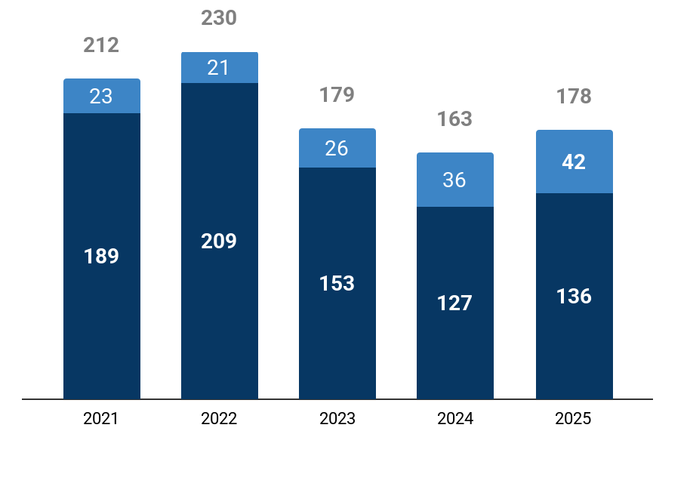










Exit Snapshot - 2025
IPOs - 2025 (vs 2024)
42 (vs 36)
13.9 (vs 9.2)
$245M (vs $266M)
$731M (vs $578M)
# IPOs
Avg. yrs from first funding to IPO
Avg. Funding raised before IPO
Avg. IPO Mcap
Acquisitions - 2025 (vs 2024)
136 (vs 127)
15 (vs 9.5)
$25.0M (vs $14.2M)
$131M (vs $75.1M)
# Acquisitions
Avg. yrs from first funding to Acq.
Avg. Funding raised before Acq.
Avg. Acq. Price
Top Investors by # Exits - 2025
Y-o-Y Exit Trends
Top Exits - 2025
Investor | # Exits | Notable Exit
Peak XV Partners | 10 | BlueStone
Trifecta Capital | 7 | Urban Company
Alpha Wave Global | 6 | PropTiger
Alteria Capital | 6 | axio
Tiger Global Management | 5 | Urban Company
Angel List | 5 | Zenduty
Type | Company |  | Acq. Price/IPO Mcap
Acq. |  | Resulticks (2012, Chennai) | $2.0B
 |  | Magma General Insu.. (1988, Mumbai, $110M) | $516M
 |  | Minimalist (2018, Jaipur, $17.0M) | $350M
IPO |  | Groww (2016, Bengaluru, $596M) | $7.0B
 |  | Meesho (2015, Bengaluru, $1.4B) | $5.6B
 |  | Physics Wallah (2016, Noida, $312M) | $3.6B
‹#›
# Acquisitions
# IPOs

Slide 27







List of Acquisitions - 2025 (1/2)
Company | Acquirer(s) | Acq. Date | Acq. Price
Resulticks (2012, Chennai) | Diginex | Jun 2025 | $2.0B
Magma General Insurance (1988, Mumbai, $110M) | DS Group, Patanjali Ayurved | Mar 2025 | $516M
Minimalist (2018, Jaipur, $17.0M) | HUL | Jan 2025 | $350M
Wingify (2009, Delhi) | Everstone Capital | Jan 2025 | $200M
Ecom Express (2012, Gurugram, $324M) | Delhivery | Apr 2025 | $165M
Web Werks (1996, Mumbai) | Iron Mountain | Apr 2025 | $164M
Fisdom (2015, Bengaluru, $48.6M) | Groww | May 2025 | $150M
People Strong (2005, Gurugram, $30.7M) | Goldman Sachs | Apr 2025 | $130M
Pepperfry (2011, Mumbai, $307M) | Tccltd | Sep 2025 | $74.9M
Deltatech (2011, Panaji) | Head Digital Works | Feb 2025 | $57.5M

Slide 28










List of Acquisitions - 2025 (2/2)
Company | Acquirer(s) | Acq. Date | Acq. Price
Biryani By Kilo (2015, Gurugram, $67.1M) | Devyani International | Apr 2025 | $49.1M
Stocko (Delhi, $38.7K) | InCred Money | Jun 2025 | $35.0M
Fintellix (2006, Bengaluru, $22.5M) | ICRA | Jun 2025 | $26.0M
Candela Labs (1996, Bengaluru, $97.3K) | Sapiens | Apr 2025 | $22.0M
Reginald Men (2022, Hyderabad) | Honasa Consumer | Dec 2025 | $21.7M
FindiBANKIT (2017, Noida) | Findi | Jan 2025 | $18.5M
Bombay Ortho Industries (2001, Rajkot) | Alkem Laboratories | Feb 2025 | $16.8M
Dice (2018, Pune, $6.5M) | Zaggle | Jun 2025 | $14.3M
Nautilus Mobile (2013, Hyderabad, $5.4M) | Krafton | Mar 2025 | $14.0M
Inzpera (2016, Mumbai) | Cipla | Nov 2025 | $12.5M
View all 136 companies on Tracxn Platform

Slide 29





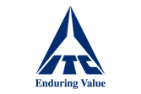


Most Active Acquirers - 2025
# | Acquirer | Country | # Acq. | Companies Acquired
1 | Zaggle | India | 3 | Dice, EffiaSoft, Rio
2 | WLDD | India | 2 | ScoopWhoop, 7-10.in
3 | CreativeFuel | India | 2 | MissMalini, Recommendation Community
4 | Spinny | India | 2 | GoMechanic, Autocar India
5 | India Accelerator | India | 2 | StartersCFO, MySoho
6 | Incuspaze | India | 2 | Trios, Vskout
7 | DeHaat | India | 2 | AgriCentral, NEERX
8 | ITC | India | 2 | Mother Sparsh Baby Care, Meatigo
9 | Chargebee | United States | 2 | INAI, Trainn
10 | Perfios | India | 2 | CreditNirvana, Clari5
Notes:
Confine to 1 Slide

Slide 30
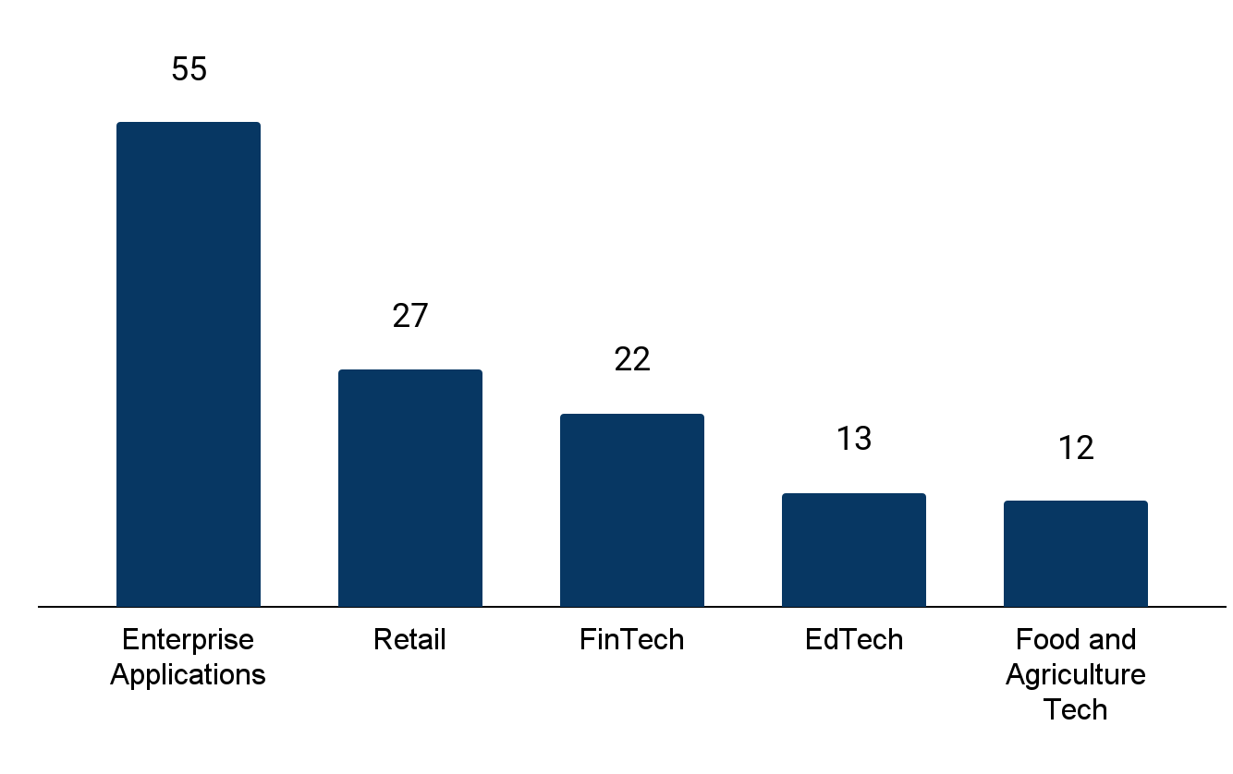
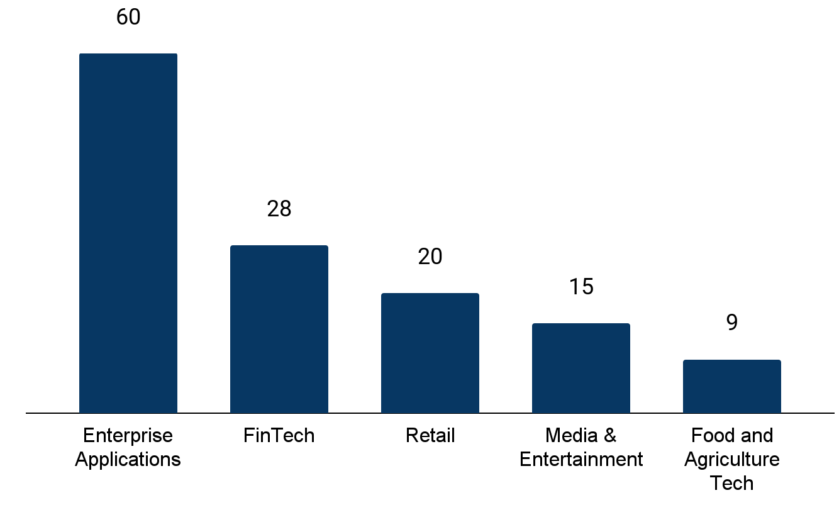








Sector-wise Acquisition Activity - 2025
Top 5 Sectors by Tech Acquisitions – 2025 vs 2024
Tracxn Spotlight
Top Acquired Sectors in 2025
Top Acquired Sectors in 2024
Enterprise Applications continues to lead acquisition activity, with 55 acquisitions in 2025, remaining broadly in line with 2024 levels (60 acquisitions). This consistency points to sustained buyer demand for enterprise software and digital infrastructure assets, even amid a more selective funding environment.
The rise in Retail alongside moderation in FinTech, suggests a gradual broadening and recalibration of consolidation beyond core enterprise software into consumer-facing and essential service sectors.
Acquisition activity in 2025 has been supported by marquee investors such as Peak XV Partners, Chiratae Ventures, and Gemba Capital indicating a phase of capital recycling through strategic exits rather than IPO-led liquidity.
Overall, the data reflects a market characterized by sector maturity and buyer-led consolidation, with acquisitions serving as a major exit route for scaled but capital-efficient companies.
▼7%
▲35%
▼21%
▲117%
▲33%
Total # of Acquisitions
Total # of Acquisitions
Top Investors in Acquisitions (2025)
Investor Name |  | # Portfolio Companies
 | Peak XV Partners | 4
 | Chiratae Ventures | 4
 | Gemba Capital | 4
 | Alpha Wave Global | 4
 | Inflection Point Ventures | 4
Top Investors in Acquisitions (2024)
Investor Name |  | # Portfolio Companies
 | Accel | 3
 | Inflection Point Ventures | 3
 | QED Innovation Labs | 3
 | New Enterprise Associates | 2
 | Venture Catalysts | 2
‹#›

Slide 31
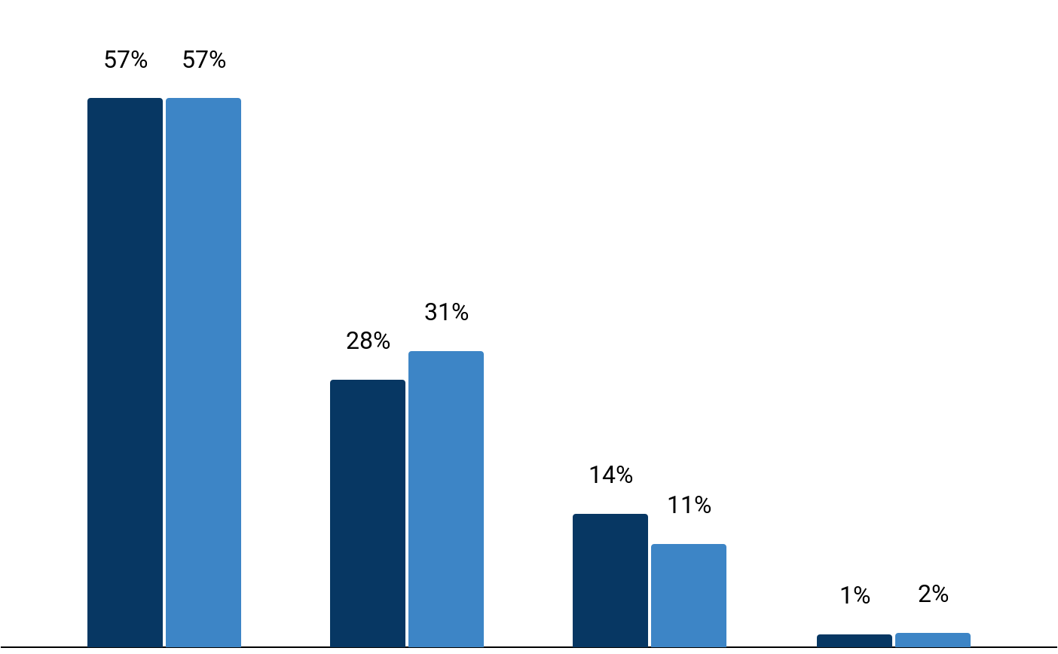
Funding Stage Breakdown of Acquired Companies
Acquisition Count by Last Funding Stage (2025 vs 2024)
Tracxn Spotlight
In 2025, of the 136 acquisitions, 72 companies had previously raised equity funding, compared with 65 of the 127 acquisitions in 2024.
While Seed and Early-stage companies still account for the majority of acquisitions, there is a relative increase in late-stage acquisitions, rising to 14% in 2025 from 11% in 2024.
This shift reflects acquirer preference for scaled, revenue-generating companies that offer immediate market presence, operational maturity, and faster integration, reducing execution risk in a cautious capital environment..
Recent late-stage acquisitions in 2025, including Ecom Express, Fisdom, and Pepperfry, illustrate this market trend. Delhivery acquired Ecom Express to enhance last-mile logistics and network consolidation, while Groww acquired Fisdom to expand its wealth management offerings and customer engagement.
Seed
Early Stage
Late Stage
Others
2025
2024
*Only companies with their latest equity funding stage available are considered.Percentages represent the share of companies out of the total acquisitions in the respective year.
Seed includes Seed, Angel rounds. Early Stage includes Series A,B rounds. Late Stage includes Series C+, PE, Pre-IPO rounds. “Others” in the figure includes Unattributed, Equity Crowdfunding, Convertible Debt, and PE
‹#›

Slide 32
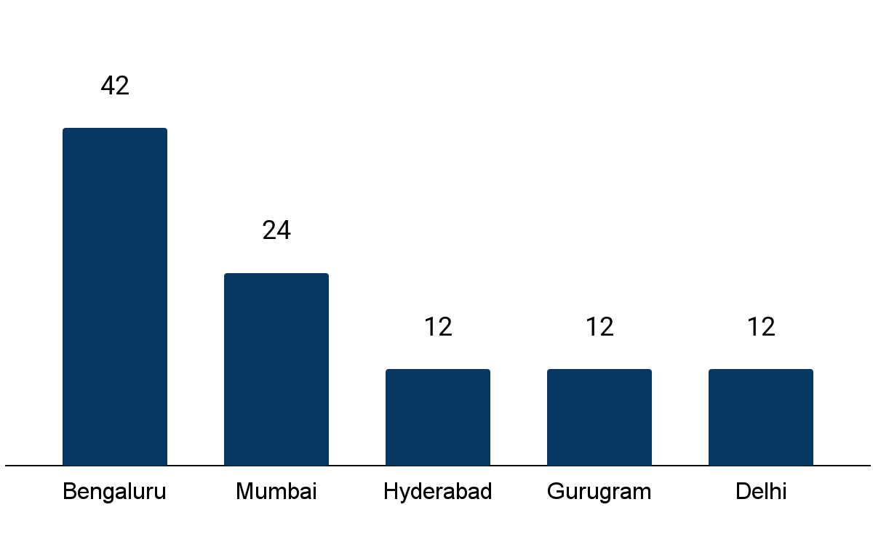
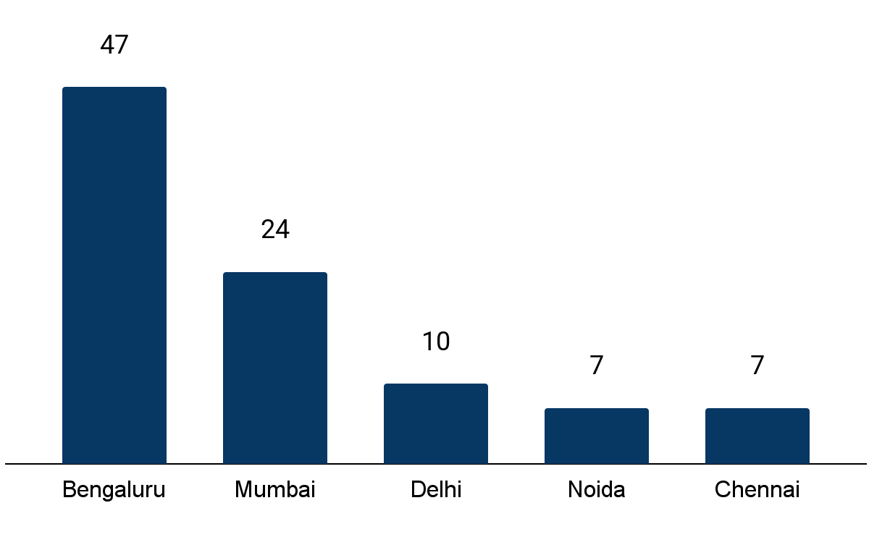
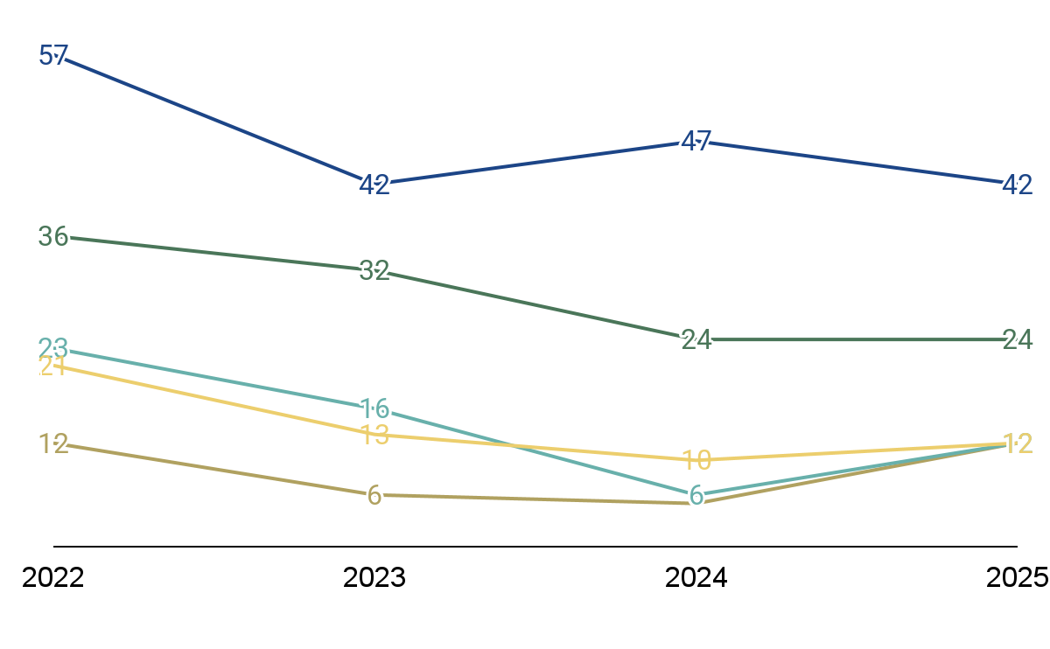
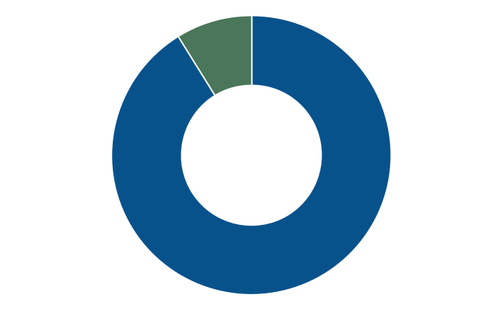
Citywise Acquisition Activity
Acquisition Data and Trends by Cities
Tracxn Spotlight
Top Cities by Acquisitions – 2025
Top Cities by Acquisitions – 2024
Bengaluru continues to lead in startup acquisitions in India, topping the charts both in 2024 (47 acquisitions) and 2025 (42 acquisitions). Its established ecosystem, deep tech talent pool, and leading role in SaaS, AI, and fintech ensure it outpaces other cities by a significant margin.
Mumbai followed closely with 24 acquisitions in 2025, in line with the 24 recorded in 2024. Hyderabad (12) and Gurugram (12) also recorded notable activity, underscoring their rising prominence as strategic startup hubs driven by pro-business policies and strong digital infrastructure.
City-wise distribution highlights that over 90% of acquisitions continue to occur in Tier 1 cities, underscoring acquirer preference for mature ecosystems with established corporate presence and lower integration risk. However, rising funding activity in Tier 2 and Tier 3 cities may signal a gradual geographic broadening of exit activity over the longer term
Total # of Acquisitions
Total # of Acquisitions
City Wise Distribution (Count)
Acquisitions by Top Cities (Last 4 years)
Tier 1 (91%)
Tier 2/Tier 3 (9%)
5
‹#›
Bengaluru
Mumbai
Hyderabad
Gurugram
Delhi

Slide 33
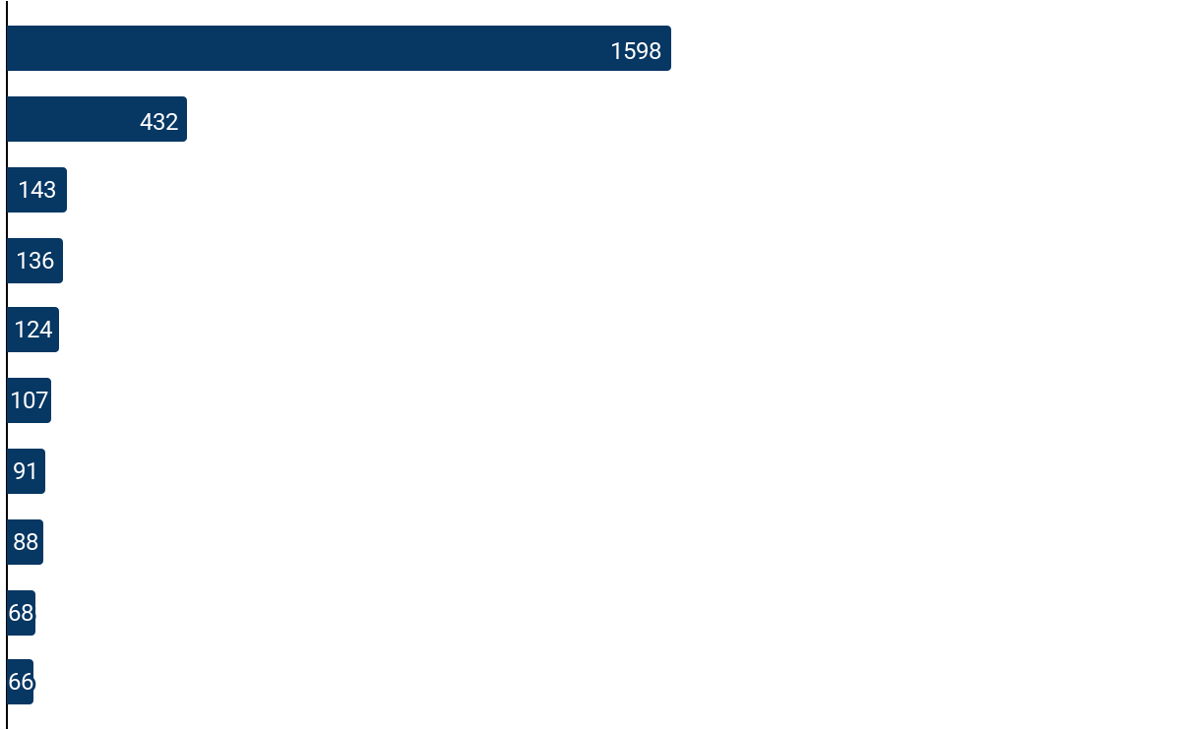










Global Acquisition Trends – 2025
Acquisition Count by Country vs Top Acquired Sector
Tracxn Spotlight
Top Acquired Sector
Global acquisition activity in 2025 remains heavily concentrated in the U.S., which recorded 1,598 deals, reflecting its deep buyer base, mature acquisition ecosystem, and consistent demand for technology-led consolidation across sectors.
Across geographies, acquisition activity is largely shaped by local market structure and regulatory priorities, with Healthcare IT leading in the U.S., HRTech and Marketing Tech featuring prominently in the UK and Europe, and Banking Tech emerging as a key acquisition focus in India.
India’s 136 acquisitions position it among the more active global markets, with deal flow driven primarily by financial services digitization and platform integration, rather than horizontal consolidation.
While acquisition volumes vary widely by country, sector-specific consolidation is closely aligned with domestic demand drivers and ecosystem maturity, rather than a uniform global M&A pattern.
U.S.
Healthcare IT
UK
HRTech
Germany
AI Infrastructure
India
Banking Tech
Canada
Marketing Tech
France
Marketing Tech
Australia
Sports Tech
Netherlands
Logistics Tech
Spain
Enterprise Resource
Planning
Israel
Cybersecurity
‹#›

Slide 34












Top 3 Landmark Acquisitions in India – 2025
Deal Overview: Acquisition Price : $2B Acquisition Date: 05 Jun, 2025
Strategic Rationale: Strengthen Diginex’s customer engagement and digital marketing with Resulticks’ platform. Expand Diginex blockchain applications into customer data, personalization, and analytics.
Key Insights/Impact: Strengthens Diginex’s financial position and AI capabilities. Enhances ESG intelligence and customer engagement through Resulticks’ Genie framework.
Deal Overview: Acquisition Price : $516M Acquisition Date: 13 Mar, 2025
Strategic Rationale: Strengthens DS Group and Patanjali’s position in India’s fast-growing insurance sector. Expands revenue streams and reduces reliance on core FMCG and wellness businesses.
Key Insights/Impact: Provides DS Group and Patanjali an entry into India’s fast-growing general insurance sector. Leverages their extensive FMCG and wellness distribution networks to expand insurance reach, especially in rural markets
Deal Overview: Acquisition Price : $350M Acquisition Date: 22 Jan, 2025
Strategic Rationale: Strengthens HUL’s presence in the premium skincare and beauty segment Adds a fast growing D2C brand with strong digital-first capabilities
Key Insights/Impact: Accelerates HUL’s entry into digital-native and younger consumer segments Provides scale-up potential by taking Minimalist offline and global through HUL’s distribution network
acquired
acquired
acquired
Note: Logos are displayed with the acquired company on the right and the acquirer on the left. A handshake icon indicates an acquisition.
‹#›

Slide 35










Top 3 Global Landmark Acquisitions – 2025
Deal Overview: Acquisition Price : $55B Acquisition Date: 29 Sep, 2025
Strategic Rationale: Provides EA with long-term capital to accelerate game development and platform innovation. Supports expansion across live services and immersive digital entertainment experiences.
Key Insights/Impact: The acquisition strengthens EA’s ability to invest in franchises without any market pressure. Backing from PIF-led investors enhances EA’s global reach and long-term growth flexibility.
Deal Overview: Acquisition Price : $33B Acquisition Date: 29 Mar, 2025
Strategic Rationale: Strengthens XAI’s portfolio by integrating X’s capabilities into its AI-driven ecosystem. Expand XAI’s capability across data management, automation, and advanced analytics.
Key Insights/Impact: The acquisition will boosts XAI’s competitive positioning in the global AI market. With enhanced resources, X can accelerate innovation and reach new markets.
Deal Overview: Acquisition Price : $32B Acquisition Date: 18 Mar, 2025
Strategic Rationale: Strengthens Google Cloud security offerings with Wiz’s cloud-native security platform. Enhances Google’s capability to provide an integrated security experience for enterprise customers.
Key Insights/Impact: Builds greater trust among enterprise customers by improving security posture. Simplifies deployment and integration of cloud security services.
acquired
acquired
acquired
Note: Logos are displayed with the acquired company on the right and the acquirer on the left. A handshake icon indicates an acquisition.
Electronic Arts was acquired by a consortium of firms, including the Public Investment Fund, Silver Lake, and Affinity Partners.
‹#›
Notes:
https://investors.ea.com/press-releases/press-release-details/2025/EA-Announces-Agreement-to-be-Acquired-by-PIF-Silver-Lake-and-Affinity-Partners-for-55-Billion/default.aspx : Saudi Arabia’s Public Investment Fund (PIF) already owns 9.9% of EA and will not sell its stake for cash.

Slide 36
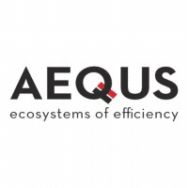






List of IPOs - 2025(1/2)
Company | Investors | IPO Date | IPO Mcap
Meesho (2015, Bengaluru, $1B) | Y Combinator, Facebook, +32 more | Dec 2025 | $5.6B
Aequs (2000, Belgaum, $101M) | Amansa Capital, Steadvi.., +12 more | Dec 2025 | $924M
Ravel (2018, Mumbai) | - | Dec 2025 | $9.9M
Excelsoft (2000, Mysuru, $869K) | Uti Venture Funds Man.., +4 more | Nov 2025 | $155M
Capillary Technologies (2008, Bengaluru, $239M) | American Express, Peak .., +18 more | Nov 2025 | $516M
Physics Wallah (2016, Noida, $312M) | WestBridge Capital, +9 more | Nov 2025 | $3.6B
Pine Labs (1998, Noida, $1B) | Peak XV Partners, Sofina, +45 more | Nov 2025 | $2.9B
FinanceBuddha (2012, Bengaluru, $576K) | Acsys Investments, +4 more | Nov 2025 | $30.5M
Groww (2016, Bengaluru, $596M) | Y Combinator, Ribbit Ca.., +18 more | Nov 2025 | $7.0B
TradeUNO (2015, Gurugram, $155K) | We Founder Circle, RISE | Nov 2025 | $20.6M

Slide 37









List of IPOs - 2025(2/2)
Company | Investors | IPO Date | IPO Mcap
Zappfresh (2015, Gurugram, $16M) | SIDBI Venture Capital, +24 more | Oct 2025 | $25.1M
Advance Agrolife (2002, Jaipur) | - | Oct 2025 | $72.4M
Zelio E Bikes (2021, Hisar) | - | Oct 2025 | $32.4M
Sheel Biotech (1991, Delhi) | - | Oct 2025 | $14.4M
Infinity Infoway (2004, Rajkot) | Paytm | Oct 2025 | $9.5M
TruAlt Bioenergy (2021, Bengaluru) | Nirani Sugars | Oct 2025 | $479M
earKART (2021, Noida, $1M) | Agility Ventures, Blume.., +1 more | Oct 2025 | $20.9M
Seshaasai (1993, Mumbai) | Florintree | Sep 2025 | $770M
Anand Rathi (1994, Mumbai) | - | Sep 2025 | $292M
Jaro Education (2009, Mumbai) | Parishi Capital, Kamalj.., +6 more | Sep 2025 | $222M
View all 42 companies on Tracxn Platform

Slide 38
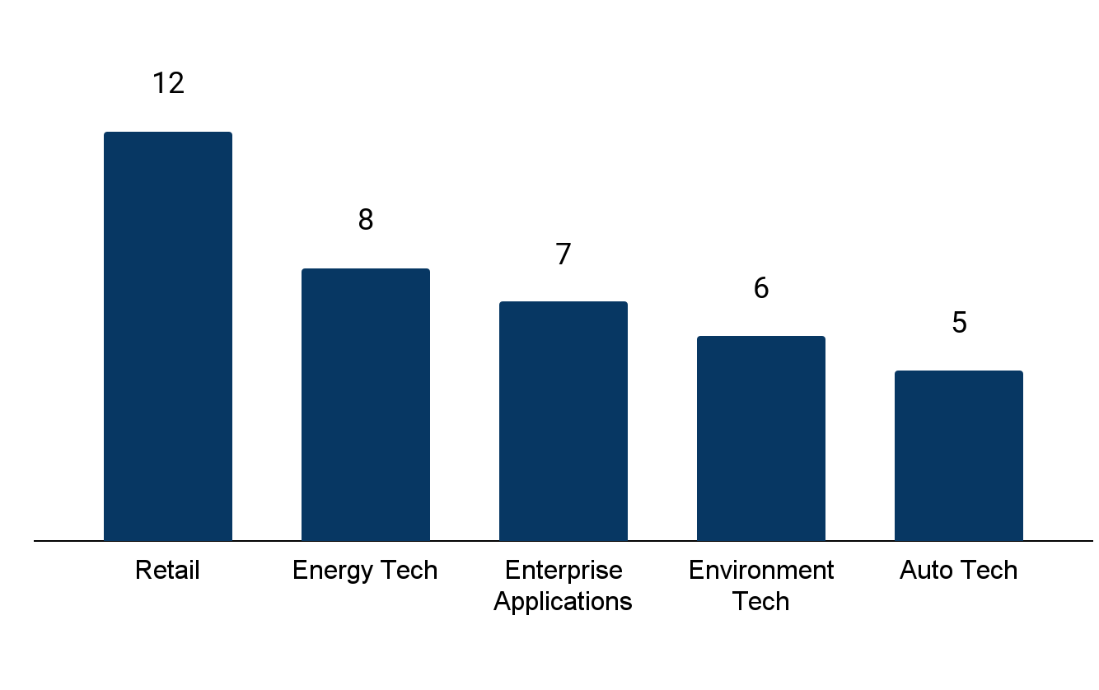
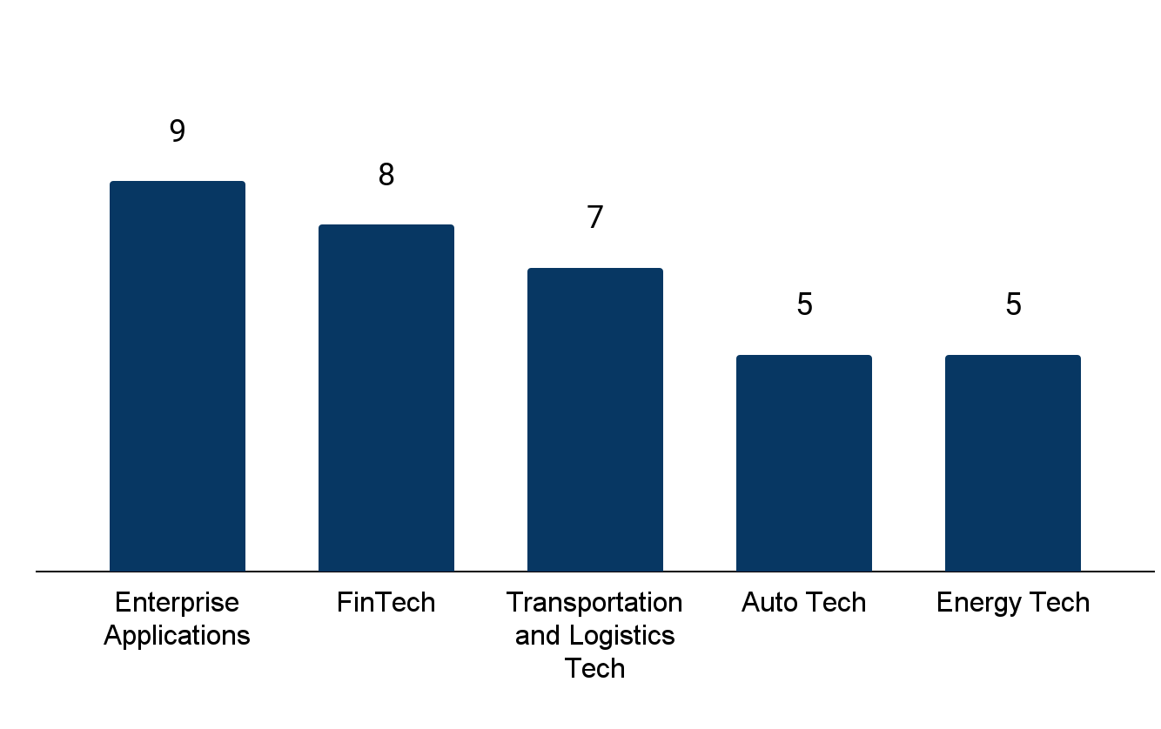





Sector-wise IPO Activity
Top 5 Sectors by Tech IPOs – 2025 vs 2024
Tracxn Spotlight
Top IPO sectors in 2025
Top IPO sectors in 2024
In 2025, IPO activity was led by Retail with 12 listing and Energy Tech with 8 listings each, marking a shift in market readiness. This contrasts with 2024, when Enterprise Applications dominated with 9 IPOs, followed by FinTech.
Retail and Energy Tech drove IPO activity in 2025, supported by omnichannel expansion in retail and increasing investments in renewable energy, grid modernization, and energy management technologies.
Enterprise Applications recorded 7 listings, driven by continued enterprise digitization, strong demand for cloud-based SaaS, and wider adoption of AI and automation to improve efficiency, decision-making, and scalability.
Investors like Peak XV Investor, Tiger Global Management and Prosus exited via IPOs to gain higher valuations and provide companies capital for further expansion.
▲200%
▲60%
▼22%
▲20%
-
Total # of IPOs
Total # of IPOs
Top Investors in IPOs (2025)
Investor Name |  | # Portfolio Company
 | Peak XV Investor | 6
 | Tiger Global Management | 4
 | Prosus | 3
 | Think Investment | 3
 | Accel | 2
Top Investors in IPOs (2024)
Investor Name |  | #Portfolio Company
 | Peak XV Investor | 4
 | Elevation Capital | 3
 | Trifecta Capital | 3
 | Tiger Global Management | 3
 | Accel | 2
‹#›

Slide 39
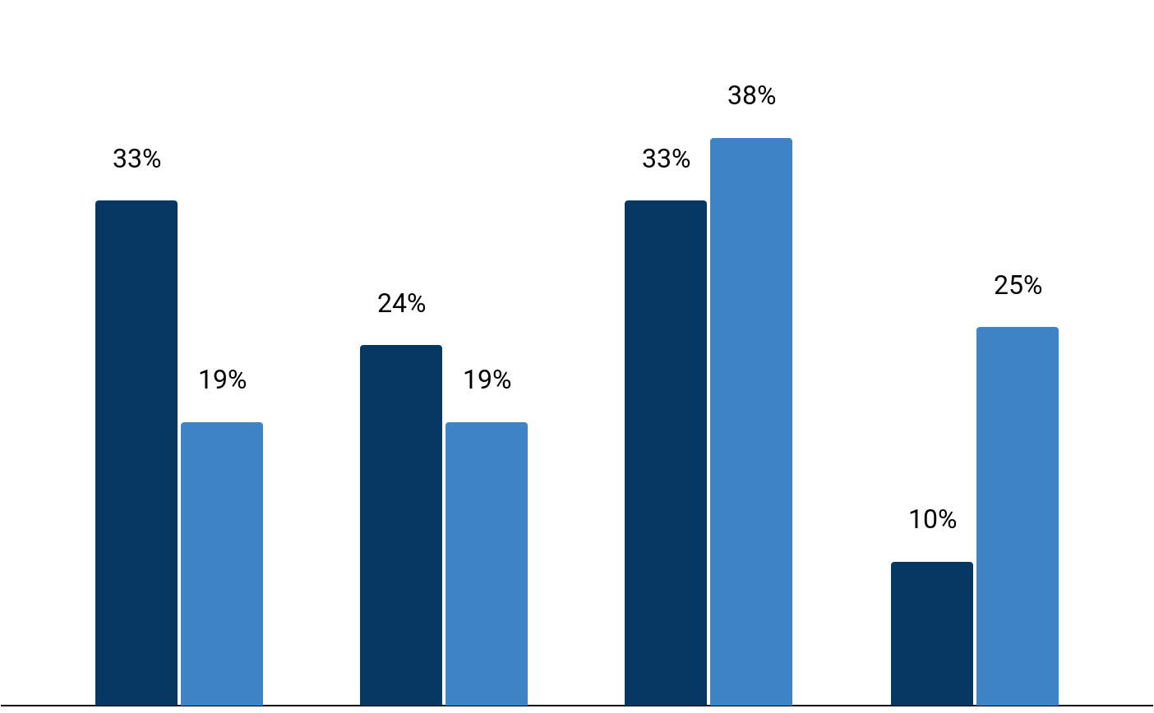
Stage-wise IPO Activity
Stage-Wise IPO Count Comparison (2025 vs 2024)
Tracxn Spotlight
In 2025, 21 of the 42 IPOs had previously raised equity funding rounds, compared with 16 of the 36 IPOs in 2024. Seed and Early Stage companies accounted for 57% of IPOs in 2025, up sharply from 38% in 2024, signaling a strong tilt toward younger startups entering public markets earlier, while larger late-stage listings remained more measured.
In 2025, a rising wave of seed and early-stage startups are going public to raise growth capital and provide liquidity for investors. Companies like Maxvolt Energy, and VolerCars launched IPOs at the seed stage, while Physics Wallah, Infinity Infoway, and ArisInfra made their public debut during the Early Stage.
Maxvolt Energy went public to raise funds for expanding renewable energy projects. VolerCars entered the market to strengthen its electric vehicle production and expand market reach. PhysicsWallah went public to expand its hybrid learning ecosystem, scale offline and tech-enabled centres, and strengthen its brand presence in India’s growing edtech market.
Seed
Early Stage
Late Stage
Others
2025
2024
*Only companies with their latest equity funding stage available are considered.Percentages represent the share of companies out of the total IPOs in the respective years.
Seed includes Seed, Angel rounds. Early Stage includes Series A,B rounds. Late Stage includes Series C+, PE, Pre-IPO rounds. “Others” in the figure includes Unattributed, Equity Crowdfunding, Convertible Debt, and PE
‹#›

Slide 40
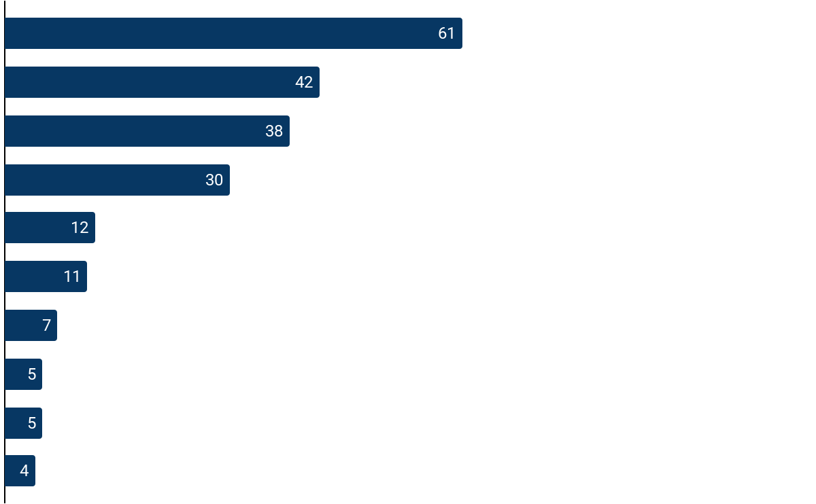






Global IPO Trends – 2025
IPO Count by Country vs Top Public Sector
Tracxn Spotlight
Top Public Sector
Global IPO activity in 2025 remains concentrated in a few mature public markets, with the U.S. leading at 61 listings, followed by India (42) and China (38). This reflects sustained investor participation in markets with deep liquidity, institutional capital, and predictable listing frameworks.
Sectoral trends show healthcare and life sciences leading IPO activity in the U.S. and China, particularly in Oncology, supported by advances in biotech R&D and a stable regulatory environment.
In contrast, India’s IPO activity in 2025 is led by Electric Vehicles, reflecting strong investor appetite for mobility and energy-transition platforms.
Overall, IPO activity remains selective and concentrated, consistent with a cautious reopening of public markets that favors sectors with regulatory clarity, scale, and revenue visibility.
U.S
Oncology
India
Electric Vehicles
China
Oncology
South Korea
Oncology
Japan
Geographic Information Systems
Taiwan
-
Singapore
-
UK
-
Canada
Oil & Gas Tech
Sweden
-
Note: A “–” under public sectors indicates that no single sector had a prominent share of IPOs in that country
‹#›

Slide 41
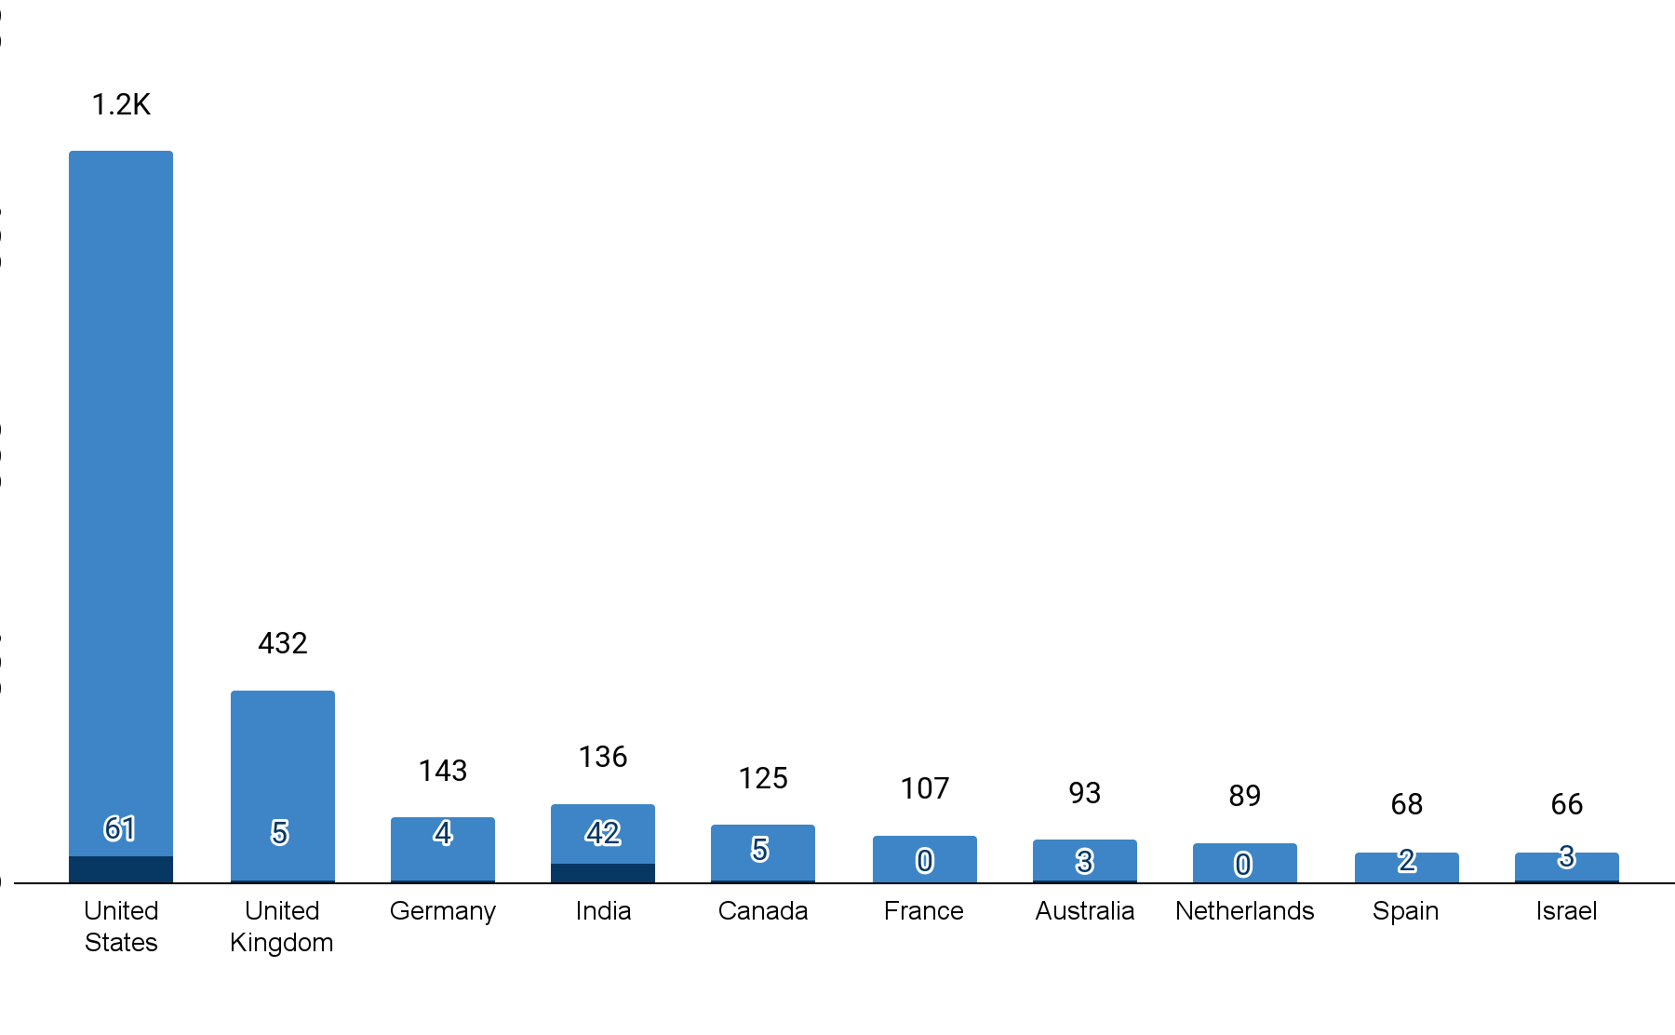
Exit Split across various geographies - 2025
Exit Split by Country: Total Acquisitions vs Total IPOs
Tracxn Spotlight
In 2025, acquisitions remained the dominant exit route across most geographies, with the U.S. leading in absolute acquisition volumes, reflecting its mature and highly active acquisition ecosystem.
India stands out among major markets with a comparatively higher share of IPOs alongside acquisitions, recording 42 IPOs versus 136 acquisitions, indicating broader exit optionality relative to peers.
In contrast, markets such as the UK and Germany remain heavily skewed toward acquisitions, with IPO activity remaining limited during the period, while Canada shows modest IPO participation relative to deal volume.
Overall, the data highlights a geographic divergence in exit pathways, where India offers a more balanced mix of public and private exits, while most other markets continue to rely predominantly on acquisition-led outcomes.
Total # of IPOs
Total # of Acquisitions
‹#›

Slide 42
Contents
Snapshot
Investments
Investors
Exits
New Unicorns |  | Unicorn Trends
Citywise Trends |  | List of New Unicorns
Women Co-Founded Trends |  | Unicorn Club: Trends and Insights
News |  | List of New Soonicorns
Funded Deadpooled Companies
Appendix

Slide 43





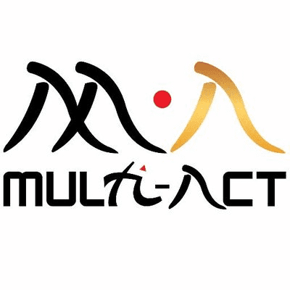



Unicorn Trends in 2025
India Tech - 2025 (vs 2024)
5 (vs 5)
5.8 (vs 6.8)
$149M (vs $220M)
3.4 (vs 8.4)
11 (vs 17.6)
# Total Unicorns
Avg Years from Series A to Unicorn Round
Avg $ Funding before Unicorn Round
Avg # Funding Rounds
before Unicorn Round
Avg Institutional Investors before Unicorn Round
Global Tech - 2025 (vs 2024)
111 (vs 91)
7.2 (vs 8.8)
$171M (vs $235M)
3.5 (vs 3.7)
8.7 (vs 8.9)
# Total Unicorns
Avg Years from Series A to Unicorn Round
Avg $ Funding before Unicorn Round
Avg # Funding Rounds
before Unicorn Round
Avg Institutional Investors before Unicorn Round
Top Seed Stage Investors
3F Ventures
Blume Venture
Mirae Asset Venture Investments
Multi-Act
Nexus Venture Partners
Top Early Stage Investors
Kalaari Capital
Nexus Venture Partners
Accel
Beenext
Capria
Top Late Stage Investors
Artal Asia
SoftBank Vision Fund
Accel
Ajax Partners
Alteria Capital
Top Cities
Bengaluru (3)
Mumbai (2)
+ 5 more
+ 40 more
+ 21 more
Note: Investors refers to Institutional Investors only. Top Investors are calculated based on investments before the Unicorn Round.
‹#›
Notes:
Compare Quarter data with Previous Year data

Slide 44





List of New Unicorns
Company | Short Description | Unicorn Event Date | Time from Series A (yrs)¹ | $Funding before Unicorn Round² | # Rounds² | # Investors²
Raise (2021, Mumbai, $146M) | Developer of technology-led platforms providing financial, investment, and trading services | Oct 2025 | 3.9 | $26M | 2 | 15
Navi (2012, Bengaluru, $445M) | Provider of financial products including UPI, loans, insurance, and mutual funds | Sep 2025 | 5.4 | $445M | 4 | 1
Jumbotail (2015, Bengaluru, $279M) | B2B marketplace and retail platform offering food and grocery products | Jun 2025 | 8.1 | $159M | 7 | 34
JSW One MSME (2020, Mumbai, $92M) | Retailer of various steel products including mild, stainless, and structural | May 2025 | 2.1 | $25M | 1 | 1
Juspay (2012, Bengaluru, $106M) | Provider of payment orchestration, recurring payments, and checkout experience solutions | Apr 2025 | 9.5 | $88M | 3 | 4
Full List of 5 unicorn is available on Tracxn Platform
1 - Time taken from First funding to the Unicorn Event Date. 2 - Before Unicorn Round
Notes:
Confine to 2 Slides (Include Decacorns here only)

Slide 45






Unicorn Club: Indian Landscape in 2025 (1/3)
Top 5 Cities with Unicorns
Tracxn Spotlight
124
$91.1B
466
India’s unicorn ecosystem in 2025 remains highly concentrated, with Bengaluru, Mumbai, and Gurugram accounting for over 70% of unicorns, reinforcing the role of mature capital networks, talent density, and founder repeatability.
Global growth-stage investors such as Tiger Global, PEAK XV Partners, and Accel continue to dominate unicorn portfolios, reflecting sustained conviction in India’s scaled digital platforms despite a more selective funding environment.
While Tier 2 and Tier 3 cities have begun producing unicorns, their current emergence remains limited and sector-specific, largely enabled by digital-first distribution, improving logistics, and localized execution rather than broad ecosystem depth.
This divergence highlights a barbell ecosystem: innovation and scaling remain metro-led, while selective breakout successes are emerging beyond traditional hubs as infrastructure and market access improve.
Unicorns
Total Funding raised
Total VC Investors
Gurugram
20
Top VC Investors across Unicorns
Company | # Portfolio Companies
Tiger Global Management | 46
PEAK XV Partners | 36
Accel | 23
SoftBank Vision Fund | 22
Alpha Wave Global | 17
Pune
7
Mumbai
19
Unicorns by Tier 2 and Tier 3 Cities
# Unicorns |  | City
 | Molbio Diagnostics | Salcete
 | Slice | Guwahati
 | OfBusiness | Ahmedabad
 | Infra.Market | Thane
 | CarDekho | Jaipur
Bengaluru
Chennai
52
7
Note: This analysis includes both Tech and Non-Tech unicorns
Slice relocated its registered headquarters to Guwahati following its merger with Guwahati-based North East Small Finance Bank (NESFB)
Notes:
Confine to 1 Slide

Slide 46




























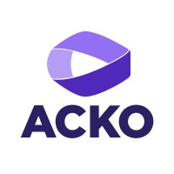



















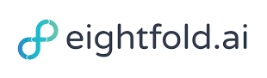




































































Unicorn Club: Indian Landscape in 2025 (2/3)
Private Unicorns (96)
Exited Unicorn (28)
Note: This analysis includes both Tech and Non-Tech unicorns, regardless of their current stage. The unicorns are listed in order of their total equity funding raised. Navi is recognized as a unicorn in the Hurun Unicorn Index 2025.

Slide 47


Unicorn Club: Indian Landscape in 2025 (3/3)
Consumer-based Unicorns
(72)
Enterprise-based Unicorns
(52)
Note: Consumer-based Unicorns: Companies offering products/services directly to individual end-users for personal use (e.g., e-commerce, food delivery, education apps).
Enterprise-based Unicorns: Companies providing solutions/services to businesses, organizations, or institutions to support operations or growth (e.g., SaaS, logistics, B2B platforms).

Slide 48
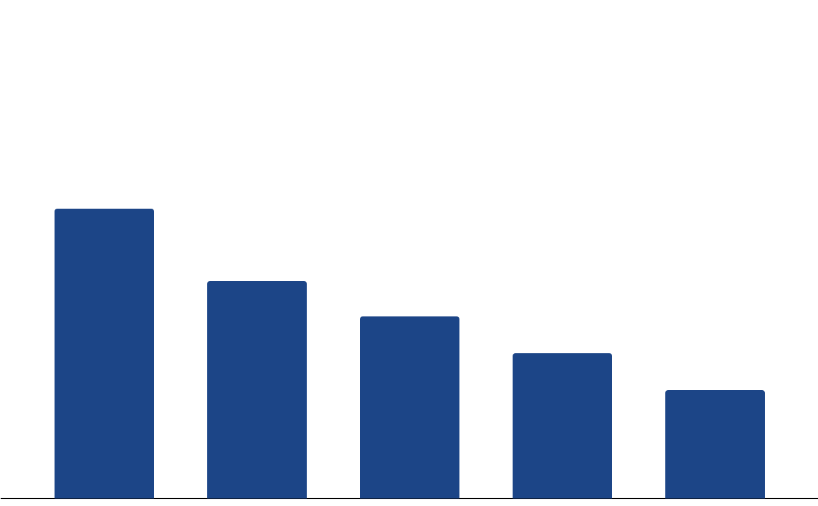
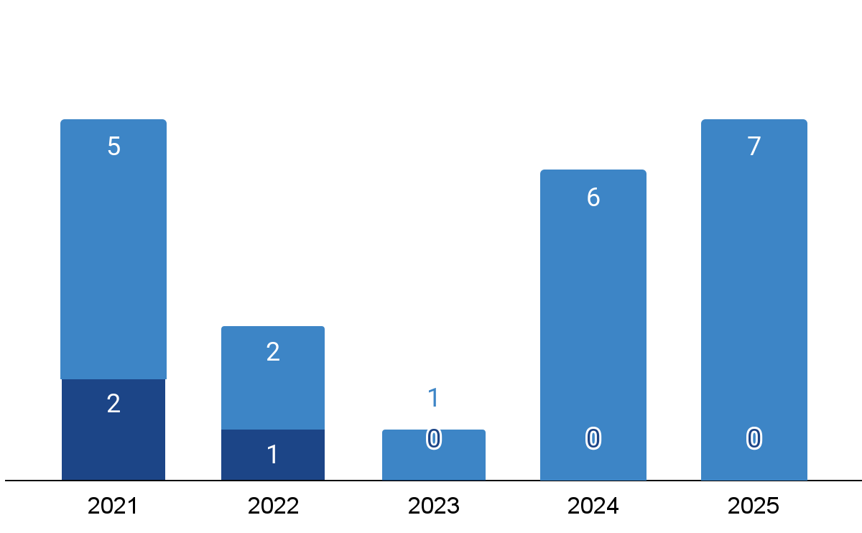
Unicorn Club: The Graduates (Public & Acquired)
Exited Unicorn (Public)
Exited Unicorn Top Sector
Tracxn Spotlight
8
Retail leads unicorn exits, supported by faster revenue realization, clearer unit economics, and brand-led models that public markets can underwrite. Companies like Nykaa, Mamaearth, and FirstCry demonstrate how consumer trust and repeat demand enable IPOs or high-value acquisitions.
FinTech (6) and Transportation & Logistics Tech (5) exits highlight ecosystem expansion and consolidation plays, as firms scale offline presence, strengthen regulatory alignment, and improve capital efficiency.
IPO-led exits have rebounded since 2024 amongst unicorns, indicating renewed confidence in Indian public markets and founder preference for long-term capital access over early secondary exits.
Public listings are increasingly used to strengthen balance sheets, fund capital-intensive expansion, and improve operational flexibility in margin-pressured sectors such as quick commerce and mobility.
6
5
4
3
Retail
FinTech
Transportation
and Logistics
Tech
Food and Agriculture Tech
Auto Tech
Unicorn Exits (Last 5 years)
Exited Unicorn (Acquired)
Acquisitions
IPOs

Slide 49
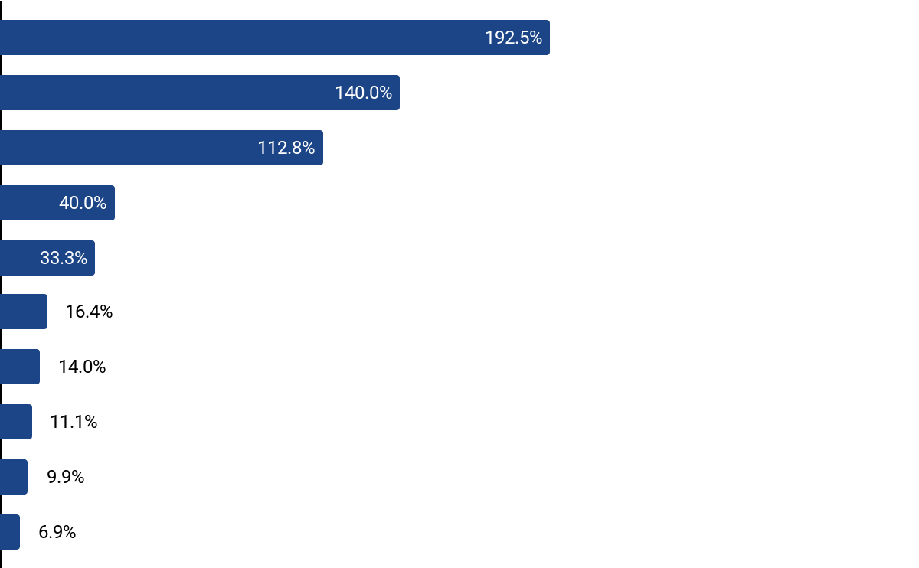










Unicorn Club: Highest Valuation growth (2024 & 2025)
Top 10 Private Unicorns by Valuation Growth in 2024 and 2025
Tracxn Spotlight
Company Name
Latest Valuation (USD)
India’s tech unicorns achieved substantial valuation growth in 2024 and 2025, propelled by targeted innovation and market demand in fintech, e-commerce, and edtech sectors.
The graph spotlights the post-unicorn momentum valuations built after crossing the unicorn benchmark highlighting on sustained growth trajectories
Zerodha, Fractal Analytics, and Rapido have experienced significant valuation surges after achieving unicorn status, driven by Zerodha’s growth through its low-cost brokerage model and strong retail investor adoption, Fractal Analytics’ rise through advanced AI-powered decision intelligence solutions, and Rapido’s expansion through its asset-light mobility network and rising demand for affordable last-mile services.
Others like Zepto and Zeta sustained momentum through affordability, global reach, and adaptive hybrid models.
Zerodha
(2010, Bengaluru)
$10.5B
Fractal Analytics
(2000, Mumbai)
$2.4B
Rapido
(2015, Bengaluru)
$2.3B
Zepto
(2021, Bengaluru)
$7.0B
Zeta
(2015, Bengaluru)
$2.0B
Perfios
(2008, Bengaluru)
$1.2B
CoinDCX
(2018, Mumbai)
$2.5B
Rebel Foods
(2010, Mumbai)
$2.0B
One Card
(2019, Pune)
$1.4B
Eruditus
(2010, Mumbai)
$3.1B
*Only Private Unicorns with latest valuations from 2024/2025 are considered, tracking growth post unicorn status.
Fractal has been Currently Valued at 2.44B Valuation post a secondary share-sale transaction
Notes:
Confine to 1 Slide
time to unicorn
is it profitable when it became a unicorn?

Slide 50







Unicorn Club: Top Profitable Private Unicorns (FY24 & FY25)
Financials of Top Profitable Private Unicorns as per March 31, 2024 or March 31, 2025*
Company |  | Revenue (USD) | Profit (USD) (Profit Margin) | EBITDA (USD) (EBITDA Margin) | Unicorn Event Date
 | Infra.Market (2016, Thane) | $1.8B | $45.7M (3%) | $149.8M (8%) | Feb 25, 2021
 | Navi (2012, Bengaluru) | $339.8M | $43.3M (13%) | $131.5M (39%) | Sep 11, 2025
 | Mu Sigma (2004, Bengaluru) | $103.9M | $32.8M (32%) | $63.4M (61%) | Feb 28, 2013
 | Money View (2014, Bengaluru) | $281.4M | $28.4M (10%) | $82.6M (29%) | Sep 12, 2024
 | OYO (2012, Gurugram) | $669.5M | $27.7M (4%) | $153.4M (23%) | Apr 15, 2020
 | Fractal Analytics (2000, Mumbai) | $333.2M | $26.1M (8%) | $47.1M (14%) | Jan 5, 2022
 | Raise (2021, Mumbai) | $45.9M | $18.8M (41%) | $24.5M (53%) | Oct 6, 2025
 | BrowserStack (2011, Mumbai) | $91.2M | $17.3M (19%) | $25.3M (28%) | Jun 16, 2021
 | Molbio Diagnostics (2000, Salcete) | $121.6M | $16.4M (13%) | $30.4M (25%) | Sep 23, 2022
 | BillDesk (2000, Mumbai) | $295.5M | $14.6M (5%) | $27.3M (9%) | Nov 16, 2018
Tracxn Spotlight
Profitability remains the exception, not the norm, among Indian unicorns. Of the 95 private unicorns that disclosed financials as of FY24 or FY25, only 30 are profitable, underscoring the structural difficulty of achieving scale with sustained margins.
Profitable unicorns are disproportionately concentrated in B2B, Infrastructure, Enterprise Applications, and FinTech, where demand is recurring, pricing power is stronger, and customer acquisition costs are structurally on the lower end.
Companies such as Infra.Market, Navi, and Mu Sigma demonstrate how tech-enabled execution in traditional sectors, coupled with disciplined cost structures and operational leverage, enables earlier profitability even at scale.
In the post-2021 funding environment, unicorn profitability is increasingly associated with operating discipline rather than growth-at-all-costs. The limited pool of profitable unicorns reflects a market recalibration where margin sustainability has gained significant importance.
*Note: This analysis includes both Tech and Non-Tech unicorns. The unicorns are sorted based on the reported Net Profit
Financials pertain to the primary legal entity which could, in some cases, be based outside India as well
Financials reflect the latest available disclosures for FY24 (year ended March 31, 2024) or FY25 (year ended March 31, 2025)
Notes:
Confine to 1 Slide
time to unicorn
is it profitable when it became a unicorn?
https://www.businesstoday.in/technology/news/story/right-unit-economics-profitability-to-drive-startup-ecosystem-in-2024-432560-2024-06-07 →Link of news for stronger unit economics

Slide 51
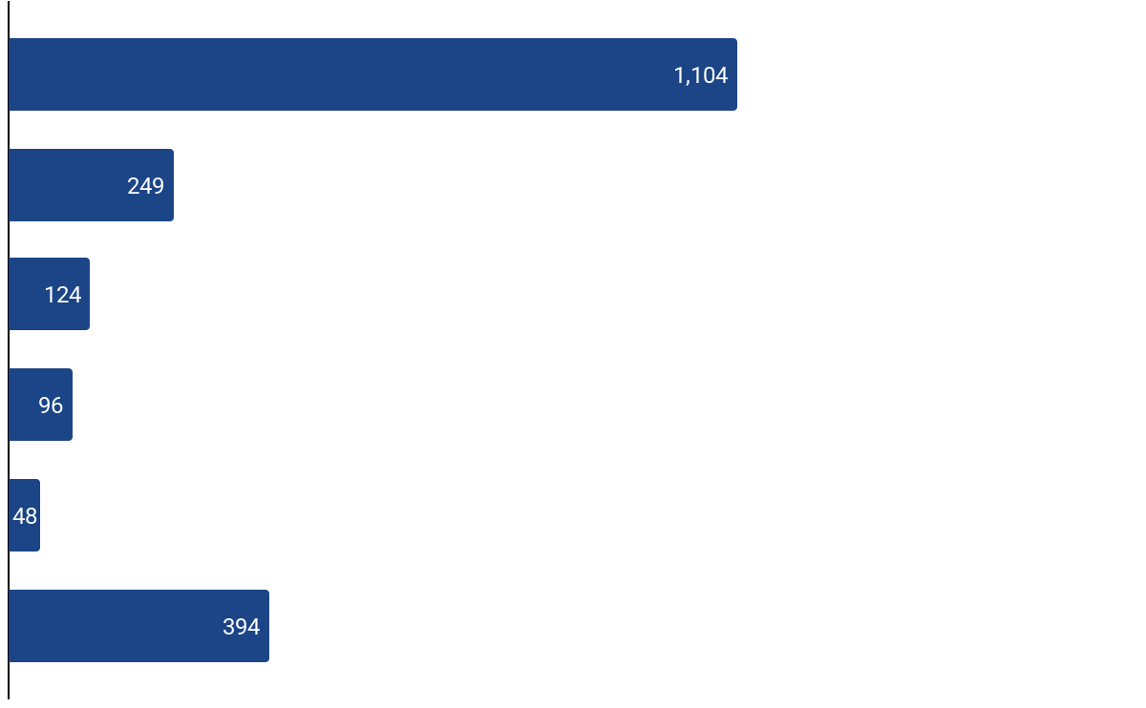

Unicorn Club: Global Landscape - India’s Standing
Top Geographies by Unicorn Count
Tracxn Spotlight
Unicorn Distribution by Country (%)
India hosts 124 unicorns, accounting for ~6% of the global total, positioning it as the third-largest unicorn ecosystem after the U.S. and China.
The U.S. continues to account for a significant share of global unicorns, supported by deep late-stage capital availability and mature exit markets. China’s unicorn base reflects scale advantages from large domestic markets and policy-backed platform ecosystems.
India’s unicorn formation has been driven by a large addressable market, improving digital infrastructure, and expanding VC participation. However, compared to the U.S. and China, the ecosystem remains earlier in its scale-up maturity, with relatively fewer globally dominant category leaders and a more selective late-stage funding environment.
Overall, the data suggests an ecosystem that has successfully built breadth in unicorn creation, while the next phase of growth will depend on sustained late-stage capital formation and increased global market penetration.
U.S.
55%
12%
6%
5%
2%
20%
China
India
UK
Germany
Others
Note:This analysis includes both Tech and Non-Tech unicorns. A company could be tagged to multiple locations as well.
“Others” includes companies that are not headquartered in the U.S., China, India, the UK, and in Germany.
‹#›
Notes:
Confine to 1 Slide
time to unicorn
is it profitable when it became a unicorn?
https://www.businesstoday.in/technology/news/story/right-unit-economics-profitability-to-drive-startup-ecosystem-in-2024-432560-2024-06-07 →Link of news for stronger unit economics

Slide 52
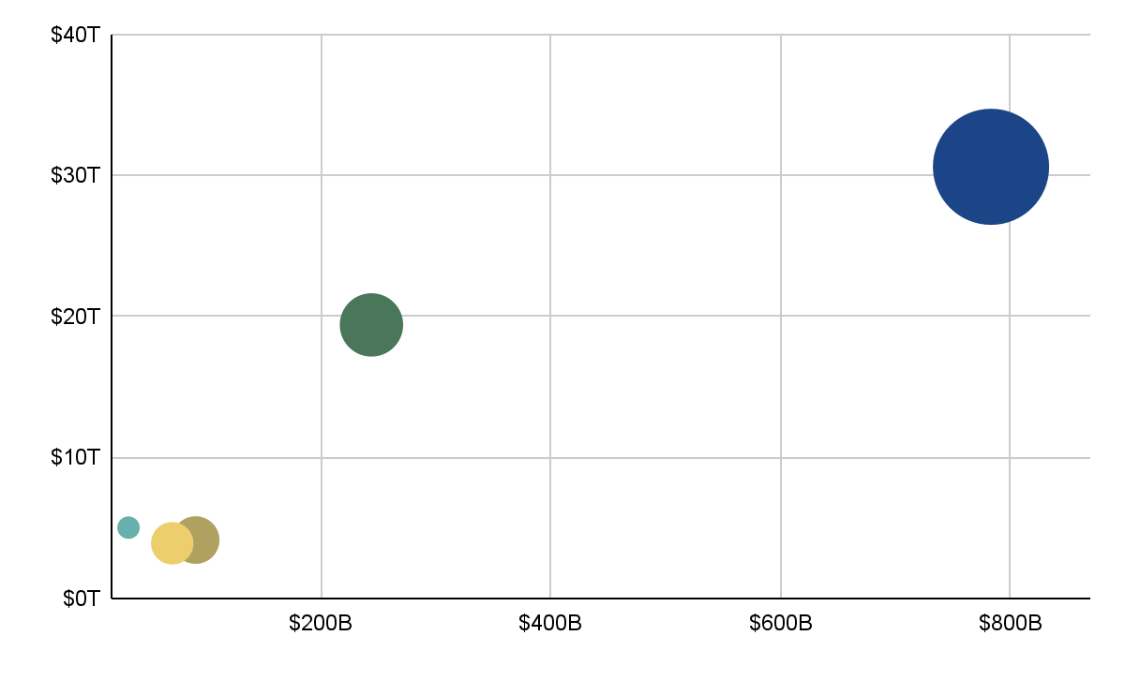
Unicorn Club: GDP and Funding across Top Nations
Top 5 Unicorn Regions: Comparison of GDP, Funding, and Number of Unicorns
Tracxn Spotlight
The United States leads in unicorn creation, with $783B in funding and 1,104 unicorns, supported by a strong correlation between GDP and startup investment (2.56% of its $30.5T GDP). Its expanding economic capacity, combined with abundant capital and established innovation hubs like Silicon Valley, continues to drive sustained startup growth.
India emerges as a prominent startup hub, generating 124 unicorns with $91.1B in funding, supported by a growing economy and an increasingly active entrepreneurial ecosystem with a GDP of $4.1T.
India’s advantage comes from a large, young population adopting digital services quickly, especially in fintech and SaaS. Investors favor startups with scalable models targeting underserved markets, particularly in smaller cities. Supportive government policies and digital infrastructure investments have further fueled this growth.
GDP in USD Trillion
Funding in USD Billion
United States (1,104 Unicorns)
India (124 Unicorns)
Germany (48 Unicorns)
China (249 Unicorns)
United Kingdom (96 Unicorns)
Note:This analysis includes both Tech and Non-Tech unicorns. A company could be tagged to multiple locations as well.
GDP data has been sourced from the IMF (International Monetary Fund) website, considering nominal GDP for this analysis.
‹#›
Notes:
Confine to 1 Slide
time to unicorn
is it profitable when it became a unicorn?
https://www.businesstoday.in/technology/news/story/right-unit-economics-profitability-to-drive-startup-ecosystem-in-2024-432560-2024-06-07 →Link of news for stronger unit economics

Slide 53
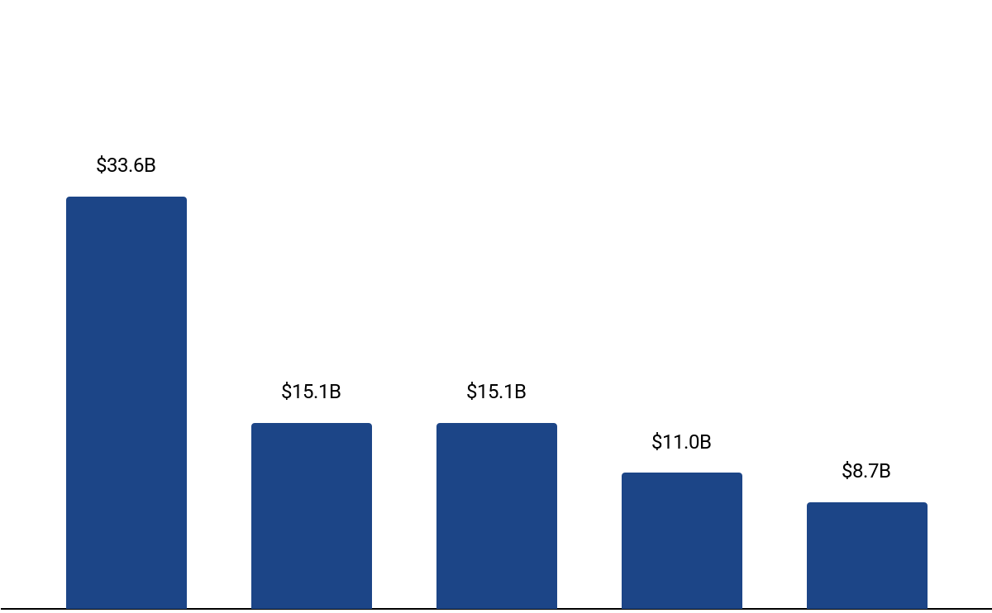
Unicorn Club: Indian Landscape - Sector Spread
Top Funded Sectors across India
Tracxn Spotlight
Retail leads unicorn funding in India with $33.6B, reflecting sustained investor preference for large consumer markets, faster revenue visibility, and category-leading platforms capable of scaling across formats such as e-commerce and quick commerce.
Enterprise Applications and FinTech, each with $15.1B in funding, form the second tier, highlighting continued backing for infrastructure-led, B2B, and financial services platforms that enable digital adoption across businesses and consumers.
Funding in Food & Agriculture Tech ($11.0B) and Transportation & Logistics Tech ($8.7B) underscores growing interest in tech-enabled supply chains and essential services, at a more measured pace compared to consumer-facing and core infrastructure sectors.
Overall, the sectoral spread indicates a capital allocation bias toward scalability and monetization clarity, with selective investments in sectors addressing large, structurally embedded markets.
Retail
Enterprise Applications
FinTech
Food and Agriculture Tech
Transportation and Logistics Tech
Total Funding
‹#›
Note:This analysis includes both Tech and Non-Tech unicorns
Notes:
Confine to 1 Slide
time to unicorn
is it profitable when it became a unicorn?
https://www.businesstoday.in/technology/news/story/right-unit-economics-profitability-to-drive-startup-ecosystem-in-2024-432560-2024-06-07 →Link of news for stronger unit economics

Slide 54
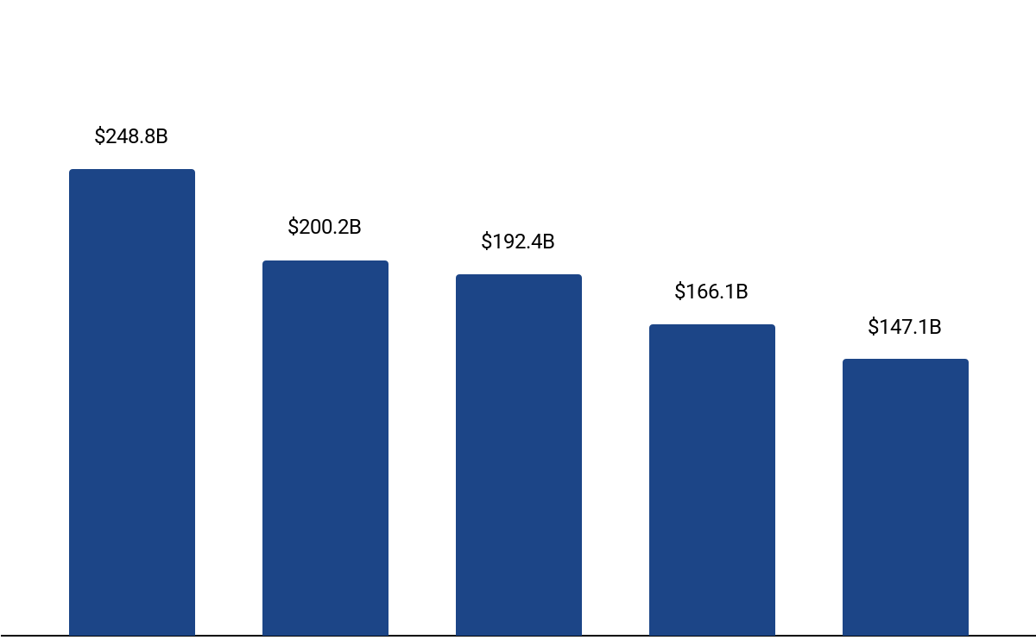
Unicorn Club: Global Landscape - Sector Spread (1/2)
Top Funded Sector on a Global scale
Tracxn Spotlight
Global unicorn funding remains concentrated in FinTech ($248.8B) and Enterprise Applications ($200.2B), reflecting sustained investor preference for platforms that enable financial services, digital infrastructure, and enterprise productivity at scale.
The prominence of Auto Tech ($192.4B) highlights increasing capital allocation toward mobility, electric vehicles, and automotive software, driven by long-term structural shifts in transportation and energy systems.
Retail ($166.1B) and Transportation & Logistics Tech ($147.1B) continue to attract significant funding, though at relatively lower levels, indicating a more selective approach toward consumer-facing and asset-heavy business models.
Overall, the sectoral spread suggests that global capital is prioritizing infrastructure-led, platform-driven models with large addressable markets and long-term monetization potential.
FinTech
Enterprise Applications
Auto Tech
Retail
Transportation and Logistics Tech
Top Funded Sector Globally
‹#›
Note:This analysis includes both Tech and Non-Tech unicorns
Notes:
Confine to 1 Slide
time to unicorn
is it profitable when it became a unicorn?
https://www.businesstoday.in/technology/news/story/right-unit-economics-profitability-to-drive-startup-ecosystem-in-2024-432560-2024-06-07 →Link of news for stronger unit economics

Slide 55
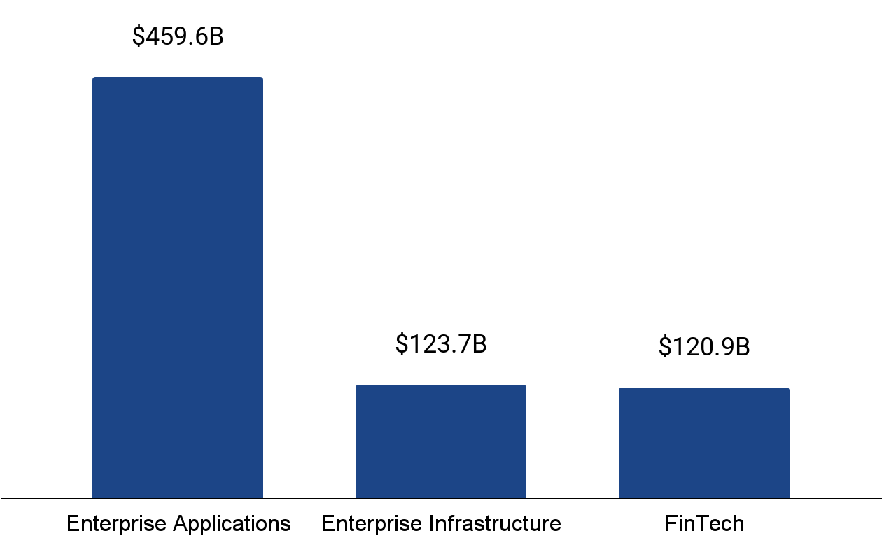
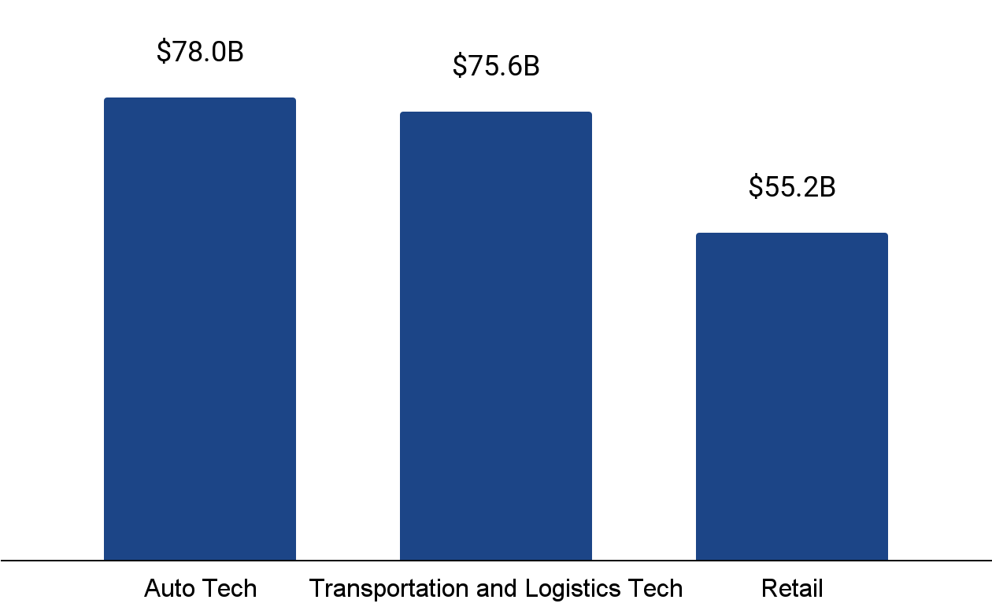
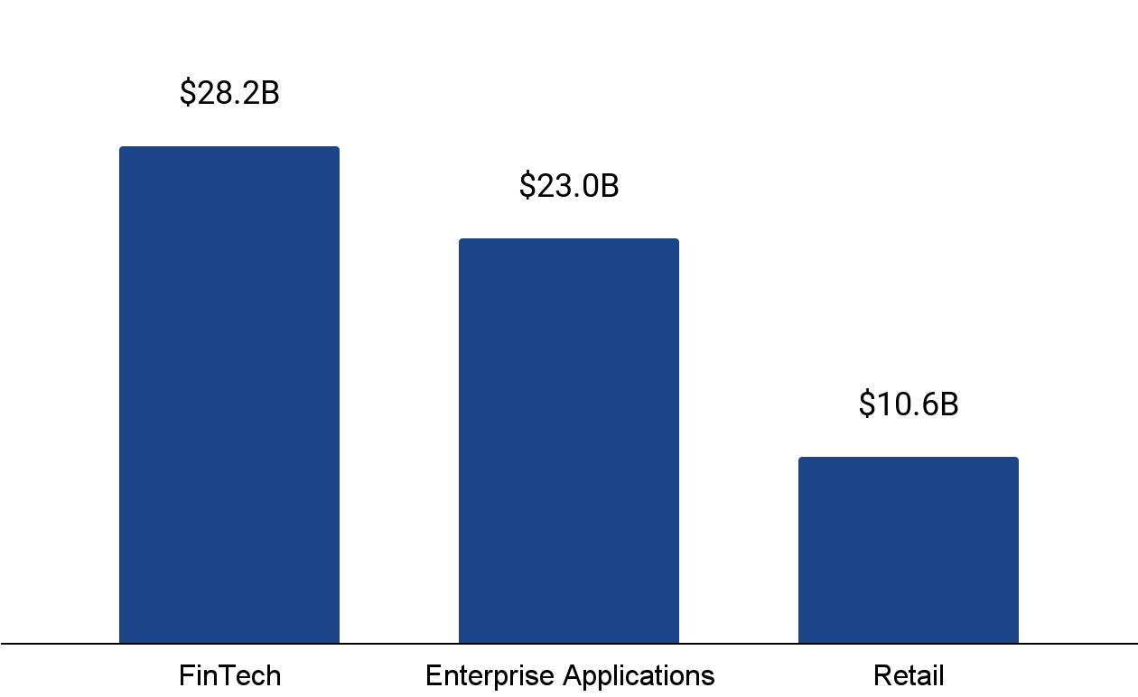
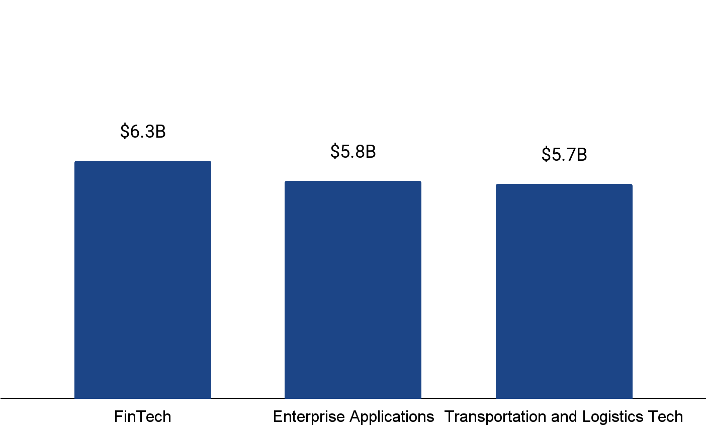
Unicorn Club: Global Landscape - Sector Spread (2/2)
Top Funded Sector across US
Top Funded Sector across China
Tracxn Spotlight
Global unicorn funding varies across ecosystems, reflecting structural differences in market demand, industrial strengths, and capital priorities.
The U.S. ecosystem is heavily skewed toward Enterprise Applications, supported by deep enterprise IT spending, global SaaS adoption, and mature capital markets that favor scalable software platforms.
In contrast, China’s unicorn funding is concentrated in Auto Tech and Transportation & Logistics, aligned with its manufacturing base, domestic mobility demand, and state-supported infrastructure development.
The UK’s unicorn funding mix is led by FinTech and Enterprise Applications, reflecting its role as a global financial hub, while Germany shows a more balanced but smaller-scale distribution, anchored in FinTech, Logistics, and Enterprise-focused innovation.
Overall, this divergence highlights how unicorn creation is shaped less by a uniform global playbook and more by local economic structure and sectoral strengths.
$364.4B
$510B
Top Funded Sector across UK
Top Funded Sector across Germany
$158.1B
$96.2B
$51.4B
$35.5B
‹#›
Note:This analysis includes both Tech and Non-Tech unicorns
Notes:
Confine to 1 Slide
time to unicorn
is it profitable when it became a unicorn?
https://www.businesstoday.in/technology/news/story/right-unit-economics-profitability-to-drive-startup-ecosystem-in-2024-432560-2024-06-07 →Link of news for stronger unit economics

Slide 56
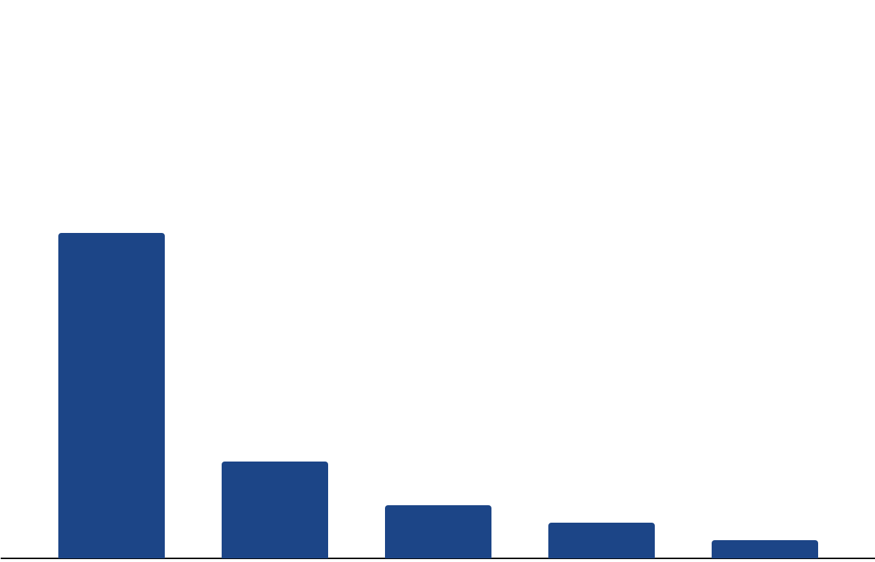


Unicorn Club: India’s Unicorn Capital by City
Top Indian Cities by Total Funding and Leading Sectors
Tracxn Spotlight
Retail
Retail
Enterprise Applications
FinTech
Enterprise Applications
India’s unicorn capital remains highly concentrated, with Bengaluru accounting for $51.6B in funding – exceeding the combined total of the next four cities. This underscores the city’s role as the country’s primary hub for scaled, multi-sector unicorn creation.
Bengaluru leads as large unicorns such as Flipkart, Swiggy, and Ola have raised much larger funding rounds than startups in other cities.
Gurugram ($15.4B) emerges as a strong secondary center, driven largely by consumer-facing and retail-led unicorns, while Mumbai ($8.5B) and Noida ($5.7B) have developed more specialized strengths in Enterprise Applications and FinTech, respectively.
Sector dominance across cities broadly mirrors local demand concentration, talent availability, and proximity to enterprise or financial customers, resulting in a hub-and-spoke ecosystem rather than evenly distributed unicorn capital.
$51.6B
$15.4B
$8.5B
$5.7B
$2.8B
Bengaluru
Gurugram
Mumbai
Noida
Pune
Total Funding
Top Funded Sectors
‹#›
Notes:
Confine to 1 Slide
time to unicorn
is it profitable when it became a unicorn?
https://www.businesstoday.in/technology/news/story/right-unit-economics-profitability-to-drive-startup-ecosystem-in-2024-432560-2024-06-07 →Link of news for stronger unit economics

Slide 57














Soonicorn Club - List of New Soonicorns
Company | Tracxn Score
AppsForBharat (2020, Bengaluru, $53M) | 80.6
Scapia (2022, Bengaluru, $72M) | 79.8
Pilgrim (2019, Mumbai, $50M) | 76.5
The Sleep Company (2019, Mumbai, $64M) | 74.4
Flipspaces (2011, Mumbai, $65M) | 74.3
SNITCH (2018, Bengaluru, $53M) | 73.8
Farmley (2017, Noida, $57M) | 71.0
Foxtale (2021, Mumbai, $57M) | 70.3
FinBox (2015, Bengaluru, $51M) | 69.3
TMRW (2022, Bengaluru, $50M) | 66.7
Company | Tracxn Score
Raphe mPhibr (2017, Noida, $154M) | 63.2
Recyclekaro (2010, Navi Mumbai, $14M) | 60.5
Leap Finance (2019, Bengaluru) | 54.2
75F (2012, Bengaluru, $81M) | 51.5
Propelld (2017, Bengaluru, $70M) | 49.6
Note: A Soonicorn is a company which is likely to achieve US $1 billion valuation in the short to medium term. Tracxn Score is a proprietary score based on various market signals reflecting the company’s size, execution and growth.
Notes:
Confine to 1 Slide

Slide 58
Contents
Snapshot
Investments
Investors
Exits
New Unicorns
Citywise Trends |  | Cities by Total Funding
Women Co-Founded Trends |  | Cities by Funding raised in last 2 years
News |  | Cities by Companies Founded in last 2 years
Funded Deadpooled Companies
Appendix

Slide 59
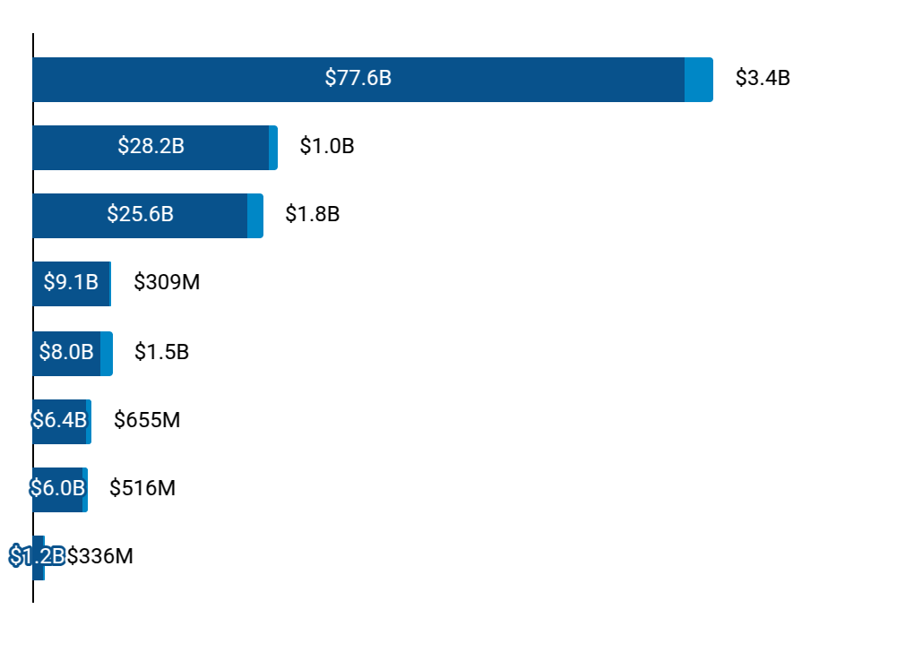
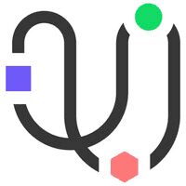








Citywise Trends - Total Funding
Distribution by Cities - Total Funding ($)
# Rounds
Top Funded Companies in 2025
Bengaluru
Gurugram
Mumbai
Noida
Delhi
Chennai
Pune
Thane
478
170
233
51
133
67
77
12
 | Zepto ($349M) |  | Groww ($202M) |  | Jumbotail ($120M)
 | Spinny ($171M) |  | InsuranceD.. ($87.7M) |  | UnifyApps ($50.0M)
 | GreenLine ($285M) |  | Weaver ($170M) |  | Raise ($120M)
 | Raphe mPhi.. ($100M) |  | RMSI ($56.0M) |  | Farmley ($42.0M)
 | Erisha E M.. ($1.0B) |  | Euler Moto.. ($75.4M) |  | Marg Compu.. ($45.7M)
 | Uniphore ($260M) |  | Access Hea.. ($211M) |  | AgniKul ($30.3M)
 | EKA ($80.7M) |  | Icertis ($50.0M) |  | Fibe ($35.0M)
 | Infra.Mark.. ($292M) |  | Kult ($20.0M) |  | Goapptiv ($15.0M)
2025 Funding
All time Funding
‹#›

Slide 60
















Citywise Trends - Funding raised in last 2 years
Funding raised in 2 Yrs (Market Share %)
Rank | City | 2025 |  | 2024 |  | Top Funded Companies in 2025
 |  | # | % | # | %
1 | Bengaluru | $3.4B | 32 % | $5.4B | 43 % |  | Zepto ($349M) |  | Groww ($202M) |  | Jumbotail ($120M)
2 | Mumbai | $1.8B | 18 % | $1.9B | 15 % |  | GreenLine ($285M) |  | Weaver ($170M) |  | Raise ($120M)
3 | Delhi | $1.5B | 14 % | $758M | 6 % |  | Erisha E M.. ($1.0B) |  | Euler Moto.. ($75.4M) |  | Marg Compu.. ($45.7M)
4 | Gurugram | $1.0B | 10 % | $1.2B | 10 % |  | Spinny ($171M) |  | InsuranceD.. ($87.7M) |  | UnifyApps ($50.0M)
5 | Chennai | $655M | 6 % | $977M | 8 % |  | Uniphore ($260M) |  | Access Hea.. ($211M) |  | AgniKul ($30.3M)
6 | Pune | $516M | 5 % | $493M | 4 % |  | EKA ($80.7M) |  | Icertis ($50.0M) |  | Fibe ($35.0M)
7 | Thane | $336M | 3 % | $166M | 1 % |  | Infra.Mark.. ($292M) |  | Kult ($20.0M) |  | Goapptiv ($15.0M)
8 | Noida | $309M | 3 % | $617M | 5 % |  | Raphe mPhi.. ($100M) |  | RMSI ($56.0M) |  | Farmley ($42.0M)
9 | Hyderabad | $218M | 2 % | $436M | 4 % |  | Qapita ($26.5M) |  | Kshema ($20.0M) |  | Cognida ($15.0M)
10 | Ahmedabad | $201M | 2 % | $91M | 1 % |  | Amnex ($52.0M) |  | R for Rabb.. ($27.0M) |  | Lendingkart ($20.7M)
‹#›

Slide 61


































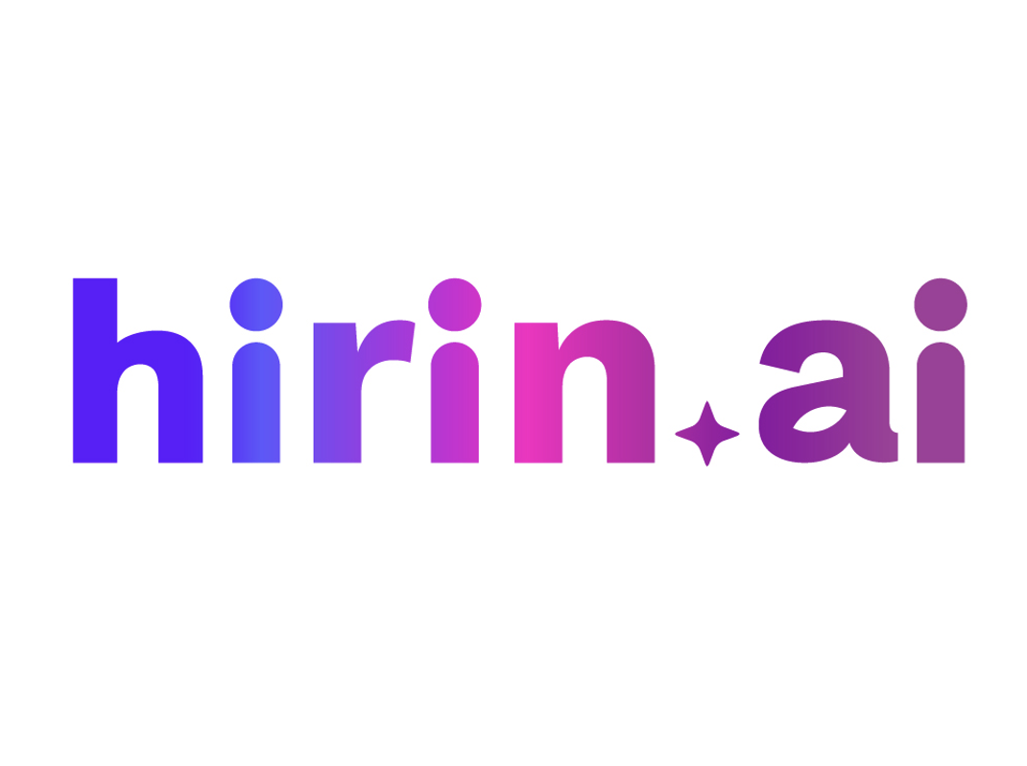


Citywise Trends - Companies Founded in last 2 years
Companies Founded in 2 Yrs (Market Share %)
Rank | City | 2025 | 2024 | Companies Founded in 2025
1 | Bengaluru | 21 % | 15 % |  | Kluisz.ai ($9.7M) |  | Maieutic Sem... ($4.3M) |  | Peeko ($3.2M) |  | Trupeer ($3.0M)
2 | Mumbai | 8 % | 7 % |  | Pluro Fertil... ($15.0M) |  | Lucira Jewel... ($5.5M) |  | ZILO ($4.5M) |  | Shink ($113K)
3 | Delhi | 10 % | 9 % |  | Vaya ($1.5M) |  | Climitra ($541K) |  | Zbee Mobilit... - |  | OrbOps AI -
4 | Gurugram | 6 % | 5 % |  | OZi ($3.3M) |  | Rotoris ($3.0M) |  | Frex ($1.1M) |  | Krieya Beaut... ($793K)
5 | Chennai | 4 % | 3 % |  | Soefia ($205K) |  | Kathaipetti - |  | Sunloom Expo... - |  | Madhi.ai -
6 | Pune | 3 % | 3 % |  | club80percen... - |  | Collegese - |  | Artsays - |  | Datadesh -
7 | Thane | 1 % | 1 % |  | Kadac - |  | Freshcon - |  | Right To Aud... - |  | BasisPoint I... -
8 | Noida | 3 % | 4 % |  | Flick TV ($2.3M) |  | Recyclaro.co... ($1.0M) |  | Nationlist - |  | Harmoni Yoga -
9 | Hyderabad | 7 % | 5 % |  | Axirium Aero... ($3.5M) |  | Cosmoserve S... ($3.2M) |  | Ampivo - |  | POPI -
10 | Ahmedabad | 1 % | 2 % |  | Orbitt ($1.0M) |  | Hirin.ai - |  | Clozzet - |  | Vibe3D -
‹#›

Slide 62
Contents
Snapshot
Investments
Investors
Exits
New Unicorns
Citywise Trends
Women Co-Founded Trends |  | Snapshot
News |  | Funding Trends and Insights
Funded Deadpooled Companies |  | Top Funding Rounds in 2025
Appendix

Slide 63





Women Co-Founded Startups: 2025 Snapshot
Tracxn Spotlight
$1.0B (vs $1.1B,▼3%)
341
(vs 566,▼40%)
91 (vs 132,▼31%)
81 (vs 127,▼36%)
Funding for women-led tech startups in India moderated at $1.0B in 2025, broadly flat YoY, but masked a sharp contraction in activity, with funding rounds down 40% and first-time funded companies down 36%.
Capital deployment increasingly favored fewer, larger deals, led by late-stage rounds such as GIVA’s $62M Series C and Amnex’s $52M Series A, indicating investor preference for scaled, market-ready businesses in a cautious environment.
At the same time, acquisitions rose sharply to 33 deals, signaling accelerated consolidation and capital recycling, as exit pathways gained prominence over new unicorn creation in 2025.
$ Funding
# Funding rounds
Series A+ rounds
First Time Funded Companies
28 (vs 52,▼46%)
0 (vs 0)
33 (vs 12,▲175%)
1 (vs 3,▼67%)
New additions to Soonicorn Club
New Unicorns
Acquisitions
IPOs
Top Funding Rounds
Company | Round Details
GIVA (2019, Bengaluru) | $62M - Series C
Amnex (2008, Ahmedabad) | $52M - Series A
Routematic (2007, Bengaluru) | $40M - Series C
Square Yards (2014, Gurugram) | $35M - Series B
Intangles (2016, Pune) | $30M - Series B
Top Feeds
Feed | $Funding
Fashion Tech | $137M
Beauty Tech | $108M
Road Transport Tech | $88M
Online Grocery | $86M
Air Pollution Management Tech | $56M
Top Cities
City | $Funding
Bengaluru | $323M
Gurugram | $182M
Mumbai | $148M
Ahmedabad | $81M
Delhi | $77M
*Data from 01-Jan-2025 to 15-Dec-2025 is considered in report
Note: Numbers in bracket indicate the values of 2024
‹#›
‹#›

Slide 64
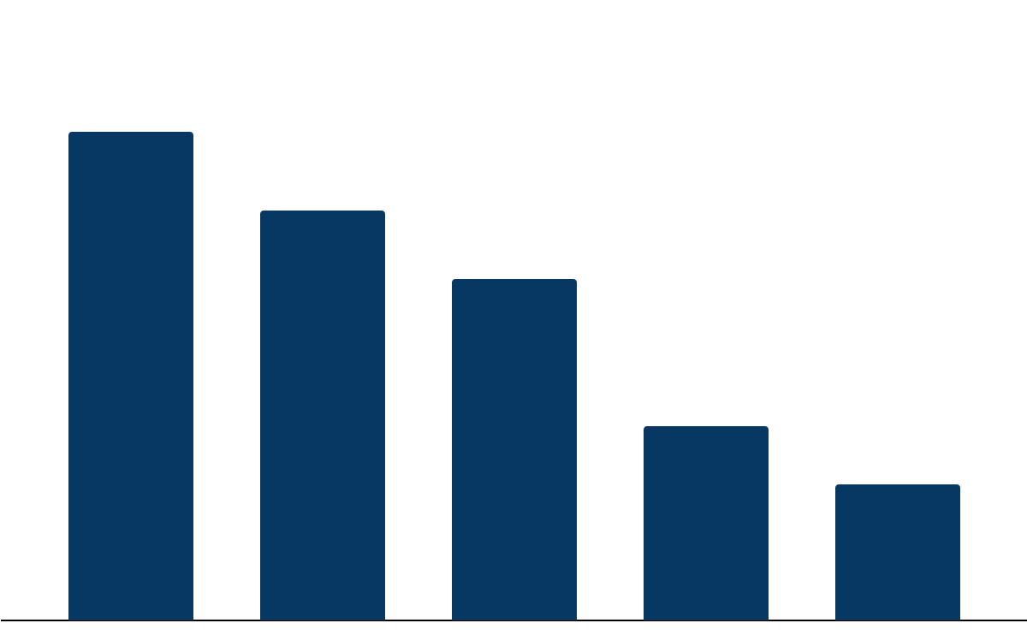
Women Co-Founded Startups - Company by Cities
Total All-Time Women Co-founded Startups by City
Tracxn Spotlight
Women co-founded startup activity in India remains concentrated in major metro ecosystems, led by Bengaluru (2,457), Mumbai (2,068), and Delhi (1,722).
The city-wise distribution indicates that women-led startup formation largely mirrors India’s broader startup geography, with activity centered in established tech hubs rather than emerging cities.
Livspace and Amagi represent some of the most prominent women-led startups headquartered in Bengaluru. Through leadership roles and mentorship, these startups are promoting women-led innovation and attracting more female founders to Bengaluru’s ecosystem.
Similarly, Mumbai hosts leading women-led startups such as Nykaa, Upstox, and others.
Gurugram (981) and Hyderabad (688) are emerging but remain smaller compared to the top metro cities.
2,457
2,068
1,722
981
688
Bengaluru
Mumbai
Delhi
Gurugram
Hyderabad
Total # of Startups
‹#›
‹#›

Slide 65
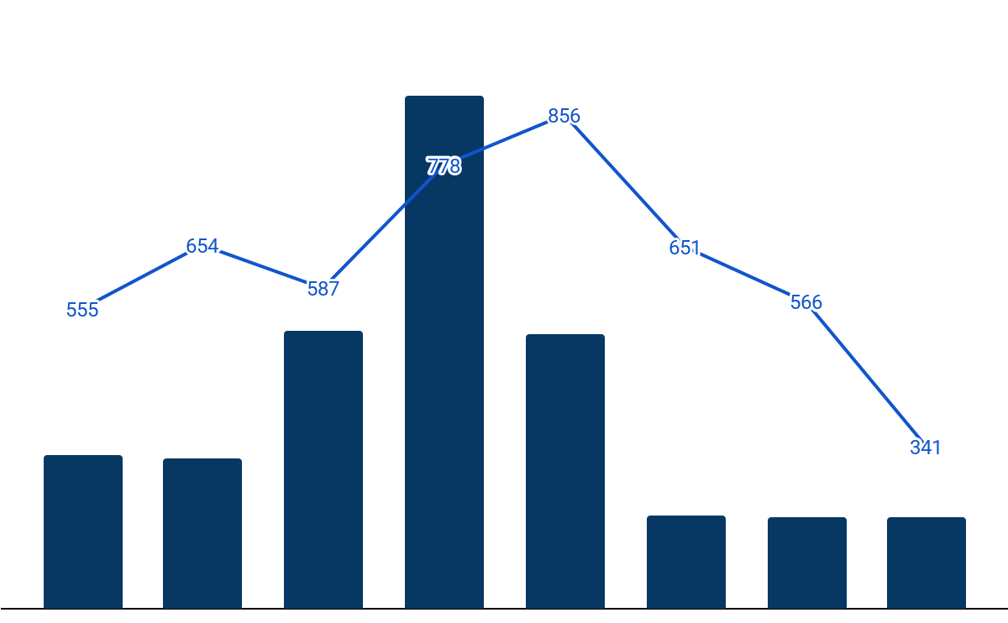
Women Co-Founded Startup Funding Cycle (2018–25)
Y-o-Y Women Co-founded startups Funding Trends (Last 8 Years)
Tracxn Spotlight
$5.9B
Funding for women co-founded startups in India rose steadily from $1.8B in 2018 to a peak of $5.9B in 2021, before correcting sharply alongside the broader venture slowdown.
This funding has, however, declined since 2021, mirroring the broader tech funding slowdown driven by higher interest rates, global uncertainty, and a shift toward profitability-focused investing.
Since 2022, funding levels and deal volumes have moderated significantly, with total funding stabilizing around the $1-1.1B range during 2023-2025. This indicates a prolonged normalization phase rather than a rapid rebound.
The decline in both capital deployed and number of funding rounds suggests a shift towards more selective, fundamentals-driven investing, disproportionately impacting early- and mid-stage women-led startups.
$3.2B
$3.1B
$1.8B
$1.7B
$1.1B
$1.1B
$1.0B
2018
2019
2020
2021
2022
2023
2024
2025
Total Funding
Funding Rounds
‹#›
‹#›

Slide 66
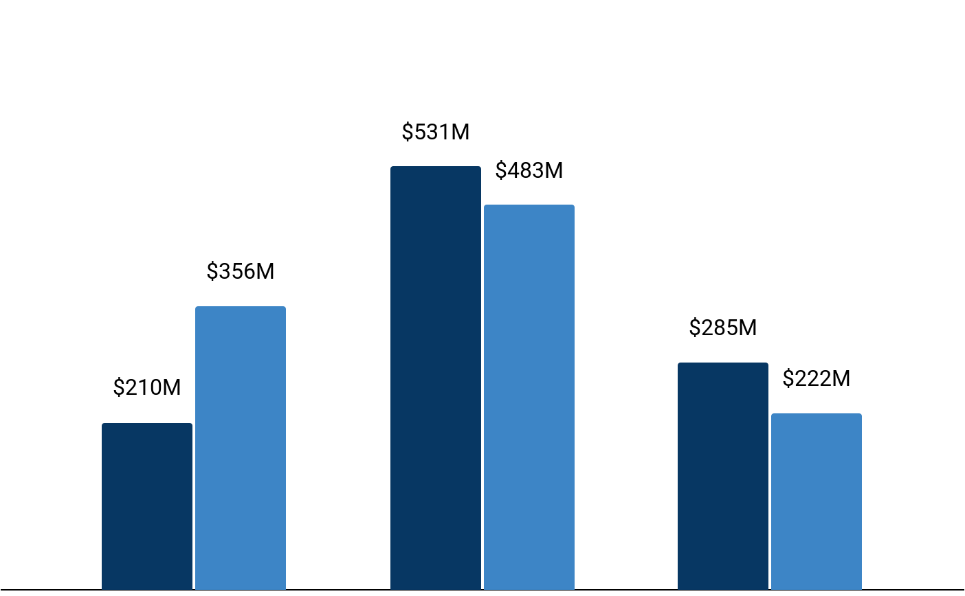
Women Co-Founded Startups: Stage-Wise Funding (2025 vs 2024)
Stage-Wise Funding Trends in Women Co-Founded Startups
Tracxn Spotlight
Overall, the funding landscape remains steady across most stages in 2025, with the key change being a sharp drop in seed funding that signals a shift toward more proven startups.
Seed funding declined from $356M in 2024 to $210M in 2025, and early-stage funding stayed increased from $483M to $531M. Late-stage funding increased from $222M in 2024 and $285M in 2025.
Early-stage funding in 2025 was driven by AMNEX’s $52M Series A and the $35M Series B rounds of Square Yards and FinBox, with these startups raising capital to accelerate expansion and strengthen their technology capabilities, particularly in AI-driven financial infrastructure.
Late-Stage activity in 2025 was led by GIVA’s $62M Series C, alongside $40M and $30M Series C rounds from Routematic and Foxtale.
250
434
70
103
21
29
Seed
Early Stage
Late Stage
2025
2024
Funding Rounds
‹#›

Slide 67
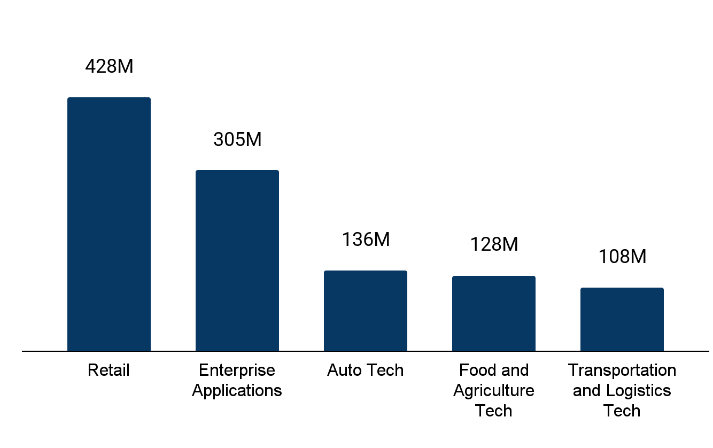
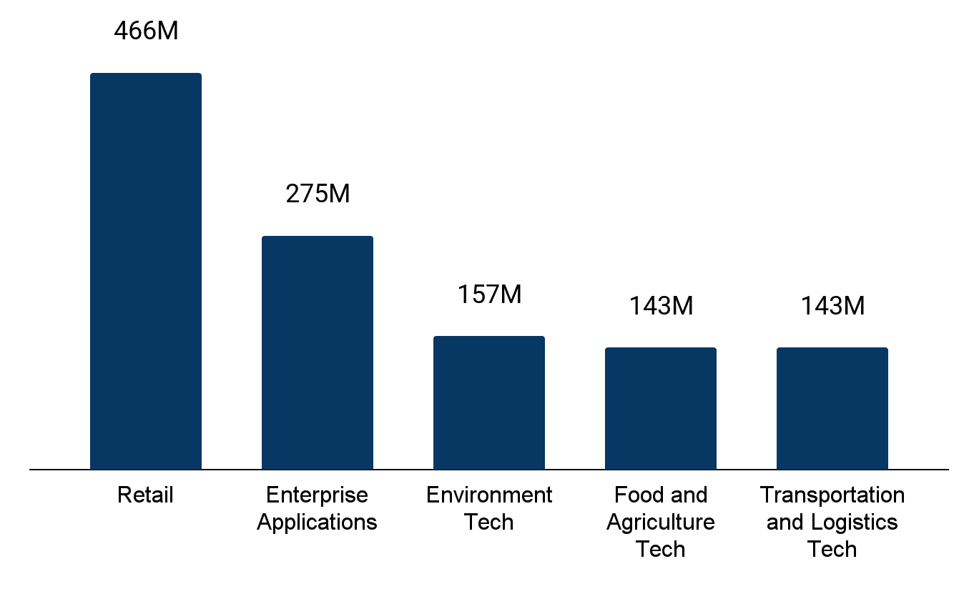





Women Co-Founded Startups – Sector wise Funding
Top 5 Funded Sectors – 2025 vs 2024
Tracxn Spotlight
Top Funded sectors in 2025
Top Funded sectors in 2024
Retail ($428M) and Enterprise Applications ($305M) together accounted for the majority of women co-founded startup funding in 2025, reflecting investor preference for proven, revenue-led business models amid a cautious funding environment.
Retail leads funding due to faster revenue realization and clearer unit economics, enabling women founders to scale with lower capital burn. Strong funding in Fashion Tech, Beauty Tech, and D2C reflects deep consumer insight, brand-led execution, and trust-driven engagement
This momentum is further supported by rising digital adoption and increased spending across lifestyle and personal consumption categories, strengthening demand for women-led retail brands.
Investors such as Venture Catalysts, Inflection Point Ventures and Fireside Ventures actively participated to support growth and secure higher valuations.
▼8%
▲11%
▲32%
▼11%
▼25%
Total Funding
Total Funding
Top Investors in these companies (2025)
Investor Name |  | # Portfolio Companies
 | Venture Catalysts | 10
 | Inflection Point Ventures | 9
 | Fireside Ventures | 7
 | Titan Capital | 6
 | PeakXV Partners | 5
Top Investors in these companies (2024)
Investor Name |  | # Portfolio Companies
 | Venture Catalysts | 13
 | Inflection Point Ventures | 11
 | Z47 | 9
 | We Founder Circle | 9
 | 100X.VC | 7
‹#›

Slide 68




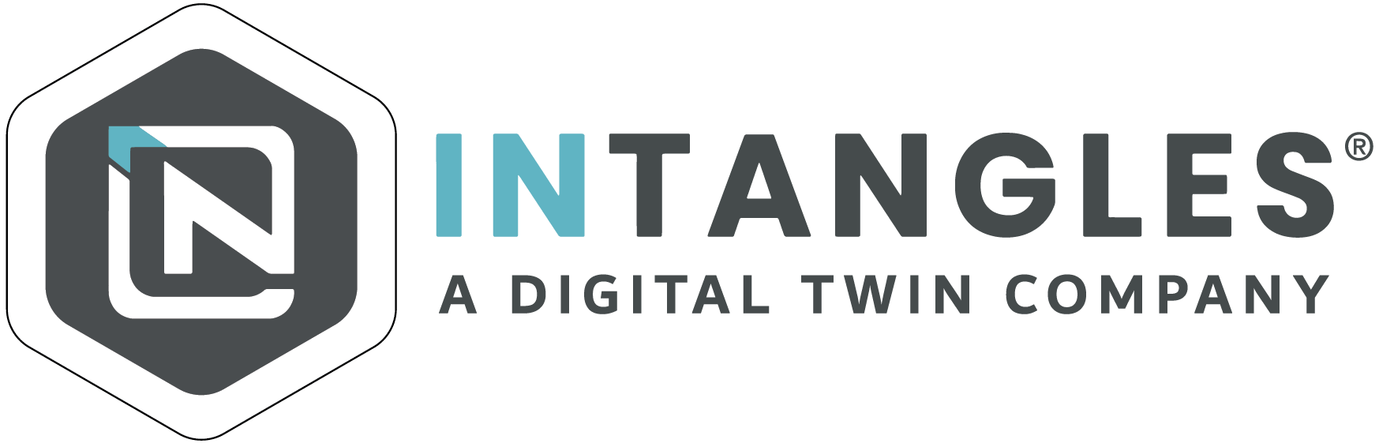

Women Co-Founded Startups: Top Funding Rounds of 2025
The top 2025 funding rounds showcased here highlight the targeted capital allocation across diverse growth agendas, with every company detailing how these funds will strengthen their overall market trajectory
$62M Series C, Jun 2025
$52M Series A, Aug 2025
Expand retail footprint and reinforce supply-chain & tech infrastructure
Grow lab-grown diamond line and accelerate nationwide expansion
Accelerate development of AI, IoT, GIS and cloud-powered intelligent platforms
Expand sector reach and scale tech-led smart systems globally
$40M Series C, May 2025
$35M Series B, Nov 2025
Scale fleet and establish city command centers
Accelerate EV adoption and expand operations nationwide
Expand real-estate & mortgage services platform and reinforce fintech-led growth engine
Expand operations and accelerate path to unicorn valuation
$30M Series B, Oct 2025
$30M Series B, Nov 2025
Scale its predictive AI platform and scale fleet management solutions.
Expand operations into new geographies.
Scale soil carbon measurement and verification infrastructure
Expand regenerative agriculture programs and grow high-integrity carbon credit supply
‹#›
Notes:
Udaan :https://www.business-standard.com/companies/start-ups/ipo-bound-udaan-raises-75-million-from-m-g-lightspeed-and-others-125021700903_1.html
GIVA: https://www.livemint.com/companies/start-ups/giva-funding-round-creaegis-investment-giva-giva-lab-grown-diamonds-giva-jewellery-expansion-premji-invest-giva-11750833629344.html; https://www.angelone.in/news/market-updates/jewellery-startup-giva-secures-rs-530-crore-in-series-c-funding-led-by-creaegis
AMNEX:
Routematic: https://analyticsindiamag.com/ai-news-updates/routematic-raises-40-million-in-series-c-round-led-by-fullerton-shift4good/ ; https://www.techinasia.com/news/indian-employee-transport-firm-routematic-nets-40m-series
Square Yards: https://www.cnbctv18.com/business/startup/square-yards-fundraise-unicorn-status-india-real-estate-tech-19782899.htm
FinBox: https://www.business-standard.com/companies/news/finbox-raises-40-million-series-b-westbridge-capital-embedded-finance-125091700601_1.html; https://www.moneycontrol.com/news/business/startup/westbridge-leads-40-million-round-in-flipkart-backed-finbox-to-expand-b2b-digital-lending-platform-13551721.html

Slide 69
Contents
Snapshot
Investments
Investors
Exits
New Unicorns
Citywise Trends
Women Co-Founded Trends
News |  | Recent Key News
Funded Deadpooled Companies
Appendix

Slide 70
Recent Key News (1/3)
Transactions
Shiprocket files updated DRHP to raise Rs 1,100 Cr via fresh issue StartupNews
Turn Capital bets on influencer-driven fashion with FRND acquisition e27
Paytm invests Rs 2,250 cr in payments services arm NewsDrum
OneCard Secures $4.5 Million in Debt Funding from Alteria Capital StartupNews
Care group acquires Worcester facility in “proud moment” Insider Media
JIWYA raises USD 350,000 to scale its 100% plant-based fashion ecosystem The Tribune
BoAt IPO Revised DRHP Flags Auditor Concerns electronicsforyou.biz
Fidelity International acquires 6.3 pc stake in Meesho Moneycontrol
Indian startup Axirium Aerospace raises $3.5 million Evertiq
ICICI Prudential AMC garners Rs 3,022 Cr from anchor investors; IPO to open on Friday NewsDrum
Company Updates
HalfPe.com Transforms India's Shopping Culture with 50-90% Discounts The Tribune
Infibeam Avenues elevates Vishwas Patel to MD & CEO, rebrands to AvenuesAI Viestories
Kyocera and Rohde & Schwarz to Demonstrate OTA Characterization of mmWave PAAM at CES 2026 everything RF
TrueReach AI Launches Entropy AI-Native SDLC Platform, Reduces Development Time by 75% onlinemediacafe.com
Sridhar Vembu Says His Company Uses AI to Boost Productivity & Streamline UI Development but Does No.. Latestly
Toyow's $TTN Token Lists on CoinDCX, Strengthening India's Position in the Global RWA Economy The Tribune
Vida Dirt.E K3: Electric Dirt Bike Launched In India at Rs 69,990 ZigWheels
DigiLawyer Launches India's Most Affordable Legal Platform The Tribune
Dhan delivers 45X returns to Kunal Shah, PhonePe founders and other angels Entrackr
LoveLocal launches its own delivery partner network to strengthen last-mile reliability HotelierIndia
Notes:
New Sections to be included:
Transactions
Company Updates
Legal
Partnerships
People Movement
Others

Slide 71
Recent Key News (2/3)
Legal
Delaware court reverses $1 billion damages ruling against Byju Raveendran Moneycontrol
SEBI launches PaRRVA to curb misleading return claims, sets a global benchmark The Tribune
Synopsys, Inc. (SNPS) Shareholders Who Lost Money Have Opportunity to Lead Securities Fraud Lawsuit PR Newswire
Cyril Amarchand Mangaldas Represented Coinswitch in a Domain Name Dispute Lexology
Zluri Named in the Gartner® Report: Reduce Your IAM Attack Surface Using Visibility, Observabil.. Business Wire
SEBI, exchanges replace penalty-first model with ATR system for compliance Moneycontrol
Arattai Commences SIM Binding Compliance After DoT Directive, Highlighting UX Concerns Business Line
63 moons shares surge 16% as NCLT approves NSEL settlement scheme Moneycontrol
Byju Raveendran to file $2.5B damages, disputes GLAS Trust's fund diversion claims CNBC-TV18
SEBI Cracks Down On DroneAcharya, Founders Over IPO Fraud, Revenue Inflation Inc42
Partnerships
ideaForge partners with C-DAC to boost drone integration in India’s emergency response onlinemediacafe.com
ConverSight Partners with Pine Services Group for AI Supply Chain Decision Intelligence MarTech Series
Sanyou Bio and KanryBio Partner to Develop Biomarker Assay Kits PR Newswire
Yatra Online partners with RateGain to manage corporate travel through Yatra for Business The Tribune
IIT Bombay and Groww Foundation Launch Landmark Partnership to Drive Deep-Tech Innovation IndianWeb2
ServicePower and Marcone Appliance Parts Partner to Streamline Field Service Management MarTech Series
Ozonetel–Locobuzz Join Forces to Solve India's CX Fragmentation VCCircle
Amazon India partners with Government to empower artisans, entrepreneurs, and logistics s.. onlinemediacafe.com
Seed Group partners with CloudSEK to boost cyber risk management in the Middle East Indiatimes
Uber forays into B2B Logistics with Uber Direct, launches metro ticketing in Bangalore, power.. Media Bulletins
Notes:
New Sections to be included:
Transactions
Company Updates
Legal
Partnerships
People Movement
Others

Slide 72
Recent Key News (3/3)
People Movement
Simplilearn Appoints Sudipto Mitra as Chief Revenue Officer to Lead Revenue Growth The Tribune
Prashanth Prakash joins WTFund as strategic advisor; fund unveils cohort Moneycontrol
Spyne Appoints Jatin Jain To Lead Technology And AI CyberMedia India Online
MMTC-PAMP Appoints Gaurav Nijhawan as Head of Marketing onlinemediacafe.com
Singulr AI Appoints Former VMware and Dell CIO Bask Iyer as Strategic Advisor Business Wire
InCred Capital appoints Sanjay Singh as head of its investment banking unit Moneycontrol
Business Intellect Elevates Manish Maakan to Executive President & Group Chief Revenue Of.. onlinemediacafe.com
ParadigmIT and Pathsetter AI appoint Som Prakash Satsangi to the Board The Tribune
Innoviti Appoints Sandeep Mina As Chief Business Officer - Retail The Tribune
Former Paytm exec Varun Sridhar joins Aspora as CEO for wealth and lending Entrackr
Other
Joy E-bike posts flat scale in FY25; profit falls 53% Entrackr
SLCM Wins Prestigious CII SCALE Award 2025 for Excellence in Agri-Warehousing Media Bulletins
Yu Foods FY25: Revenue More Than Doubles To INR 35.1 Cr Inc42
Lords Mark Renalyx Wins Licence to Make Class C World's First AI-Based Smart HemoDialysis Machine.. The Tribune
Spruce Up Industries Joins Forbes India DGEMS 2025 Select 200, Showcasing Indian Tech Globally The Tribune
Analytics Insight Earns 2025 Great Place To Work Certification™ The Tribune
Excelsoft Technologies Secures Four Global Honours Across LearnX Live! and Brandon Hall Awards The Tribune
Airpay secures all three RBI payment-aggregator licences Entrackr
Groww Secures SEBI’s Online Bond Distribution License Entrackr
SS Innovations Submits FDA 510(k) Notification for SSi Mantra Surgical Robotic System GlobeNewswire
Notes:
New Sections to be included:
Transactions
Company Updates
Legal
Partnerships
People Movement
Others

Slide 73
Contents
Snapshot
Investments
Investors
Exits
New Unicorns
Citywise Trends
Women Co-Founded Trends
News
Funded Deadpooled Companies |  | Funded Deadpooled Companies
Appendix

Slide 74












Funded Deadpooled Companies
Company | $ Funding
Dunzo (2014, Bengaluru) | $452M
Cellix (2014, Hyderabad) | $5M
Zeda (2020, Bengaluru) | $3M
Prodo (2021, Gurugram) | $2M
Mabel (2021, Bengaluru) | $2M
Tangibl (2022, Bengaluru) | $92K
MedNest AI (2024, Mumbai) | $10K
Placements365 (2018, Noida) | -
TellerSpot (2022, Delhi) | -
Fideo (2022, Gurugram) | -
Company | $ Funding
LEGOAI (2023, Bengaluru) | -
Yelow (2021, Delhi) | -

Slide 75
Contents
Snapshot
Investments
Investors
Exits
New Unicorns
Citywise Trends
Women Co-Founded Trends
News
Funded Deadpooled Companies |  | Explore more on Tracxn
Appendix |  | Explore other Reports on Tracxn

Slide 76
Explore more on Tracxn
Companies
Investment Activity
Reports
All Tech Companies
UAE Tech Companies
Online Travel Companies
Companies using AI in Healthcare
Soonicorn club in Fintech
Analyst Picks in Israel Tech
Recent funding rounds
Investment Trends
Most Active Investors
Top Funded Business Models
Delhivery - Company Report
HRTech - Feed Report
FinTech - Top Business Models Report
India Tech - Top Business Models Report
Company Due Diligence
Exits
Miscellaneous
Company Detail Page of DoorDash
Competitors of Freshworks
Cap Table for TransferWise
Financials for Ola
Employee Count for Revolut
Public Companies
Acquired Companies
Most Active Acquirers
Key News in FinTech
Angel Investors in United States
Bluebox
‹#›
Notes:
Companies
Companies covered = All Tech companies on platform
Soonicorn club in Enterprise Applications
Editor’s Pick in Consumer
AI Comapnies in Enterprise Infrastructure
Company Due Diligence
Detailed profile <C1> - CDP homepage
Competitors of <C2> - Competitors page
Cap Tables - Last six month. Select top company. Show Captable view on CDP.
Financials - Parked. Pending API
Employee Count - Parked. Pending API
Investment Activity
Links are static
Exits
Links are static
Reports
Report category = Company DD/ Company Report, Sort by Tracxn Score for domain. Date filter = Last 3 months. Take the first company. Give link for this. Example - https://tracxn.com/a/reports/pha7h0nBCNjCF2qydnJOJz0MpSxqp9UBL7o0z0SWWEg/Vlocity%20-%20Company%20Report

Slide 77
Explore other Reports on Tracxn
Explore other Reports on Tracxn
Company Reports
Company Reports
Business Model Reports
Business Model Reports
Feed Reports
Feed Reports
Top Business Models in PA
Top Business Models in PA
Geo Monthly Reports
Geo Monthly Reports
Transferwise
Coursera
BigBasket
HRTech
Cybersecurity
Food Tech
FinTech
Enterprise Applications
Artificial Intelligence
India Tech
Transferwise
Coursera
BigBasket
Novel Foods
Blockchain Network
P2P Remittance
Novel Foods
Blockchain Network
P2P Remittance
Feed Geo Reports
Feed Geo Reports
Top Business Models in Geo
Top Business Models in Geo
FinTech Europe
Consumer Digital SEA
HiTech US
FinTech Europe
Consumer Digital SEA
HR Tech US
India Tech
Israel Tech
UK & Ireland Tech
India Tech
Israel Tech
UK & Ireland Tech
‹#›
‹#›
Notes:
Show recent three reports for each category

Slide 78

Any and all information either accessed from the website www.tracxn.com or having otherwise originated from Tracxn Technologies Limited including but not limited to the information contained herein ("Data") is the sole property of Tracxn Technologies Limited (hereinafter "Tracxn"). You shall not recirculate, distribute, transmit, publish, or sell the Data or any portion thereof in any form or by any means, either for commercial or non-commercial use, or permit any third party to use or distribute the Data or any portion thereof; to any other party, except with the prior written consent of Tracxn. You may however incorporate insubstantial portions, extracts, abstracts or summaries from the Data into analysis, presentations or tools for your customers or for your internal use, so long as Tracxn is clearly and visibly identified as the source of information.
For further information please refer to our Terms of Use at www.tracxn.com

