Slide 1
Content essentials for a complex world
Kate Thomas
Content Strategy Seattle
17 September 2025
Notes:
Thank you, Ariel, Paula for the invitation to speak. And hello everyone!

Slide 2



Kate Thomas www.linkedin.com/in/katharinethomas/
Subheadings should be short,
  Editor for first online learning system for RMIT University, Melbourne
  Redesign of pm.gov.au, dmpc.gov.au
  Publishing system to manage PM and departmental websites
  Bupa content architect, from Oct 2024
  Award-winning eLearning portal for financial markets training company
  Manged 500+ CMS authors for King’s College London
  21% revenue increase for Europcar.com
  Honda Europe content re-platformed
  Content model for Honda F1 website
  Cut PayPal publishing timeframe from 6 weeks to 2 days (marketing content)
  Content framework for PayPal core platforms
  Scalable, strategic storytelling content framework for LBJ Presidential Library website
  120% increase in revenue; 2 x conversion for ecommerce client via taxonomy
Notes:
I’m Kate, my linked details are here – let’s connect. And for those in the States, I’m dialling in from the future ;) It’s about 11am on Thursday for me.
I’m in Australia, living on the east coast, a couple of hours from Melbourne.
I’ve had the privilege of helping organisations in 3 countries deliver content solutions.
I moved to the UK in 2006 “for a couple of years” and got back last year, after a 6-year detour in Austin Texas.

Slide 3
And you?
Experience level?
If you’re working, organisation size
and flavour?
Notes:
And you? Can you pop in the chat your experience level, and organisation you work for. And I’ll use AI to adjust my presentation on the fly. KIDDING! We will, of course, be touching on the technology du jour. But I can assure you – no AI used for this presentation

Slide 4
And breathe.
Notes:
But before we start. A deep breath.
My title, Content essentials for a complex world. A complex world atm, is of course a ridiculous understatement.
I’m wearing one of my KUTX t-shirts from Austin, in solidarity with all Americans on the call, and the ongoing challenges to NPR and other parts of your world atm.
And whilst I think some controls around information/content flows may help cool the global jets…. For today, I will just be focusing on the complexity of our work life. And how longstanding content practices can bring clarity, calm and coherence.

Slide 5
Complex world
Organisational and content chaos
Unstructured content
No system view
No shared understanding
Magic wand syndrome
Notes:
What does complexity look like in our work?
< read list from slide >
Throw in:
trying to keep on top of multiple internal messaging platforms
making and keeping connections in our post-Covid video life and
working for employers who value shareholder returns more than our expertise, meaning many live toil with precarious relationships with employers
And breathe.

Slide 6
Content essentials
4
5
1
2
3
Content lifecycle
Structured content
  Governance and ops
All the contents!
Reframing our work
Notes:
These are the content essentials that can help bring clarity to our 9-5.
Content lifecycle
Structured content
Governance and ops
All the contents!
Reframing our work

Slide 7
Content lifecycle
Analyze
Requirements
Collect
Acquire
Manage
Modelling/typing
Publish
Aggregate
Personas, scenarios
Governance
Budget
Author/Edit
Version/Localise
Metadata
Configure/components
Structure/standards
Repository
Transform
Present
Syndicate
Revise/Sunset
Content Strategy: The Book by Rahel Anne Bailie and Noz Urbina
Notes:
Every bit of content in the experience has a lifecycle.
Which affords us the opportunity to plan the resources, support and connective context it needs.
Analyse / discovery / strategic alignment: often the most difficult, as our mission is to invite people on a journey we’re planning as we travel
Collect / create / write / design: where we can start to map $ and resources and put some meat on the bones of our idea
Manage / model / configure: where the rubber meets the road. That abstract discussion you had with an application architect back in Requirements? I hope they were taking notes, as we now need to connect the front end with the back, and get ready to….
Publish: the big day! Hinted at here are some of the other teams with a stake in this content: localisation, marketing, third-party partners. Who hopefully have been involved before now

Slide 8
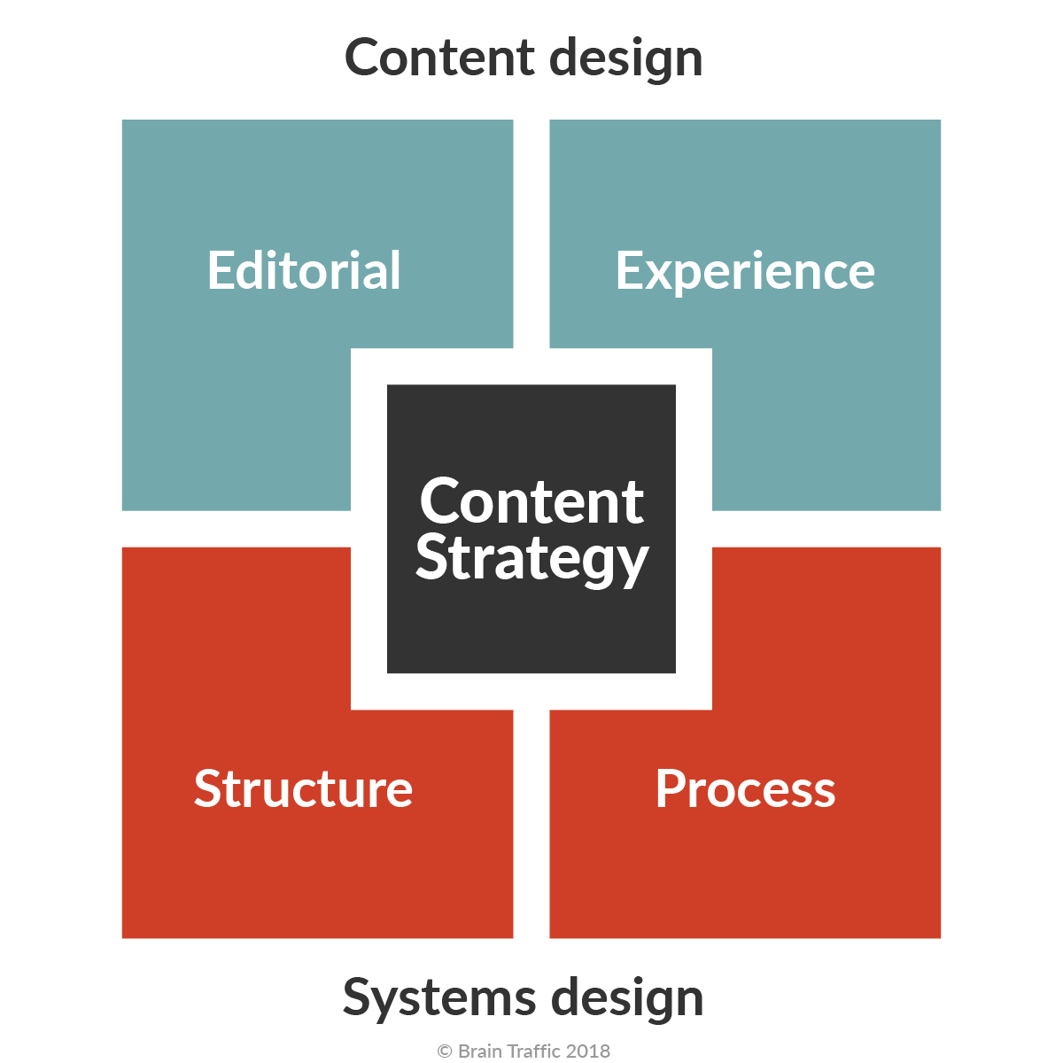
Content strategy quad
New Thinking: Brain Traffic’s Content Strategy Quad - Brain Traffic blog
Notes:
This is another way to articulate the contents’ needs in the experience.
Content design maps to Analyze and Collect
Systems design to Manage and Publish
Leaning into the specific needs of content, this is another
Content strategy needs:
Content AND systems design:
Content design: using data and evidence to give the audience the content they need, at the time they need it, and in a way they expect” (coined by Sarah Richards of Content Design London) is comprised of:
Editorial strategy (What is our editorial mission? Audience? Voice and tone?”
Experience design: (Users’ needs and preferences? Customer journeys? Content ecosystem?
Systems design: defining the architecture, modules, interfaces, and data for a system to satisfy specified requirements.
Structure (content architecture/engineering): How will we organize cRepeatable systems—both for machines and for people—to ensure content integrity over time. Comprised of:ontent for browse-and-find? What tags and categories do we need? How will we structure our content for future reuse?
Process: How will content move through its lifecycle? Tools needed? Who is responsible and accountable for content? Who needs to be consulted and informed along the way? What standards and metrics

Slide 9
How does the content lifecycle bring calm?
A way to show the support successful content needs, from cradle to grave
Maps to business, sales, technical, UX, SEO strategies… allowing you to talk about content as the critical business asset that it is
Helps you control project pace
Notes:
A content lifecycle is a flexible, fluid doc. Very high level – you can hang off this what you need.
Excellent for aligning stakeholders and for Exec communication and making explicit the work (resources, time) involved in content success
Eg can you turn this into a dashboard? To show how you’re getting through the myriad tasks to deliver a strategic, supported experience?

Slide 10
Structured content
Content
+
Schema
+
Metadata
“Structured content is content that is broken into its smallest reasonable pieces, which are explicitly organized and classified so that computers and humans can understand them.”
Carrie Hane, Structured Content 101: A Beginner's Guide | Sanity
Notes:
Structured content: the explicit expression of our editorial guidelines

Slide 11
Structured content + semantic layer → content as infrastructure
Semantically structured content
Content that can be processed by and understood by machines
Levels of structure:
  Unstructured (e.g. a call centre note in Salesforce log)
  Semi-structured (e.g. Word/Google doc with H1, H2 etc defined)
  Highly structured (e.g. tech docs tagged for reuse using taxonomy etc)
A well-defined and standardised semantic framework connects organisational knowledge assets (content items, files, videos, media)
A semantic approach = solving business problems by managing data in a manner that is optimised for capturing business meaning and context – and designing it for end user experience
Structured content
Semantic layer
A managed federation
(Disparate) content repositories are catalogued, cross-referenced and accessible via API
Content management is an operational activity distinct from content production operations
Content as infrastructure
Notes:
Structured content is like the savoiardi biscuits in a tiramisu: foundational. (And less soggy ;) )
If you add content schema, taxonomy/metadata to structured content in a semantic layer…. You're on the way to the promised land: a content machine, where content is part of the infrastructure for your organisation.
The idea of content as infrastructure was born in tech docs and is really only relevant if your organisation has MASSES of content. However. As we never quite know what’s round the corner, it’s worth investing in the foundations

Slide 12
How this helps
Benefits
Efficiency
Findability
Future-proof
Content reuse
Technical quality
“…agentic AI demands intelligent, highly structured, semantically rich, self-describing content more than ever before.”
Michael Iantosca, Thought for the day
Notes:
To bring us back to structured content: by just focusing on this, you get all these benefits
Efficiency. less duplication, searching, maintenance, and updating of content
Findability. Structured content is much easier to find, both within an organization’s database and on the internet. This means that users will spend less time searching and more time indulging in the information your company provides.
Future-Proof. You'll be prepared for future shifts in technology or redesigns of your website. Structured content simplifies any moving or editing of content, making any restructuring projects much more manageable.
Content Reuse. Perhaps the biggest benefits is content reuse. Instead of copying and pasting content. Instead, authors can use and reuse content blocks, ultimately eliminating duplication and saving time. COPE
Technical Quality. Structured content makes it possible to provide accurate, conforming, and consistent.
And I recommend you follow Michael Iantosca on LinkedIn to learn about all things content infrastructure and building content supply chains. He’s pretty much wrote the book on this.
oh. And the technology du jour: no structured content, no sensible AI, as Michael states

Slide 13
Content governance, content operations
Governance
“Digital governance is a framework for establishing accountability, roles, and decision-making authority for an organization’s digital presence... By making clear who has authority for:
Digital strategy
Digital policy
Digital standards”
Operations
“Content Operations (ContentOps) is the implementation of a strategy that incorporates people, processes, and technologies to optimize content production, so that organizations can leverage their content as business assets while retaining content quality.”
Lisa Welchman
Rahel Bailie
Notes:
The guardian angels of the experience. Digital governance, or who gets to say no.
Two sides of the same coin: governance plans the journey; operations loads the wagons

Slide 14
How do governance and ops help us
Organisational and content transparency chaos
Unstructured content
No system view
No shared understanding
Sword and shield for Magic wand syndrome
Notes:
A content strategy (AKA: your business strategy manifest in content) can only succeed within governance and ops frameworks
Ensures we’re explicit in what we want our content to do, how the experience ladders back to our organisation’s goals.
And helps us stay compliant, correct and coherent: for everyone, from the CEO to the call centre to our customers.

Slide 15
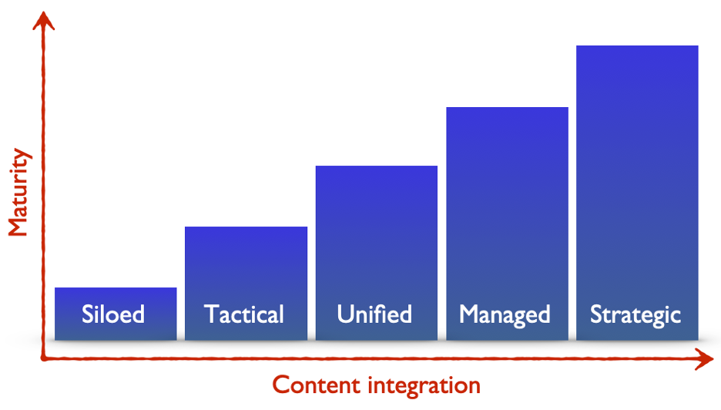
Content maturity model
Maturity model for holistic content strategy
Sarah O’Keefe
Notes:
But how do you get from where you are now, to where you need to be?
Step 1: map where you are against a content maturity model that articulates the discrete steps you can take to get your content in shape.
Siloed: Each content type (marcom, techcomm, and so on) is developed and deployed separately.
Tactical: High-level coordination for terminology or UX. Content types are authored and published in separate silos.
Unified: Customers receive unified content, but authoring and delivery processes are fragmented.
Managed: Content governance is consistent across content types. Authoring/publishing systems allow for content sharing and linking.
Strategic: Business strategy recognizes each content type as a contributor to the overall customer experience. Systems support holistic approach.

Slide 16
Countering the magic wand syndrome with governance and ops
Truth Collapse:
“the erosion of shared and personal truth caused by mediating our learning, communication, and decision-making through algorithms whose goals aren’t aligned with human well-being.”
Truth Collapse by Noz Urbina
Recognise the digital experience as a tool and an asset
Invest strategically in technology infrastructure – use vendors, but own the process
Don’t boil the ocean: Set priorities and boundaries
Notes:
How do governance and ops help?
Well, they’re a great counter to the magic wand syndrome. Which today, is of course AI.
I have no skin in the AI game aside from a sceptical eyebrow. The AI tsunami hit when I was moving countries, so I missed getting on at the ground floor, and have only an AI adjacent relationship in my current role.
However. I will say just two things:
I’m grateful to my experienced content brains, like Noz, who continue to make the AI cheer squad accountable. And help me counter the existential anxiety I feel when I think about this.
And second: the money. Big tech has spent $155bn on AI this year. More than the US government as on education, jobs and social services. And this week, Microsoft announced they’re spending $30bn on AI infrastructure in the UK
I can’t comprehend the scale of these eye watering sums. But with private investments in AI climbing 44% from 2023-2024, that’s a whole lotta money not being spent on other things. Give me half of one percent of that number for content ops, and governance please

Slide 17
All the contents!
Content designer
…written and designed well…
Glorious digital experience!
Content governance
The right content…
Content strategist
…accurate, current, compliant…
Content engineer
…well managed.
Content operations
Content management
…structured and working in code…
Content architect
Notes:
If you’re in a large organisation, content will move through many teams, through the content lifecycle we saw earlier, or this might be a product or software lifecycle.
Either way. Content needs support. It needs representation across the build.
Content architecture sits between content strategy (our desire and hope) and content management (our reality)
Add notes re: content quality/content effectiveness
If you don’t have someone in each of these roles in your org, I’m sure you’re still getting by. Doing that thing that content people are very good at: flexing and adapting and picking up a slack that our colleagues or management often can’t or won’t see.
However. By making explicit the support that content needs, delivered by professionals with different skill sets, I think we can move to organisations treating content as a strategic business asset.

Slide 18

Make it easy to succeed. Make it harder, impossible to fail.
Hilary Marsh - Making Content Strategy Stick: Operationalizing and Socializing Your Work
Seattle Content Strategy Meetup, September 2020
Notes:
And no matter what your job title, THIS is your job.
A quote from Hilary Marsh, from this very event 5 years ago.
I keep this on a post it note as a reminder about staying focused on my latest goal, ensuring it stays top of mind

Slide 19
Reframing our work
“No one cares about your content. They care about what your content does.”
Andrea L. Ames | LinkedIn
Ask:
What are your pressure points?
Where are the problems?
Here’s the short, med, long
term way content can help.
Notes:
OK. So what do we do with all of this?
Or your models.
Or your taxonomy.
Or your beautiful UX.
Content is a strategic business asset.
Our organisations care about sales numbers. And not breaking the law. And meeting needs of <patients>, <the electorate>, etc.

Slide 20
Global, industrial group replatforming plan
Replatform
request
April 2017
Tech design and build
June - October 2017
Site builds
Oct 2017 - Feb 2018
Multi-site launches
May 2018
Content-first solution
April-June 2017
Platform release
October 2017
1 x site launch
March 2018
Notes:
Branding and publishing platform:
15 brand sites. 90% with websites, 10% no web presence
New acquisitions annually, so also need process to quickly onboard to platform

Slide 21
Replatforming reality
Replatform
request
April 2017
Tech design and build
June - October 2017
Site builds
Oct 2017 - Feb 2018
Multi-site launches
May 2018
Platform realisation?
Strategic churn
Jul-Oct
Client
re-set
Oct-Mar
?
Agency content/
design
refresh
Content-first solution
April-June 2017
Platform release
October 2017
1 x site launch
March 2018

Slide 22
Clarity not complexity!
Organisational and content transparency chaos
Unstructured content
No system view
No shared understanding
Sword and shield for Magic wand syndrome

Slide 23
References
Content Strategy: The Book by Rahel Anne Bailie and Noz Urbina
New Thinking: Brain Traffic’s Content Strategy Quad - Brain Traffic blog
Carrie Hane, Structured Content 101: A Beginner's Guide | Sanity
Michael Iantosca, Thought for the day
Truth Collapse by Noz Urbina
Hilary Marsh - Making Content Strategy Stick: Operationalizing and Socializing Your Work
Andrea L. Ames | LinkedIn
Managing Chaos | Lisa Welchman
Content Operations from Start to Scale: Perspectives from Industry Experts
Enterprise content strategy maturity model, Sarah O’Keefe (based on work done by Rahel Anne Bailie as early as 2011.)
Big tech has spent $155bn on AI this year. It’s about to spend hundreds of billions more | Artificial intelligence (AI) | The Guardian
AI could boost UK economy by 10% in 5 years, says Microsoft boss
Economy | The 2025 AI Index Report | Stanford HAI

Slide 24
Questions?

