Slide 1



TITLE IX
STAFF
&
FACULTY
Presented By :
Angel Ellison
January 4, 2026
Title IX Coordinator

Slide 2

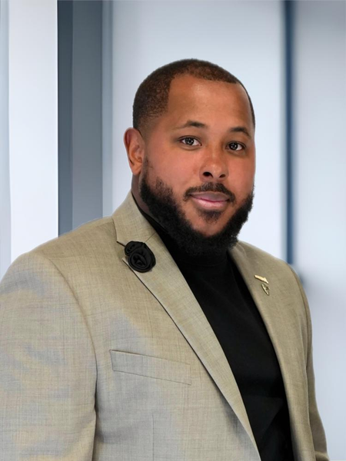
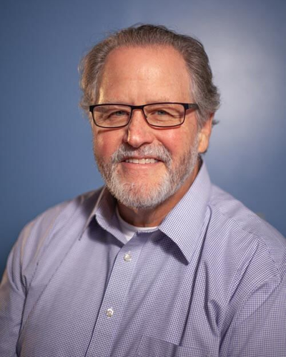
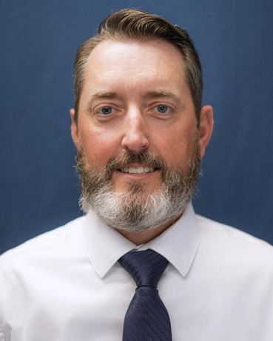
MEET
THE
TEAM
Confidential Employee
Coach J. Clark
Key Official
Paul Lindley
Key Official
Coach D. Ellison
Key Official
Dr. Malone

Slide 3

CHAMPION IS
COMMITTED TO
YOU!
Champion Christian College is committed to addressing all reports of sexual misconduct and harassment with seriousness and urgency. Individuals found in violation of this Policy will be subject to prompt disciplinary action. Reports that fall outside the defined scope of this policy may be referred to the College President and designated administrative officials for further evaluation.

Slide 4
CHAMPION IS
COMMITTED TO
YOU!
Champion Christian College is committed to addressing all reports of sexual misconduct and harassment with seriousness and urgency. Individuals found in violation of this Policy will be subject to prompt disciplinary action. Reports that fall outside the defined scope of this policy may be referred to the College President and designated administrative officials for further evaluation.

Slide 5

WHO DOES TITLE IX APPLY TO?
EVERYONE.
Student
Employee
The College’s most important expectations of its administration,
faculty, staff, and students are precisely those made clear in the Bible.
Violations of these include, but are not limited to, those who,
whether knowingly, negligently, recklessly, or in any other way,
participate in or promote the following:
Any kind of sexual immorality/impurity/perversion and/or harrassment.

Slide 6

KEY TERMS
An individual who is alleged to be the victim of conduct that could constitute
sexual harassment.
Complainant
An individual who has been reported to be the perpetrator of conduct that could
constitute sexual harassment.
Respondent
IDR 800 Million
Expenses:
Someone designated to receive information about sexual misconduct without being required to report it to the Title IX office.
Confidential
Employee
Formal Complaint
An allegation of Sexual Harassment against a Respondent, signed by the Complainant or Title IX Coordinator
Final Determination
The written decision issued at the end of the grievance process, stating whether the respondent is found responsible. It becomes FINAL after the appeal period ends.
Net profit:

Slide 7
KEY TERMS
Prohibited Conduct
Sexual Harrassment, sexual assult, rape, fondling, incest, statutory rape, dating violence, domestic violence, stalking
Informal
Resolution
At any time after a Formal Complaint has been signed and before a determination regarding responsibility has been reached, the parties may voluntarily agree to participate in an informal resolution.
At any time after the Title IX Coordinator is on notice of
sexual harassment, Champion may remove a respondent
on an emergency basis.
Emergency
Removal
(1) The Complainant withdraws it in writing, (2) the Respondent
is no longer enrolled or employed by Champion, or (3) there is insufficient evidence.
(1) the alleged conduct doesn’t meet the Policy’s definition of Sexual Harassment, (2) it didn’t occur within Champion’s educational program or activity, or (3) it didn’t occur in the United States.
Dismissal

Slide 8
Some form of
prohibited
contact and/or
behavior takes
place.
Appeal of Final Determination
(must be filed within 5 business days)
A report is made
to Titile IX Coordinator
Confidential Employee
Anonymously
Law Enforcement
PROCESS
Grievance Process
Gather Evidence
Notice of Allegations
(Recorded)
Live Hearing
(Written) Determination
Title IX Coordinator contacts Complainant.
Complainant fills out a detailed formal complaint and submits it to who.

Slide 9




ADDITIONAL INFO.
Champion Christian College is committed to upholding all legal and biblical standards as they relate to Title IX. While we strive to prevent incidents of misconduct, it is our mission to address any such situations with the seriousness, urgency, and care they deserve. Additionally, individuals are encouraged to contact external agencies if they believe their concerns have not been adequately addressed.
Students may report to external agencies.
(1) U.S. Department of Education—Office of Civil Rights
(2) Transnational Association of Christian Schools
(3) Arkansas Department of Education.
Employees may report to external agencies.
(1) U.S. Equal Employment Opportunity Commission
(2) Arkansas Human Rights Commission (AHRC)
For more details on how to make a formal complaint please acces our FULL TITLE IX POLICY on our website.

Slide 10
THANK YOU!
In compliance with the USDE, this training slide show was updated August 25, 2025 by Title IX Coordinator, Angel Ellison.

