Slide 1


STUDENT
ORIENTATION
&
TITLE IX
2025-2026

Slide 2

Mission statement
Champion Christian College's mission is to develop Christ-centered servant leaders through a challenging academic environment in order to impact the world for the kingdom of God.
WHAT DOES THIS MEAN?
The college emphasizes a biblical worldview and the integration of faith and learning. Champion aims to develop students into leaders that serve others with humility and compassion. Champion understands the importance of nurturing the mind, spirit, and character of students while fostering academic achievement.

Slide 3
Code Of Conduct
Academic
Financial
Students are expected to uphold academic integrity at all times.
If a student is finding a class challenging, we encourage them to reach out to their academic advisor .
All accepted students have signed the student handbook, affirming their understanding of its policies.
Students are expected to maintain good financial standing by submitting their monthly payment by the first of each month.
1
2
3
STUDENT EXPECTATIONS

Slide 4





Chapel
Check in via Populi
Be Punctual
No Headphones
NO PHONES

Slide 5
Allowed
Not Allowed
Hats
Beanies
Head Scarf (females only)
Tank Tops 2"
Slides and flip flops
*Shorts 2pm and after OR in the lobby or cafeteria if you are an on campus student and getting a meal to go.*
Slippers
Pajama Pants
Vulgar or inappropriate Imagery or Words
Exposed Undergarments
Any top exposing a students midriff.
Bonnets (lobby only)
Du-rag (lobby only)
Being barefoot on the office/classroom floor .
Dress
code

Slide 6

If a student believes
they have experienced treatment that violates Title IX protections,
they may file a
complaint through the link provided on the college website under Student Complaint Procedures or reach out to a Title IX Contact.
Champion Christian College is fully accredited by the Transnational Association of Christian Colleges and Schools (TRACS).
Title IX is a comprehensive federal law that prohibits discrimination on the basis of sex in any federally funded education program or activity.
Accreditation & Title ix

Slide 7


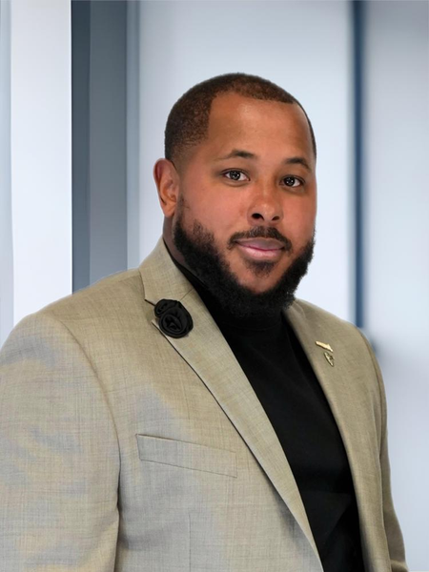
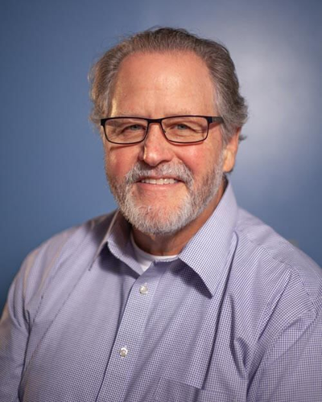
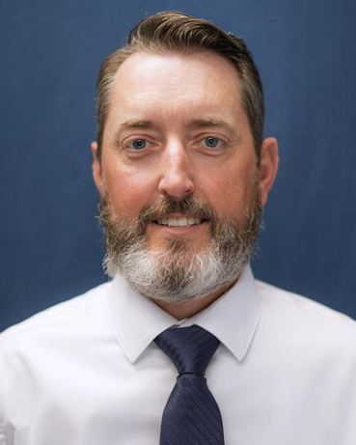
POINTS
OF
CONTACT
Title IX
Coordinator
Angel Ellison
Key Official
Coach D. Ellison
Confidential Employee
Coach J. Clark
Key Official
Paul Lindley
Key Official
Dr. Malone

Slide 8

CHAMPION IS
COMMITTED TO
YOU!
Champion Christian College is committed to addressing all reports of sexual misconduct and harassment with seriousness and urgency. Individuals found in violation of this Title IX Policy will be subject to prompt disciplinary action. Reports that fall outside the defined scope of this policy may be referred to the College President and designated administrative officials for further evaluation.

Slide 9
WHO DOES TITLE IX APPLY TO?
EVERYONE.
Student
Employee
The College’s most important expectations of its administration,
faculty, staff, and students are precisely those made clear in the Bible.
Violations of these include, but are not limited to, those who,
whether knowingly, negligently, recklessly, or in any other way,
participate in or promote the following:
Any kind of sexual immorality/impurity/perversion and/or harrassment.

Slide 10




ADDITIONAL INFO AND REPORTING
Champion Christian College is committed to upholding all legal and biblical standards as they relate to Title IX. While we strive to prevent incidents of misconduct, it is our mission to address any such situations with the seriousness, urgency, and care they deserve. Additionally, individuals are encouraged to contact external agencies if they believe their concerns have not been adequately addressed.
Students may report to external agencies.
(1) U.S. Department of Education—Office of Civil Rights
(2) Transnational Association of Christian Schools
(3) Arkansas Department of Education.
Employees may report to external agencies.
(1) U.S. Equal Employment Opportunity Commission
(2) Arkansas Human Rights Commission (AHRC)
For more details on how to make a formal complaint please acces our FULL TITLE IX POLICY on our website.

Slide 11

THANK YOU
FOR LISTENING!
In compliance with the USDE, this orientation and Title IX slide show was updated August 25, 2025 by Title IX Coordinator, Angel Ellison.

