Slide 1

Tribal Council Meeting
VVoter Instructions

Slide 2
Logging In to Zoom
Step 1: Click on the Zoom link in your invitation email
Step 2: Enter the Zoom session code from the invitation email

Slide 3
Logging In to VVoter - Three Step Process
Step 1: Open your browser and go to www.vvoter.com
www.vvoter.com
Step 2: Enter the Session ID for the meeting
Session ID: 172 945 926
Step 3: Enter your Enrollment Number as your Login ID
Enrollment Number

Slide 4
Logging In to VVoter: STEP 1
Step 1: Open your browser and go to www.vvoter.com
www.vvoter.com

Slide 5
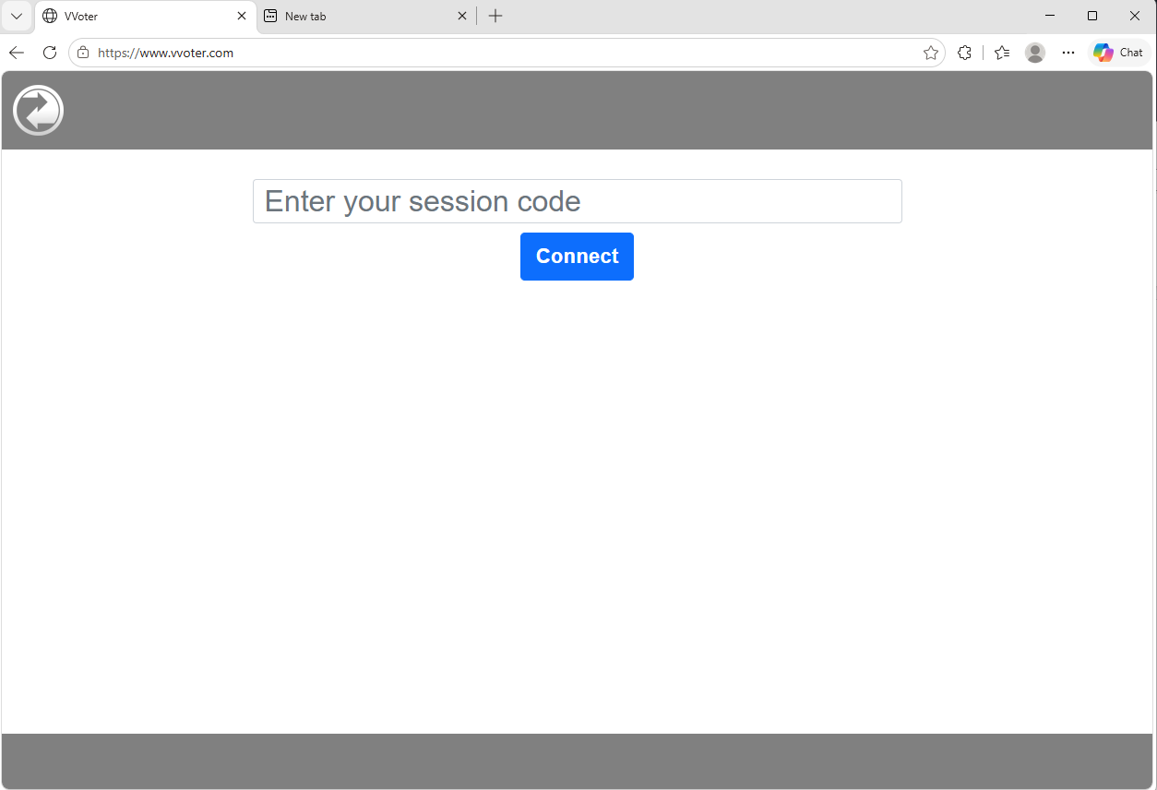

Slide 6
Logging In to VVoter: STEP 2
Step 2: Enter the Session ID for the meeting
Session ID: 172 945 926

Slide 7
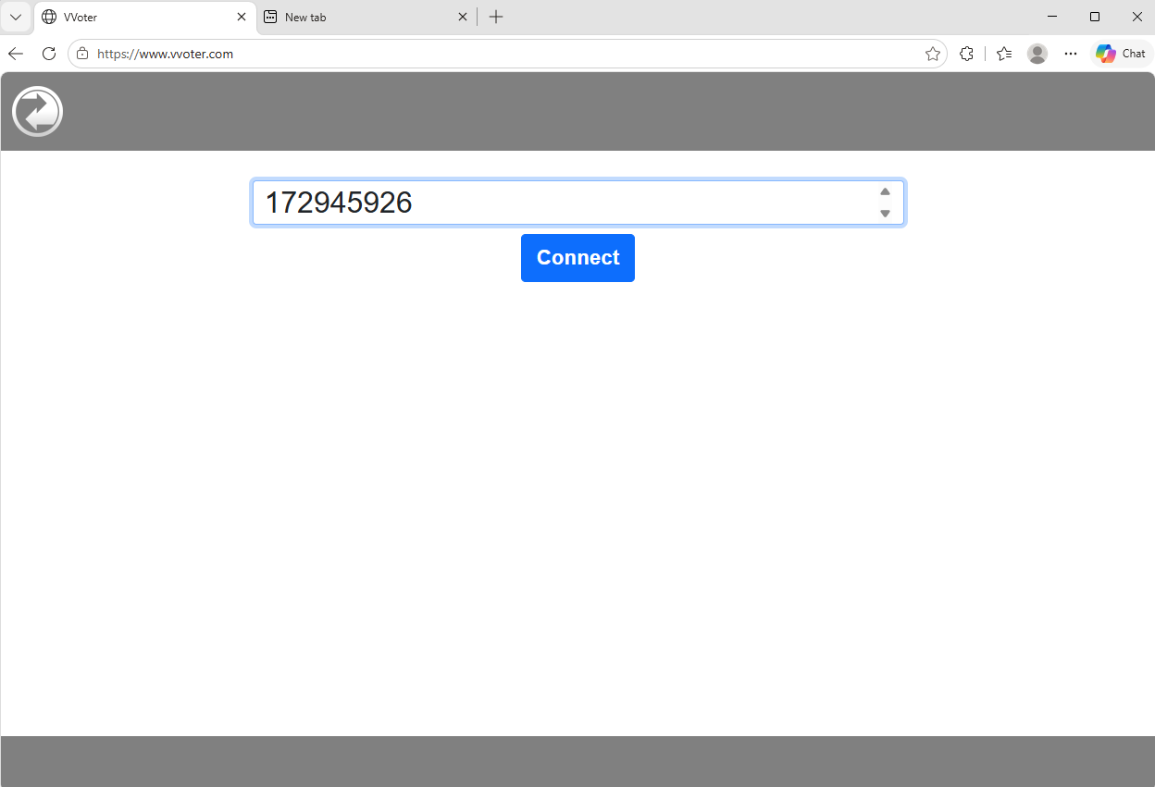
Enter Session ID 172459926 and click Connect

Slide 8
Logging In to VVoter: STEP 3
Step 3: Enter your Enrollment Number as your Login ID
Enrollment Number

Slide 9
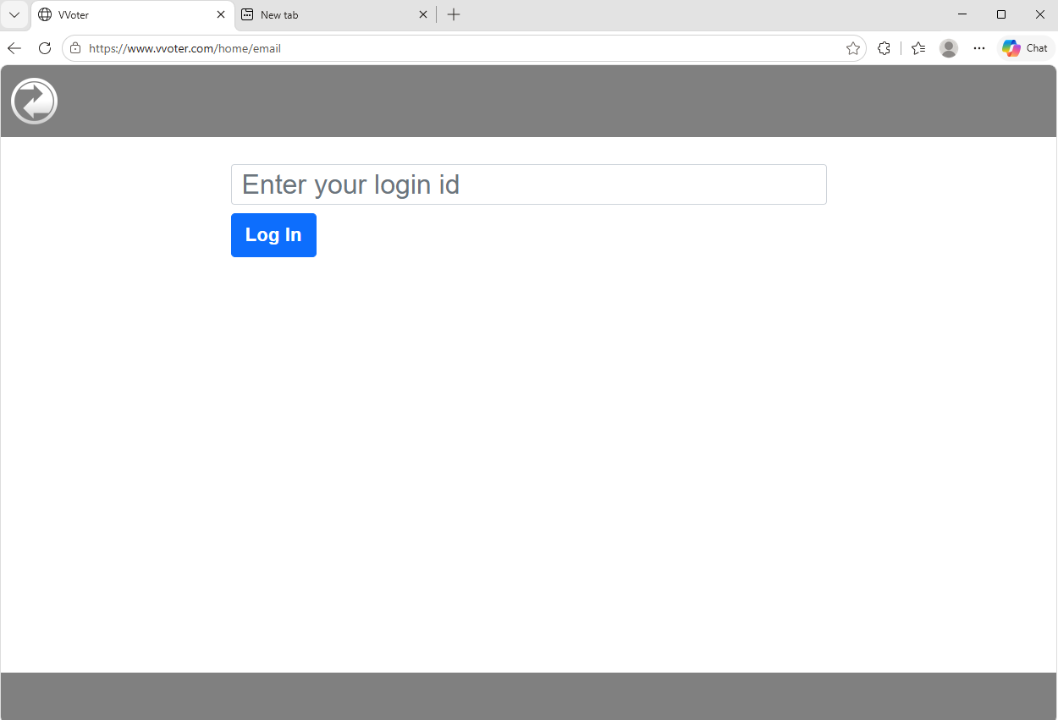
Enter your Tribal Enrollment Number and click Log In

Slide 10
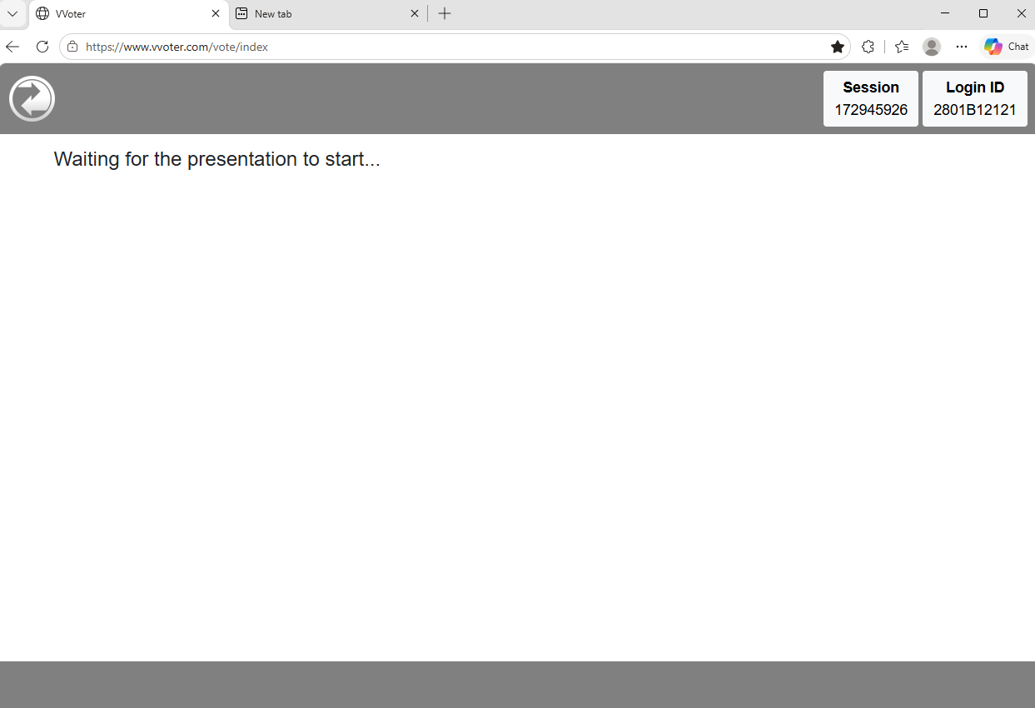
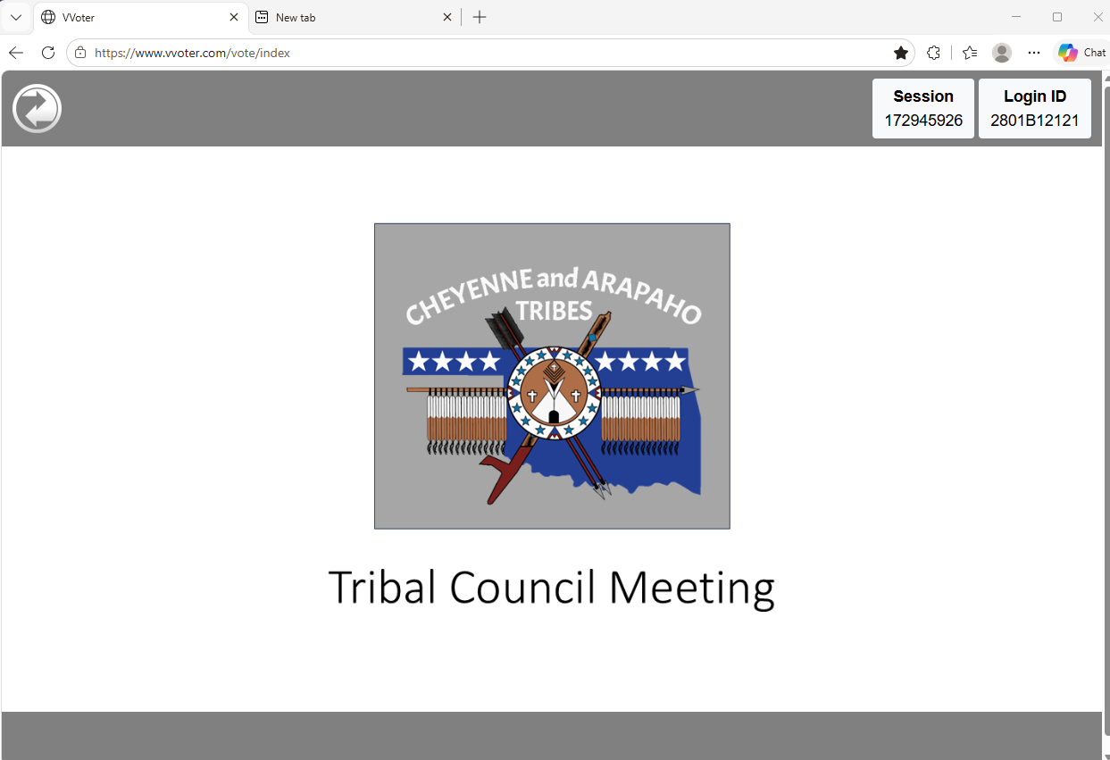
What You Will See…

Slide 11
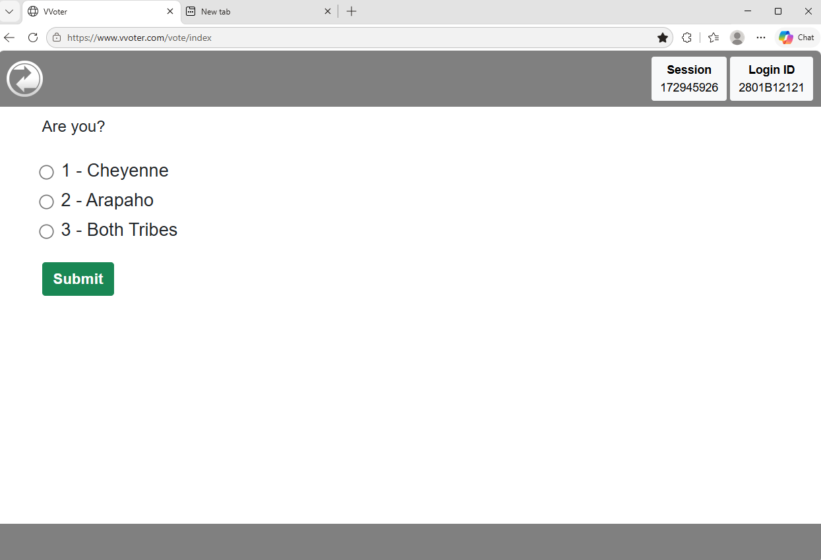
Practice Voting Slide – Example
Enter your vote and click Submit

Slide 12
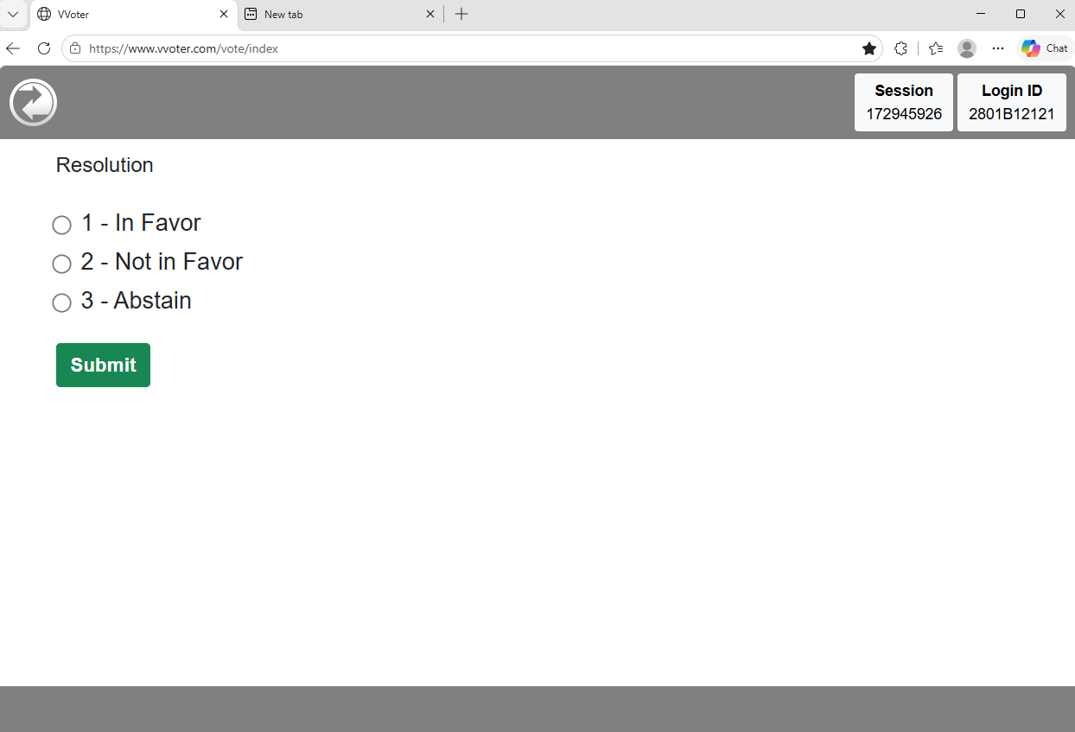
Resolution Voting Slide – Example
Enter your vote and click Submit

Slide 13
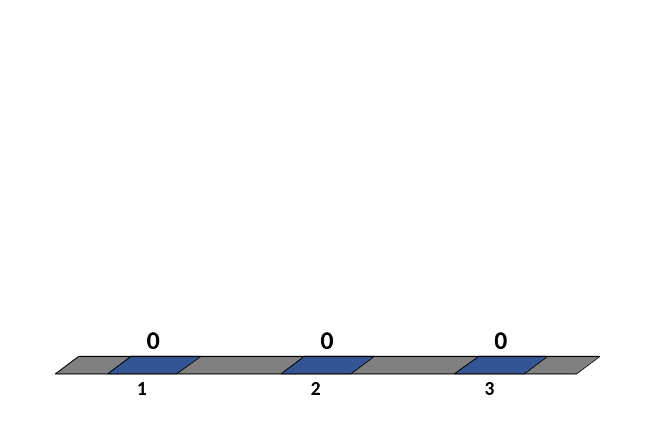
Are you?
Cheyenne
Arapaho
Both Tribes
0 / 72
Cross-tab label

Slide 14

Resolution
In Favor
Not in Favor
Abstain
0 / 72
Cross-tab label

Slide 15
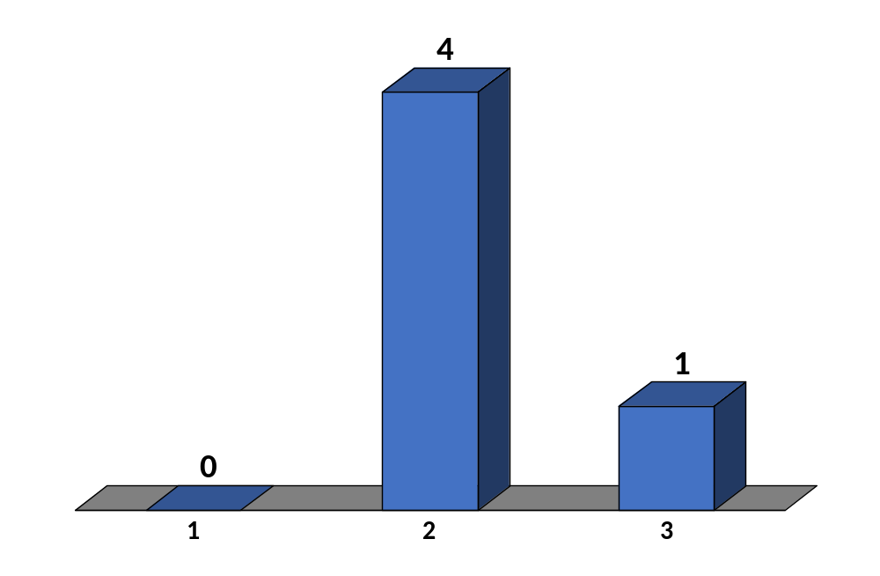
Have you ever used Zoom before?
Yes
No
Abstain
5 / 625
Cross-tab label

Slide 16
Tribal Council Meeting

