Slide 1

CHNC Educational Web Series: Emergency Preparedness and Disaster Management for NICUs

Slide 2

Welcome to the Emergency Preparedness and
Disaster Management web series!
This series is developed in collaboration with the CHNC Educational Advisory Committee, CHNC Transport Focus Group, and the Pediatric Pandemic Network.
Calls occur the 2nd Wednesday of each month
3-4pm CT / 4-5pm ET
Next call will be January 14, 3-4pm CT / 4-5pm ET
If you are registered for this call, you should have all the 2025 invites on your calendar. If you need to register, please reach out to eac@thechnc.org
Notes:
Welcome, everyone, to the CHNC webinar on NICU Emergency Preparedness and Disaster Management. This series is developed in collaboration with the CHNC Educational Advisory Committee, CHNC Transport Focus Group, and the Pediatric Pandemic Network.
If you are registered for this call, you should have all the 2025 invites on your calendar. If you need to register, please reach out to eac@thechnc.org
Next call will be DATE, 3-4pm CT / 4-5pm ET

Slide 3
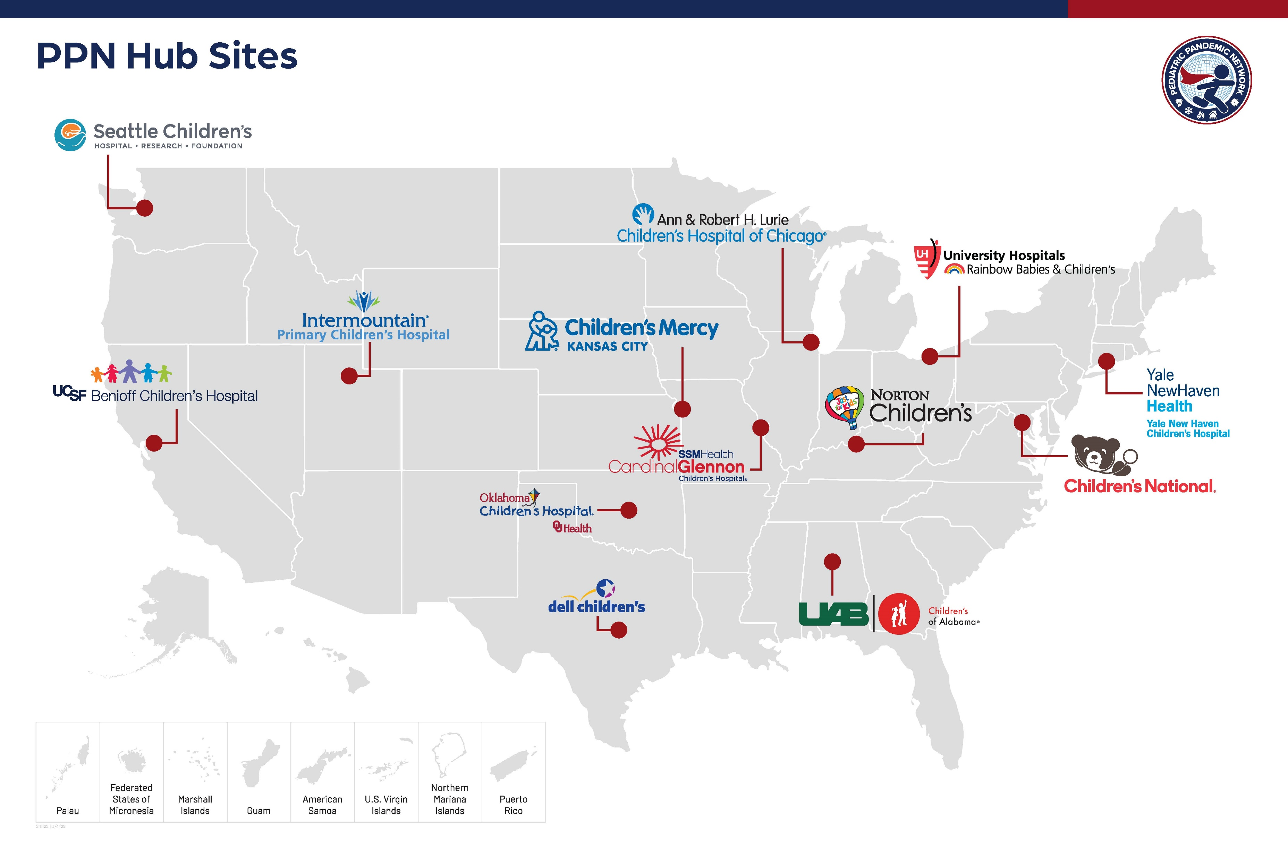
Pediatric Pandemic Network
Notes:
The series is a collaboration between the Educational Advisory Committee, the CHNC Transport focus group, and the Pediatric Pandemic Network. We aim to provide 16-18 monthly webinars that cover varied topics of specific relevance to Level IV NICUs but are also relevant to regional NICUs, transport teams, hospital administrators, and local and state emergency preparedness personnel.

Slide 4


Continuing Education Learner Notification
Relevant Financial Relationships​
The planning committee and presenters have no relevant financial relationships with ineligible companies.
Financial and In-Kind Commercial Support
No financial nor in-kind commercial support was received for this education activity.
Joint Accreditation: In support of improving patient care, this activity has been planned and implemented by Children’s National Hospital. Children’s National Hospital is jointly accredited by the Accreditation Council for Continuing Medical Education (ACCME), the Accreditation Council for Pharmacy Education (ACPE), and the American Nurses Credentialing Center (ANCC), to provide continuing education for the healthcare team. Children’s National Hospital Accreditation Provider# 4008362
Credit Designation Statements:
ACCME: Children’s National Hospital designates this live/enduring activity for a maximum of 1.0 AMA PRA Category 1 CreditsTM for physicians. Physicians should claim only the credit commensurate with the extent of their participation in the activity.
ANCC: Children’s National Hospital designates this activity for a maximum of 1.0 Live/Enduring ANCC contact hours.
Pharmacy: Children’s National Hospital is accredited by the Accreditation Council for Pharmacy Education (ACPE) as a provider of continuing pharmacy education. This program meets ACPE criteria for 1.0 contact hours.
Requirements to Claim Continuing Education (CE) Credit: Participants may obtain CE credit for this session if you attend the entire session and complete an evaluation. A code and link/text number will be provided at the end of the session.
Notes:
Slide to add at start of the presentation

Slide 5
Disclosure
This content is provided for CHNC participants as educational material for informational purposes only. This material does not constitute the provision of medical advice or a specific standard for care and is not intended to be a substitute for independent professional medical judgment, advice, diagnosis, or treatment.
Notes:
This content is provided for CHNC participants as educational material for informational purposes only. This material does not constitute the provision of medical advice or a specific standard for care and is not intended to be a substitute for independent professional medical judgment, advice, diagnosis, or treatment.

Slide 6


Michael Lauer Vice President, Emergency Management, EH&S and Security

Slide 7
Introduction Mike Lauer
Currently Vice President of Emergency Management, EH&S and Public Safety for BJC Health.
Former Director of Public Safety for Saint Louis University
Former commander of Homicide for St. Louis Police Department
Served the City of St. Louis for 20 years as a police officer, detective, sergeant and lieutenant.
Assignments included the 5th District, Gang Unit, Homicide, Internal Affairs, Commander of Communications/911 and then commander of Homicide for final three years of his career.
Graduate of the FBI National Academy

Slide 8
Today’s Program
Violence in the workplace
Violence in the community
Active shooter preparedness and response

Slide 9
Workplace Violence
OSHA defines workplace violence as “any act or threat of physical violence, harassment, intimidation or other threatening disruptive behavior that occurs at the work site.”
OSHA estimates that about 2 million workers report violent workplace incidents each year across all industries.

Slide 10
Examples of Workplace Violence
Threatening behavior – shaking fists, destroying property, vandalism, sabotage, theft, throwing objects.
Verbal or written threats - expression of intent to inflict harm.
Harassment - behavior that demeans, embarrasses, humiliates, annoys, alarms or verbally abuses a person and that is known or would be expected to be unwelcome. Included are words, gestures, pranks, arguments, psychological trauma, rumors, intimidation, bullying, or other inappropriate activities.

Slide 11
Examples of Workplace Violence
Verbal abuse - swearing, insults or condescending language.
Physical attacks - hitting, shoving, pushing or kicking. Extremes include rape, arson and murder.
Bullying - uninvited physical contact; “sarcastic jokes” and “teasing” used as insult delivery systems; status slaps intended to humiliate their victims; rude interruptions; two-faced attacks; dirty looks; recruiting others to be bullies; treating someone as if they are invisible.

Slide 12
Cost of Workplace Violence
18,000 workplace violence assaults are logged each week in the United States.
Estimated cost to industry? $121 billion each year in lost productivity, lawsuits and settlements, damaged reputation, and lost sales or contracts.
According to OSHA, the healthcare and social assistance industry accounted for 72.8% of all WPV incidents in private industry.

Slide 13
Mitigating Workplace Violence
Develop a no tolerance policy towards workplace violence
Covers employees, contractors, visitors or anyone else who interacts with company personnel.
Develop a well-written and implemented WPV prevention program, combined with engineering controls, administrative controls and training.
Should be part of your safety and health program.
Should be in the employee handbook.
Critical that employees understand the WPV policy and understand that all claims of workplace violence will be investigated and remedied promptly.

Slide 14
Mitigating Workplace Violence
Perform regular background checks
Adopt a no tolerance policy
Get to know your employees
Get involved
Properly train staff on the warning signs of workplace violence.
Make it safe to speak up!

Slide 15
Mitigating Workplace Violence
Provide help to employees who are experiencing stress
It is okay to speak to someone, including EAP
Set rules for terminated employees.
Secure the workplace.
Work with security or law enforcement to investigate threats.

Slide 16
Warning Signs of Workplace Violence
Threats
Unreasonable behaviors
Intimidation and control oriented
Paranoid
Angry, argumentative, and lacks impulse controls
Irresponsible – makes excuses and blames others
Anti-social behaviors – fascination with violence, applaud violence, talk of shooting sprees, obsession with weapons.

Slide 17
Warning Signs of Workplace Violence
Vindictive – “one of these days I will make them pay…”
Bizarre or weird behaviors – coupled with other signs, may be an indicator.
Desperation – a person is experiencing extreme desperation with family, finances, or personal problems.
Obsessive compulsive behaviors
Substance abuse
Chronic depression

Slide 18

Warning Signs of Workplace Violence

Slide 19

Warning Signs of Workplace Violence

Slide 20


Slide 21
Active Shooter Video: Run, Hide, Fight
RUN. HIDE. FIGHT.® Surviving an Active Shooter Event - English - YouTube

Slide 22
What is an Active Shooter
An Active Shooter is an individual actively engaged in killing or attempting to kill people in a confined and populated area; in most cases, active shooters use firearms(s) and there is no pattern or method to their selection of victims.
Because active shooter situations are often over within 10 to 15 minutes, before law enforcement arrives on the scene, individuals must be prepared both mentally and physically to deal with an active shooter situation.

Slide 23
What to do in an Active Shooter event
Good practices for coping with an active shooter situation:
Be aware of your environment and any possible dangers.
Take note of the two nearest exits in any facility you visit.
If you are in an office, stay there and secure the door.
If you are in a hallway, get into a room and secure the door.
As a last resort, attempt to take the active shooter down. When the shooter is at close range and you cannot flee, your chance of survival is much greater if you try to incapacitate him/her.
CALL 911 WHEN IT IS SAFE TO DO SO!

Slide 24
What to tell 911.
Information to provide to law enforcement or 911 operator:
Location of the active shooter.
Number of shooters, if more than one.
Physical description of shooter/s.
Name of the shooter, if known.
Number and type of weapons held by the shooter/s.
Number of potential victims at the location.

Slide 25
What to do in an Active Shooter event
Quickly determine the most reasonable way to protect your own life. Remember that patients and visitors are likely to follow the lead of employees during an active shooter situation.

Slide 26
Get out!
Evacuate If there is an accessible escape path, attempt to evacuate the premises.
Have an escape route and plan in mind.
Evacuate regardless of whether others agree to follow.
Leave your belongings behind.
Help others escape, if possible.

Slide 27
Get out!
Prevent individuals from entering an area where the active shooter may be.
Keep your hands visible.
Follow the instructions of any police officers.
Do not attempt to move wounded people.
Call 911 when you are safe.

Slide 28
Hide out!
If evacuation is not possible, find a place to hide where the active shooter is less likely to find you. Your hiding place should:
Be out of the active shooter’s view.
Provide protection if shots are fired in your direction (i.e., an office with a closed and locked door).
Not trap you or restrict your options for movement.
To prevent an active shooter from entering your hiding place:
Lock the door
Blockade the door with heavy furniture
Silence your cell phone and be quiet

Slide 29
Take out!
As a last resort, and only when your life is in imminent danger, attempt to disrupt and/or incapacitate the active shooter by:
Acting as aggressively as possible against him/her.
Throwing items and improvising weapons, such as IV poles or fire extinguishers.
Yelling
Committing to your action.

Slide 30
What happens next?
Law enforcement’s purpose is to stop the active shooter as soon as possible.
Officers will proceed directly to the area in which the last shots were heard.
Officers usually arrive in teams of four (4), but things have changed…
Officers may wear regular patrol uniforms or external bulletproof vests, Kevlar helmets, and other tactical equipment.
Officers may be armed with rifles, shotguns, handguns.

Slide 31
What to do when you encounter officers.
Remain calm and follow officers’ instructions.
Put down any items in your hands (i.e., bags, jackets).
Immediately raise hands and spread fingers.
Keep hands visible at all times.
Avoid making quick movements toward officers such as holding on to them for safety.
Avoid pointing, screaming and/or yelling.
Do not stop to ask officers for help or direction when evacuating, just proceed in the direction from which officers are entering the premise.

Slide 32
Be aware!
Monitor social media postings about your business.
Alert your staff to threats
Create an open dialogue with employees so they are comfortable reporting threats or suspicious behaviors.
Threat Assessment Team - Have security/public safety conduct risk assessments on any threat of violence to staff or the hospital.

Slide 33
Emergency Action and Notification Plans
Create a committee of employees who can create this plan, DO NOT place this on one employee’s shoulders
Emergency Action Plans should include:
How to communicate the danger. Text? PA? What about employees off site?
How to move to a safe location
Designate Safe Area’s within the building or work site
Establish medical supplies and training
Try and have the same rally points for any emergency. Plan for at least two rally points. These should be at opposite sides of the building and need to consider hazards, like open ground, bridges, tall buildings.

Slide 34
Pediatric Healthcare Data
Polling of 874 pediatric nurses and 81 patient/family advisers:
Prefer Secure – Preserve – Fight measures.
Only 30% felt prepared for an active threat situation.
Most respondents agreed that nurses have a professional duty to protect their patients, but agreed this is a personal choice, not a moral obligation.
Most respondents reported they would not leave their patient/child during an active shooter event.
Source: Journal of Pediatric Nursing, vol. 60, Sept-Oct. 2021

Slide 35
Again…speak up!
If you see something, say something!
Alert your manager, Security/Public Safety, or Human Resources if you believe an employee or coworker exhibits potentially violent behavior.

Slide 36
Questions and answers
Contact info: Michael.Lauer@BJC.org

Slide 37

Thank you for attending the
Emergency Preparedness and
Disaster Management web series!
This series is developed in collaboration with the CHNC Educational Advisory Committee, CHNC Transport Focus Group, and the Pediatric Pandemic Network.
Calls occur the 2nd Wednesday of each month
3-4pm CT / 4-5pm ET
Next call will be January 14, 3-4pm CT / 4-5pm ET
If you are registered for this call, you should have all the 2025 invites on your calendar. If you need to register, please reach out to eac@thechnc.org

Slide 38
Instructions for Claiming Continuing Education Credit
Text attendance code FOHMEB to 216-412-9068 or enter it at https://ce.pedspandemicnetwork.org/code
You must be logged in to your Pediatric Pandemic Network (PPN) CE website account to claim credit.
Log in to PPN CE website at ce.pedspandemicnetwork.org (create an account on OpenPPN, the PPN’s single sign-on app).
Set up your profile:
Select “profession” (i.e. nurse, physician, etc…)
Input mobile number used to text attendance code
Go to pending activities (Click My Account > My Activities > Pending Activities) and complete the course evaluation.
Generate and download CE certificate
Credit can be claimed up to 60 days from the date of the live event.
Notes:
Slide to add at the end of the presentation

