Slide 1
Review of approaches to unbundle BELCO’s volumetric charge and TOU Pilot Considerations
13 October, 2023

Slide 2
Agenda
Introduction
Rate Model Submitted by BELCO and Alternatives
TOU Pilot

Slide 3
Introduction: Why are we considering a rate design?
Introduction
Improve fairness in billing
Improve cost reflectivity in electricity bills
Improve transparency in electricity bills
Aim to protect customers from price shocks and fluctuations

Slide 4


Concerns with current structure
Introduction
Electricity bill composition
Fixed charge (e.g. $/month, $/kW)
Variable charges (e.g. $/kWh)
Fixed charge (e.g. $/month, $/kW)
Variable charges (e.g. $/kWh)
Ideally recover costs unrelated to consumption level
(e.g. Equipment and its management, grid connection, etc)
Ideally recover costs which vary with consumption level (e.g. Production related)
Currently groups Generation, Transmission, Distribution together

Slide 5
Rate Design Options Considered
Introduction
 | Current Structure | Option A | Option B | Option C | Option D
Residential
Fixed Charges ($/month) | Consumption-driven GFC tiers | Consumption-driven GFC tiers | Consumption-driven GFC tiers | Single fixed charge | Single fixed charges
Variable Charges ($/kWh) | 1 IBT charge | 2 non-IBT charges: Generation and TD&R/Residual | 3 non-IBT charges: Transmission, generation, and distribution/retail | 3 non-IBT charges: Transmission, generation, and distribution/retail | 3 non-IBT charges: Transmission, generation, and distribution/retail
Demand Charges ($/kW) | None | None | None | Demand-driven GFC tiers | Single demand charges
% of Fixed Costs in Variable Charges | Status Quo | Lower than status quo | Lower than A | Lower than B | Lower than C
Commercial
Fixed Charges ($/month) | Single fixed charge | Single fixed charge | Single fixed charge | Single fixed charge | Single fixed charges
Variable Charges ($/kWh) | 1 IBT charge | 2 IBT charges: Generation and TD&R/Residual | 3 IBT charges: Transmission, generation, and distribution/retail | 3 IBT charges: Transmission, generation, and distribution/retail | 3 IBT charges: Transmission, generation, and distribution/retail
Demand Charges ($/kW) | None | None | None | Single demand charge | Single demand charges
% of Fixed Costs in Variable Charges | Status Quo | Lower than status quo | Lower than A | Lower than B | Lower than C
Demand
Fixed Charges ($/month) | Single fixed charge | Single fixed charge | Single fixed charge | Single fixed charge | Single fixed charge
Variable Charges ($/kWh) | 1 DBT charge | 2 DBT charges: Generation and TD&R/Residual | 3 DBT charges: Transmission, generation, and distribution/retail | 3 DBT charges: Transmission, generation, and distribution/retail | 3 DBT charges: Transmission, generation, and distribution/retail
Demand Charges ($/kW) | 3 types of demand charges | 3 types of demand charges | 3 types of demand charges | 3 types of demand charges | 3 types of demand charges
% of Fixed Costs in Variable Charges | Status Quo | Lower than status quo | Lower than A | Lower than B | Lower than C
3 scenarios with increasing fixed charge weighting vs BAU
Increasing cost reflectivity

Slide 6







Rate Design Progress
Introduction
BELCO submitted report on “Tariff Design Modernisation Strategy”
BELCO submitted a rate redesign model
RA released a Public Report to collate public feedback
Discussions with BELCO
Refining and finalising rate redesign model
Calculate and implement rates with approved revenue allowance
Conduct customer impact analysis
Legend
Completed
In progress
To be completed

Slide 7
Rate Design Progress
Introduction
BELCO submitted report on “Tariff Design Modernisation Strategy”
BELCO submitted a rate redesign model
RA released a Public Report to collate public feedback
Discussions with BELCO
Refining and finalising rate redesign model
Calculate and implement rates with approved revenue allowance
Conduct customer impact analysis
To be discussed today + TOU
Legend
Completed
In progress
To be completed

Slide 8
BELCO’s Calculations

Slide 9
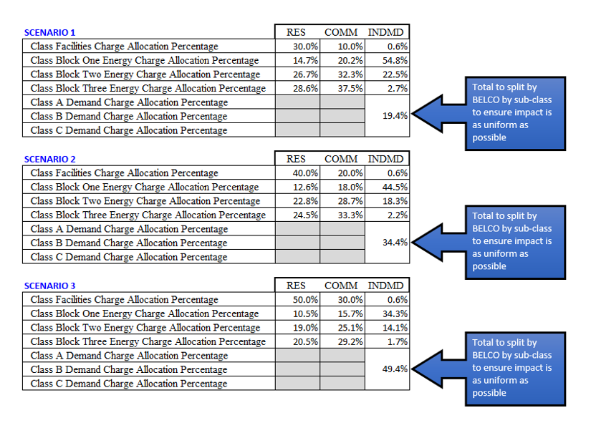
Model Request by the RA
Rate Design Model
Information Request
1
Increase weightings of fixed charge over variable charge for all customer classes
2
Provide option to retain or eliminate increasing block variable tariffs for residential and/or commercial customers
3
Disaggregate variable charge into generation charge (recover BG revenue allowance) and a network charge (residual component)
4
Demand allocation percentages should be disaggregated by sub-class (A, B, C) rather than by demand tariff block (Class one, two)
BELCO was also asked to provide statistical analysis for each scenario to quantify impact on customers (% and BMD)

Slide 10
BELCO’s Proportion of Generation Volumetric charges
Rate Design Model
ECOSS % for customer class Ci
Provided in IR 4 for 3 scenarios for customer class Ci
 | Production |  | Network
Energy (Tot_{e}) | Production Energy (P_{e}) |  | 0
Demand (Tot_{d}) | Production Demand (P_{d}) |  | Transmission demand (T_{d}), Distribution Demand (D_{d}), N_{d} = T_{d} + D_{d}
Customer (Tot_{c}) |  |  | Network customer
 | Share (%) of revenue for class
Energy | R_{e} (%) for total energy – also Ret (%) by tier (t)
Demand | R_{d} (%)
Customer | R_{c} (%)
$$Allocation for volumetric generation charge \left(Ci,t\right)=\left(Pd \left(Ci\right)\%+Pe \left(Ci\right)\%\right)∗\left(\frac{Pd\left(Ci\right)}{Pd\left(Ci\right)+Td\left(Ci\right)+Dd\left(Ci\right)}\right)∗\frac{Re(t)}{R_{e}}$$
We do not understand
Then, to find the volumetric network charge – calculated as: 1 – customer charge % - generation volumetric charge % - demand charges %

Slide 11
BELCO’s Proportion of demand charges
Rate Design Model
ECOSS % for customer class Ci
Provided in IR 4 for 3 scenarios for customer class Ci
 | Production |  | Network
Energy (Tot_{e}) | Production Energy (P_{e}) |  | 0
Demand (Tot_{d}) | Production Demand (P_{d}) |  | Transmission demand (T_{d}), Distribution Demand (D_{d}), N_{d} = T_{d} + D_{d}
Customer (Tot_{c}) |  |  | Network customer
 | Share (%) of revenue for class
Energy | R_{e} (%) for total energy – also Ret (%) by tier (t)
Demand | R_{d} (%)
Customer | R_{c} (%)
BELCO gets the demand charge by splitting out into blocks first
BELCO splits demand charge into network vs generation
We do not understand
$$Allocation for generation demand charge \left(Ci,block\right)=Rd \left(Ci\right)\left(\%\right)∗\left(either 25\% for block 1 or 75\% for block 2\right)∗Pd \left(Ci\right)\left(\%\right)∗\frac{Pd \left(Ci\right)}{Pd \left(Ci\right)+Nd(Ci)}$$
$$Allocation for network demand charge \left(Ci,block\right)=Rd \left(Ci\right)\left(\%\right)∗\left(either 25\% for block 1 or 75\% for block 2\right)−Allocation for generation demand charge (Ci, block)$$

Slide 12
Alternatives
Rate Design Model
We propose to consider 2 alternatives to BELCO’s approach
Alternative A considers volumetric charge allocation in isolation from fixed and demand charges
Alternative B is more complex but more accurate: it recognises that the standing charge (customer driven) may be under cost-reflective and that residual revenues should be accounted for as 100% delivery
Both alternatives follow a 2-stage calculation whereby
  STAGE 1 is the allocation of total revenues between types of charges by customer class
  STAGE 2 is the allocation of class revenues by sub-class and by type of charge

Slide 13
Alternative A- Staged calculation approach

Slide 14
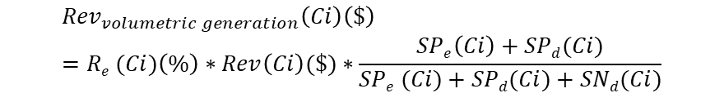
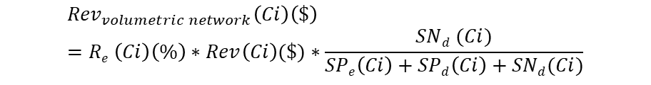
Alternative A – Stage 1 calculations
Rate Design Model
ECOSS in $ by multiplying ECOSS % times revenue for 2023 for customer class Ci
Provided in IR 4 for 3 scenarios for customer class Ci
 | Share (%) of revenue (Rev($)) for class
Energy | R_{e} (%) for total energy – also Ret (%) by tier
Demand | R_{d} (%)
Customer | R_{c} (%)
$ value | Production | Network
Energy (STot_{e}) | Production Energy (SP_{e}) | 0
Demand (STot_{d}) | Production Demand (SP_{d}) | Transmission demand (ST_{d}), Distribution Demand (SD_{d}), SNd = ST_{d} + SD_{d}
Customer (STot_{c}) |  | Network customer | Established that residual customer is network-related
3
Volumetric Network charge revenue
1
Customer charge revenue
$${Rev}_{volumetric network}\left(Ci\right)\left(\$\right)=Re \left(Ci\right)\left(\%\right)∗Rev\left(Ci\right)(\$)∗\frac{SNd (Ci)}{SPe\left(Ci\right)+SPd\left(Ci\right)+SNd(Ci)}$$
$${Rev}_{customer charge}\left(Ci\right)\left(\$\right)=Rc \left(Ci\right)\left(\%\right)∗Rev(Ci)(\$)$$
2
4
Demand charge revenue
Volumetric generation charge revenue
$${Rev}_{demand charge}\left(Ci\right)\left(\$\right)=Rd \left(Ci\right)\left(\%\right)∗Rev(Ci)(\$)$$
$${Rev}_{volumetric generation}\left(Ci\right)\left(\$\right)=Re (Ci)\left(\%\right)∗Rev\left(Ci\right)(\$)∗\frac{SPe\left(Ci\right)+SPd(Ci)}{SPe (Ci)+SPd(Ci)+SNd(Ci)}$$

Slide 15
Alternative A – Stage 2 Calculations
Rate Design Model
ECOSS in $ by multiplying ECOSS % times revenue for 2023 for customer class Ci
Provided in IR 4 for 3 scenarios for customer class Ci
 | Share (%) of revenue for class
Energy | R_{e} (%) for total energy – also Ret (%) by tier
Demand | R_{d} (%)
Customer | R_{c} (%)
$ value | Production | Network
Energy (STot_{e}) | Production Energy (SP_{e}) | 0
Demand (STot_{d}) | Production Demand (SP_{d}) | Transmission demand (ST_{d}), Distribution Demand (SD_{d}), SNd = ST_{d} + SD_{d}
Customer (STot_{c}) |  | Network customer | Established that residual customer is network-related
1
Customer charge allocation
$${Alloc}_{customer charge}\left(residential, tier\right)\left(\%\right)=\frac{{Rev}_{customer charge}\left(Ci\right)\left(\$\right)}{Rev\left(Ci\right)\left(\$\right)}∗\frac{revenue recovered tier t at current rates}{total revenue recovered from customer charge at current rates}$$
$${Alloc}_{customer charge}\left(all other classes\right)\left(\%\right)=\frac{{Rev}_{customer charge}\left(Ci\right)\left(\$\right)}{Rev\left(Ci\right)\left(\$\right)}=Rc \left(Ci\right)(\%)$$
2
Demand charge revenue
$${Alloc}_{demand charge}\left(Ci, subclass x\right)\left(\%\right)=Rd\left(Ci\right)\left(\%\right)∗\frac{revenue recovered from subclass x \left(A, B, or C\right)at current rates}{total revenue recovered from all subclasses at current rates}$$

Slide 16
Alternative A – Stage 2 Calculations
Rate Design Model
ECOSS in $ by multiplying ECOSS % times revenue for 2023 for customer class Ci
Provided in IR 4 for 3 scenarios for customer class Ci
 | Share (%) of revenue for class
Energy | R_{e} (%) for total energy – also Ret (%) by tier
Demand | R_{d} (%)
Customer | R_{c} (%)
$ value | Production | Network
Energy (STot_{e}) | Production Energy (SP_{e}) | 0
Demand (STot_{d}) | Production Demand (SP_{d}) | Transmission demand (ST_{d}), Distribution Demand (SD_{d}), SNd = ST_{d} + SD_{d}
Customer (STot_{c}) |  | Network customer | Established that residual customer is network-related
3
Volumetric charge allocation
$${Alloc}_{volumetric generation charge}\left(Ci, tier t\right)\left(\%\right)=\frac{{Rev}_{volumetric generation}\left(Ci\right)(\$)}{Rev\left(Ci\right)\left(\$\right)}∗\frac{Re (Ci,t)}{R_{e}}$$
$${Alloc}_{volumetric network charge}\left(Ci, tier t\right)\left(\%\right)=\frac{{Rev}_{volumetric network}\left(Ci\right)(\$)}{Rev\left(Ci\right)\left(\$\right)}∗\frac{Re (Ci,t)}{R_{e}}$$

Slide 17
Alternative B- Staged calculation approach

Slide 18
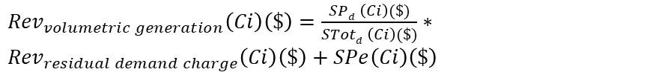
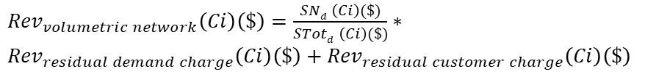
Alternative B – Stage 1 Calculations
Rate Design Model
ECOSS in $ by multiplying ECOSS % times revenue for 2023 for customer class Ci
Provided in IR 4 for 3 scenarios for customer class Ci
 | Share (%) of revenue for class
Energy | R_{e} (%) for total energy – also Ret (%) by tier
Demand | R_{d} (%)
Customer | R_{c} (%)
$ value | Production | Network
Energy (STot_{e}) | Production Energy (SP_{e}) | 0
Demand (STot_{d}) | Production Demand (SP_{d}) | Transmission demand (ST_{d}), Distribution Demand (SD_{d}), SNd = ST_{d} + SD_{d}
Customer (STot_{c}) |  | Network customer | Established that residual customer is network-related
3
Volumetric Network charge revenue
1
Customer charge revenue
${Rev}_{volumetric network}\left(Ci\right)\left(\$\right)=\frac{SNd \left(Ci\right)(\$)}{STotd \left(Ci\right)(\$)}∗$ ${Rev}_{residual demand charge}\left(Ci\right)\left(\$\right)+{Rev}_{residual customer charge}\left(Ci\right)\left(\$\right)$
$${Rev}_{customer charge}\left(Ci\right)\left(\$\right)=Rc \left(Ci\right)\left(\%\right)∗Rev(Ci)(\$)$$
$${Rev}_{residual customer charge}\left(Ci\right)\left(\$\right)=STotc \left(Ci\right)\left(\$\right)−{Rev}_{customer charge}\left(Ci\right)\left(\$\right)$$
2
4
Demand charge revenue
Volumetric generation charge revenue
${Rev}_{volumetric generation}\left(Ci\right)\left(\$\right)=\frac{SPd \left(Ci\right)(\$)}{STotd \left(Ci\right)(\$)}∗$ ${Rev}_{residual demand charge}\left(Ci\right)\left(\$\right)+SPe\left(Ci\right)\left(\$\right)$
$${Rev}_{demand charge}\left(Ci\right)\left(\$\right)=Rd \left(Ci\right)\left(\%\right)∗Rev(Ci)(\$)$$
$${Rev}_{residual demand charge}\left(Ci\right)\left(\$\right)=STotd \left(Ci\right)\left(\$\right)−{Rev}_{demand charge}\left(Ci\right)\left(\$\right)$$

Slide 19
Alternative B – Stage 2 Calculations
Rate Design Model
ECOSS in $ by multiplying ECOSS % times revenue for 2023 for customer class Ci
Provided in IR 4 for 3 scenarios for customer class Ci
 | Share (%) of revenue for class
Energy | R_{e} (%) for total energy – also Ret (%) by tier
Demand | R_{d} (%)
Customer | R_{c} (%)
$ value | Production | Network
Energy (STot_{e}) | Production Energy (SP_{e}) | 0
Demand (STot_{d}) | Production Demand (SP_{d}) | Transmission demand (ST_{d}), Distribution Demand (SD_{d}), SNd = ST_{d} + SD_{d}
Customer (STot_{c}) |  | Network customer | Established that residual customer is network-related
1
Customer charge allocation
$${Alloc}_{customer charge}\left(residential, tier\right)\left(\%\right)=\frac{{Rev}_{customer charge}\left(Ci\right)\left(\$\right)}{Rev\left(Ci\right)\left(\$\right)}∗\frac{revenue recovered tier t at current rates}{total revenue recovered from customer carge at current rates}$$
$${Alloc}_{customer charge}\left(all other classes\right)\left(\%\right)=\frac{{Rev}_{customer charge}\left(Ci\right)\left(\$\right)}{Rev\left(Ci\right)\left(\$\right)}=Rc \left(Ci\right)(\%)$$
2
Demand charge revenue
$${Alloc}_{demand charge}\left(Ci, subclass x\right)\left(\%\right)=Rd\left(Ci\right)\left(\%\right)∗\frac{revenue recovered from subclass x \left(A, B, or C\right)at current rates}{total revenue recovered from all subclasses at current rates}$$

Slide 20
Alternative B – Stage 2 Calculations
Rate Design Model
ECOSS in $ by multiplying ECOSS % times revenue for 2023 for customer class Ci
Provided in IR 4 for 3 scenarios for customer class Ci
 | Share (%) of revenue for class
Energy | R_{e} (%) for total energy – also Ret (%) by tier
Demand | R_{d} (%)
Customer | R_{c} (%)
$ value | Production | Network
Energy (STot_{e}) | Production Energy (SP_{e}) | 0
Demand (STot_{d}) | Production Demand (SP_{d}) | Transmission demand (ST_{d}), Distribution Demand (SD_{d}), SNd = ST_{d} + SD_{d}
Customer (STot_{c}) |  | Network customer | Established that residual customer is network-related
3
Volumetric charge allocation
$${Alloc}_{volumetric generation charge}\left(Ci, tier t\right)\left(\%\right)=\frac{{Rev}_{volumetric generation}\left(Ci\right)(\$)}{Rev\left(Ci\right)\left(\$\right)}∗\frac{Re (Ci,t)}{R_{e}}$$
$${Alloc}_{volumetric network charge}\left(Ci, tier t\right)\left(\%\right)=\frac{{Rev}_{volumetric network}\left(Ci\right)(\$)}{Rev\left(Ci\right)\left(\$\right)}∗\frac{Re (Ci,t)}{R_{e}}$$

Slide 21
Examples #1 (dummy data)-Residential

Slide 22
Example information – eg residential
Example 1 – Residential
ECOSS Results (%)
Revenue breakdown
 | Production | Network
Energy | 5% | 0
Demand | 30% | Transmission – 15% Distribution – 30%
Customer | 20% | Network customer
 | Residential revenue allocation
Customer charge | 50%
Energy Charge – tier 1 | 10.5%
Energy Charge – tier 2 | 19.0%
Energy Charge – tier 3 | 20.5%
Demand | 0%
 | Revenue to recover
Revenue to recover from residential ($) | 100,000,000
ECOSS Results ($) using revenue to collect
 | Production | Network
Energy | 5,000,000 | 0
Demand | 30,000,000 | Transmission – 15,000,000 Distribution – 30,000,000
Customer | 20,000,000 | Network customer

Slide 23
Example - BELCO’s approach
Notes:
Proposed approach?

Slide 24
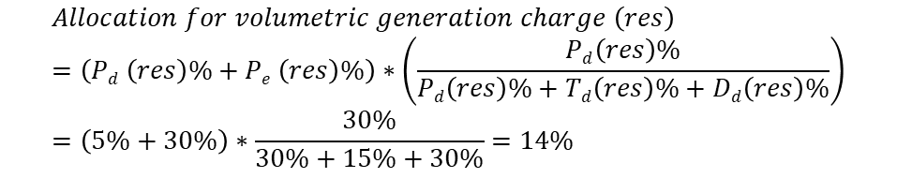
BELCO’s Approach
Example 1 – Residential
ECOSS Results (%)
Revenue breakdown
 | Production | Network
Energy | 5% | 0
Demand | 30% | Transmission – 15% Distribution – 30%
Customer | 20% | Network customer
 | Residential revenue allocation
Customer charge | 50%
Energy Charge – tier 1 | 10.5%
Energy Charge – tier 2 | 19.0%
Energy Charge – tier 3 | 20.5%
Demand | 0%
 | Revenue to recover
Revenue to recover from residential ($) | 100,000,000
1
Customer charge revenue
2
Volumetric generation revenue
$${Rev}_{customer charge}\left(res\right)\left(\$\right)=Rc (res)\left(\%\right)∗Rev(res)(\$)$$
$$Allocation for volumetric generation charge \left(res\right)=\left(Pd \left(res\right)\%+Pe \left(res\right)\%\right)∗\left(\frac{Pd\left(res\right)\%}{Pd\left(res\right)\%+Td\left(res\right)\%+Dd\left(res\right)\%}\right)=\left(5\%+30\%\right)∗\frac{30\%}{30\%+15\%+30\%}=14\%$$
$${Rev}_{customer charge}\left(res\right)\left(\$\right)=50\%∗100,000,000=\$50,000,000$$
$${Rev}_{volumetric generation}\left(res\right)\left(\$\right)=14\%∗100,000,000=\$14,000,000$$

Slide 25
BELCO’s Approach
Example 1 – Residential
ECOSS Results (%)
Revenue breakdown
 | Production | Network
Energy | 5% | 0
Demand | 30% | Transmission – 15% Distribution – 30%
Customer | 20% | Network customer
 | Residential revenue allocation
Customer charge | 50%
Energy Charge – tier 1 | 10.5%
Energy Charge – tier 2 | 19.0%
Energy Charge – tier 3 | 20.5%
Demand | 0%
 | Revenue to recover
Revenue to recover from residential ($) | 100,000,000
3
Demand charge
$$Allocation for generation demand charge \left(res\right)=Rd \left(res\right)\left(\%\right)∗\left(either 25\% for block 1 or 75\% for block 2\right)∗Pd \left(res\right)\left(\%\right)∗\frac{Pd \left(res\right)\left(\%\right)}{Pd \left(res\right)\left(\%\right)+Nd\left(res\right)\left(\%\right)}=0\%$$
$$Allocation for network demand charge \left(res,block\right)=Rd \left(res\right)\left(\%\right)∗\left(either 25\% for block 1 or 75\% for block 2\right)−Allocation for generation demand charge \left(res, block\right)=0\%$$

Slide 26
BELCO’s Approach
Example 1 – Residential
ECOSS Results (%)
Revenue breakdown
 | Production | Network
Energy | 5% | 0
Demand | 30% | Transmission – 15% Distribution – 30%
Customer | 20% | Network customer
 | Residential revenue allocation
Customer charge | 50%
Energy Charge – tier 1 | 10.5%
Energy Charge – tier 2 | 19.0%
Energy Charge – tier 3 | 20.5%
Demand | 0%
 | Revenue to recover
Revenue to recover from residential ($) | 100,000,000
4
Volumetric network revenue
$$Allocation for volumetric network \left(res\right)\left(\%\right)=1−customer charge \% −demand charge \% −volumetric generation \%=1−50\%−0\%−14\%=36\%$$
$${Rev}_{volumetric network}\left(res\right)\left(\$\right)=36\%∗100,000,000=\$36,000,000$$

Slide 27
Example- Alternative A

Slide 28
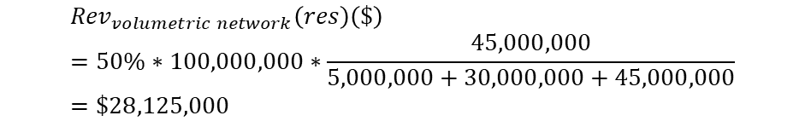
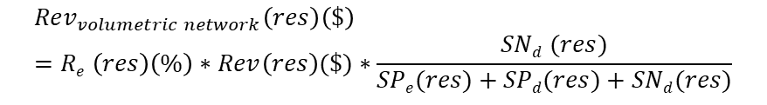
Alternative A
Example 1 – Residential
ECOSS Results ($) using revenue to collect
Revenue breakdown
 | Production | Network
Energy | 5,000,000 | 0
Demand | 30,000,000 | Transmission – 15,000,000 Distribution – 30,000,000
Customer | 20,000,000 | Network customer
 | Residential revenue allocation
Customer charge | 50%
Energy Charge – tier 1 | 10.5%
Energy Charge – tier 2 | 19.0%
Energy Charge – tier 3 | 20.5%
Demand | 0%
 | Revenue to recover
Revenue to recover from residential ($) | 100,000,000
Sum of this is = 50%=R_{e}
1
Customer charge revenue
3
Volumetric Network charge revenue
$${Rev}_{customer charge}\left(res\right)\left(\$\right)=Rc \left(res\right)\left(\%\right)∗Rev(res)(\$)$$
$${Rev}_{volumetric network}\left(res\right)\left(\$\right)=Re \left(res\right)\left(\%\right)∗Rev\left(res\right)(\$)∗\frac{SNd (res)}{SPe(res)+SPd(res)+SNd(res)}$$
$${Rev}_{customer charge}\left(res\right)\left(\$\right)=50\%∗100,000,000=\$50,000,000$$
2
$${Rev}_{volumetric network}\left(res\right)\left(\$\right)=50\%∗100,000,000∗\frac{45,000,000}{5,000,000+30,000,000+45,000,000}=\$28,125,000$$
Demand charge revenue
$${Rev}_{demand charge}\left(res\right)\left(\$\right)=Rd \left(Ci\right)\left(\%\right)∗Rev(res)(\$)$$
$${Rev}_{demand charge}\left(res\right)\left(\$\right)=0\%∗100,000,000=\$0$$
$${Alloc}_{volumetric network}\left(res\right)\left(\%\right)=\frac{28,125,000}{100,000,000}=28.13\%$$

Slide 29
Alternative A
Example 1 – Residential
ECOSS Results ($) using revenue to collect
Revenue breakdown
 | Production | Network
Energy | 5,000,000 | 0
Demand | 30,000,000 | Transmission – 15,000,000 Distribution – 30,000,000
Customer | 20,000,000 | Network customer
 | Residential revenue allocation
Customer charge | 50%
Energy Charge – tier 1 | 10.5%
Energy Charge – tier 2 | 19.0%
Energy Charge – tier 3 | 20.5%
Demand | 0%
 | Revenue to recover
Revenue to recover from residential ($) | 100,000,000
Sum of this is = 50%=R_{e}
3
Volumetric generation charge revenue
$${Rev}_{volumetric generation}\left(res\right)\left(\$\right)=Re (res)\left(\%\right)∗Rev\left(res\right)(\$)∗\frac{SPe(res)+SPd(res)}{SPe(res)+SPd(res)+SNd(res)}$$
$${Rev}_{volumetric generation}\left(res\right)\left(\$\right)=50\%∗100,000,000∗\frac{5,000,000+30,000,000}{5,000,000+30,000,000+45,000,000}=\$21,875,000$$
$${Alloc}_{volumetric generation}\left(res\right)\left(\%\right)=\frac{21,875,000}{100,000,000}=21.88\%$$

Slide 30
Example- Alternative B

Slide 31
Alternative B
Example 1 – Residential
ECOSS Results ($) using revenue to collect
Revenue breakdown
 | Production | Network
Energy | 5,000,000 | 0
Demand | 30,000,000 | Transmission – 15,000,000 Distribution – 30,000,000
Customer | 20,000,000 | Network customer
 | Residential revenue allocation
Customer charge | 50%
Energy Charge – tier 1 | 10.5%
Energy Charge – tier 2 | 19.0%
Energy Charge – tier 3 | 20.5%
Demand | 0%
 | Revenue to recover
Revenue to recover from residential ($) | 100,000,000
Sum of this is = 50%=Re
1
Customer charge revenue
2
Demand charge revenue
$${Rev}_{customer charge}\left(res\right)\left(\$\right)=Rc \left(res\right)\left(\%\right)∗Rev(res)(\$)$$
$${Rev}_{customer charge}\left(res\right)\left(\$\right)=50\%∗100,000,000=\$50,000,000$$
$${Rev}_{demand charge}\left(res\right)\left(\$\right)=Rd \left(res\right)\left(\%\right)∗Rev(res)(\$)$$
$${Rev}_{demand charge}\left(res\right)\left(\$\right)=0\%∗100,000,000=\$0$$
$${Rev}_{residual customer charge}\left(res\right)\left(\$\right)=STotc \left(res\right)\left(\$\right)−{Rev}_{customer charge}\left(res\right)\left(\$\right)$$
$${Rev}_{residual demand charge}\left(res\right)\left(\$\right)=STotd \left(res\right)\left(\$\right)−{Rev}_{demand charge}\left(res\right)\left(\$\right)$$
$${Rev}_{residual customer charge}\left(res\right)\left(\$\right)=20,000,000−50,000,000=−\$30,000,000$$
$${Rev}_{residual demand charge}\left(res\right)\left(\$\right)=30,000,000+15,000,000+30,000,000−0=\$75,000,000$$

Slide 32
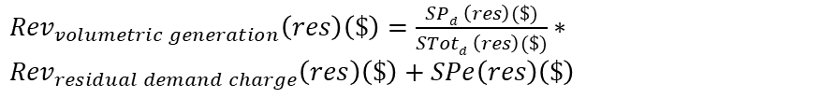
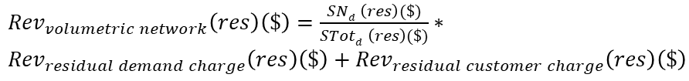
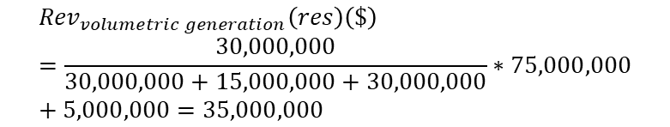
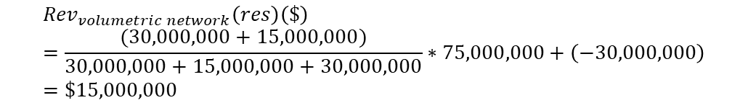
Alternative B
Example 1 – Residential
ECOSS Results ($) using revenue to collect
Revenue breakdown
 | Production | Network
Energy | 5,000,000 | 0
Demand | 30,000,000 | Transmission – 15,000,000 Distribution – 30,000,000
Customer | 20,000,000 | Network customer
 | Residential revenue allocation
Customer charge | 50%
Energy Charge – tier 1 | 10.5%
Energy Charge – tier 2 | 19.0%
Energy Charge – tier 3 | 20.5%
Demand | 0%
 | Revenue to recover
Revenue to recover from residential ($) | 100,000,000
Sum of this is = 50%=Re
3
4
Volumetric Network charge revenue
Volumetric generation charge revenue
${Rev}_{volumetric network}\left(res\right)\left(\$\right)=\frac{SNd \left(res\right)(\$)}{STotd \left(res\right)(\$)}∗$ ${Rev}_{residual demand charge}\left(res\right)\left(\$\right)+{Rev}_{residual customer charge}\left(res\right)\left(\$\right)$
${Rev}_{volumetric generation}\left(res\right)\left(\$\right)=\frac{SPd \left(res\right)(\$)}{STotd \left(res\right)(\$)}∗$ ${Rev}_{residual demand charge}\left(res\right)\left(\$\right)+SPe\left(res\right)\left(\$\right)$
$${Rev}_{volumetric network}\left(res\right)\left(\$\right)=\frac{(30,000,000+15,000,000)}{30,000,000+15,000,000+30,000,000}∗75,000,000+\left(−30,000,000\right)=\$15,000,000$$
$${Rev}_{volumetric generation}\left(res\right)\left(\$\right)=\frac{30,000,000}{30,000,000+15,000,000+30,000,000}∗75,000,000+5,000,000=35,000,000$$
$${Alloc}_{volumetric network}\left(res\right)\left(\%\right)=\frac{15,000,000}{100,000,000}=15\%$$
$${Alloc}_{volumetric generation}\left(res\right)\left(\%\right)=\frac{35,000,000}{100,000,000}=35\%$$

Slide 33
Example- Results

Slide 34
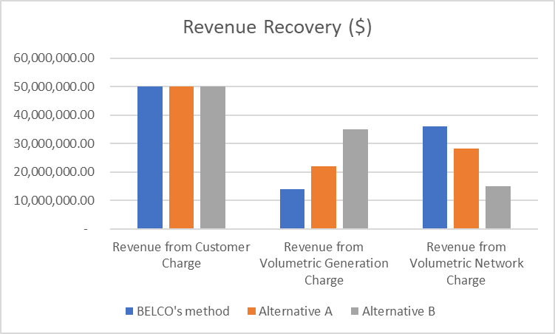
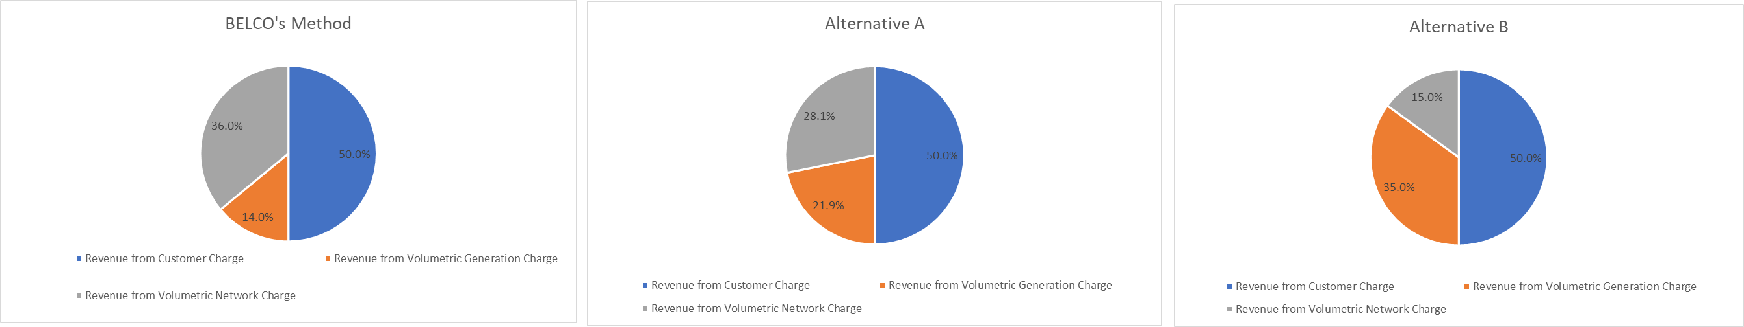
Results
Example 1 – Residential
ECOSS Results (%)
The volumetric network is lower because the customer cost over-recovery, relative to ECOSS, is placed all under network charge (in this example – there is an over-recovery from customer charge –reducing network charge)
 | Production | Network
Energy | 5% | 0
Demand | 30% | Transmission – 15% Distribution – 30%
Customer | 20% | Network customer

Slide 35
Examples #2 (Made up numbers!)-Demand Class

Slide 36
Example information – let’s say demand class now
Example 2 – Demand Class
ECOSS Results (%)
Revenue breakdown
 | Production | Network
Energy | 3% | 0
Demand | 60% | Transmission – 20% Distribution – 12%
Customer | 5% | Network customer
 | Demand class revenue allocation
Customer charge | 0.6%
Energy Charge – tier 1 | 44.5%
Energy Charge – tier 2 | 18.3%
Energy Charge – tier 3 | 2.2%
Demand | 34.4%
 | Revenue to recover
Revenue to recover from demand class ($) | 75,000,000
ECOSS Results ($) using revenue to collect
 | Production | Network
Energy | 2,250,000 | 0
Demand | 45,000,000 | Transmission – 15,000,000 Distribution – 9,000,000
Customer | 3,750,000 | Network customer

Slide 37
Example-BELCO’s approach

Slide 38
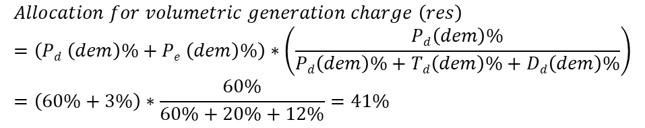
BELCO’s Approach
Example 2 – Demand Class
ECOSS Results (%)
Revenue breakdown
 | Production | Network
Energy | 3% | 0
Demand | 60% | Transmission – 20% Distribution – 12%
Customer | 5% | Network customer
 | Demand class revenue allocation
Customer charge | 0.6%
Energy Charge – tier 1 | 44.5%
Energy Charge – tier 2 | 18.3%
Energy Charge – tier 3 | 2.2%
Demand | 34.4%
 | Revenue to recover
Revenue to recover from demand class ($) | 75,000,000
1
Customer charge revenue
2
Volumetric generation revenue
$${Rev}_{customer charge}\left(dem\right)\left(\$\right)=Rc (dem)\left(\%\right)∗Rev(dem)(\$)$$
$$Allocation for volumetric generation charge \left(res\right)=\left(Pd \left(dem\right)\%+Pe \left(dem\right)\%\right)∗\left(\frac{Pd\left(dem\right)\%}{Pd\left(dem\right)\%+Td\left(dem\right)\%+Dd\left(dem\right)\%}\right)=\left(60\%+3\%\right)∗\frac{60\%}{60\%+20\%+12\%}=41\%$$
$${Rev}_{customer charge}\left(dem\right)\left(\$\right)=0.6\%∗75,000,000=\$450,000$$
$${Rev}_{volumetric generation}\left(dem\right)\left(\$\right)=41\%∗75,000,000=\$30,815,217.39$$

Slide 39
BELCO’s Approach
Example 2 – Demand Class
ECOSS Results (%)
Revenue breakdown
 | Production | Network
Energy | 3% | 0
Demand | 60% | Transmission – 20% Distribution – 12%
Customer | 5% | Network customer
 | Demand class revenue allocation
Customer charge | 0.6%
Energy Charge – tier 1 | 44.5%
Energy Charge – tier 2 | 18.3%
Energy Charge – tier 3 | 2.2%
Demand | 34.4%
 | Revenue to recover
Revenue to recover from demand class ($) | 75,000,000
3
Demand charge
$$Allocation for generation demand charge \left(dem,block\right)=Rd \left(dem\right)\left(\%\right)∗\left(either 25\% for block 1 or 75\% for block 2\right)∗Pd \left(dem\right)\left(\%\right)∗\frac{Pd \left(dem\right)\left(\%\right)}{Pd \left(dem\right)\left(\%\right)+Nd\left(dem\right)\left(\%\right)}$$
$$Allocation for generation demand charge \left(dem, block 1\right)=34.4\%∗25\%∗60\%∗\frac{60\%}{60\%+20\%+12\%}=3\%$$
$$Revdemand charge \left(dem, block 1\right)=3\%∗75,000,000=\$2,523,913.04$$
$$Allocation for generation demand charge \left(dem, block 2\right)=34.4\%∗75\%∗60\%∗\frac{60\%}{60\%+20\%+12\%}=10\%$$
$$Revdemand charge \left(dem, block 2\right)=10\%∗75,000,000=\$7,571,739.13$$

Slide 40
BELCO’s Approach
Example 2 – Demand Class
ECOSS Results (%)
Revenue breakdown
 | Production | Network
Energy | 3% | 0
Demand | 60% | Transmission – 20% Distribution – 12%
Customer | 5% | Network customer
 | Demand class revenue allocation
Customer charge | 0.6%
Energy Charge – tier 1 | 44.5%
Energy Charge – tier 2 | 18.3%
Energy Charge – tier 3 | 2.2%
Demand | 34.4%
 | Revenue to recover
Revenue to recover from demand class ($) | 75,000,000
3
Demand charge
$$Allocation for network demand charge \left(dem,block\right)=Rd \left(dem\right)\left(\%\right)∗\left(either 25\% for block 1 or 75\% for block 2\right)−Allocation for generation demand charge \left(dem, block\right)$$
$$Allocation for network demand charge \left(dem, block 1\right)=34.4\%∗25\%−3\%=5\%$$
$$Revdemand charge \left(dem, block 1\right)=5\%∗75,000,000=\$3,926,086.96$$
$$Allocation for network demand charge \left(dem, block 2\right)=34.4\%∗75\%−10\%=16\%$$
$$Revdemand charge \left(dem, block 1\right)=16\%∗75,000,000=\$11,778,260.87$$

Slide 41
BELCO’s Approach
Example 2 – Demand Class
ECOSS Results (%)
Revenue breakdown
 | Production | Network
Energy | 3% | 0
Demand | 60% | Transmission – 20% Distribution – 12%
Customer | 5% | Network customer
 | Demand class revenue allocation
Customer charge | 0.6%
Energy Charge – tier 1 | 44.5%
Energy Charge – tier 2 | 18.3%
Energy Charge – tier 3 | 2.2%
Demand | 34.4%
 | Revenue to recover
Revenue to recover from demand class ($) | 75,000,000
4
Volumetric network revenue
$$Allocation for volumetric network \left(dem\right)\left(\%\right)=1−customer charge \% −demand charge \% −volumetric generation \%=1−0.6\%−3\%−10\%−5\%−16\%−41\%=24\%$$
$${Rev}_{volumetric network}\left(dem\right)\left(\$\right)=24\%∗75,000,000=\$17,934,782.61$$

Slide 42
Example- Alternative A

Slide 43
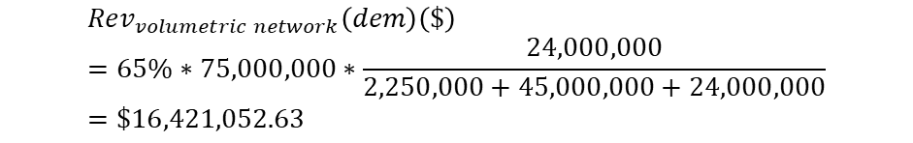
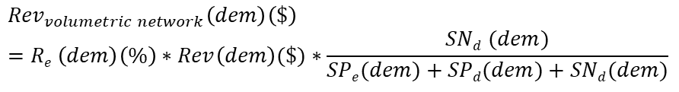
Alternative A
Example 2 – Demand Class
ECOSS Results ($) using revenue to collect
Revenue breakdown
 | Production | Network
Energy | 2,250,000 | 0
Demand | 45,000,000 | Transmission – 15,000,000 Distribution – 9,000,000
Customer | 3,750,000 | Network customer
 | Demand class revenue allocation
Customer charge | 0.6%
Energy Charge – tier 1 | 44.5%
Energy Charge – tier 2 | 18.3%
Energy Charge – tier 3 | 2.2%
Demand | 34.4%
 | Revenue to recover
Revenue to recover from demand class ($) | 75,000,000
Sum of this is = 65%=R_{e}
1
Customer charge revenue
3
Volumetric Network charge revenue
$${Rev}_{customer charge}\left(dem\right)\left(\$\right)=Rc \left(dem\right)\left(\%\right)∗Rev(dem)(\$)$$
$${Rev}_{volumetric network}\left(dem\right)\left(\$\right)=Re \left(dem\right)\left(\%\right)∗Rev\left(dem\right)(\$)∗\frac{SNd (dem)}{SPe(dem)+SPd(dem)+SNd(dem)}$$
$${Rev}_{customer charge}\left(dem\right)\left(\$\right)=0.6\%∗75,000,000=\$450,000$$
2
$${Rev}_{volumetric network}\left(dem\right)\left(\$\right)=65\%∗75,000,000∗\frac{24,000,000}{2,250,000+45,000,000+24,000,000}=\$16,421,052.63$$
Demand charge revenue
$${Rev}_{demand charge}\left(dem\right)\left(\$\right)=Rd \left(Ci\right)\left(\%\right)∗Rev(dem)(\$)$$
$${Rev}_{demand charge}\left(dem\right)\left(\$\right)=34.4\%∗75,000,000=\$25,800,000$$
$${Alloc}_{volumetric network}\left(dem\right)\left(\%\right)=\frac{16,421,052.63}{75,000,000}=21.89\%$$

Slide 44
Alternative A
Example 2 – Demand Class
ECOSS Results ($) using revenue to collect
Revenue breakdown
 | Production | Network
Energy | 2,250,000 | 0
Demand | 45,000,000 | Transmission – 15,000,000 Distribution – 9,000,000
Customer | 3,750,000 | Network customer
 | Demand class revenue allocation
Customer charge | 0.6%
Energy Charge – tier 1 | 44.5%
Energy Charge – tier 2 | 18.3%
Energy Charge – tier 3 | 2.2%
Demand | 34.4%
 | Revenue to recover
Revenue to recover from demand class ($) | 75,000,000
Sum of this is = 65%=R_{e}
3
Volumetric generation charge revenue
$${Rev}_{volumetric generation}\left(dem\right)\left(\$\right)=Re (dem)\left(\%\right)∗Rev\left(dem\right)(\$)∗\frac{SPe(dem)+SPd(dem)}{SPe(dem)+SPd(dem)+SNd(dem)}$$
$${Rev}_{volumetric generation}\left(dem\right)\left(\$\right)=65\%∗75,000,000∗\frac{45,000,000+2,250,000}{2,250,000+45,000,000+15,000,000+9,000,000}=\$32,328,947.37$$
$${Alloc}_{volumetric generation}\left(dem\right)\left(\%\right)=\frac{32,328,947.37}{75,000,000}=43.11\%$$

Slide 45
Example- Alternative B

Slide 46
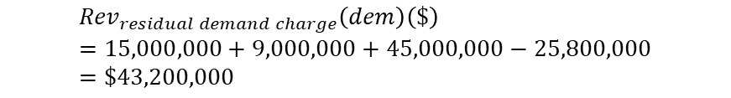
Alternative B
Example 2 – Demand Class
ECOSS Results ($) using revenue to collect
Revenue breakdown
 | Production | Network
Energy | 2,250,000 | 0
Demand | 45,000,000 | Transmission – 15,000,000 Distribution – 9,000,000
Customer | 3,750,000 | Network customer
 | Demand class revenue allocation
Customer charge | 0.6%
Energy Charge – tier 1 | 44.5%
Energy Charge – tier 2 | 18.3%
Energy Charge – tier 3 | 2.2%
Demand | 34.4%
 | Revenue to recover
Revenue to recover from demand class ($) | 75,000,000
Sum of this is = 65%=R_{e}
1
Customer charge revenue
2
Demand charge revenue
$${Rev}_{customer charge}\left(dem\right)\left(\$\right)=Rc \left(dem\right)\left(\%\right)∗Rev(dem)(\$)$$
$${Rev}_{customer charge}\left(dem\right)\left(\$\right)=0.6\%∗75,000,000=\$450,000$$
$${Rev}_{demand charge}\left(dem\right)\left(\$\right)=Rd \left(dem\right)\left(\%\right)∗Rev(dem)(\$)$$
$${Rev}_{demand charge}\left(dem\right)\left(\$\right)=34.4\%∗75,000,000=\$25,800,000$$
$${Rev}_{residual customer charge}\left(dem\right)\left(\$\right)=STotc \left(dem\right)\left(\$\right)−{Rev}_{customer charge}\left(dem\right)\left(\$\right)$$
$${Rev}_{residual demand charge}\left(dem\right)\left(\$\right)=STotd \left(dem\right)\left(\$\right)−{Rev}_{demand charge}\left(dem\right)\left(\$\right)$$
$${Rev}_{residual customer charge}\left(dem\right)\left(\$\right)=3,750,000−450,000=\$3,300,333$$
$${Rev}_{residual demand charge}\left(dem\right)\left(\$\right)=15,000,000+9,000,000+45,000,000−25,800,000=\$43,200,000$$

Slide 47
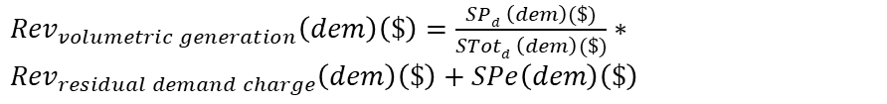
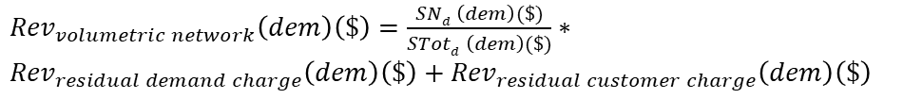
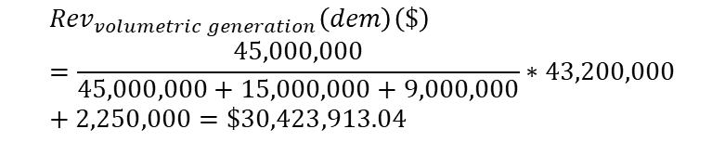
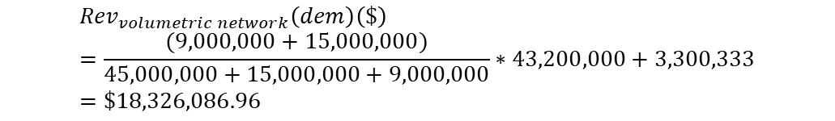
Alternative B
Example 2 – Demand Class
ECOSS Results ($) using revenue to collect
Revenue breakdown
 | Production | Network
Energy | 2,250,000 | 0
Demand | 45,000,000 | Transmission – 15,000,000 Distribution – 9,000,000
Customer | 3,750,000 | Network customer
 | Demand class revenue allocation
Customer charge | 0.6%
Energy Charge – tier 1 | 44.5%
Energy Charge – tier 2 | 18.3%
Energy Charge – tier 3 | 2.2%
Demand | 34.4%
 | Revenue to recover
Revenue to recover from demand class ($) | 75,000,000
Sum of this is = 65%=R_{e}
3
4
Volumetric Network charge revenue
Volumetric generation charge revenue
${Rev}_{volumetric network}\left(dem\right)\left(\$\right)=\frac{SNd \left(dem\right)(\$)}{STotd \left(dem\right)(\$)}∗$ ${Rev}_{residual demand charge}\left(dem\right)\left(\$\right)+{Rev}_{residual customer charge}\left(dem\right)\left(\$\right)$
${Rev}_{volumetric generation}\left(dem\right)\left(\$\right)=\frac{SPd \left(dem\right)(\$)}{STotd \left(dem\right)(\$)}∗$ ${Rev}_{residual demand charge}\left(dem\right)\left(\$\right)+SPe\left(dem\right)\left(\$\right)$
$${Rev}_{volumetric network}\left(dem\right)\left(\$\right)=\frac{(9,000,000+15,000,000)}{45,000,000+15,000,000+9,000,000}∗43,200,000+3,300,333=\$18,326,086.96$$
$${Rev}_{volumetric generation}\left(dem\right)\left(\$\right)=\frac{45,000,000}{45,000,000+15,000,000+9,000,000}∗43,200,000+2,250,000=\$30,423,913.04$$
$${Alloc}_{volumetric network}\left(res\right)\left(\%\right)=\frac{18,326,086.96}{75,000,000}=24.43\%$$
$${Alloc}_{volumetric generation}\left(res\right)\left(\%\right)=\frac{30,423,913.04}{75,000,000}=40.57\%$$

Slide 48
Example- Results

Slide 49
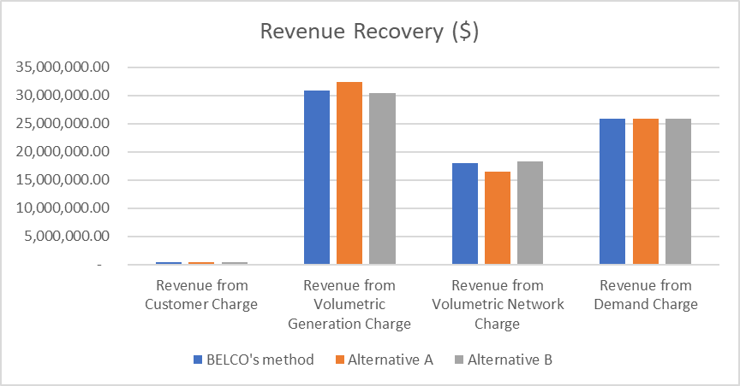
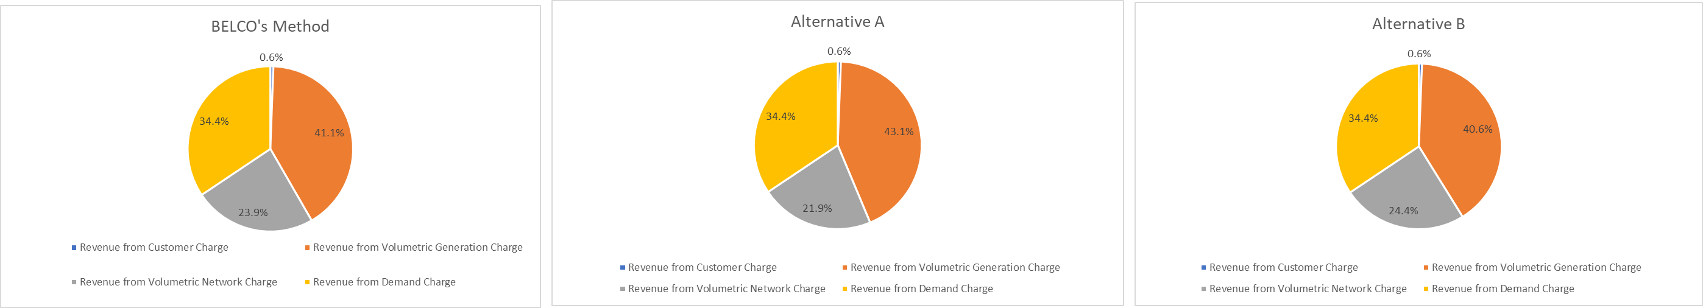
Results
Example 2 – Demand Class
ECOSS Results (%)
The volumetric network is higher because the customer cost under-recovery, relative to ECOSS, is placed all under network charge (in this example – there is an under-recovery from customer charge –increasing network charge)
 | Production | Network
Energy | 3% | 0
Demand | 60% | Transmission – 20% Distribution – 12%
Customer | 5% | Network customer

Slide 50
Next Steps and Considerations

Slide 51
Next Steps…
Rate Design Model
Next steps
1
Edit model to incorporate Alternatives A and B discussed – as a toggle
2
Incorporate toggle option to retain or eliminate increasing block variable tariffs for residential and/or commercial customers
3
Disaggregate demand allocation percentages by sub-class (A, B, C) rather than by demand tariff block (Class one, two) – incorporated through Alternatives A&B
4
Run the same three scenarios (on the right) and provide statistical analysis for each scenario (and alternative) to quantify impact on customers (in % and BMD)

Slide 52
Next Steps..
Rate Design Model
BELCO submitted report on “Tariff Design Modernisation Strategy”
BELCO submitted a rate redesign model
RA released a Public Report to collate public feedback
Discussions with BELCO
Refining and finalising rate redesign model
Calculate and implement rates with approved revenue allowance
Conduct customer impact analysis
Finalise ratios of fixed vs variable charges for customer classes
Legend
Completed
In progress
To be completed

Slide 53
TOU Pilot

Slide 54
TOU Considerations
TOU Considerations
There are two types of Time-of-use (TOU) pricing: 1) cost-based and 2) non-cost based TOU
Model | Details | Pros | Cons
Business as usual | Charges do not vary with time/season, etc | Already standardised Requires no further explanation as there is already understanding | Does not provide any signal to customers on when to consume electricity
Cost-based TOU | Pricing varies based on costs Variation can happen hourly, daily, seasonal, etc – the structure decided upon by BELCO/RA can be flexible Basis of variation is generation costs which can be market-based Rates are based on generation and system costs and granularity can depend on data available | Reflective of generation and system costs (market-based) Could be relevant with more renewable deployment Can help incentivise EVs and electrification of consumption (charging/using appliances at ‘cheaper’ times) Can help incentivise consumption during lower demand periods (efficient use of available capacity) There are a range of design options (from simple to complex) which can be tailored to ensure customer support (or buy-in) | Current levels of renewable energy results in relatively small price variation throughout different period in the day Concern that the price signal would not be strong enough to incentivise customers to change behaviour Would require public engagement and buy-in
Non-cost-based TOU | Pricing varies based on set ratio, value, or indexation (not only based on costs) Usually set to achieve a desired outcome Variation can happen hourly, daily, seasonal, etc – the structure decided upon by BELCO/RA can be flexible Basis of variation is an indexation or ratio set – can be non-market based | Can create stronger signals for customers to react (compared to cost-based) Can help incentivise consumption during lower demand periods Can help incentivise EVs/electrification of consumption There are a range of design options (from simple to complex) which can be tailored to ensure customer support (or buy-in) | Prices could be higher than costs which could reduce efficient consumption - unless there are subsidies involved or if mark-up is prices appropriately Would require public engagement – could be harder to gain public support, compared to cost-based TOU Could be difficult to move towards more cost-based once non-cost based ratios established

Slide 55
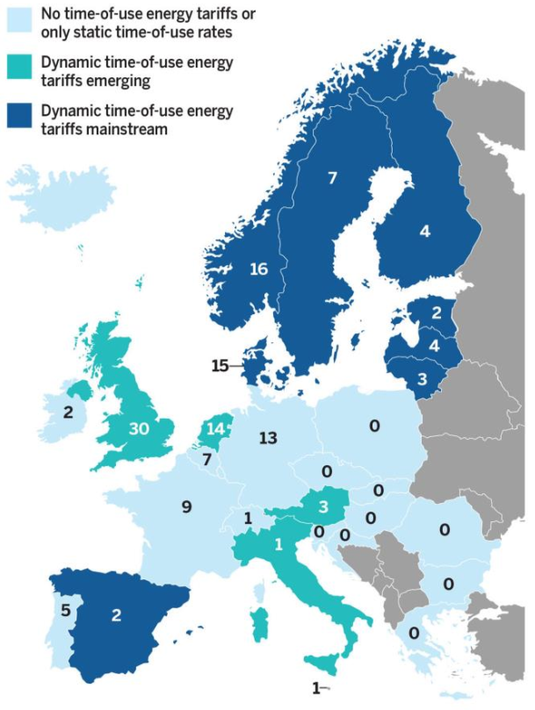
TOU in Europe
TOU Considerations
Number of EV charging tariffs per country in Europe in 2021, as well as the general availability of TOU tariff schemes (not only linked to EV charging).
A mix of tariff schemes is possible within a country
Tariff scheme is mostly dependent on the capability of the metering:
  Key driver is to understand consumption patterns and be able to minimise costs and have efficient pricing signals
  EV ownership can be a common driver to install a smart meter and/or a submeter.
  Some countries (like Spain and Scandinavia) have a full deployment of smart meters.
  In Germany, flat rates are the norm because the dominant form of meters does not allow ToU tariffication, but customers installing smart meters can benefit from more granular schemes.
  In the UK, there is a drive to replace old metering with new technology – TOU developed under metering replacement program
  ToU are shifting towards dynamic pricing (8+4 out of 29)

Slide 56






TOU Considerations for Bermuda
TOU Considerations
Considerations for TOU design in Bermuda
Questions and considerations for design
Non cost-based TOU for a range of participants across residential class
Want to understand load patterns
Frequency of variation: Night time vs day to encourage consumption (and EV connection).
Seasonal variation could help with spring and fall ‘shoulder periods’
Want to understand the evolution of generation costs throughout the day and year in smallest granularity (i.e. BELCO’s raw analysis)
Kept relatively simple to help with public understanding and response: need public engagement and important to track progress
Want to understand the ability of customers to respond

Slide 57


Designing TOU Pilot for Bermuda (1/3)
TOU Considerations
Aim
Customers/participants
Selecting participants
Need to establish motivation:
  Encourage EV deployment
  Encourage efficient investment in the network
Selecting customers:
  Customer class
  Reasonably representative group across residential customers vs
  Targeting customers (e.g. those with EVs)
Customers require AMI to participate
Options:
  Ask customers, from selected list, to participate/volunteer (i.e. optional)
  Ask for any customers to volunteer – but important to have an idea on type and number of customers we want
BELCO to select participants
Provide incentives to help increase participation?
Encourage EV deployment and efficient investment in network
Recommend a representative group in residential class as that would allow us to monitor and see if customers who don’t have EVs also change behaviour
Recommend to have a selected list and then approach those in the list and explain the pilot and ask for participation. Providing incentives could help

Slide 58


Designing TOU Pilot for Bermuda (2/3)
TOU Considerations
Number of periods
Mark-up/Discount
Electricity bills
Number of periods and specification:
  Night vs day
  More than two periods
Discount on rates during low peak periods
Mark-up on rates required to compensate for discount
Maximum/minimum discount and mark-up
Bill participants at TOU rate
Should there be a failsafe?
  e.g. Participant would not be charged more than what they would have paid on “standard rate” (i.e. standard rate is a cap)
  Run parallel metering/billing and provide a “dummy” bill
Two periods for the pilot with night vs day rates.
Could set a maximum mark-up and work out discount based on the cap to compensate.
Elicit a strong enough response.
Providing a failsafe could reduce the impact of the TOU pilot as participants would not have as much incentive to change behaviour.

Slide 59


TOU Pilot Considerations for Bermuda (3/3)
TOU Considerations
Costs
Duration
Need to establish pilot costs – will influence the size of the sample and duration
  Additional metering
  Monitoring systems and data gathering
  Collecting feedback from public
  Assume analysis will be performed by BELCO and QA’d by RA
2 – 3 years for a pilot
Quarterly progress reviews and reports from BELCO
STOP/GO after every year with potential amendments (e.g. sample size, etc)
Full detailed review after 2-3 years
Ask BELCO to provide estimate when they provide the model with TOU scenarios
Recommend a duration of 2-3 years, with quarterly reports submitted by BELCO to check progress. Every year, pilot could be amended. Full review after 2-3 years.

Slide 60







Key questions that the pilot should answer
TOU Considerations
What has been the impact on demand during system peak time?
What has been the impact on customer load profile?
What has been the average kWh shift between periods (by customer and total)?
Have customers purchased an EV because of the scheme? If so, how many?
How much have customers saved ($) throughout the scheme (average and total)? How much has BELCO saved (e.g. fuel, maintenance, balancing)?
How much has the pilot scheme cost ($) per year?
Have customers had a positive experience with the scheme?

Slide 61
Key Questions/Objectives to answer in Workshop with BELCO
TOU Considerations
Align on aim of TOU
Agree on what classes (i.e. residential only?)
Agree on whether selection should be reasonably representative or targeted towards those with EV
Agree on how the customers would be selected: volunteer, selected list
Agree on whether there should be incentives offered and if so, try and define what types
Agree on the number of periods and definitions of periods, and details on mark-ups/discounts and if there should be any max/mins
Agree on whether TOU billing is implemented for participants and whether there should be a failsafe and details if so
Agree on impact of costing and BELCO to estimate costs
Agree on duration of scheme, reporting and review frequency, ability to amend scheme annually
Agree on questions to be answered by the pilot scheme (BELCO can add)

Slide 62
Next Steps
TOU Considerations
Discussions between RA and BELCO
BELCO provides TOU model with scenarios of periods & mark-ups/discounts
BELCO provides analysis of potential impact on customer
Refine model with selected mark-ups/discounts and periods
Customer consultation, selection process……

