Slide 1



ShortCut River Quiver 2-Banger
Notes:
Generic background images here: Cover Images

Slide 2
Tool Category Name
Drill
8.5mm Drill Bit
T40 Socket
Tape Measure
Ratchet
Notes:
Note: you will likely need to resize the text box lengths

Slide 3
Components
4 - M8x30 bolts
4 - Hammer nuts
1 - River Quiver 2-Banger

Slide 4
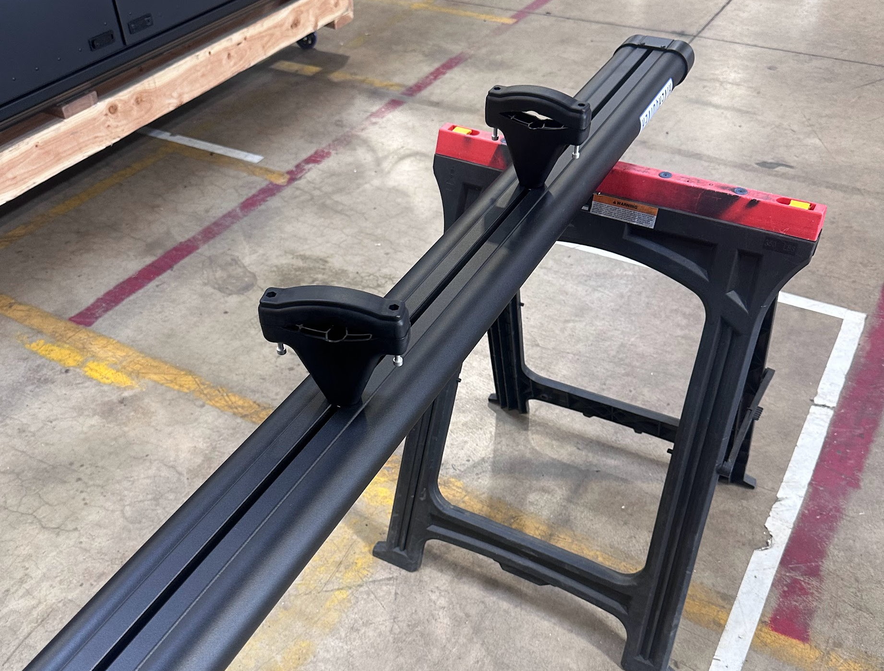
Unboxing
Using saw horses unbox the ShortCut River Quiver 2-Banger

Slide 5
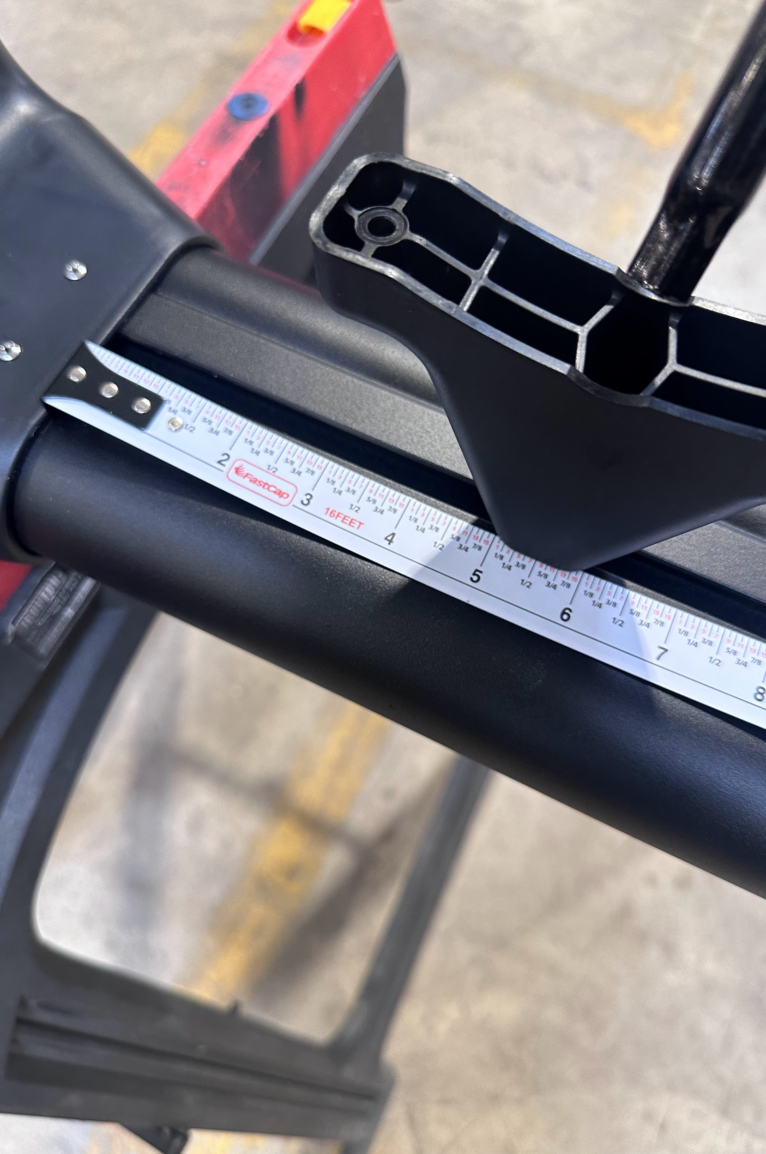
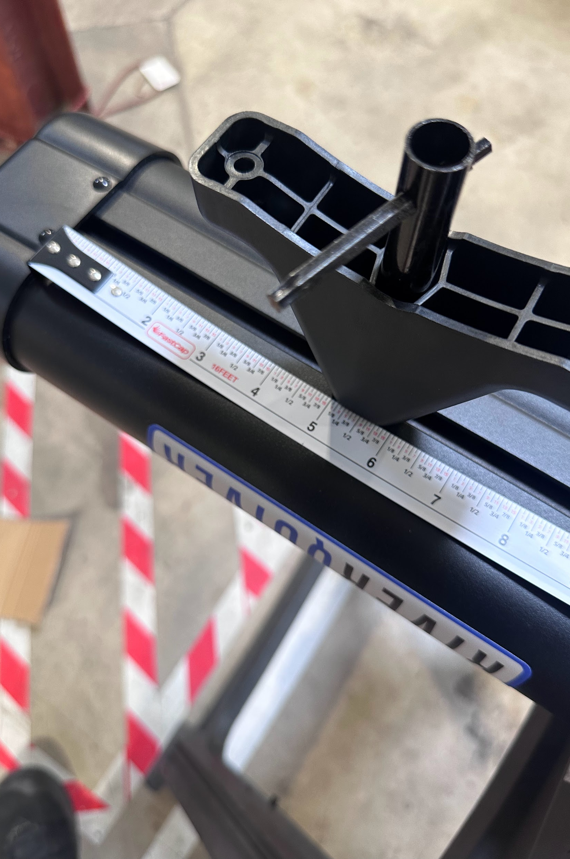
Adjusting Mounts
Using the provided tool from River Quiver turn both brackets to run parallel with the t track in the 2-Banger
Tighten down first bracket 5” from the rear of the 2-Banger
Tighten down the second bracket 5” from the front of the 2-Banger

Slide 6
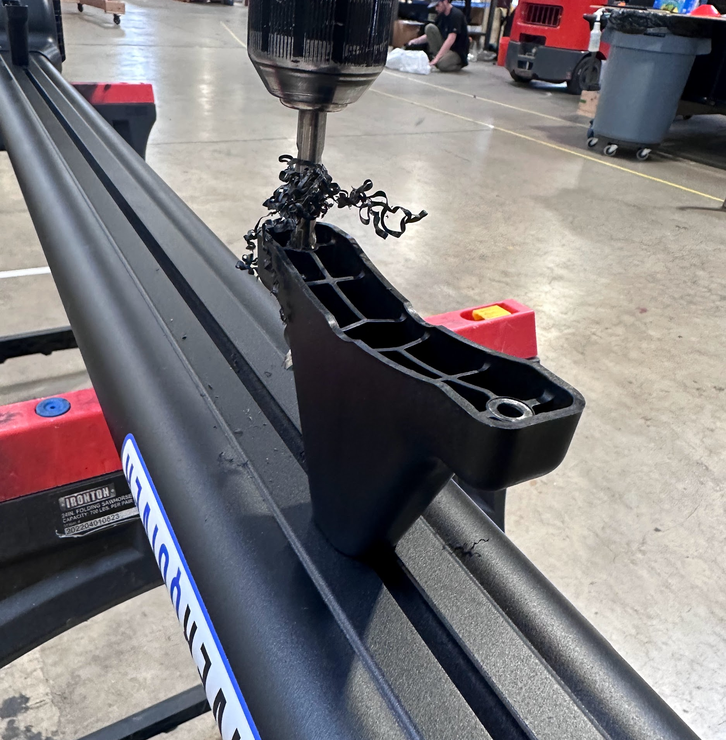

Drilling Brackets
Drill out all four holes of the 2-Banger brackets using an 8.5mm drill bit
N O T E :
When drilling out the brackets ensure you do not drill too far and hit the body of the 2-Banger

Slide 7
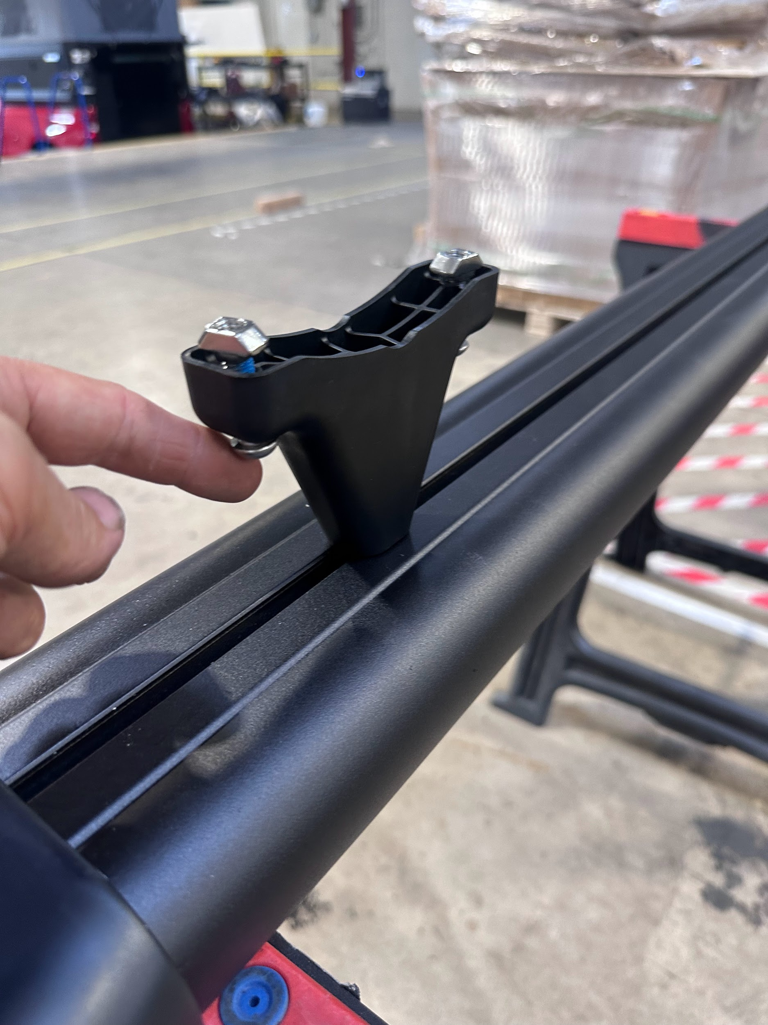
Prepping for Mounting
Install all M8x30 hardware and the included hammer nuts into the brackets

Slide 8
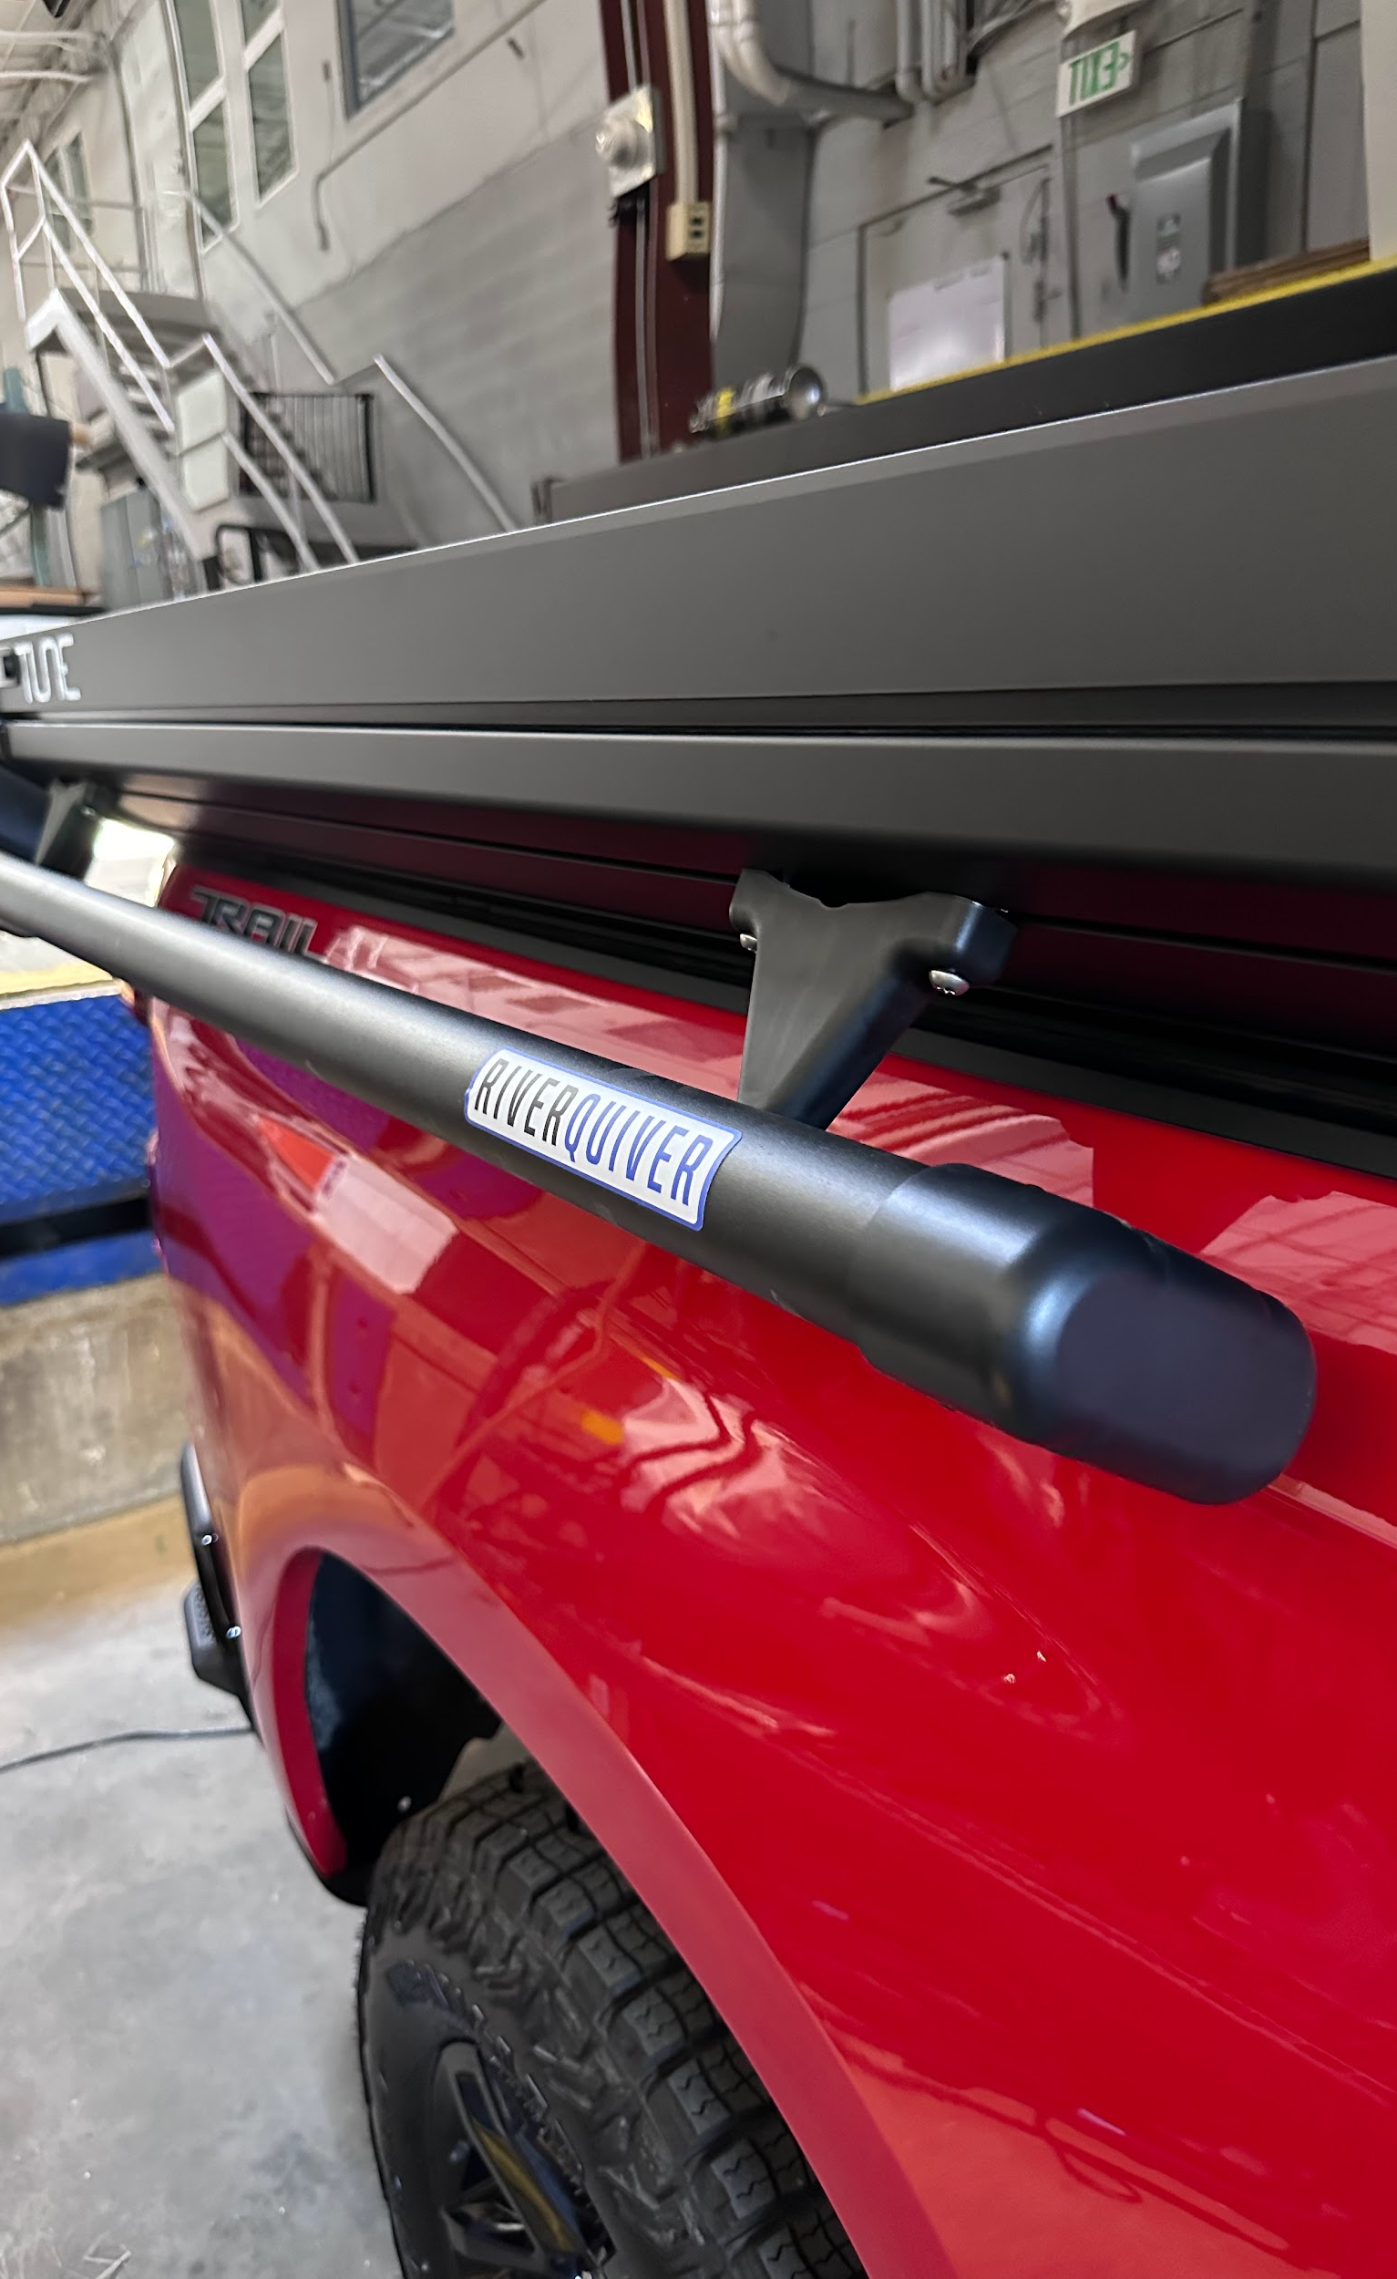
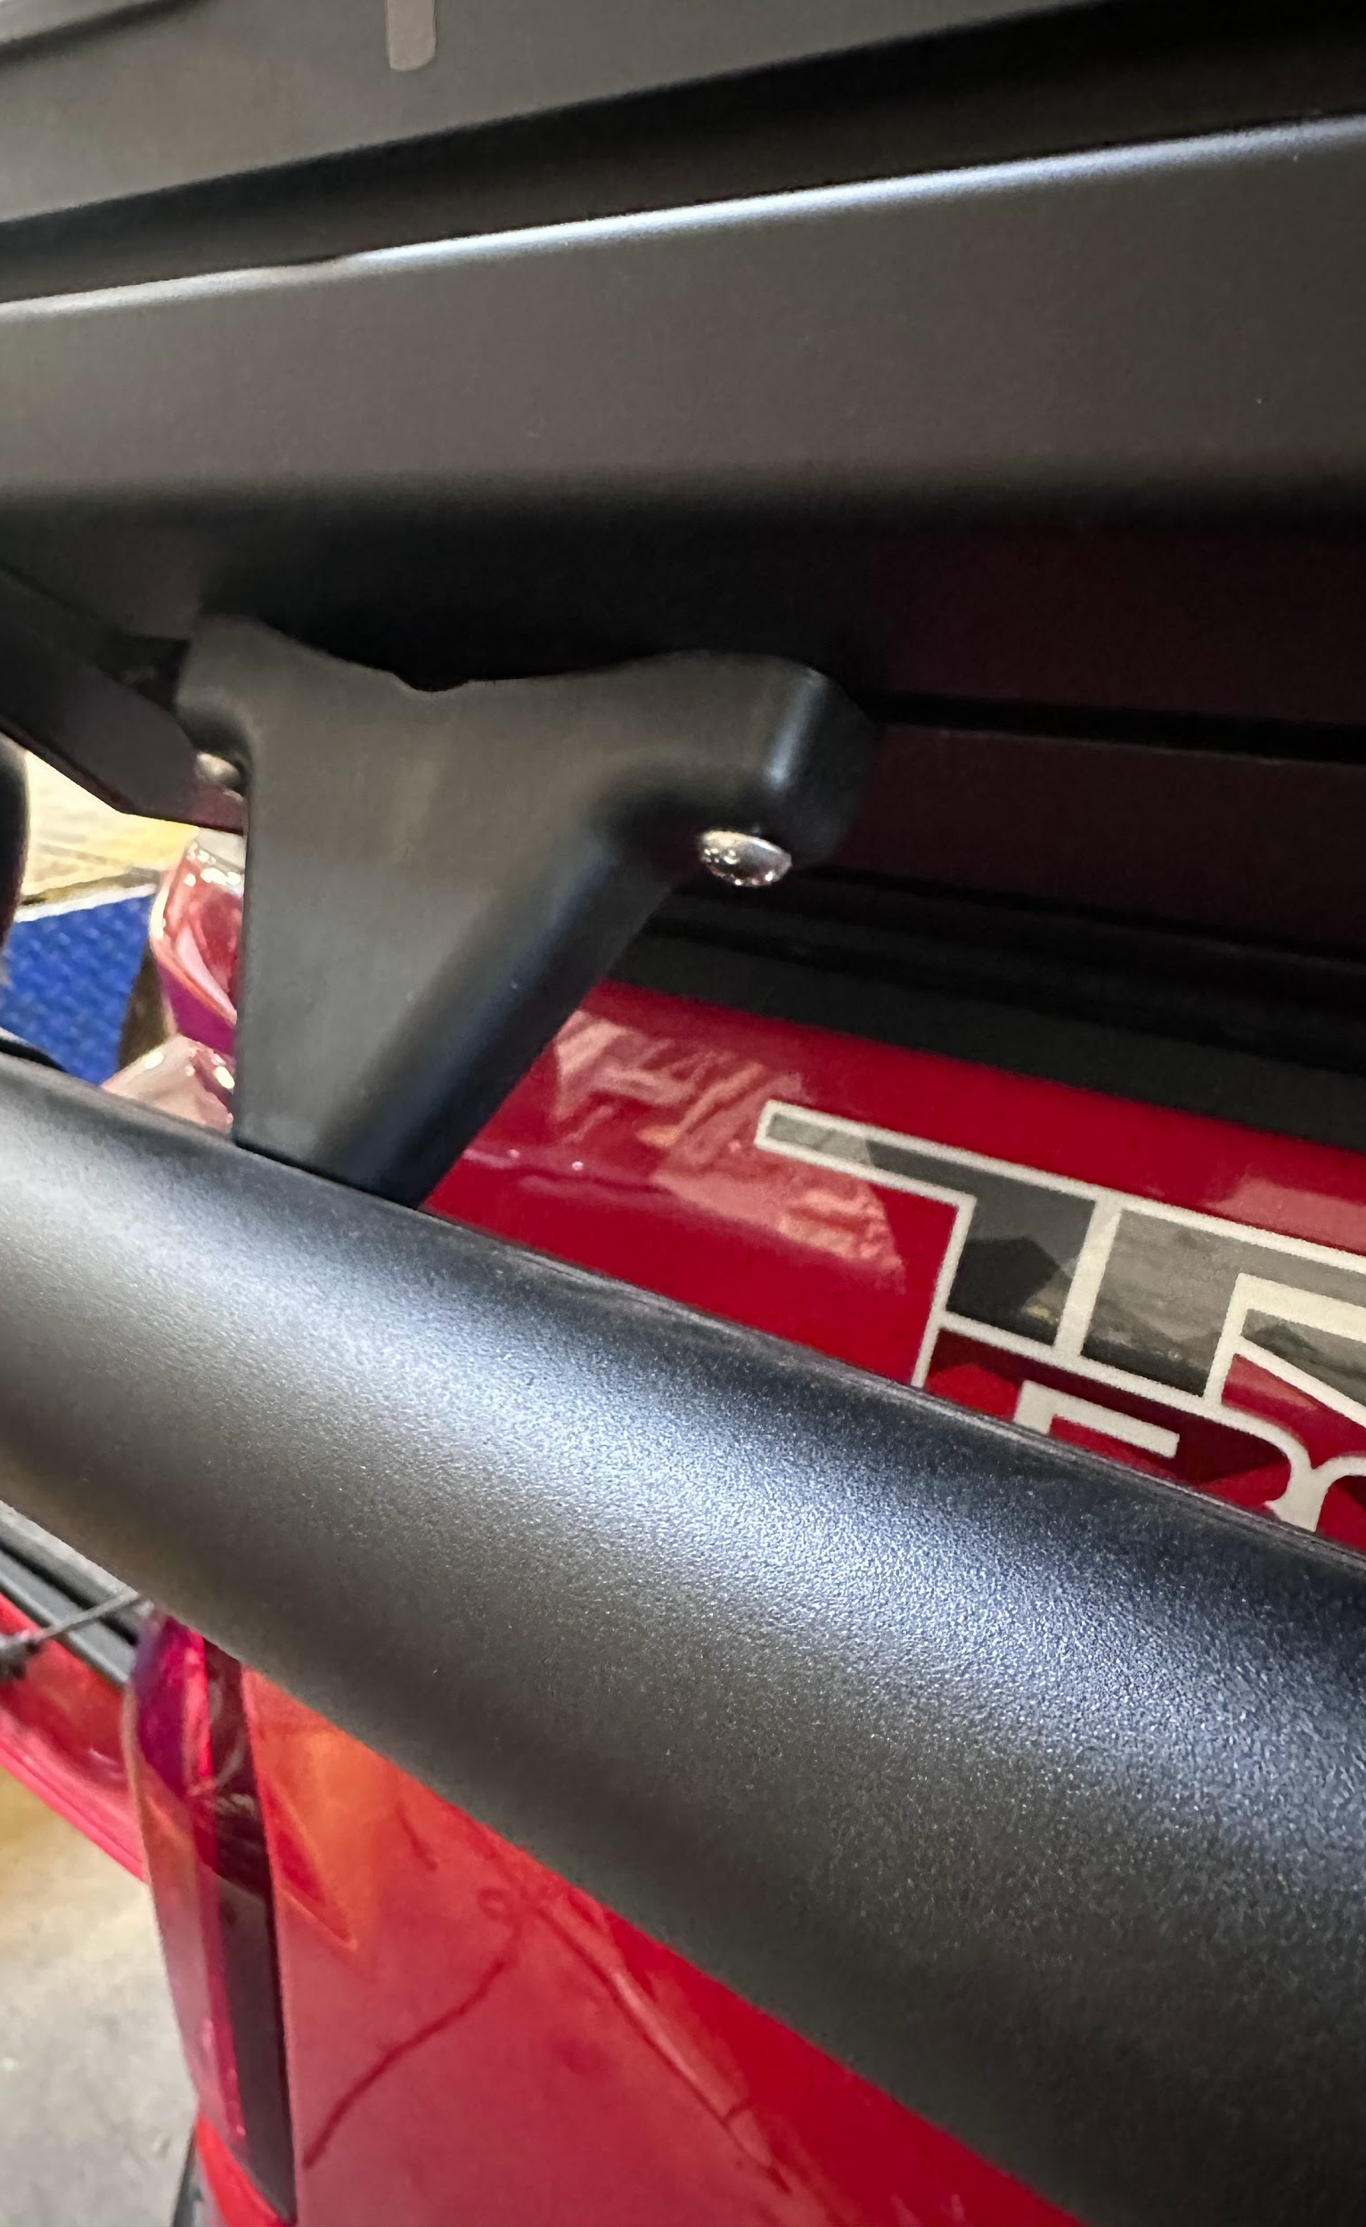
Installing ShortCut River Quiver 2-Banger
Align the hammer nuts with the uppermost t track of the Tune M1
Using a T40 socket and a ratchet tighten down all hardware
Torque to 12lb●ft
Fig. 1
Fig. 2
N O T E :
For ease of installation two people is strongly recommended.
W A R N I N G:
Ensure all hammer nuts are properly engaged in the t track. Failure to do so may result in damage to the product or vehicle.

Slide 9

Safety Disclaimer and Acknowledgment
By using the ShortCut River Quiver 2-Banger and its associated components, you acknowledge and agree to adhere to the following safety instructions and terms:
Proper Installation and Hardware Tightening:
Hammer Nut Engagement:
Responsibility and Indemnification:
All hardware must be adequately tightened to ensure secure installation of the ShortCut River Quiver 2-Banger. Loose hardware may lead to improper installation, resulting in potential damage to the vehicle or injury.
Ensure that all fasteners are checked and tightened before use of the ShortCut River Quiver 2-Banger. Periodic inspection is recommended to maintain safety during transportation.
Hammer nuts must be fully engaged in the T-track to ensure the ShortCut River Quiver 2-Banger remains securely attached. Failure to fully engage the hammer nuts may result in the ShortCut River Quiver 2-Banger detaching while driving, leading to potential accidents, property damage, or injury.
Before driving, always double-check that the hammer nuts are properly secured and that the ShortCut River Quiver 2-Banger is stable.
By using this product, the user agrees to indemnify, defend, and hold harmless the manufacturer, distributor, seller, and their affiliates, employees, and agents from any claims, damages, injuries, or losses that result from improper use, installation, or failure to follow the provided safety guidelines.
This indemnity includes any legal costs and expenses incurred in defending against such claims, including those related to negligence, misuse, or failure to adhere to the product’s instructions.

