Slide 1



Molle Panel Installation Guide
Notes:
Generic background images here: Cover Images

Slide 2
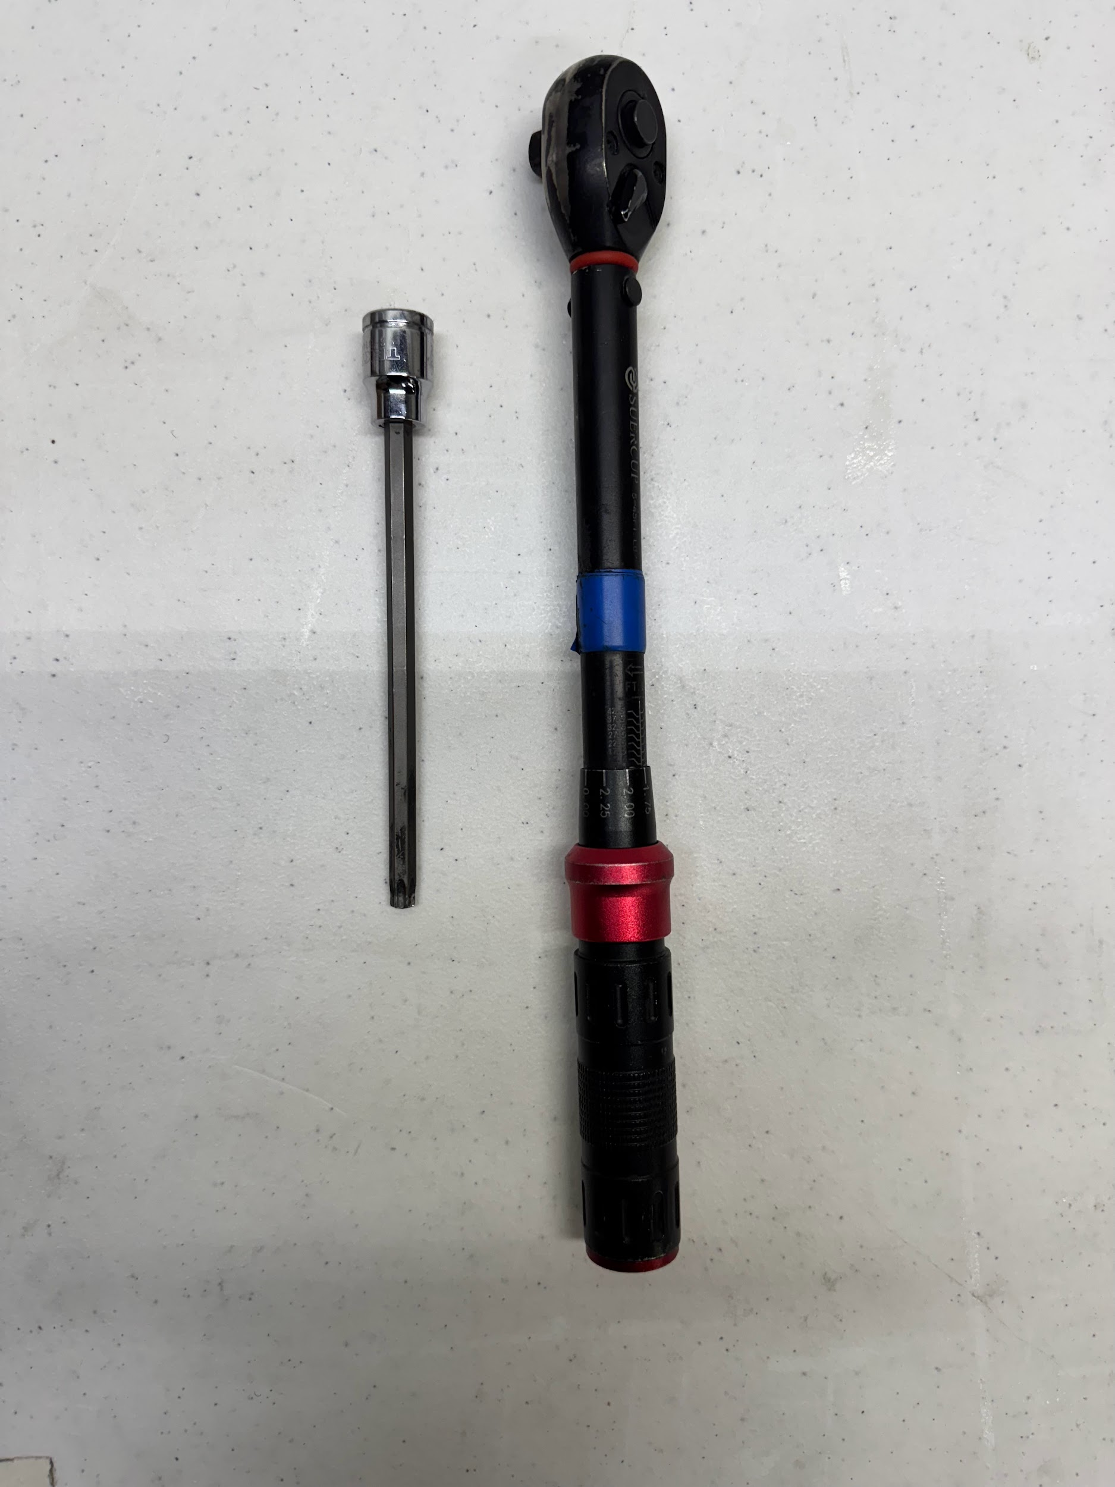
Tool Category Name
T40
Torque Wrench
Notes:
Note: you will likely need to resize the text box lengths

Slide 3
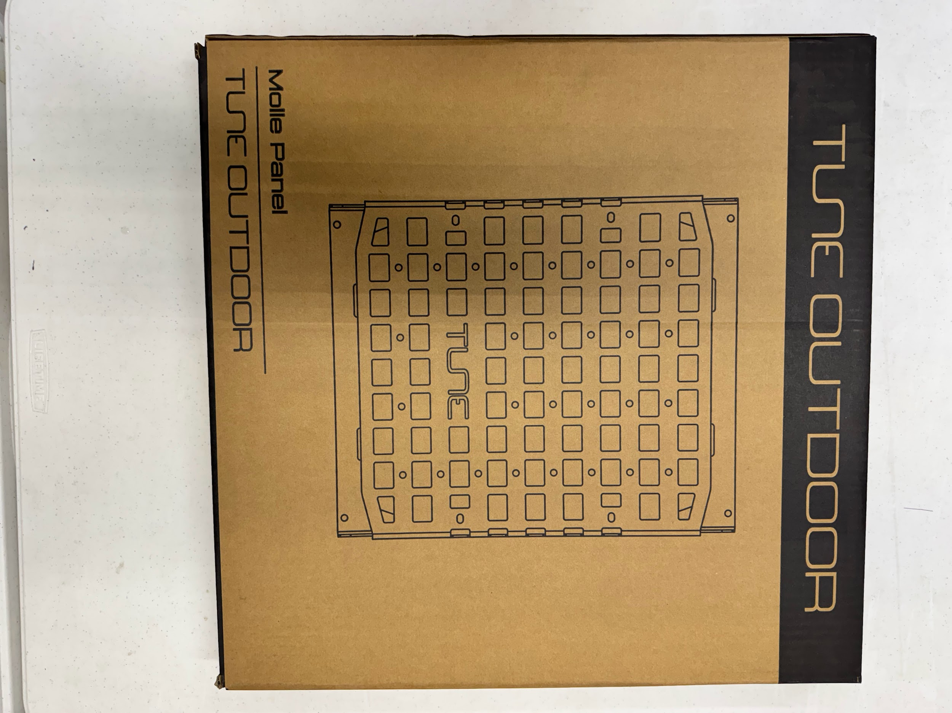
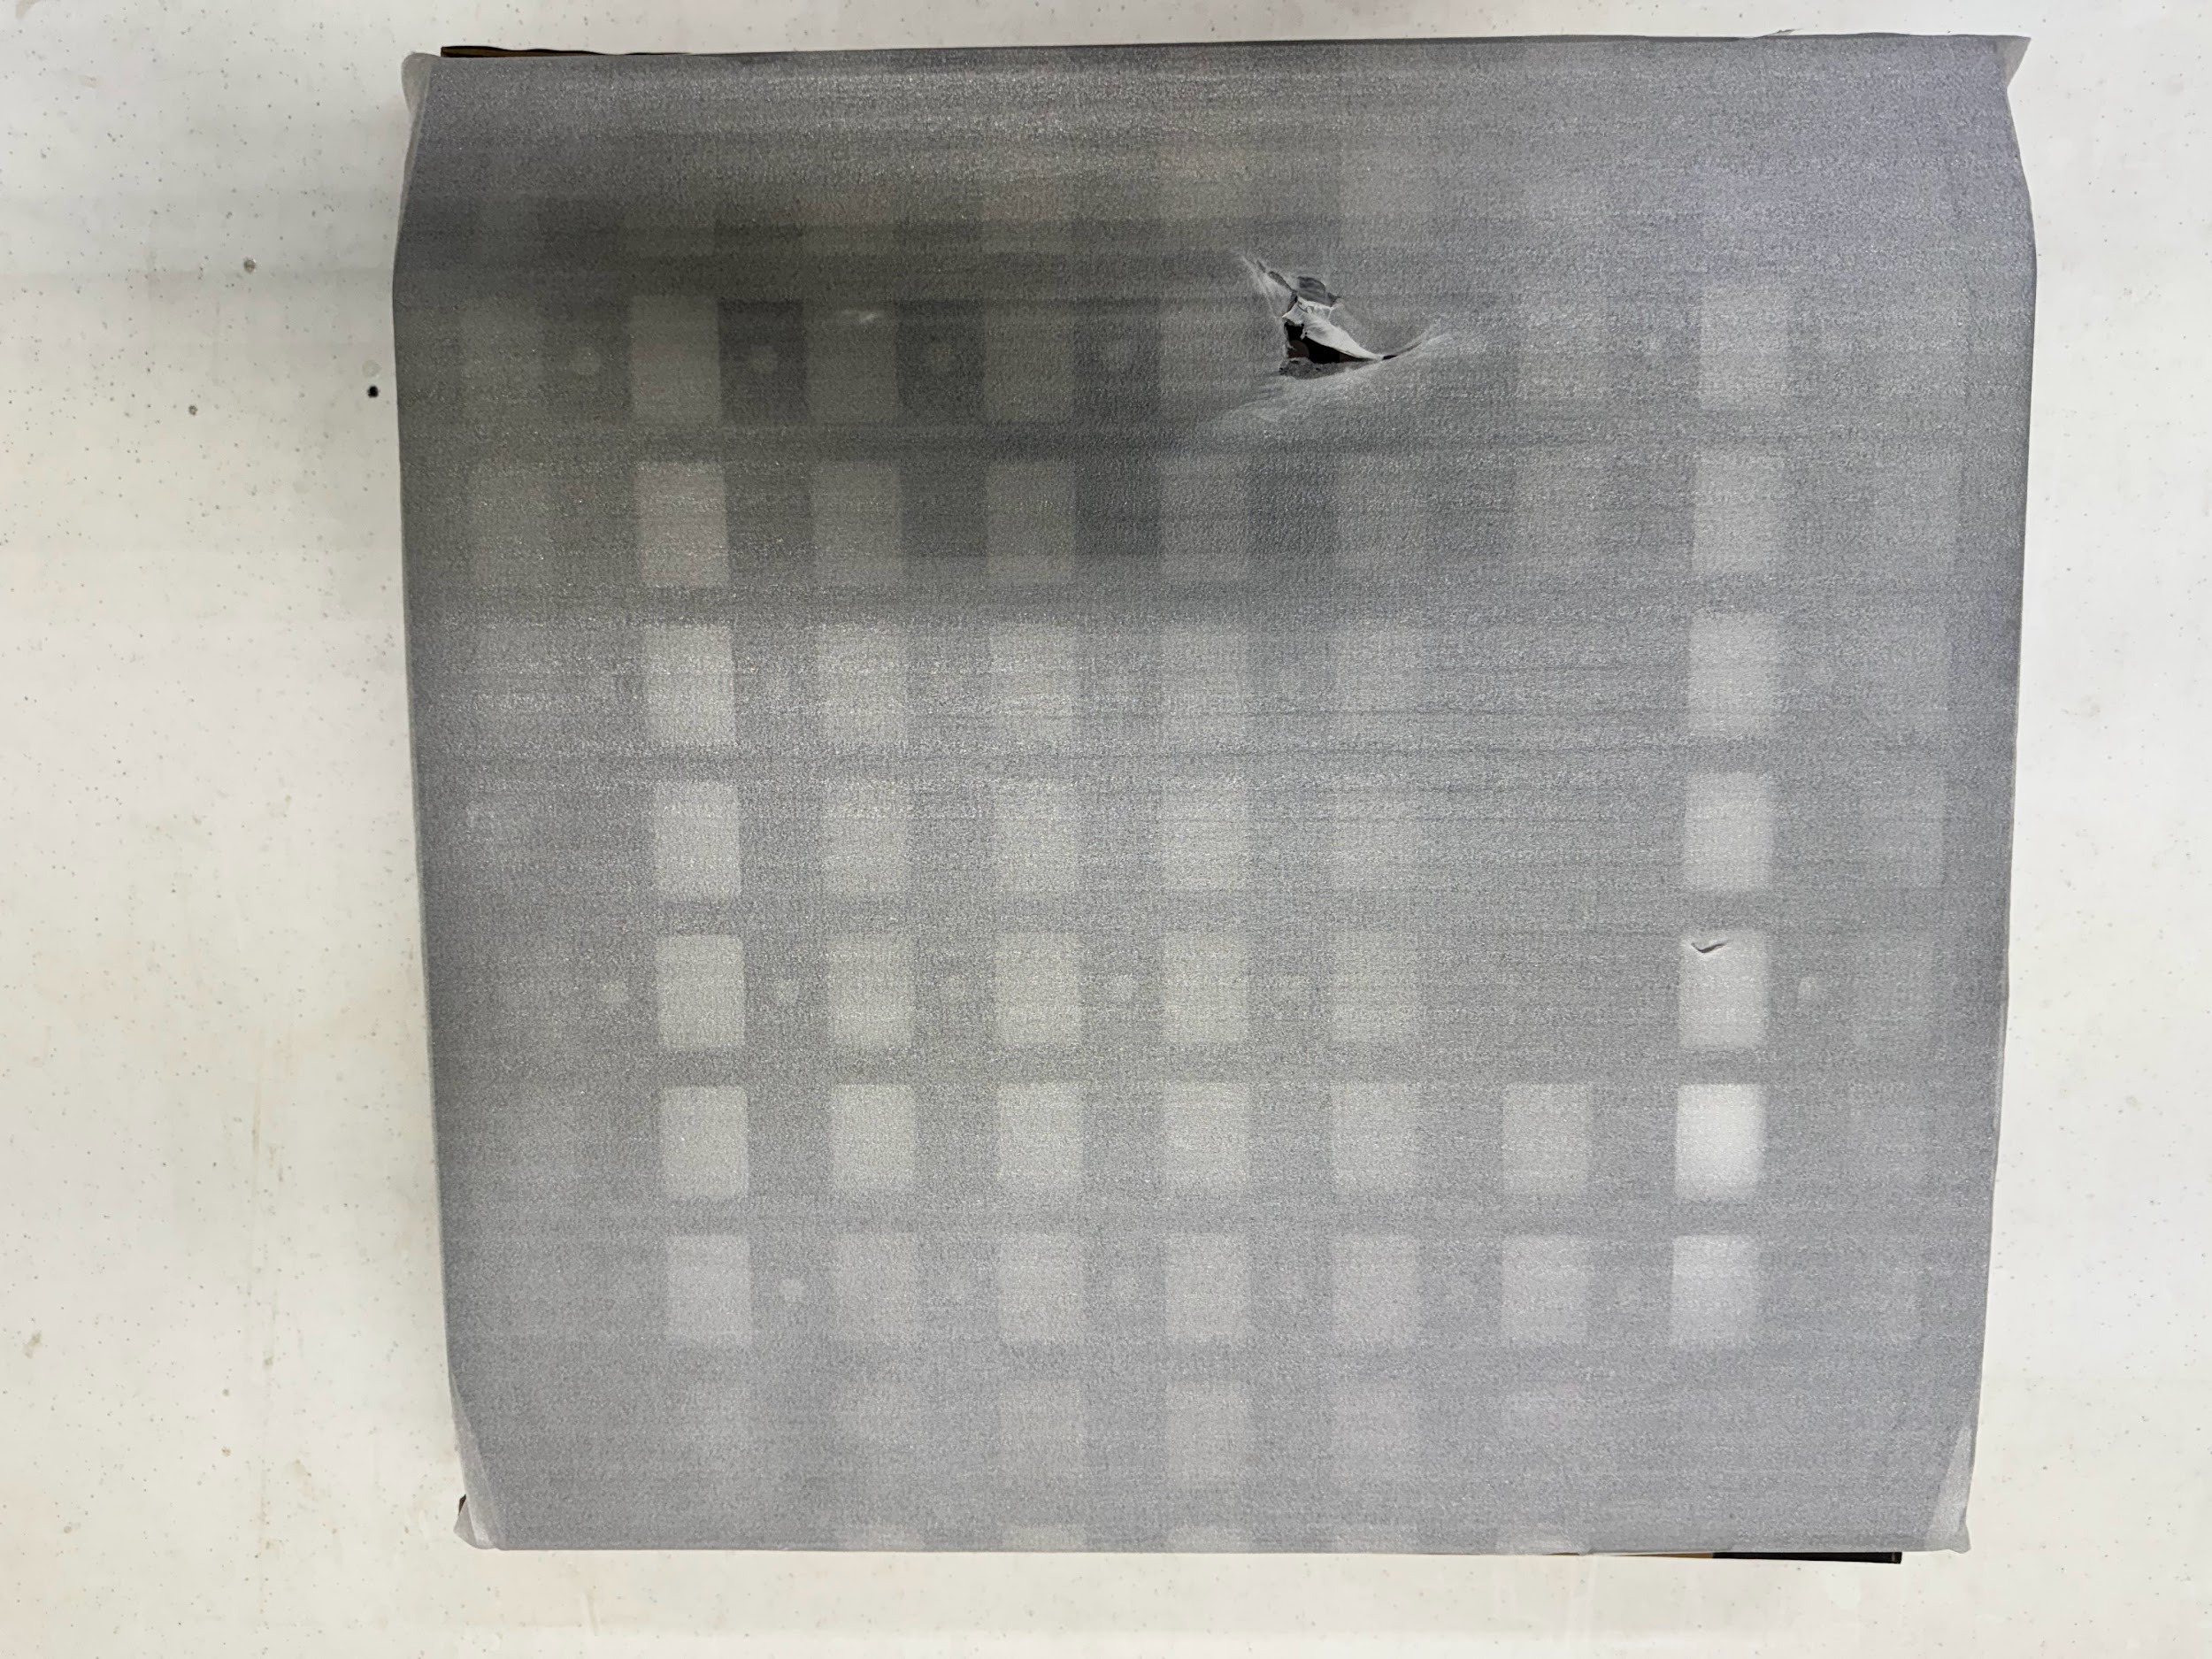
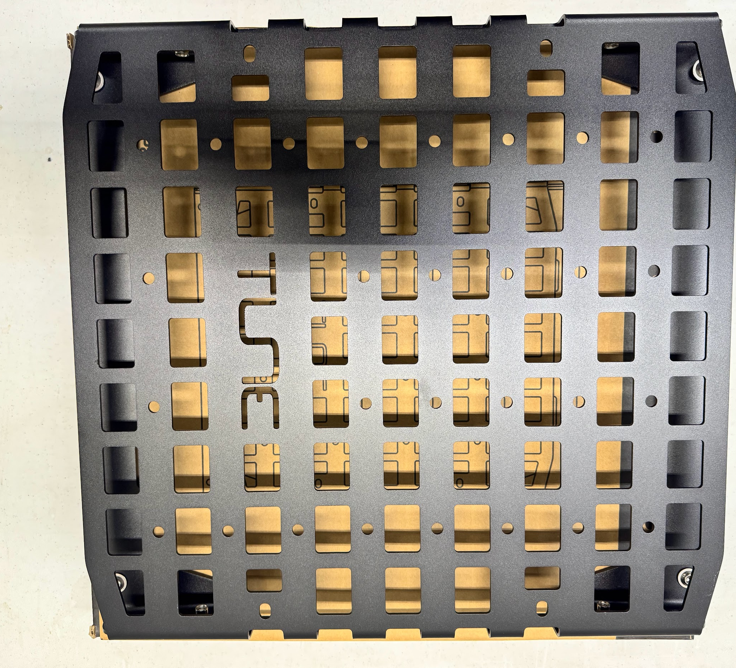
Unboxing
Open cardboard box and pull out contents
Remove protective foam covering from the molle panel

Slide 4

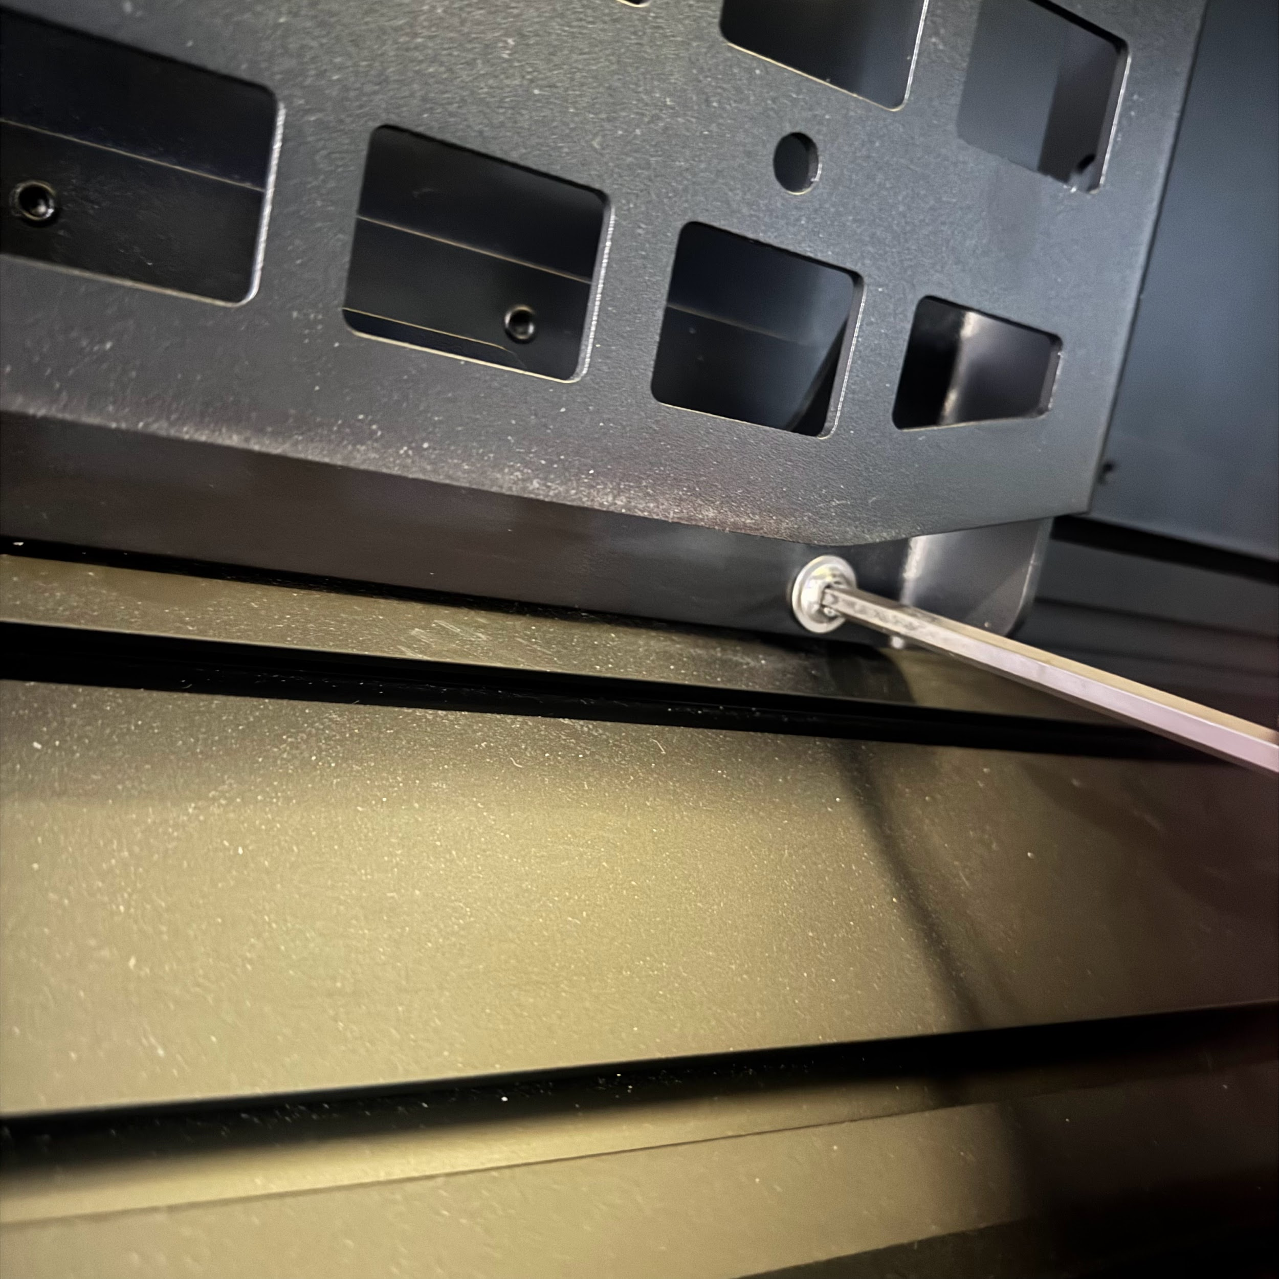
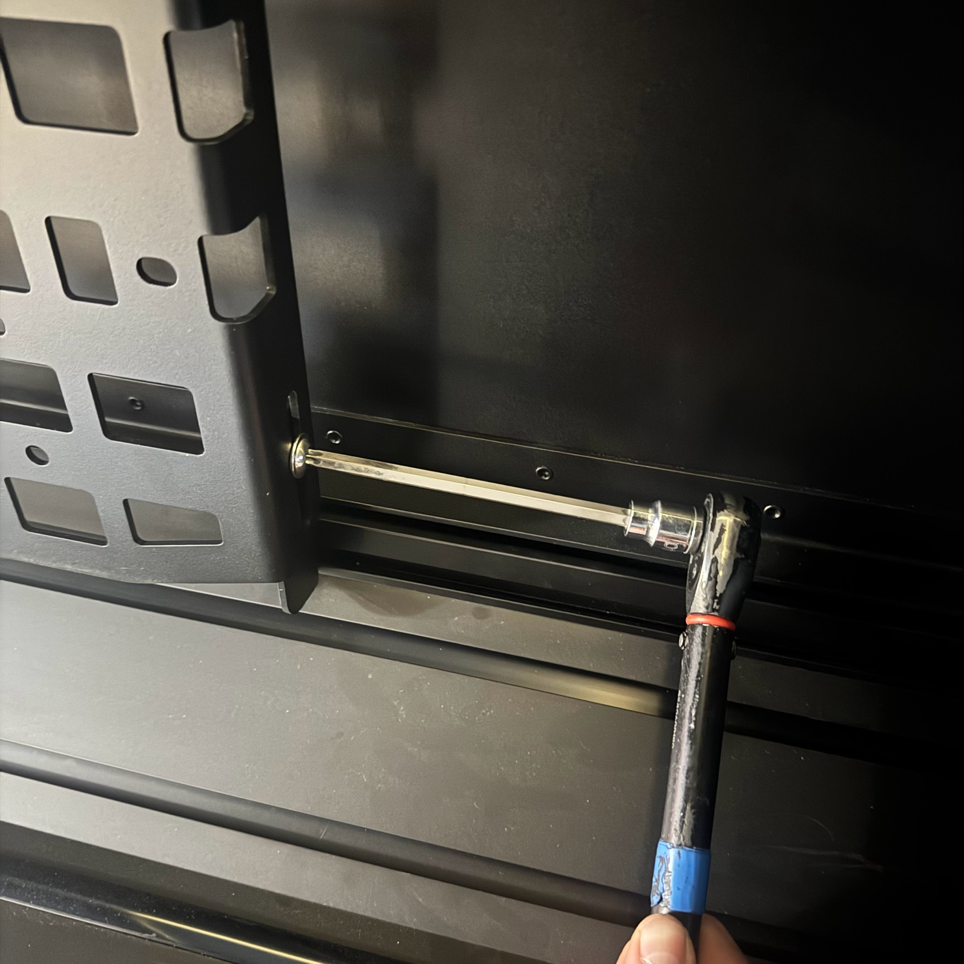
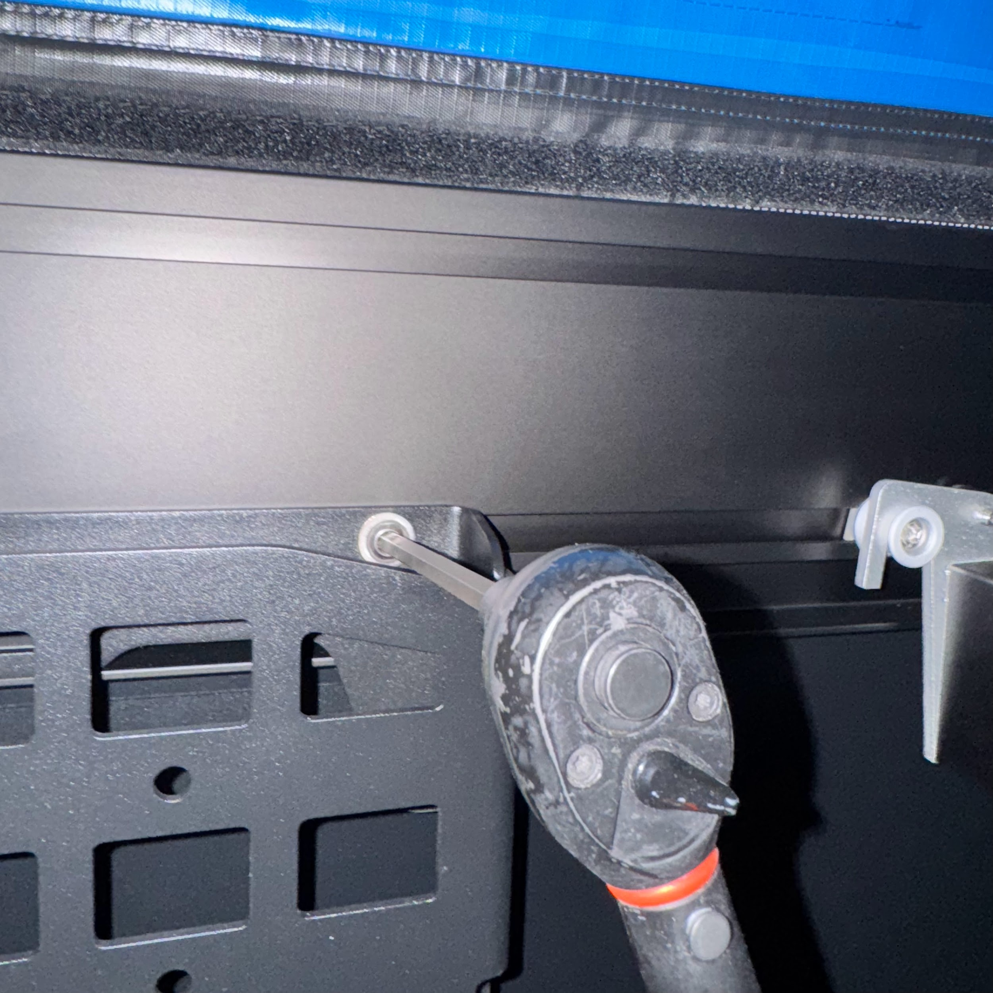

Installation
Loosen the T40 bolts on the upper and lower sides of the molle panel
  These bolts adjust the overall height of the molle panel
Align all hammer nuts with the t track
Engage the upper hammer nuts (Fig. 1)
Extend the brackets to reach the t track
Engage the lower hammer nuts (Fig. 2)
Tighten the T40 side bolts to lock in the height (Fig. 3)
Torque both upper and lower mounting bolts to 12lb●ft (Fig. 4)
Fig. 1
Fig. 2
Fig. 3
Fig. 4
W A R N I N G
Ensure all hammer nuts are properly engaged in the t track

Slide 5

Safety Disclaimer and Acknowledgment
By using the molle panel and its associated components, you acknowledge and agree to adhere to the following safety instructions and terms:
Proper Installation and Hardware Tightening:
Hammer Nut Engagement:
Responsibility and Indemnification:
All hardware must be adequately tightened to ensure secure installation of the molle panel. Loose hardware may lead to improper installation, resulting in potential damage to the vehicle or injury.
Ensure that all fasteners are checked and tightened before use of the molle panel. Periodic inspection is recommended to maintain safety during transportation.
Hammer nuts must be fully engaged in the T-track to ensure the molle panel remains securely attached. Failure to fully engage the hammer nuts may result in the molle panel detaching while driving, leading to potential accidents, property damage, or injury.
By using this product, the user agrees to indemnify, defend, and hold harmless the manufacturer, distributor, seller, and their affiliates, employees, and agents from any claims, damages, injuries, or losses that result from improper use, installation, or failure to follow the provided safety guidelines.
This indemnity includes any legal costs and expenses incurred in defending against such claims, including those related to negligence, misuse, or failure
to adhere to the product’s instructions.

