Slide 1



Battery Mount Installation Guide
Notes:
Generic background images here: Cover Images

Slide 2
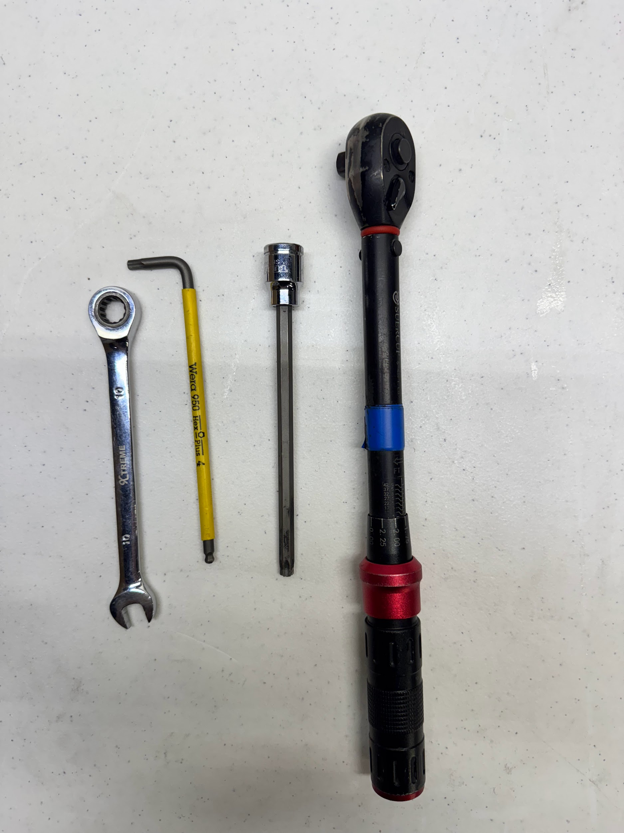
Tool Category Name
T40 Socket
Torque Wrench
T27 Torx
10mm Combination Wrench
Notes:
Note: you will likely need to resize the text box lengths

Slide 3
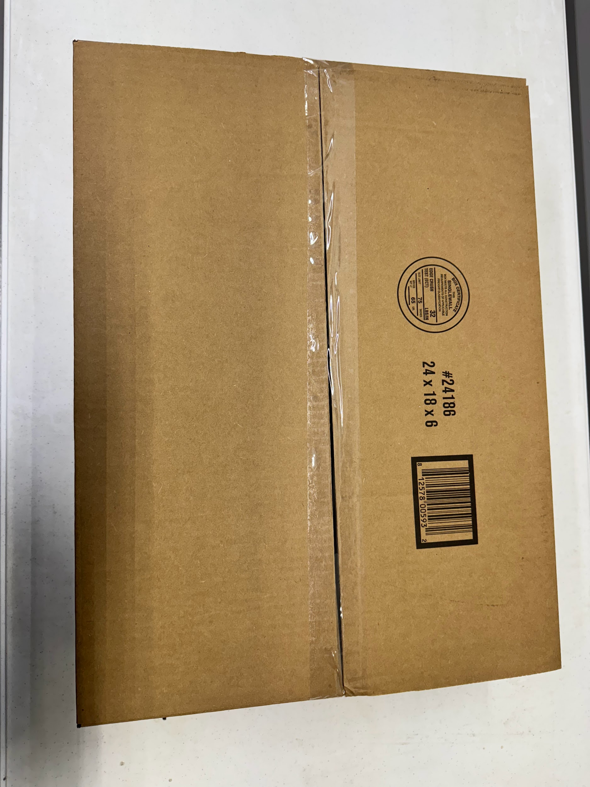
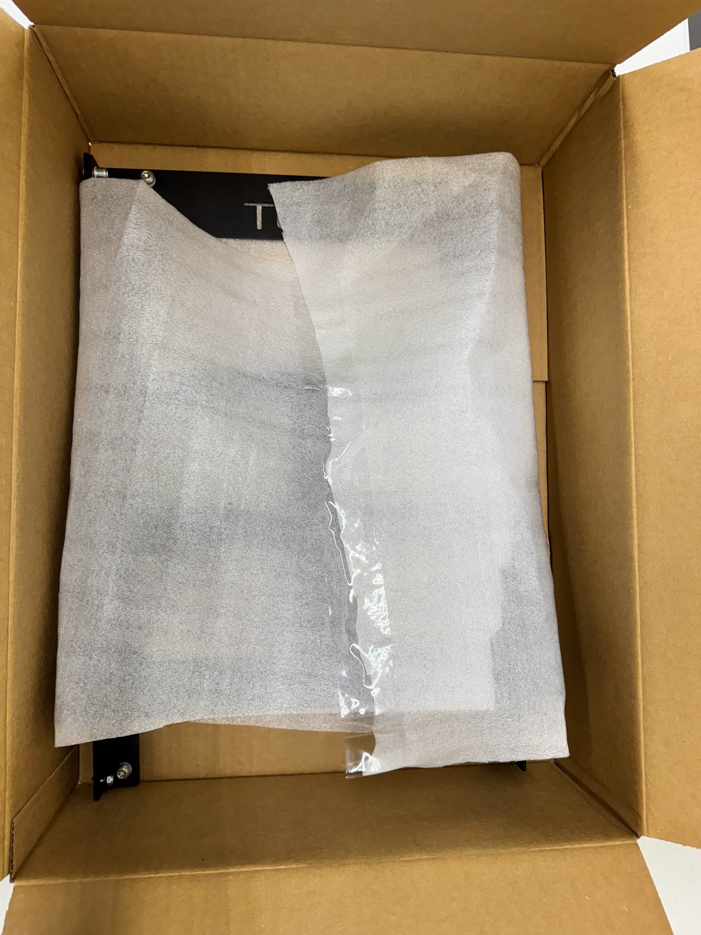
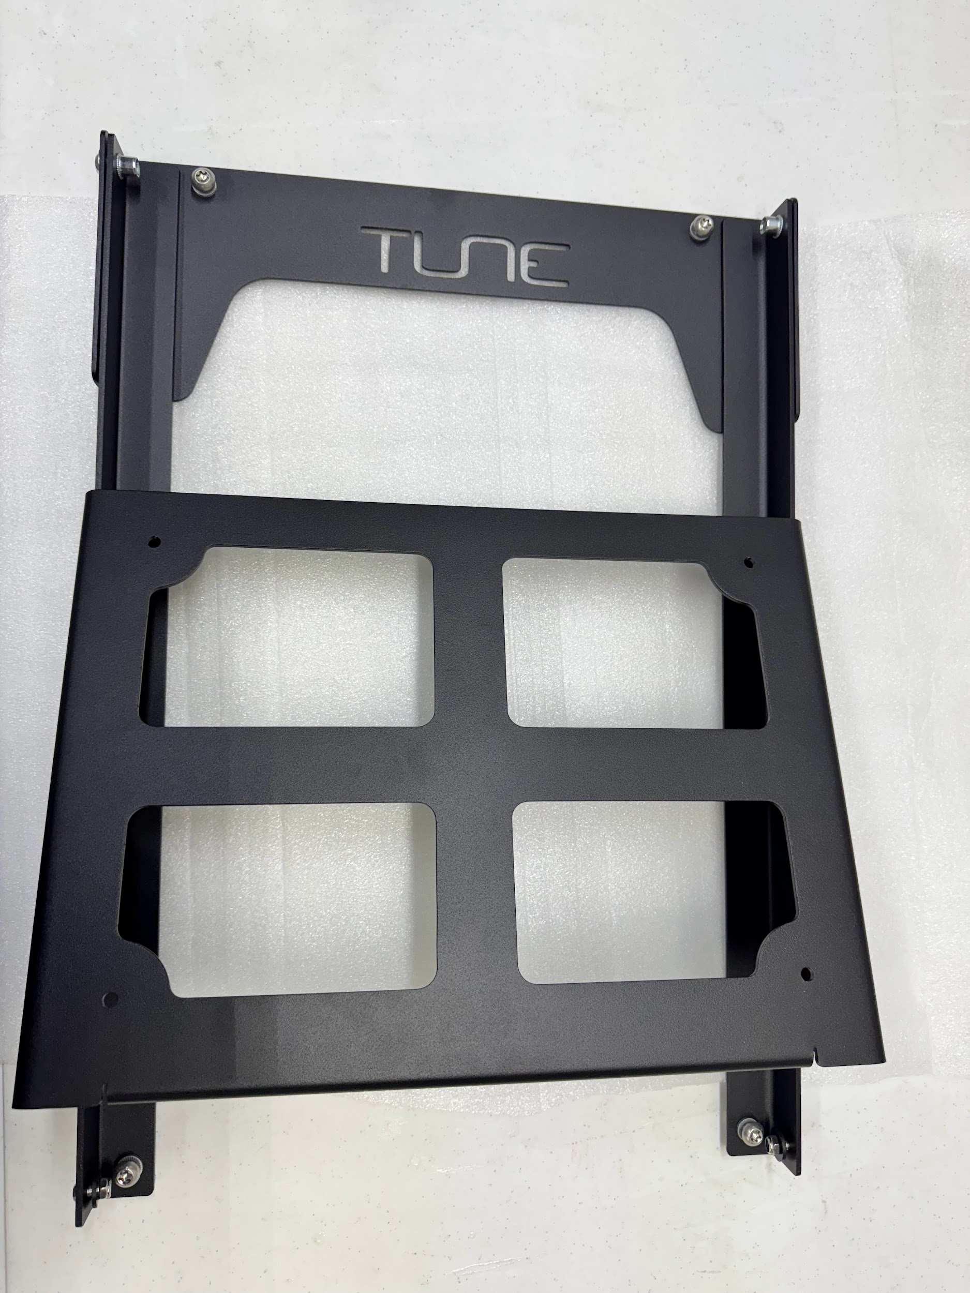
Unboxing
When opening the box be careful not to plunge too far into the box as this may scratch the powder coating

Slide 4
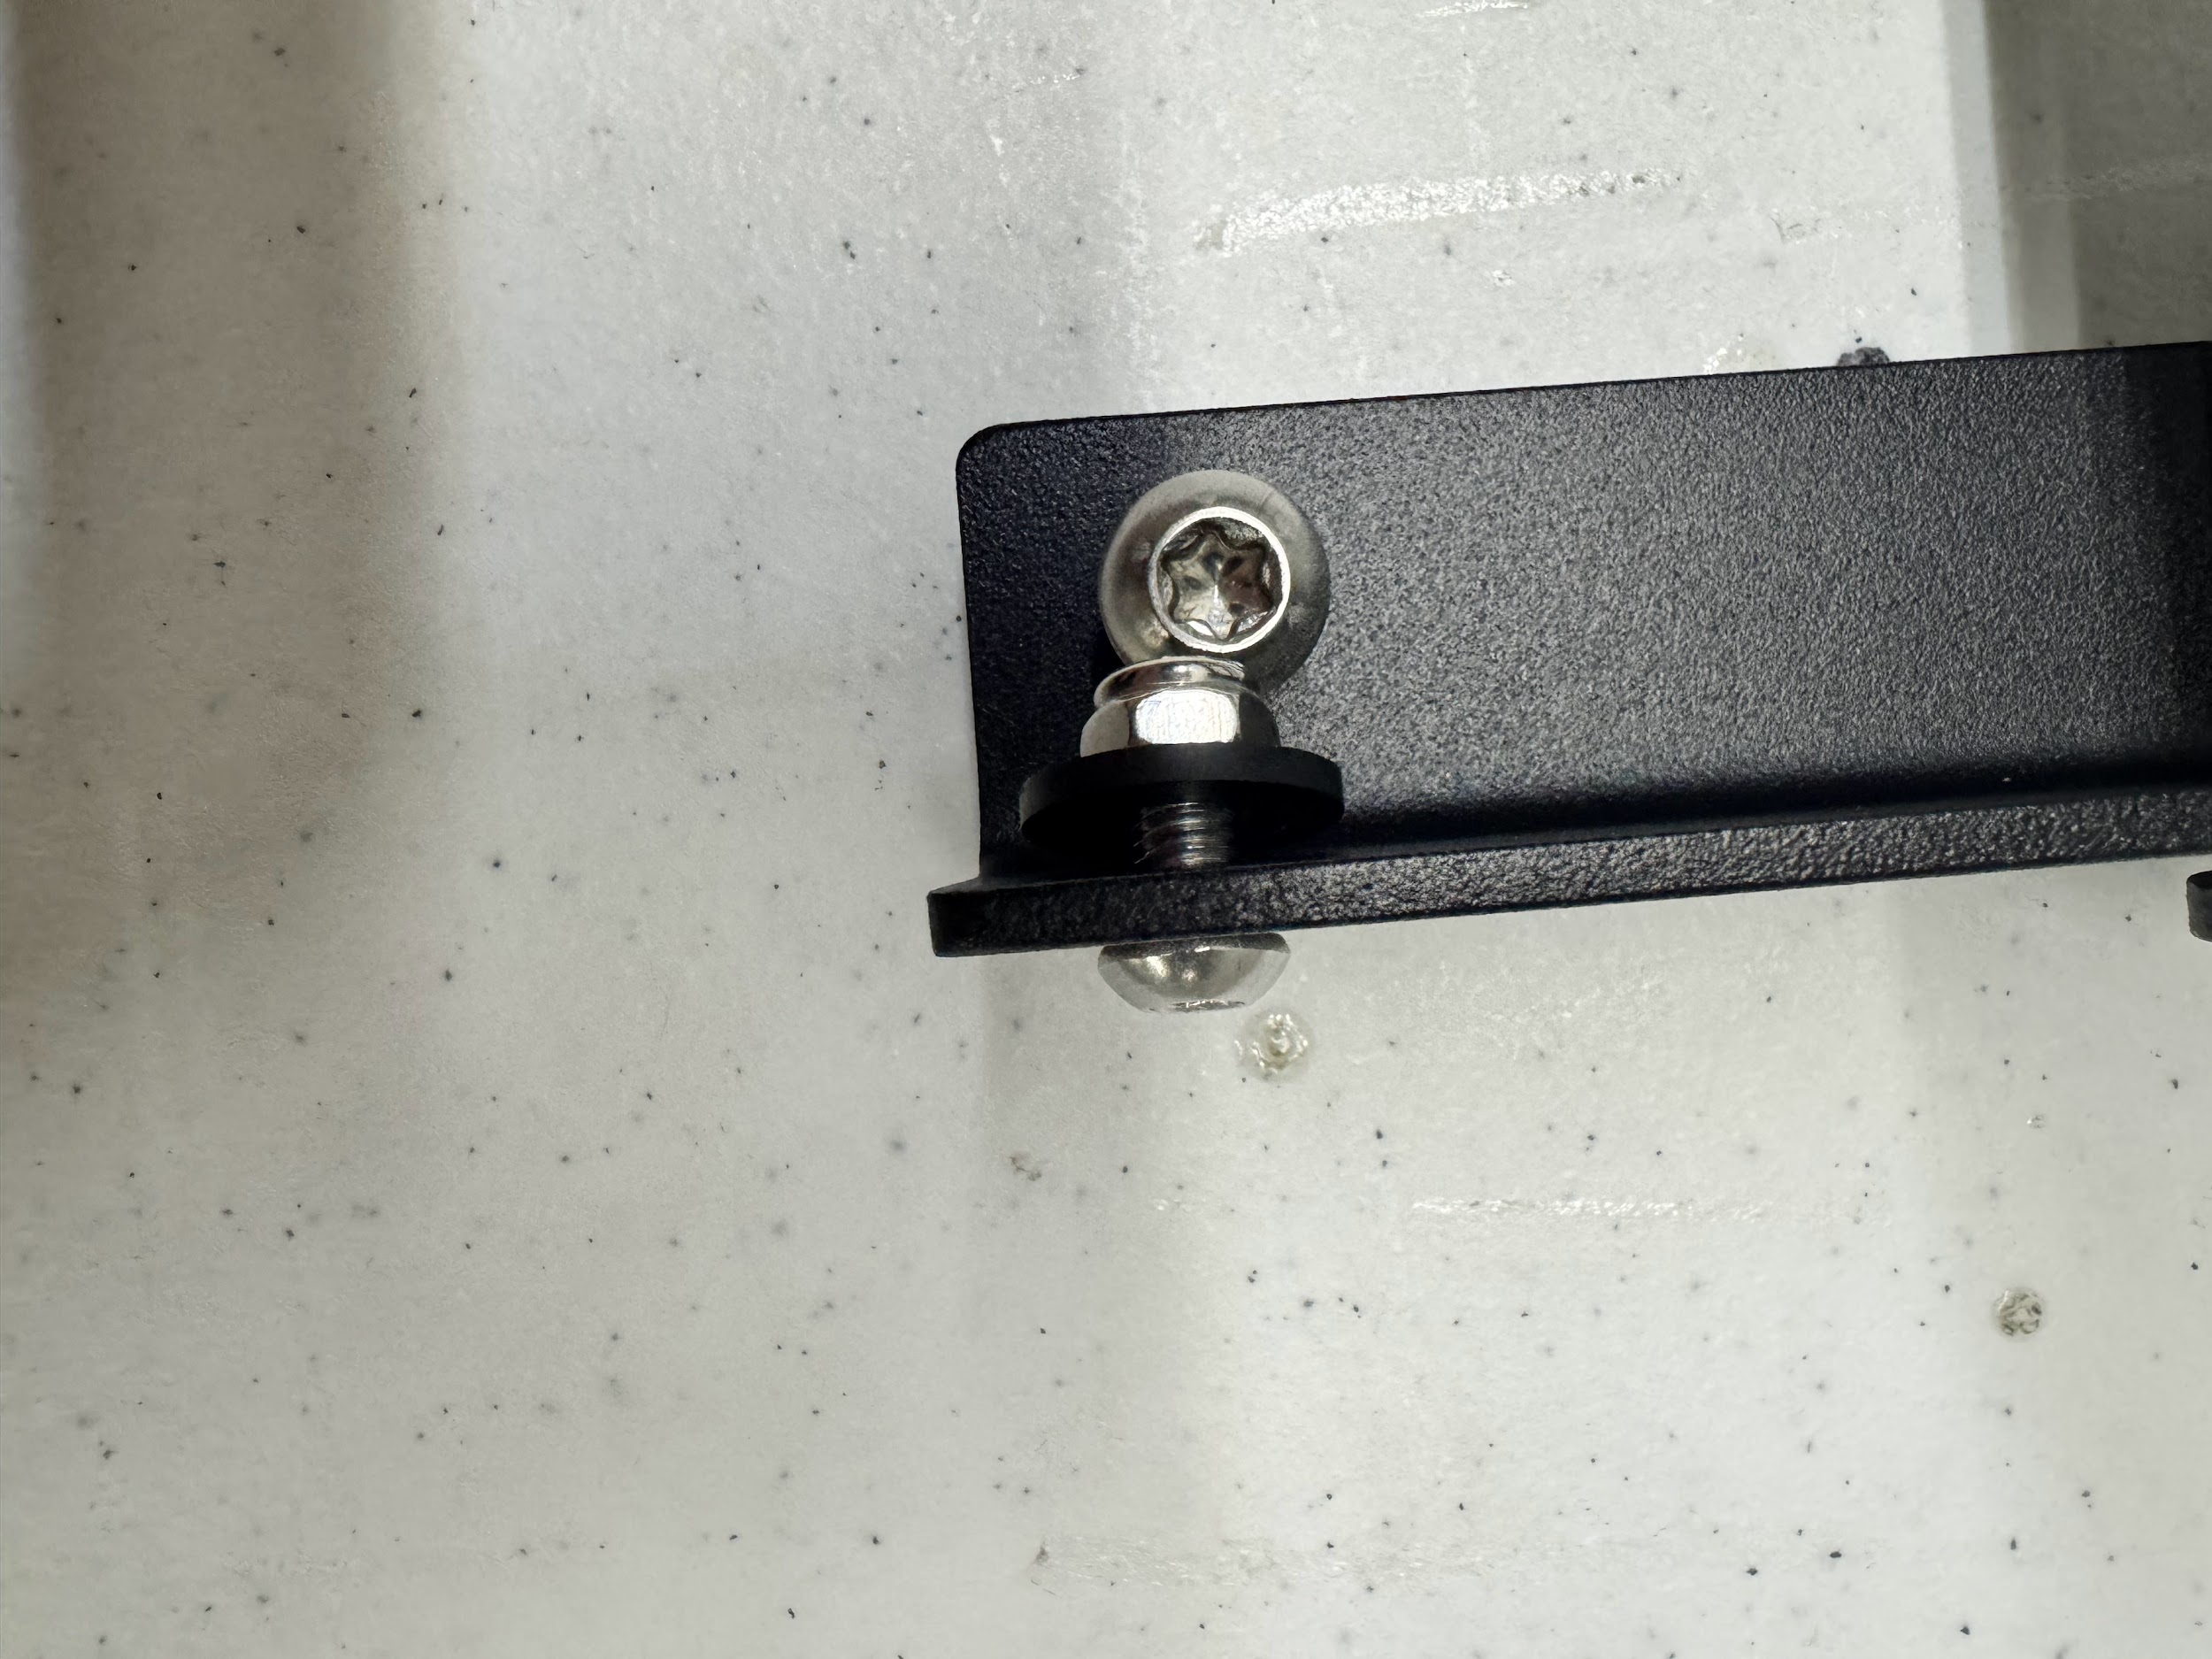
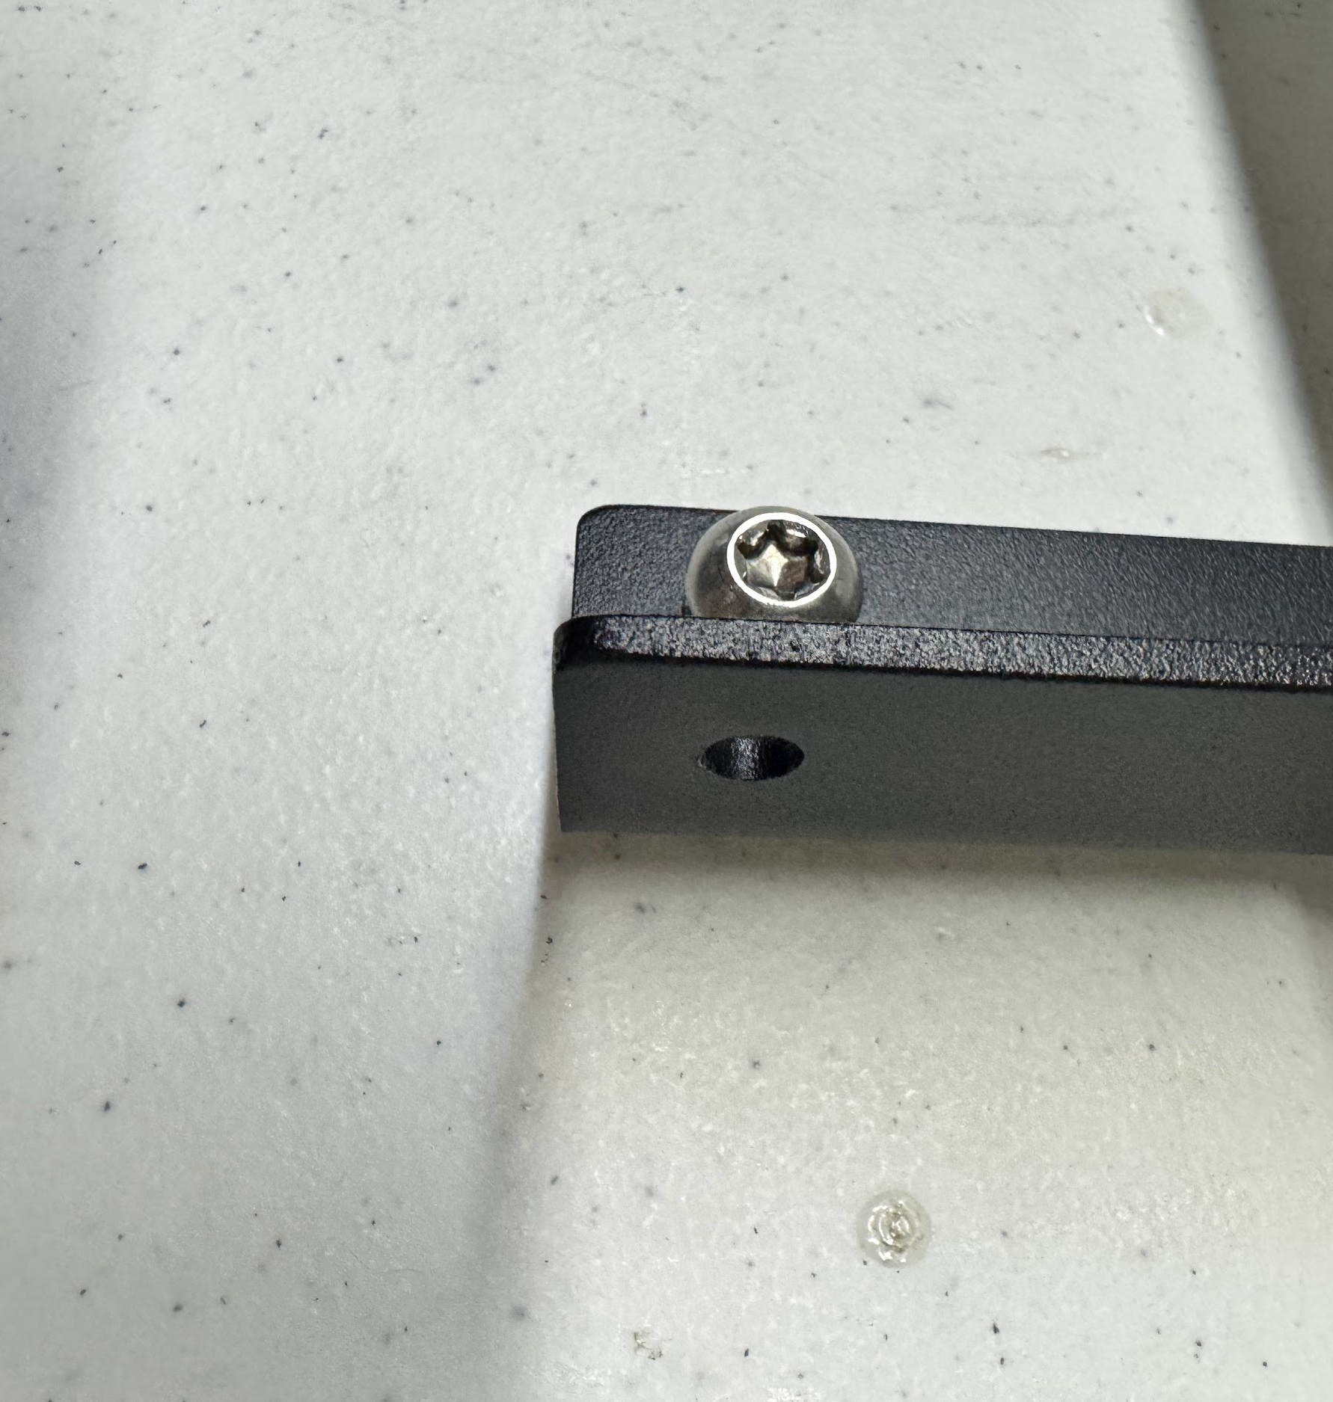

Assembly
The battery mount will come with a M6, washer, and nylock loosely threaded on in the bottom hole (Fig. 1)
Remove both M6s from both left and right side of the bracket (Fig. 2)
Fig. 1
Fig. 2
N O T E :
Keep this hardware safe as it will be used in the next step

Slide 5
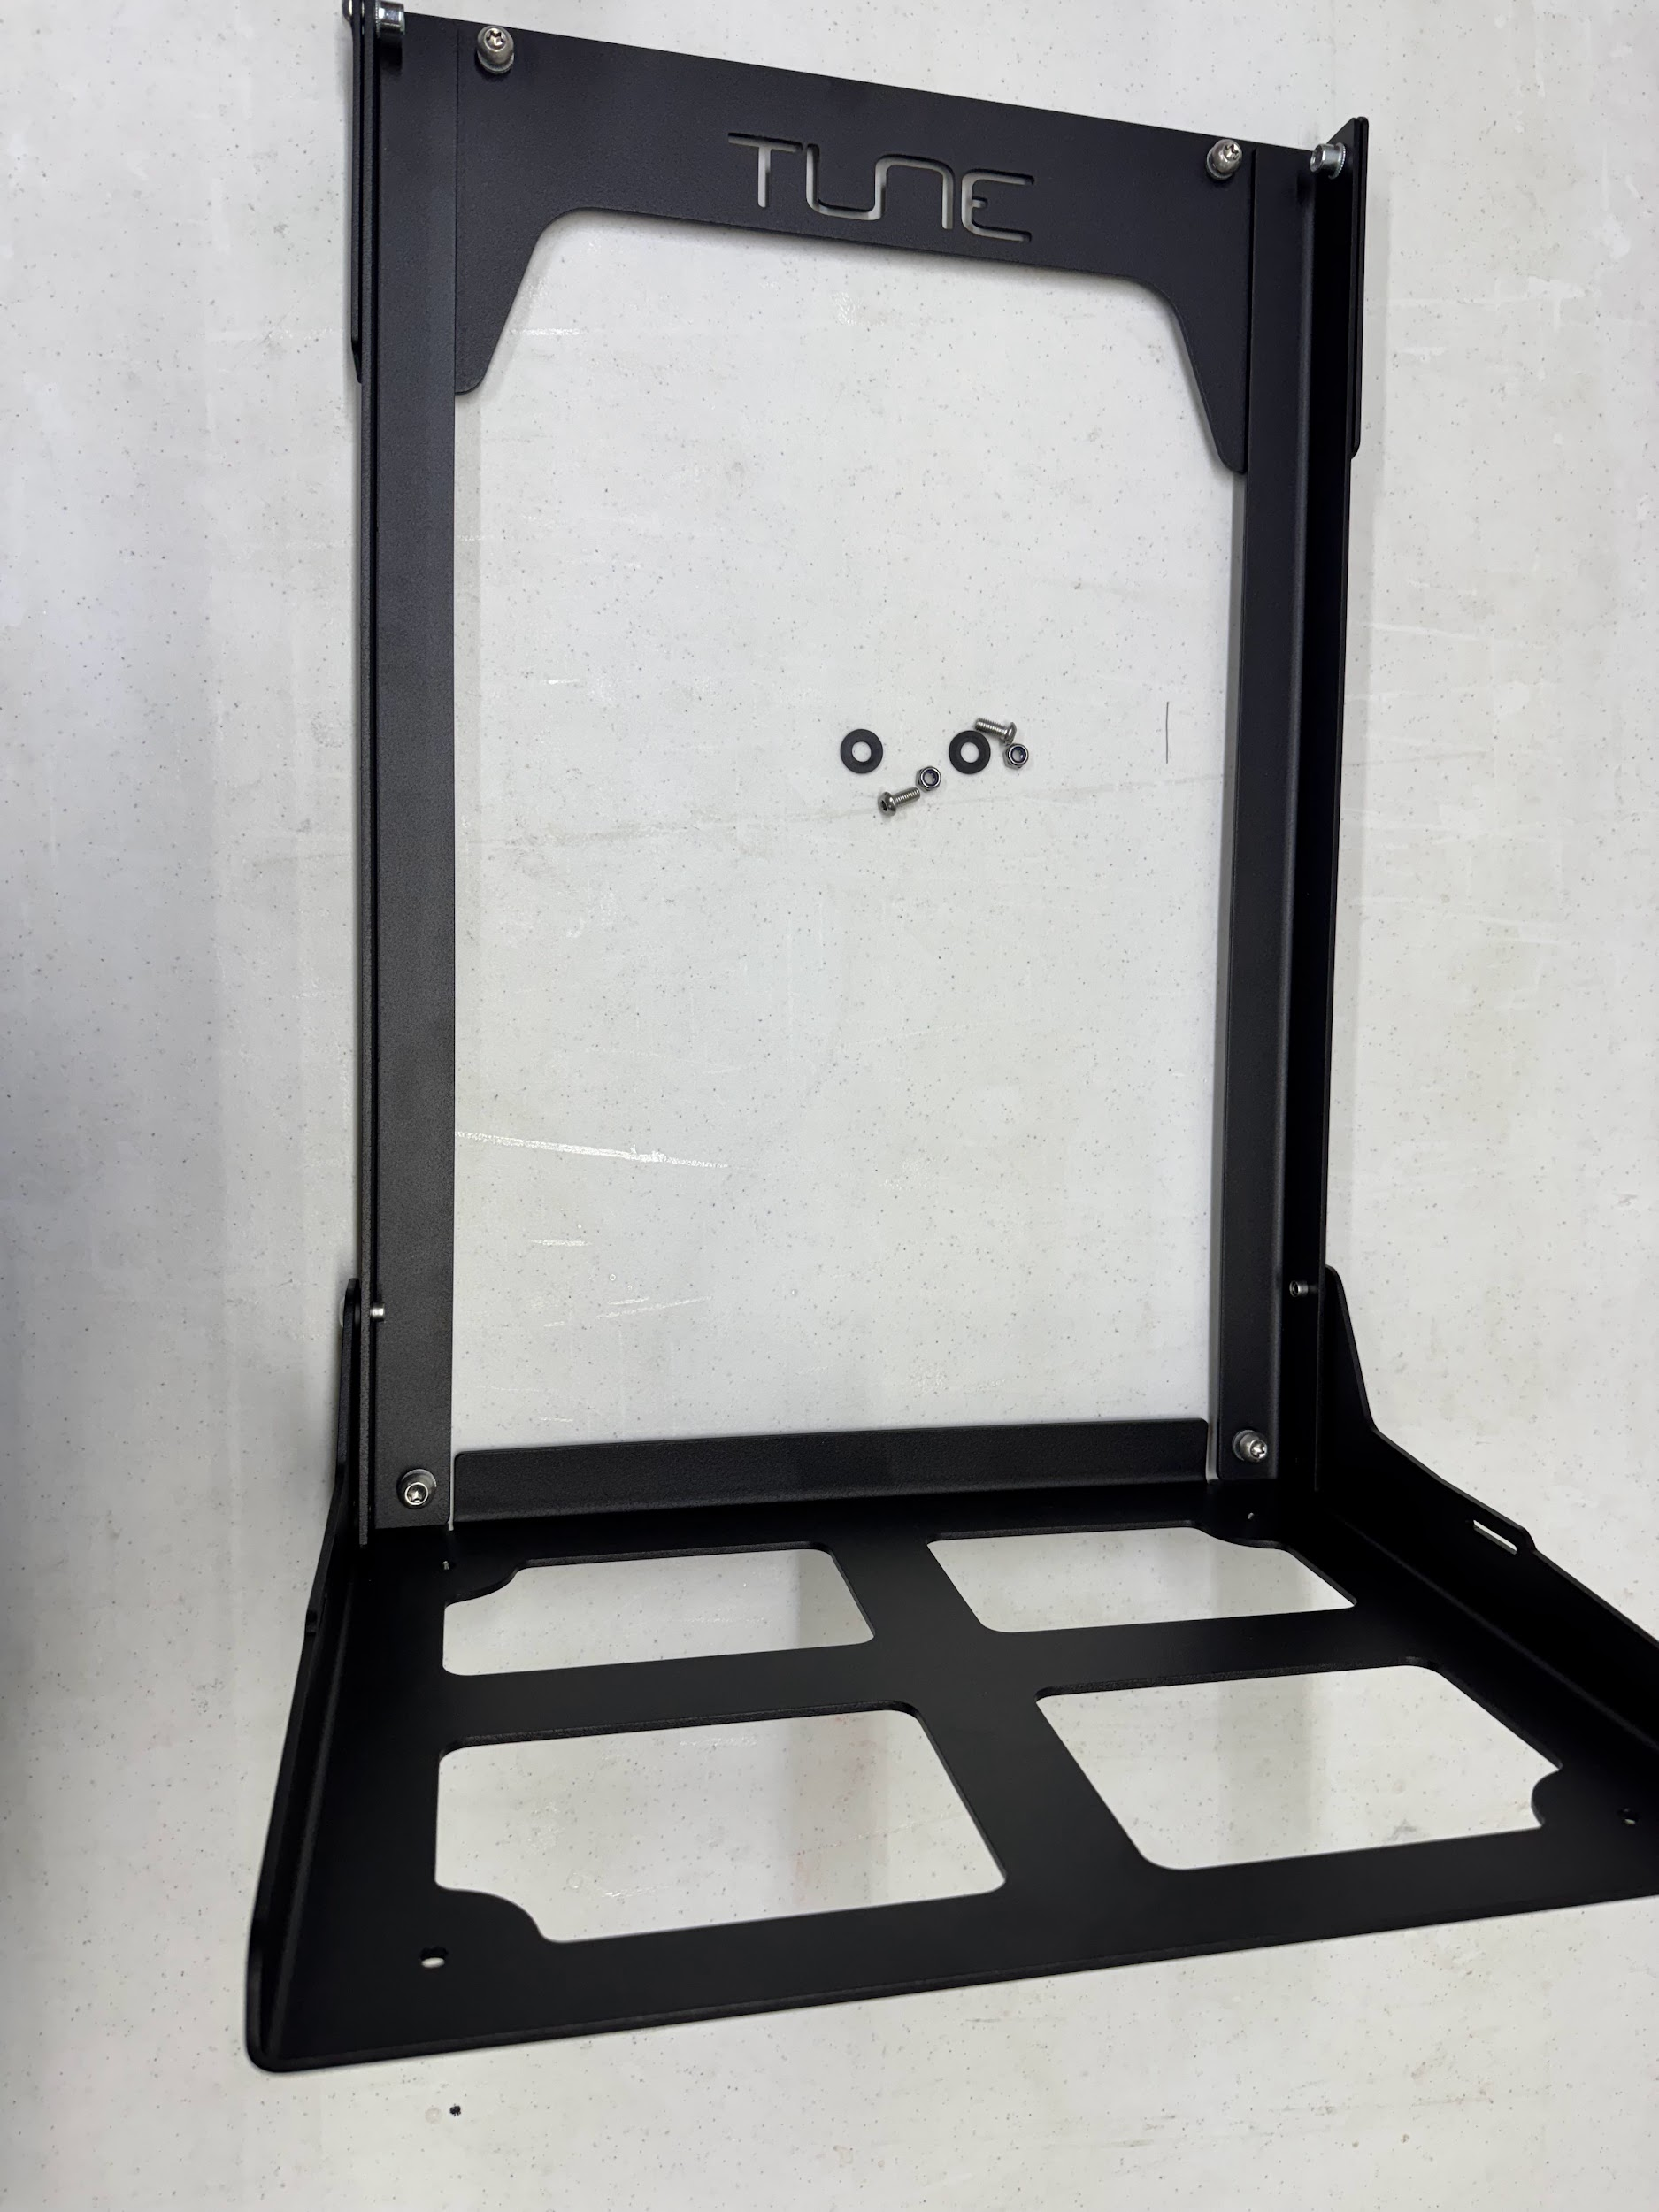
Assembly
Unfold the battery mount

Slide 6
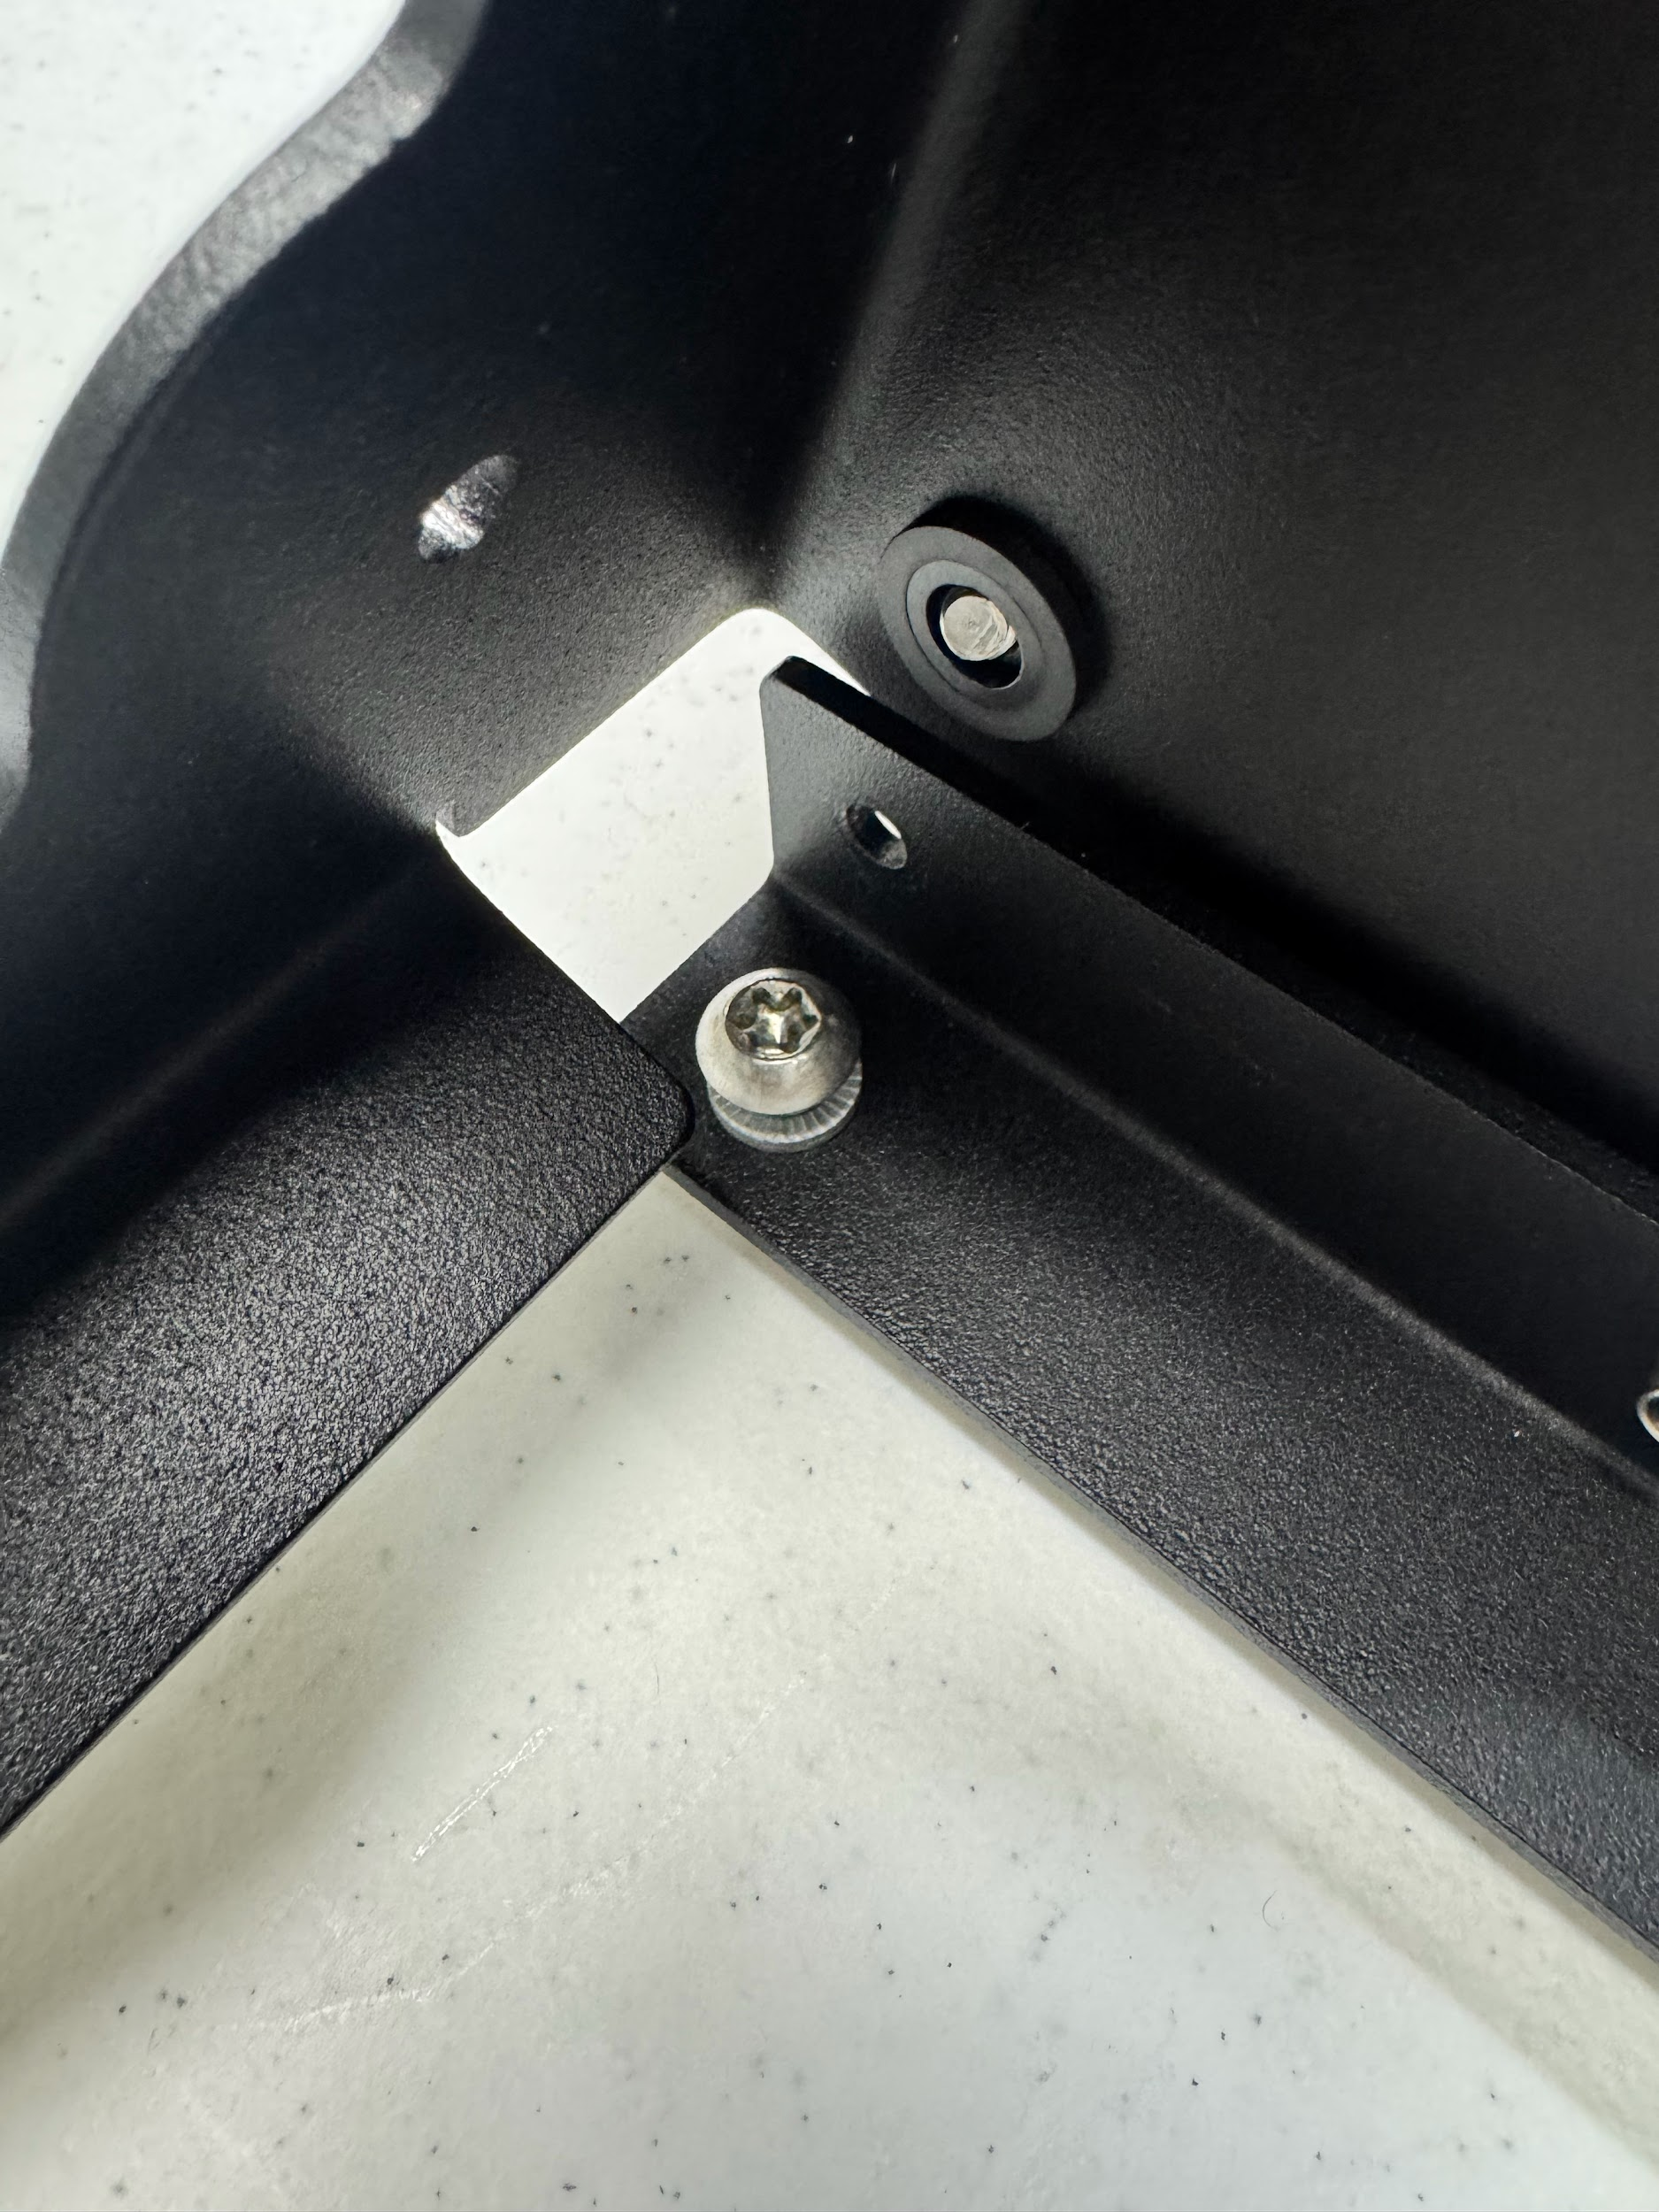
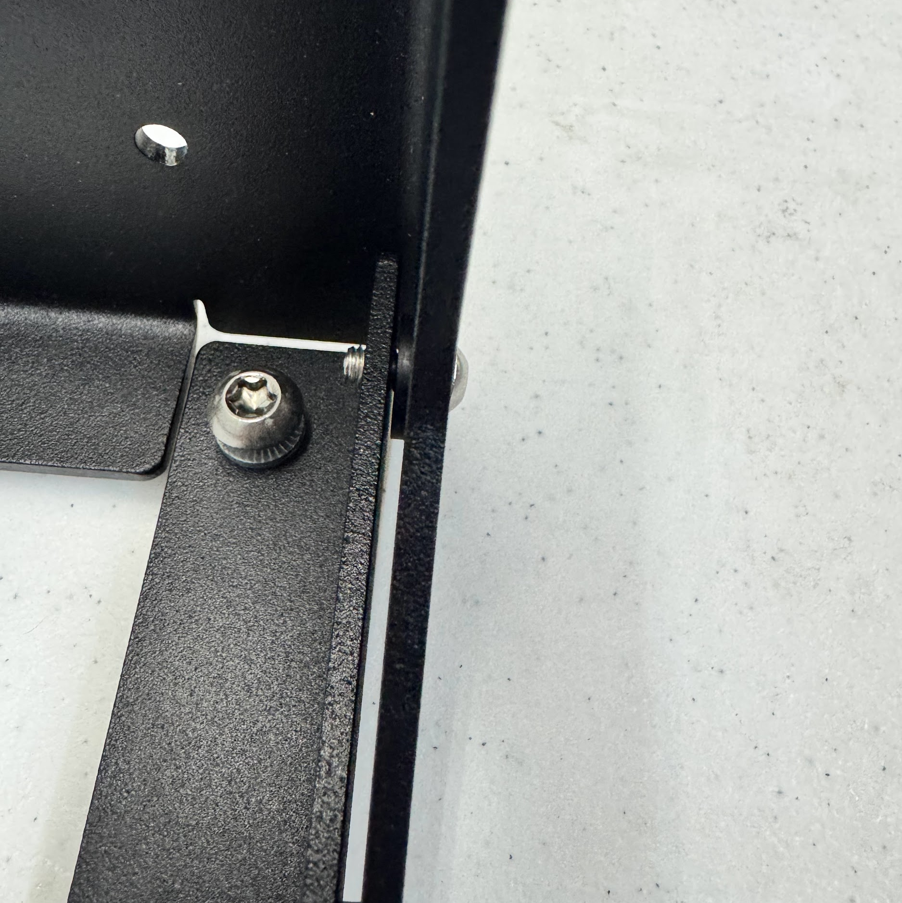
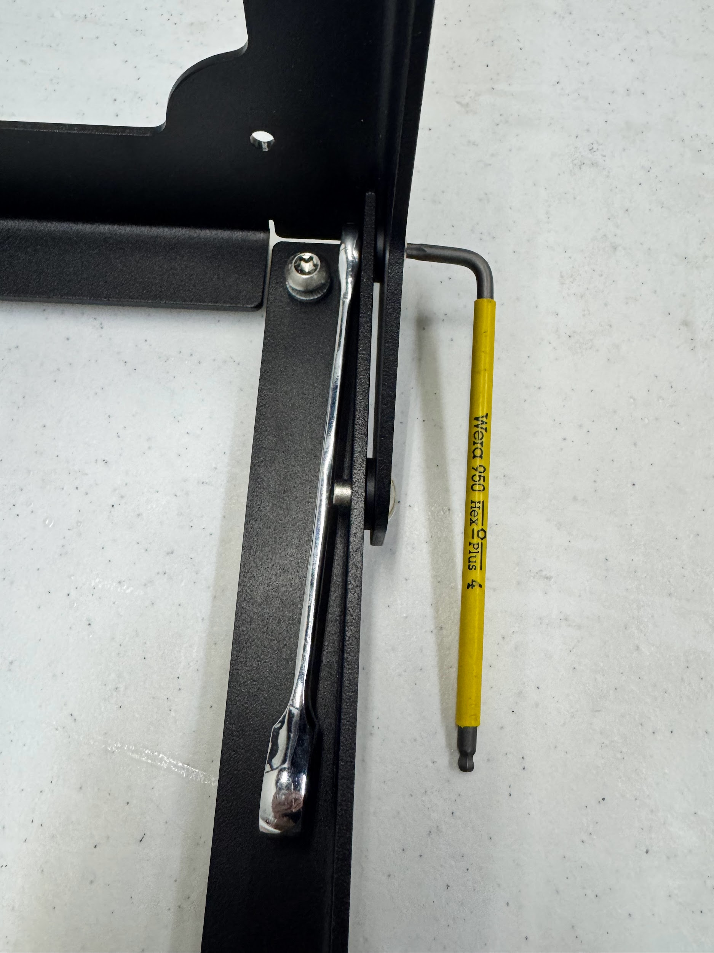
Assembly
Fig. 1
Fig. 2
Insert the M6 into the side of the tray and slide on the black washer (Fig. 1)
Push the M6 fully into the hole opposing the one on the tray (Fig. 2)
Thread on M6 nylock nut and tighten using a T27 torx wrench, and 10mm wrench
Fig. 3

Slide 7
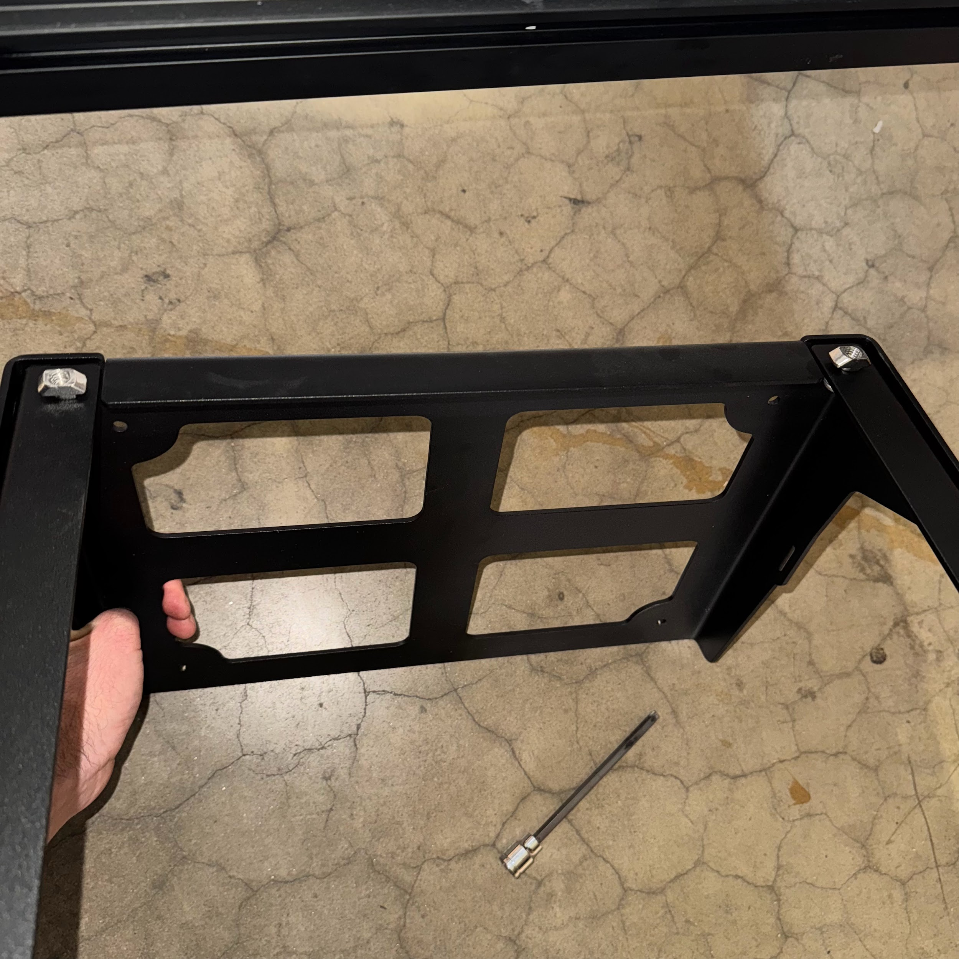
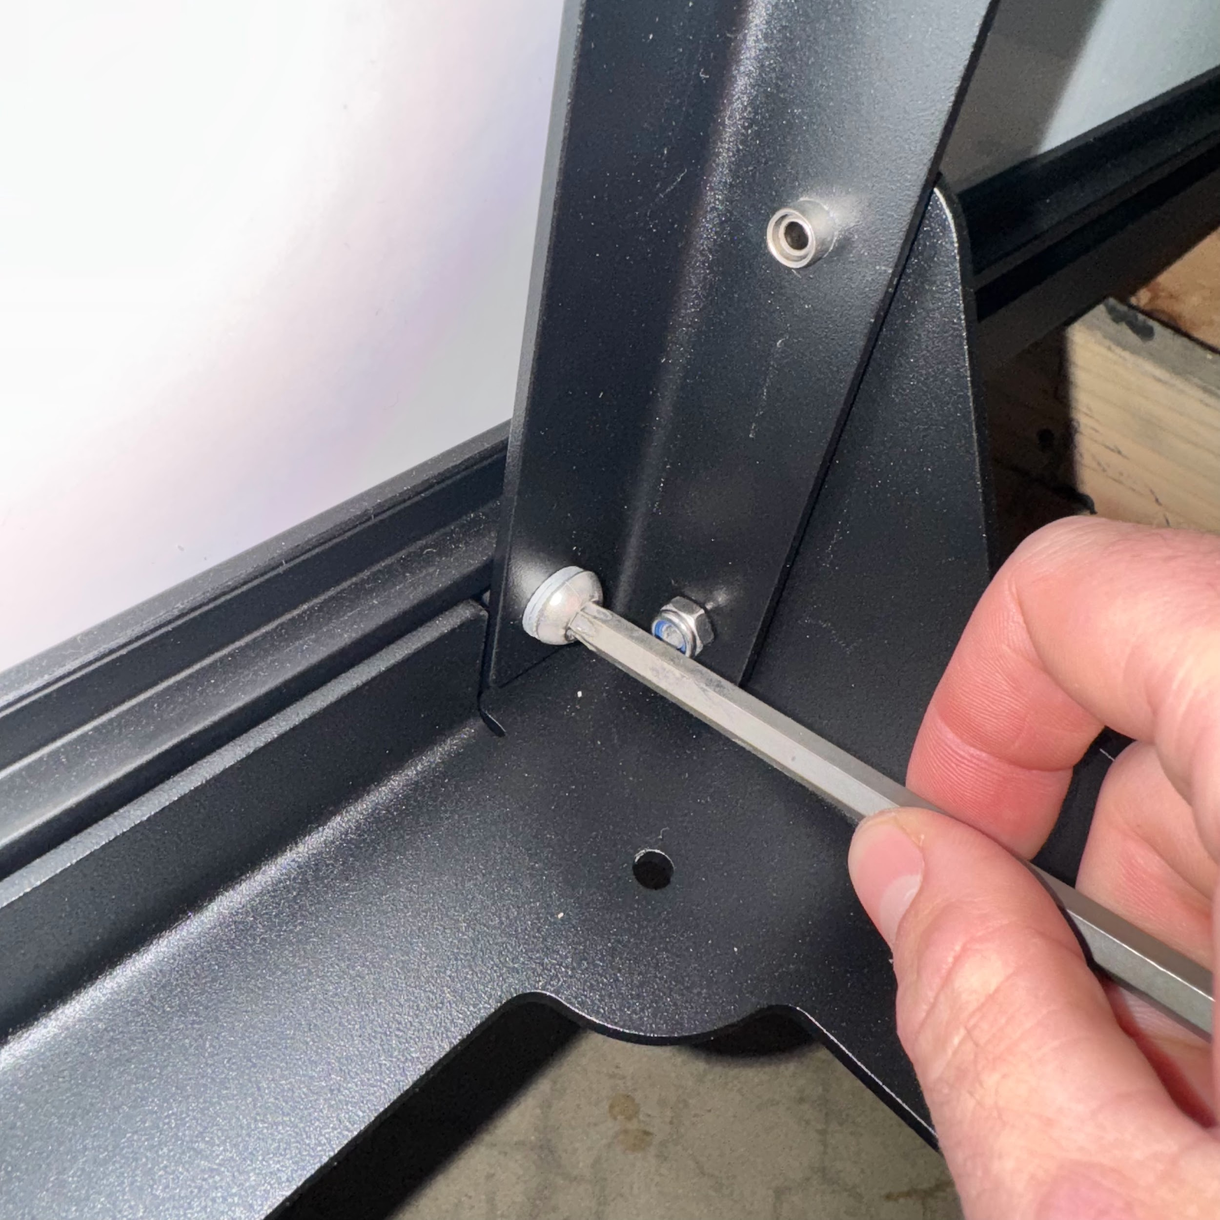
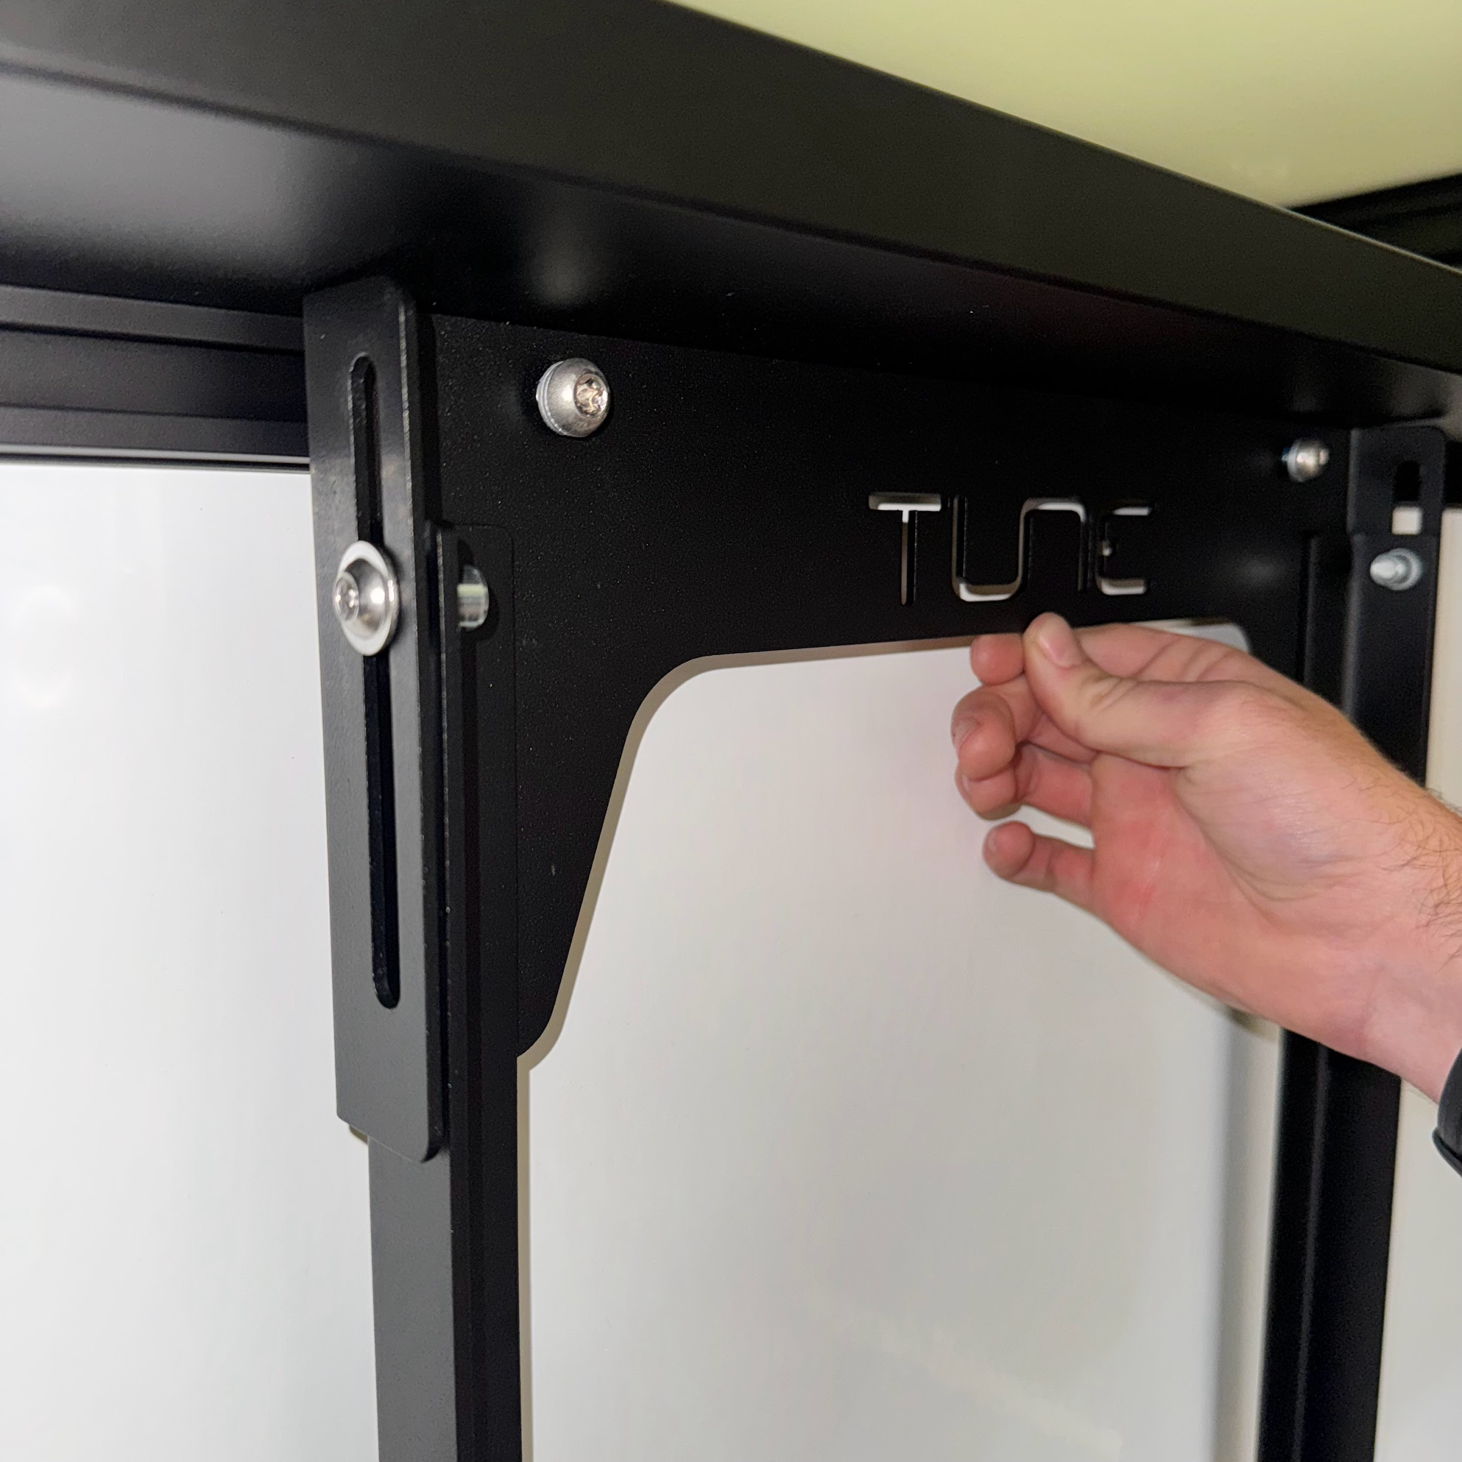
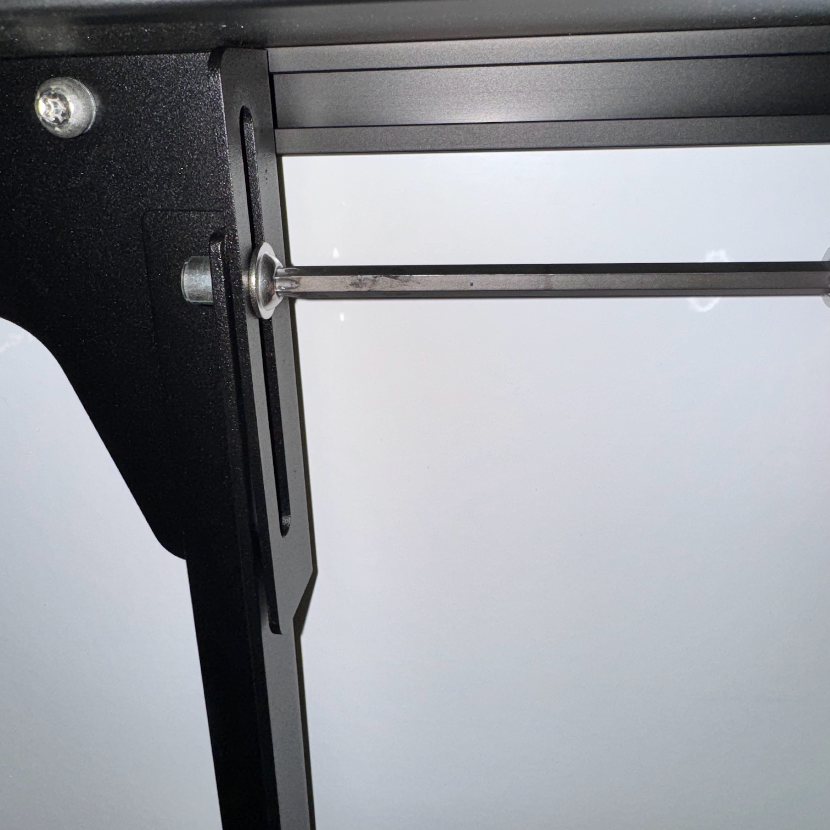

Installation
Loosen the T40 bolts on the top sides of the battery mount
  These bolts adjust the overall height of the mount
Align all hammer nuts with the t track (Fig. 1)
Engage the lower hammer nuts (Fig. 2)
Extend the upper bracket to reach the top t track (Fig. 3)
Tighten the T40 side bolts to lock in the height (Fig. 4)
Torque both upper and lower mounting bolts to 12lb●ft
Fig. 1
Fig. 2
Fig. 3
Fig. 4
W A R N I N G
Ensure all hammer nuts are properly engaged in the t track

Slide 8

Safety Disclaimer and Acknowledgment
By using the battery mount and its associated components, you acknowledge and agree to adhere to the following safety instructions and terms:
Proper Installation and Hardware Tightening:
Hammer Nut Engagement:
Responsibility and Indemnification:
All hardware must be adequately tightened to ensure secure installation of the battery mount. Loose hardware may lead to improper installation, resulting in potential damage to the vehicle or injury.
Ensure that all fasteners are checked and tightened before use of the battery mount. Periodic inspection is recommended to maintain safety during transportation.
Hammer nuts must be fully engaged in the T-track to ensure the battery mount remains securely attached. Failure to fully engage the hammer nuts may result in the battery mount detaching while driving, leading to potential accidents, property damage, or injury.
By using this product, the user agrees to indemnify, defend, and hold harmless the manufacturer, distributor, seller, and their affiliates, employees, and agents from any claims, damages, injuries, or losses that result from improper use, installation, or failure to follow the provided safety guidelines.
This indemnity includes any legal costs and expenses incurred in defending against such claims, including those related to negligence, misuse, or failure
to adhere to the product’s instructions.

