Slide 1
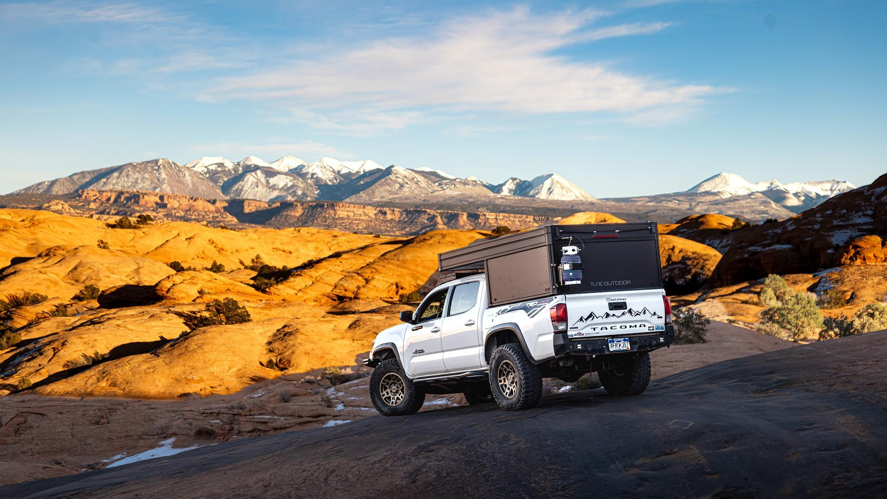


M1L MOLLE Panel -
Install Guide

Slide 2

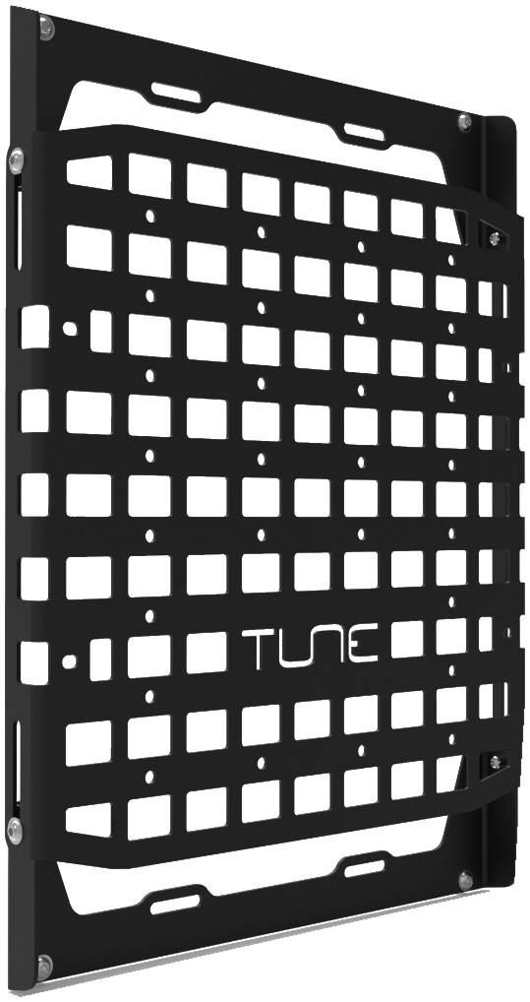
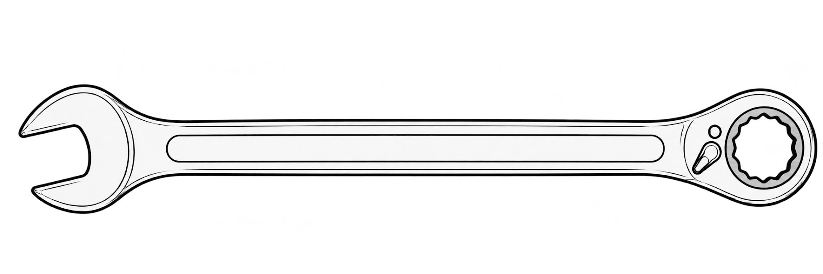
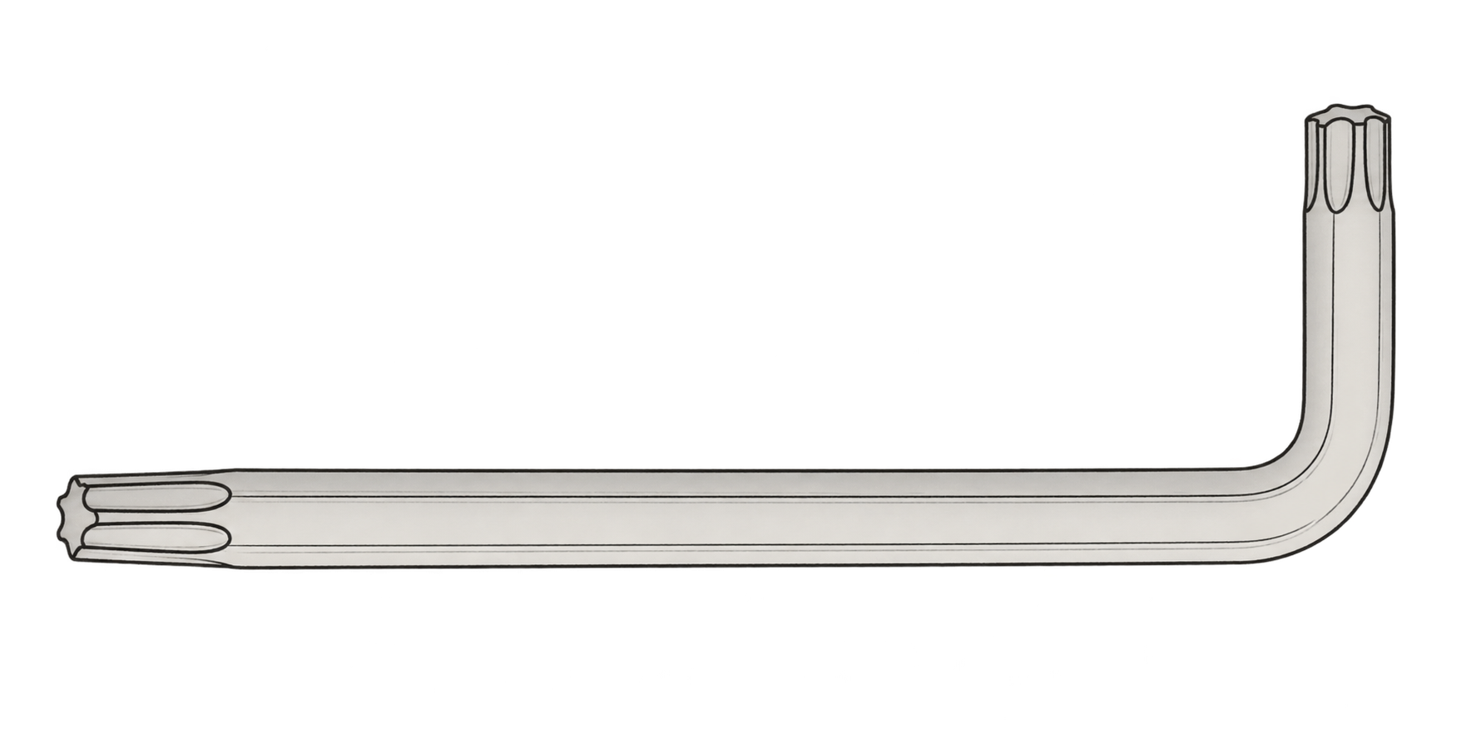
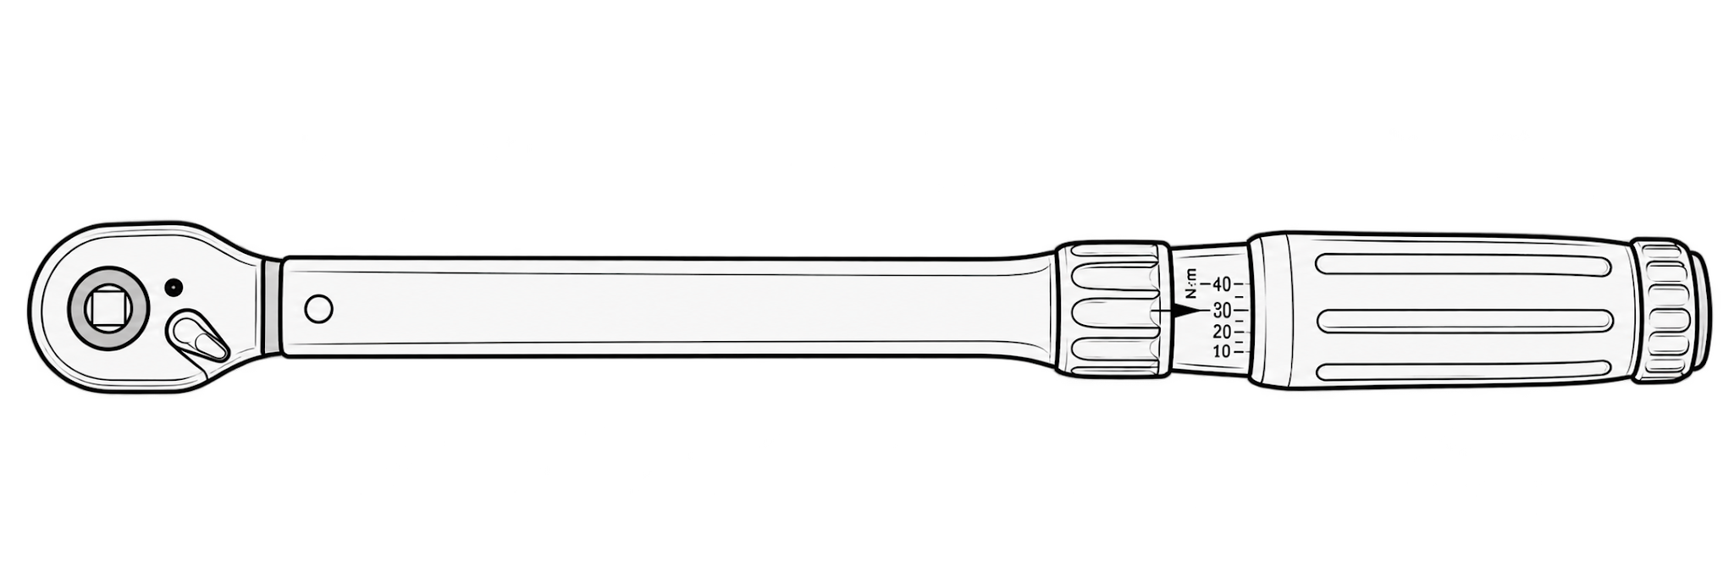
R E Q U I R E D T O O L S
Combination Wrenches
Torx Drivers
13mm Combination Wrench
T40 Torx Driver
Torque Wrench with T40 Socket Bit

Slide 3
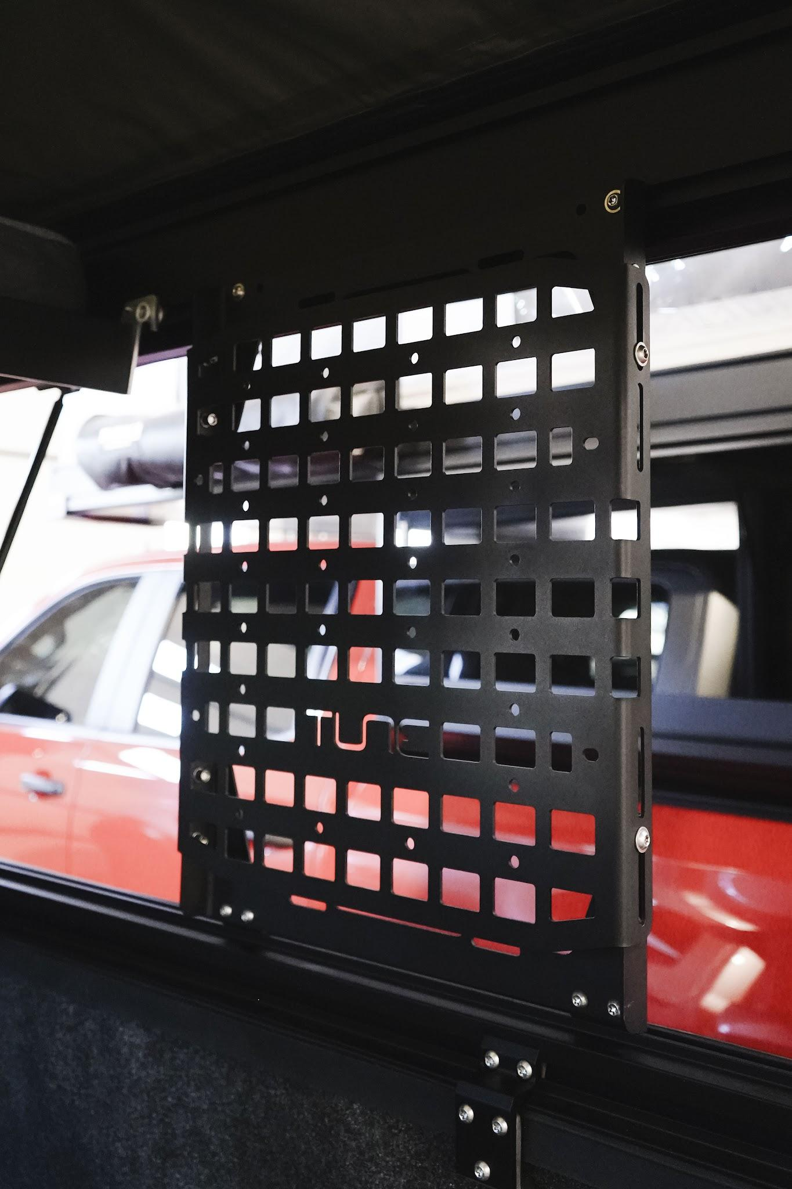

Install the Adapter Brackets:
PAGE 4
Install the Panel:
PAGE 8
Adjust and Torque:
PAGE 9

Slide 4
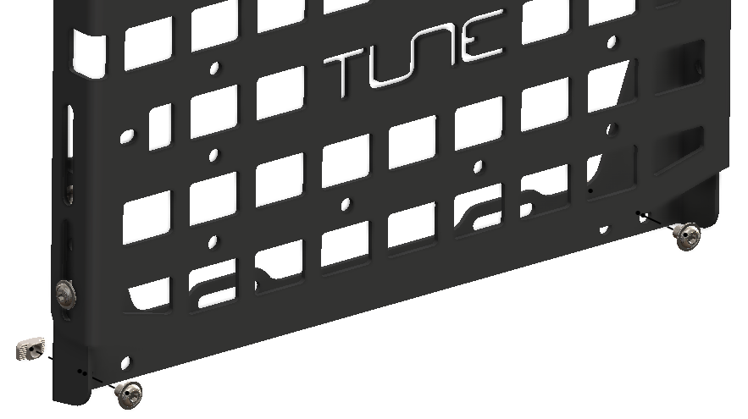
Remove the Bottom Hammer Nuts
1
2
Remove the (2) M8x10mm bolts and M8 hammer nuts on the bottom of the lower MOLLE panel mount.
Fig. 1
Set the (2) M8x10mm bolts and M8 hammer nuts to the side for later.
MOLLE Panel
Lower MOLLE Panel Mount Bracket
Remove (2) M8x10mm Flange Head Bolt
Remove (2) M8 Hammer Nut

Slide 5
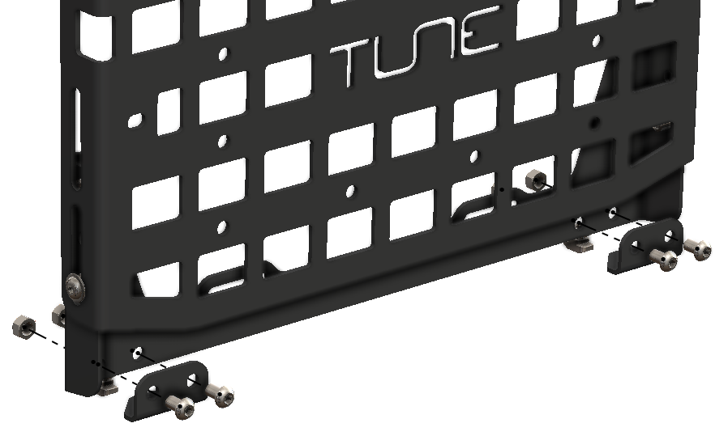
Install the Adapter Brackets
1
2
3
Fig. 1
Gather (4) M8x10mm, (4) M8 nylock nuts, and the (2) M1L MOLLE panel adapter brackets.
Install the M1L MOLLE panel adapter brackets to the lower MOLLE panel bracket with the angled mounting point facing the rear, the flat portion with two holes on the front with (2) M8x10mm bolts facing back and (2) M8 nylock nuts on the rear.
MOLLE Panel
Torque all (4) nuts and bolts to 12 ft-lbs.
Lower MOLLE Panel Mount Bracket
(4) M8x10mm Button Head Bolt
(4) M8 Nylock Nut
(2) M1L MOLLE Panel Adapter Bracket

Slide 6
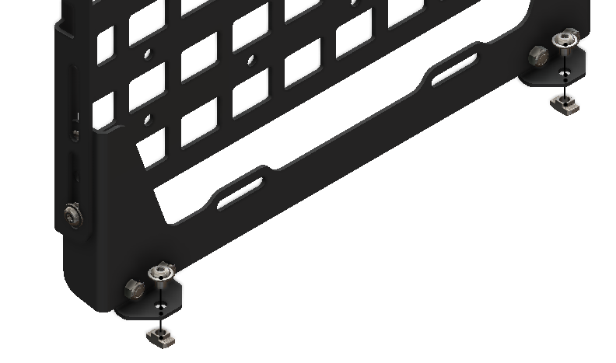
Reinstall the Bottom Hammer Nuts
1
2
3
Gather (2) M8x10mm bolts and (2) M8 Hammer Nuts.
Fig. 1
Thread the bolts through the top of the panel adapter brackets into a hammer nut on the bottom and loosely hand thread them.
Leave the hammer nuts loose enough that there is a gap to thread into the T-Track.
MOLLE Panel
Lower MOLLE Panel Mount Bracket
(2) M8x10mm Flange Head Bolt
(2) M1L MOLLE Panel Adapter Bracket
(2) M8 Hammer Nut

Slide 7
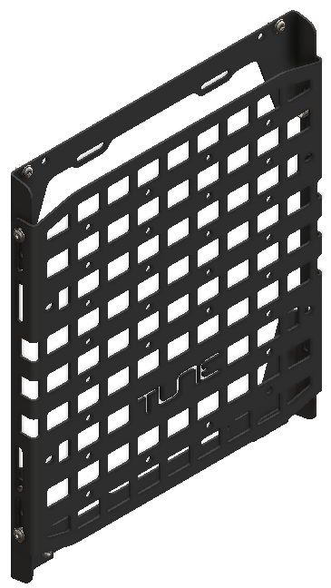
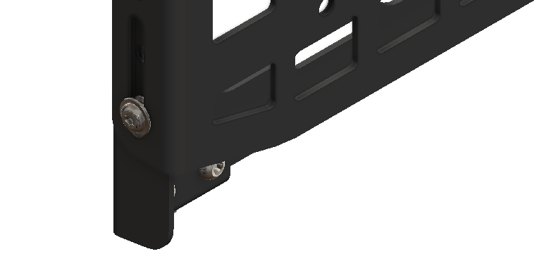
Loosen the Height Adjustment Bolts
1
Fig. 1
Loosen the (4) height adjustment bolts on the sides by 1-2 turns or until you can adjust the height without scratching the powder coating.
Fig. 2

Slide 8
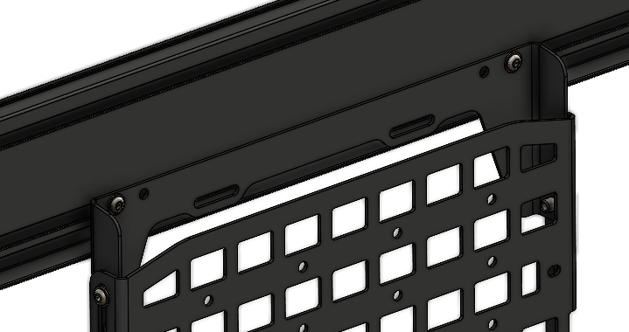
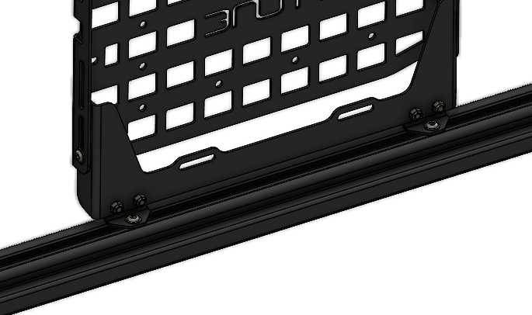

Install MOLLE Panel
1
2
3
4
Fig. 1
Insert the top hammer nuts into the lower T-Track of the support profile and gently turn the bolts until it holds in place.
Adjust the height of the lower MOLLE panel mount bracket to line the M1L MOLLE panel adapter brackets with the T-Track in the base profile.
Lower T-Track in the support profile
Insert the bottom hammer nuts into the T-Track in the base profile and gently turn the bolts until the hammer nuts engage.
T-Track in the base profile
Torque each mounting bolt to 12 ft-lbs.
Fig. 2
Accessing the lower bolts
The lower bolts are easiest to access from the outside of your truck with the side door open.

Slide 9
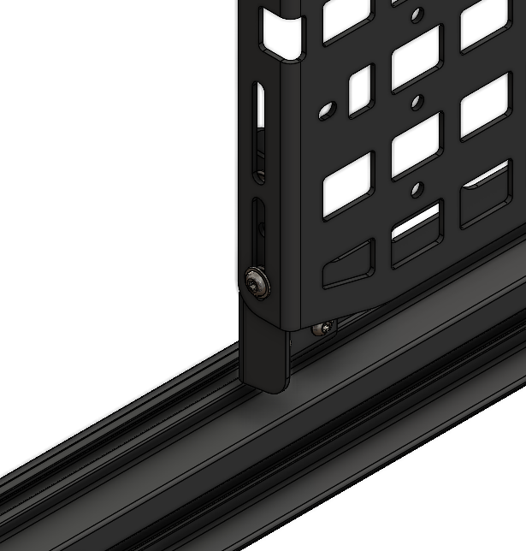
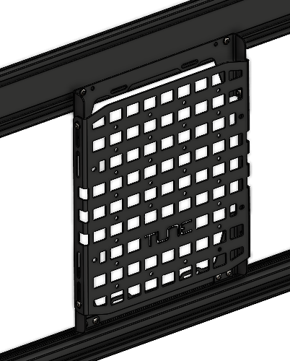
Finalize MOLLE Panel Height
1
2
Slide your MOLLE panel up and down to the desired height.
Complete your install by torquing each of the (4) height adjustment bolts to 12 ft-lbs.
Fig. 1
Fig. 2
Nothing is permanent
You can always adjust the height of your MOLLE panel at a later date. You can even slide it side-to-side as long as you remember to properly torque down the T-Track bolts when you are done.

Slide 10
Safety Disclaimer and Acknowledgment
By using Tune Outdoor products and their associated components, you acknowledge and agree to adhere to the following safety instructions and terms:
Proper Installation and Hardware Tightening:
Hammer Nut Engagement:
Responsibility and Indemnification:
All hardware must be adequately tightened to ensure secure installation of the product. Loose hardware may lead to improper installation, resulting in potential damage to the vehicle or injury.
Ensure that all fasteners are checked and tightened before use of your Tune Outdoor products. Periodic inspection is recommended to maintain safety during transportation.
Hammer nuts must be fully engaged in the T-track to ensure the product remains securely attached. Failure to fully engage the hammer nuts may result in the propane tank and mount detaching while driving, leading to potential accidents, property damage, or injury.
Before driving, always double-check that the hammer nuts are properly secured and that the product is stable.
By using this product, the user agrees to indemnify, defend, and hold harmless the manufacturer, distributor, seller, and their affiliates, employees, and agents from any claims, damages, injuries, or losses that result from improper use, installation, or failure to follow the provided safety guidelines.
This indemnity includes any legal costs and expenses incurred in defending against such claims, including those related to negligence, misuse, or failure
to adhere to the product’s instructions.

Slide 11
Getting Help
For replacement parts, warranty questions, or anything this guide does not cover, contact Tune Outdoor Customer Care.

