Slide 1
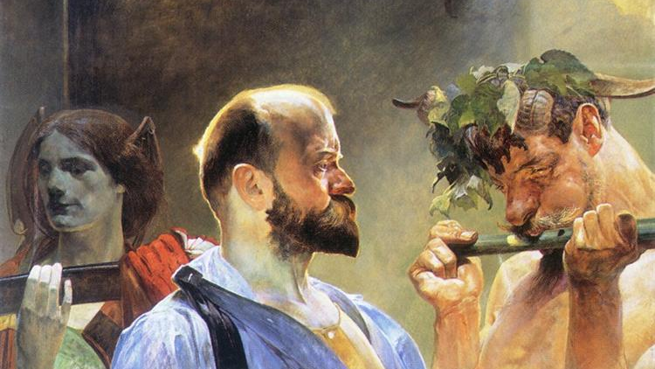
Catholicism and the Culture Wars
1. Leo vs “License”
Jacek Malczewski, Law (1903)

Slide 2

This course
Tracing a history of Church encounter with modernity
Revolving around a number of key narratives
Hinging on a master narrative around human freedom
From the 18th (but mostly 19th) Century to today
This week: early versions – “license”
Leo’s sources, Leo XIII
Vincent van Gogh, Tree Roots (1890)

Slide 3
Part 1
“License” before Leo
Jacek Malczewski, Law (1903)

Slide 4
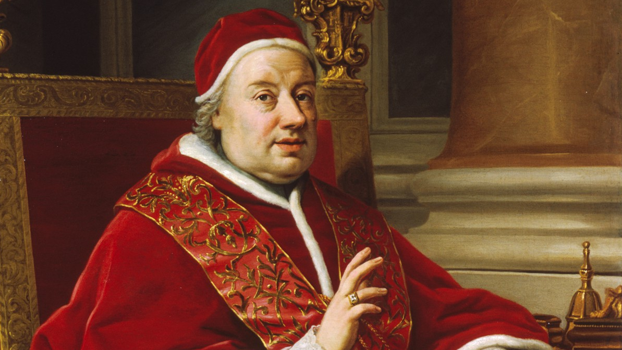
Clement XIII, Christianae Raepublicae (1766)
“They have run first of all against God in their pride...” (atheism, materialism)
“there are others who… dare to examine with human measures the hidden mysteries of faith which surpass all understanding.” (secular reasoning)
“those… who recommend to the minds of the unwary an accursed license of living, and who cause an extreme loss of faith?” (liberty)
Anton Raphael Mengsi, Portrait of Clement XIII (1759)

Slide 5
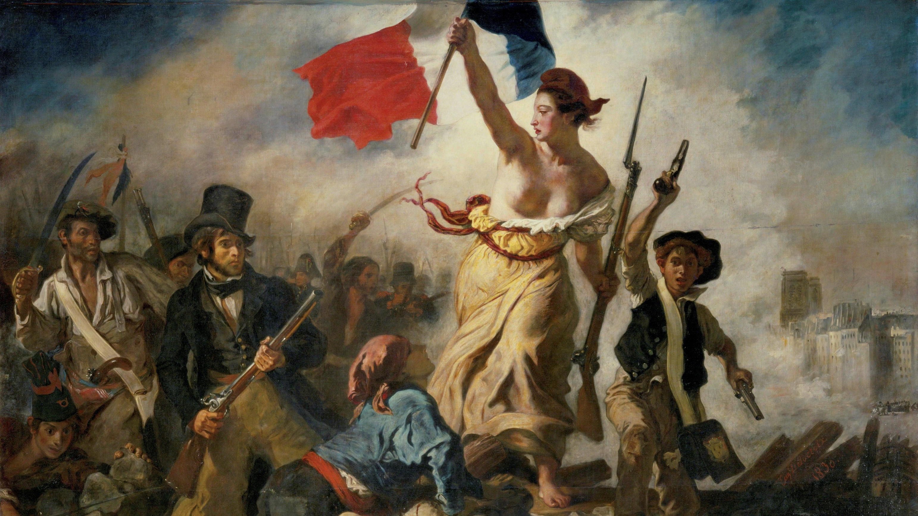
Secular liberalism
Fears confirmed by French Revolution (1789)
Chaos, destruction of social order (monarchy), threat to Church (anticlericalism)
Fundamental narrative: abused, licentious freedom
Developed by later popes
Eugene Delacroix, La Liberté guidant le peuple (1830)

Slide 6
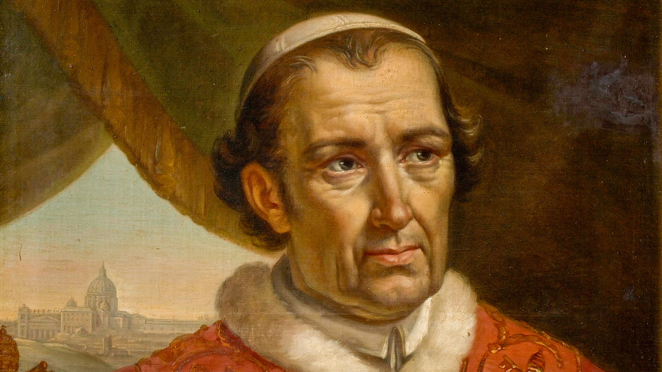
Leo XII, Ubi Primum (1824)
Condemns “unbridled license” of religious tolerance/“indifferentism”
associates with “Deism and Naturalism”
And Protestant readings of Bible outside of Church guidance – “a gospel of men, or what is worse, a gospel of the devil”
Charles Picqué, Portrait of Leo XIII (1828)

Slide 7
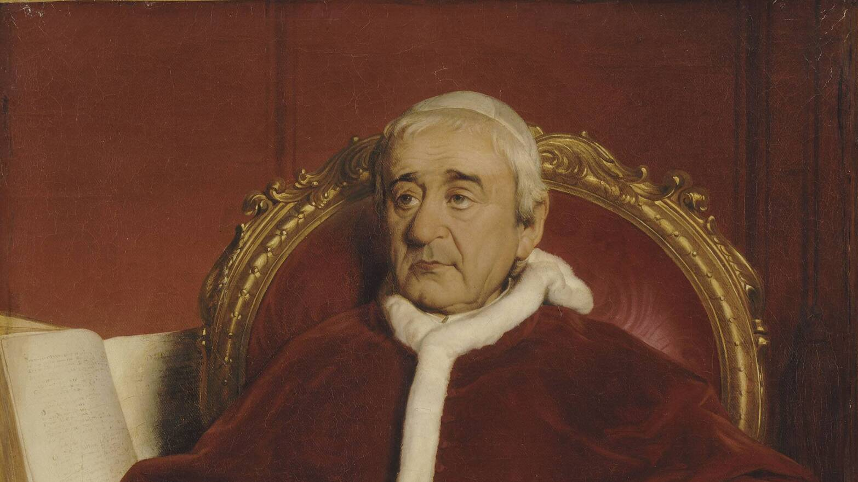
Gregory XVI, Mirari Vos (1832)
1796 – Napoleon invades, annexes Papal states; arrests Pius VI
Napoleon’s reign ends 1814; Pius VII returns, papal states restored – but tenuous
1831 rebellion against theocracy, quelled by inviting Austrian and French troops to keep order
Paul Delaroche, Gregory XVI, Pope (1765-1846) (1844)

Slide 8
Gregory XVI, Mirari Vos (1832)
“Shameless lovers of liberty” separating Church and state
No “trust & submission due to princes” (temporal rulers inc Pope)
indifferentism”, “liberty of conscience”, freedom in publishing and teaching
Schools corrupting youth with secular ideologies
Corruption of language of liberty to undermine authority while bringing “servitude”
Paul Delaroche, Gregory XVI, Pope (1765-1846) (1844)

Slide 9
Gregory XVI, Summo Iugiter Studio (1832)
Intermarriage between Protestants and Catholics in Bavaria
Failure to get dispensations – denial of Church authority
Children not raised as Catholics
Approval of divorce if Protestant spouse has had one
Coercion of priests to perform them
Leads to forgetting only Catholicism saves
Marriage as battleground – social tensions played out around it
Paul Delaroche, Gregory XVI, Pope (1765-1846) (1844)

Slide 10
Part 2
Leo vs “License”
Jacek Malczewski, Law (1903)

Slide 11
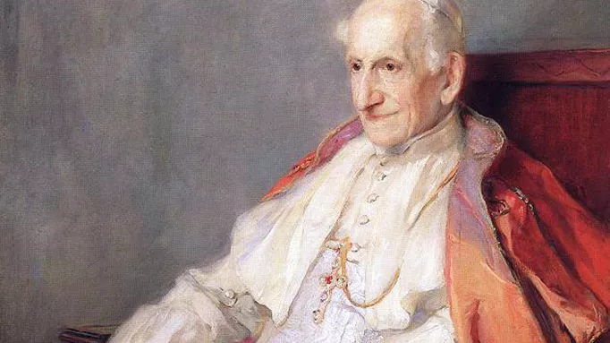
Leo XIII
1870: Italian forces conquer Rome; capital of liberal nation state
Pope confined to rule over Vatican alone
Resurgence of anticlericalism in Europe – monasteries, schools, clerical privileges, Church property under threat
Church going to collapse?!
Industrial capitalism – new kinds of exploitative employment in factories
Philip de László, Portrait of Pope Leo XIII (1900)

Slide 12
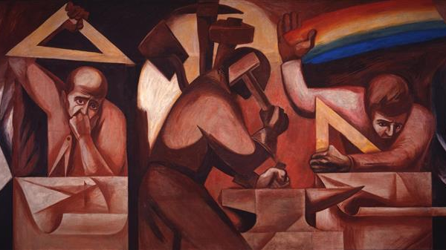
Libertas (1888)
Politics like natural science, sundering nature from creator
seeks “license” – human freedom independent of moral law
“so-called modern liberties” – religious freedom, freedom of teaching, conscience
Youth being corrupted by teachers; Catholic education keeps children from “drinking the poison of impiety” (Sapientiae Christianae)
Both Liberalism and Marxism – two sides of same coin
Leads to tyranny – democracy = majoritarianism
Clemente Orozco, The Call to Revolution and the Table of Universal Brotherhood (Science, Labor, Art (1930-1931)

Slide 13
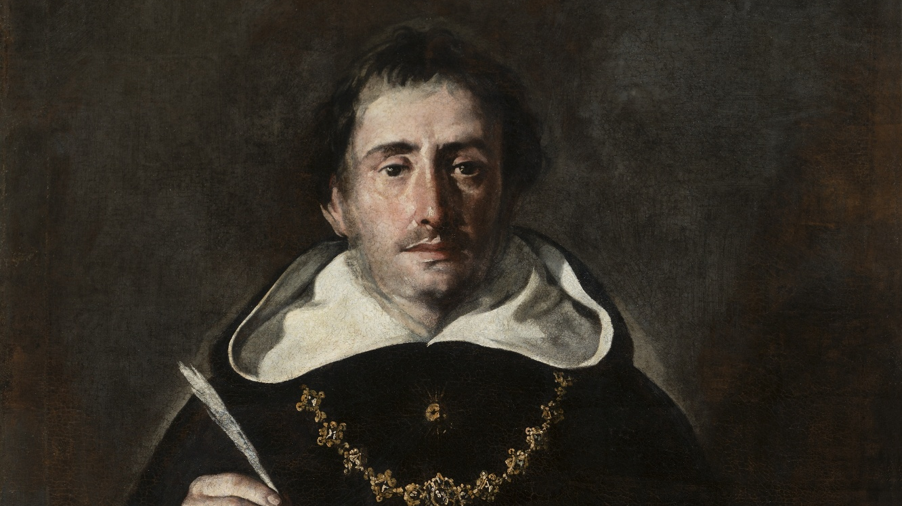
Epistemological threat: Aeterni Patris (1879)
Secular philosophy is to blame
Secular philosophy is a threat to human knowledge – no single tradition, fragmentation, uncertainty
Inadequate Catholic response – innovation has led to similar fragmentation
Leaves people free to be misled
Thomas Aquinas – philosophy perfected in service of theology
Antonio del Castillo Saavedra, St Thomas Aquinas (c.1600-1649)

Slide 14
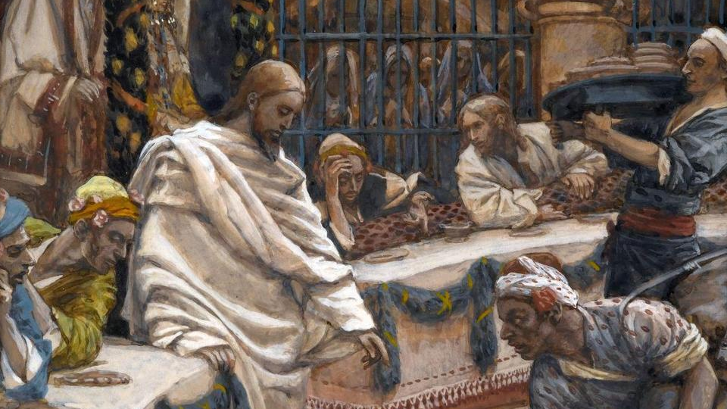
Marriage as battleground – civil marriage
Supplanting “natural and divine law by human law” (Arcanum, 1880)
Only a human contract – ended at will (divorce) (Arcanum)
Erosion of obligations and duties of marriage (using women)
A deeper social threat: marriage as cornerstone of society (Quod Apostolici Muneris, 1878)
Socialism: disorder through attack on marriage(QAM), also interferes in family (property, child-raising) (Rerum Novarum, 1891)
Capitalist workplace employs women against their nature (removes from home, wrong types of work) (Rerum Novarum)
James Tissot, The Wedding at Cana (c. 1886-1894)

Slide 15
Learning from “license”
Themes that we will see throughout this course
Forgotten!
Why might this be?
How can reading this stuff help us to understand today?
Vincent van Gogh, Tree Roots (1890)

