Slide 1
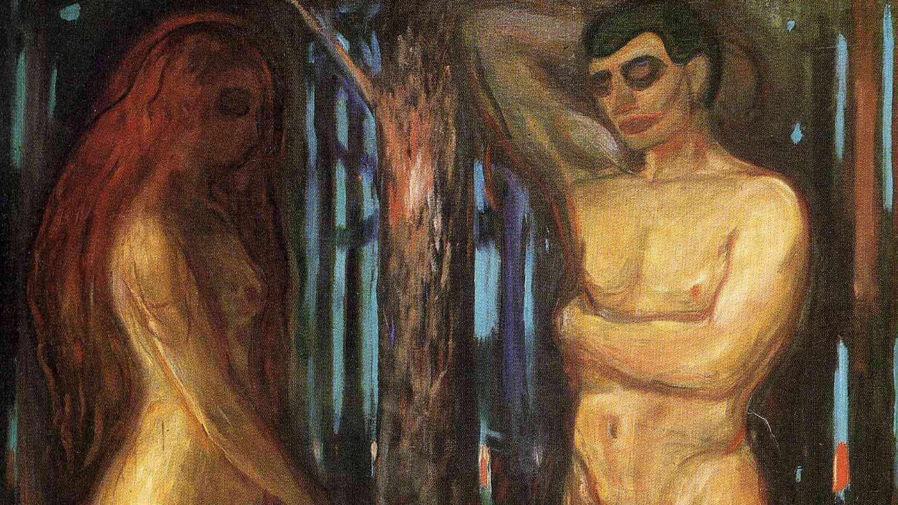
Catholicism and the Culture Wars
Week 2: Catholicism encounters feminism
Edvard Munsch, Adam and Eve (1909)

Slide 2
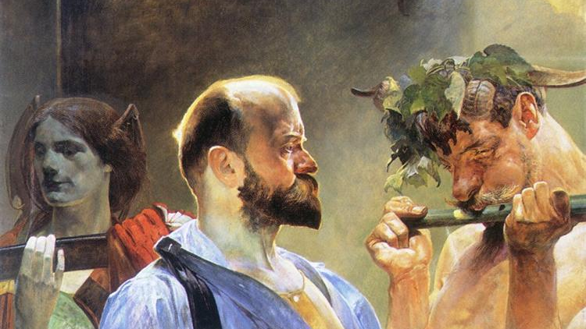
Last week
Early “license” narrative
Human freedom exercised without regard for God’s will
As embodied in authority structures
Political attack thereon: modern liberties
Marriage/the family as battleground: fundamental unit of society
This week: Pius XI – development of key modern narratives
Jacek Malczewski, Law (1903)

Slide 3
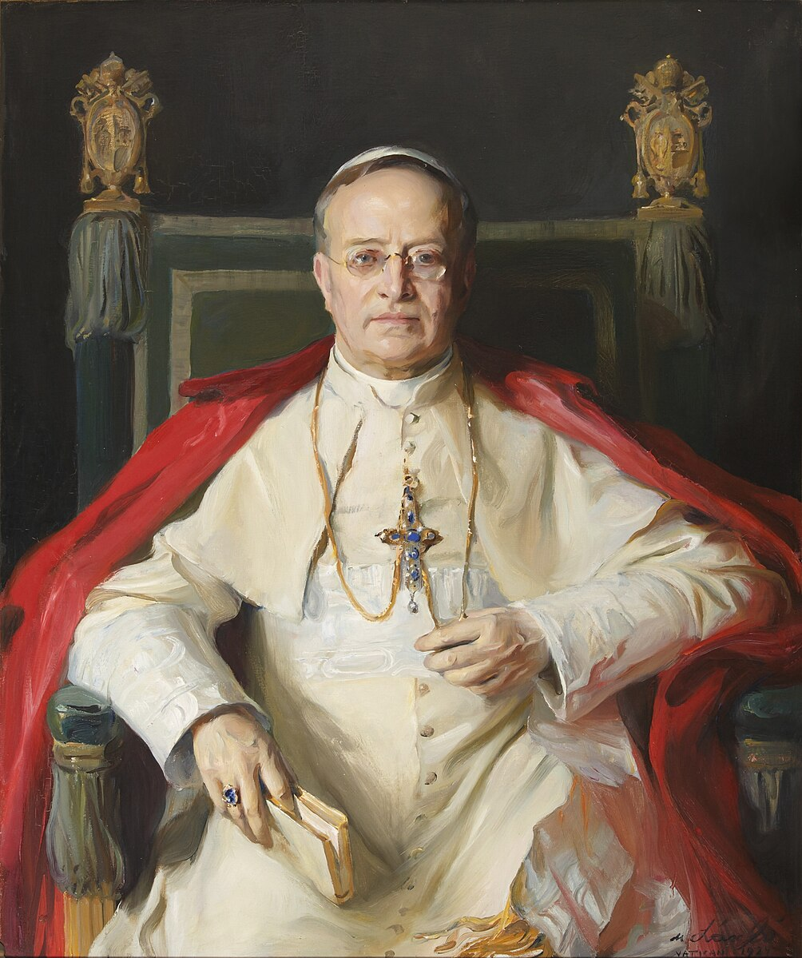
Pius XI
1922-1939 – the Pope between the wars
Marked by navigating Mussolini, Hitler, Communism
Also sexual technologies, early feminism
Philip Alexius de László , Portrait of Pope Pius XI (1857-1939) (1924)

Slide 4
Part 1
Liberty of conscience?
Edvard Munsch, Adam and Eve (1909)

Slide 5
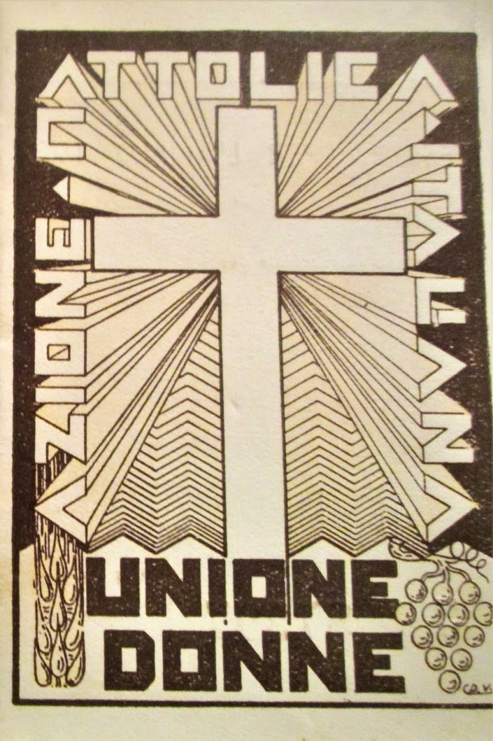
Non abbiamo bisogno (1931)
Italian People’s Party – Left wing Christian democrats, Catholic participation
Catholic Action – civil society organisation, non-party political
Undercutting Italian People’s Party – stole most members!
Attacked by Mussolini as political party itself (one party state)

Slide 6

Non abbiamo Bisogno (1931)
Pius rejects characterisation
Condemns attempts to inhibit Christian formation/society via CA
Condemns seeking to monopolise the young – own youth movements, inculcate “hatred, violence and irreverence”
Condemns persecution as “statolatry” – state appropriating from family, denying rights of church
Advocates for freedom of conscience for Catholics to engage in civil society

Slide 7
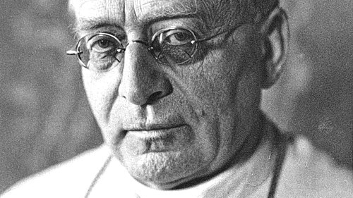
Liberty of conscience (for Catholics)
There has been no attention paid to your protests and assurances, Venerable Brethren, concerning the true nature of Catholic Action and its work, and concerning the sacred inviolable rights of souls and of the Church.
We say “the sacred and inviolable rights of souls and of the Church,”… because this matter concerns the right of souls to procure for themselves the greatest spiritual work of the Church, the divinely appointed and so mandatory of this teaching and of this work in that supernatural order… It concerns the right of souls so formed to share the treasures of the redemption with other souls, thus participating in the activities of the Apostolic Hierarchy.
It was in consideration of this double right of souls that We lately declared Ourselves happy and proud to wage the good fight for the liberty of consciences.
(no. 39-41)

Slide 8
Part 2
Human rights?
Edvard Munsch, Adam and Eve (1909)

Slide 9
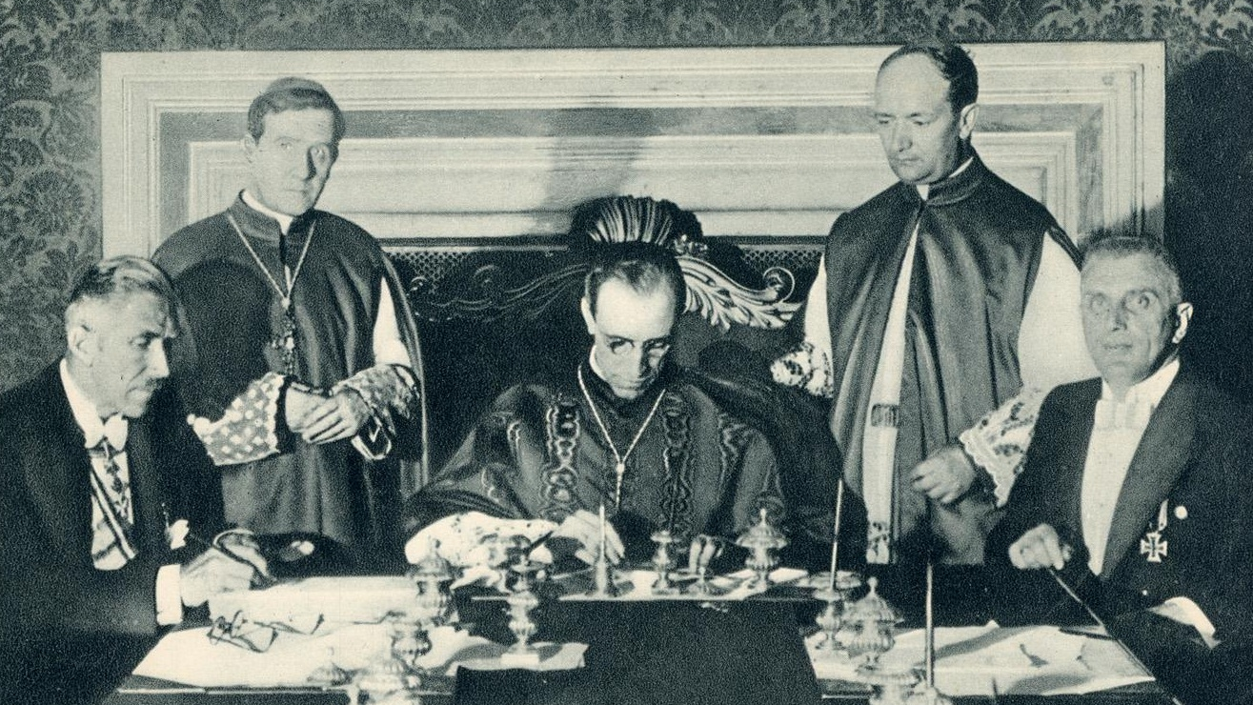
Mit brennender sorge (1937)
Reichskoncordat – signed with Nazis (assumed would be short lived)
Protect Church from interference by state
in exchange for oath of loyalty, no party politics; moral legitimacy for Nazis
Immediately betrayed by Hitler
Encyclical is careful objection – don’t bring down more trouble
No “idolatrous” veneration of race, pagan reduction of God to national spirit
Defends OT, Catholic schooling, parents

Slide 10
Early human rights reference…
Human laws in flagrant contradiction with the natural law are vitiated with a taint which no force, no power can mend. In the light of this principle one must judge the axiom, that "right is common utility,“…what is morally indefensible, can never contribute to the good of the people. But ancient paganism acknowledged that the axiom, to be entirely true, must be reversed and be made to say: "Nothing can be useful, if it is not at the same time morally good" (Cicero, De Off. ii. 30)… man as a person possesses rights he holds from God, and which any collectivity must protect against denial, suppression or neglect.
(no. 30, emphasis mine)

Slide 11
…but with a specific concern
The believer has an absolute right to profess his Faith and live according to its dictates. Laws which impede this profession and practice of Faith are against natural law.
Parents who are earnest and conscious of their educative duties, have a primary right to the education of the children God has given them in the spirit of their Faith, and according to its prescriptions. Laws and measures which in school questions fail to respect this freedom of the parents go against natural law, and are immoral. The Church, whose mission it is to preserve and explain the natural law, as it is divine in its origin, cannot but declare that the recent enrollment into schools organized without a semblance of freedom, is the result of unjust pressure, and is a violation of every common right.
(no. 31)

Slide 12
Part 3
Encountering feminism
Edvard Munsch, Adam and Eve (1909)

Slide 13
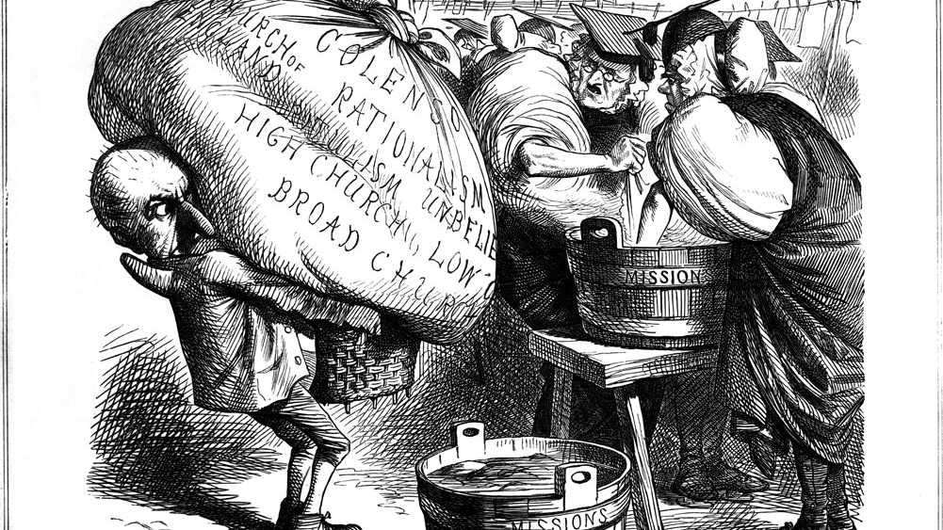
Casti conubii (1930)
1930 Lambeth Conference – accepts contraception
“in those cases where there is such a clearly felt moral obligation to limit or avoid parenthood, and where there is a morally sound reason for avoiding complete abstinence”
Pius responds – denying possibility for Catholics
Picture of marriage that also brings in associated issues
Broader response to women’s liberation
Along license narrative
Punch magazine, A Pan-Anglican Washing Day (satire of the first Lambeth Conference) (1867)

Slide 14
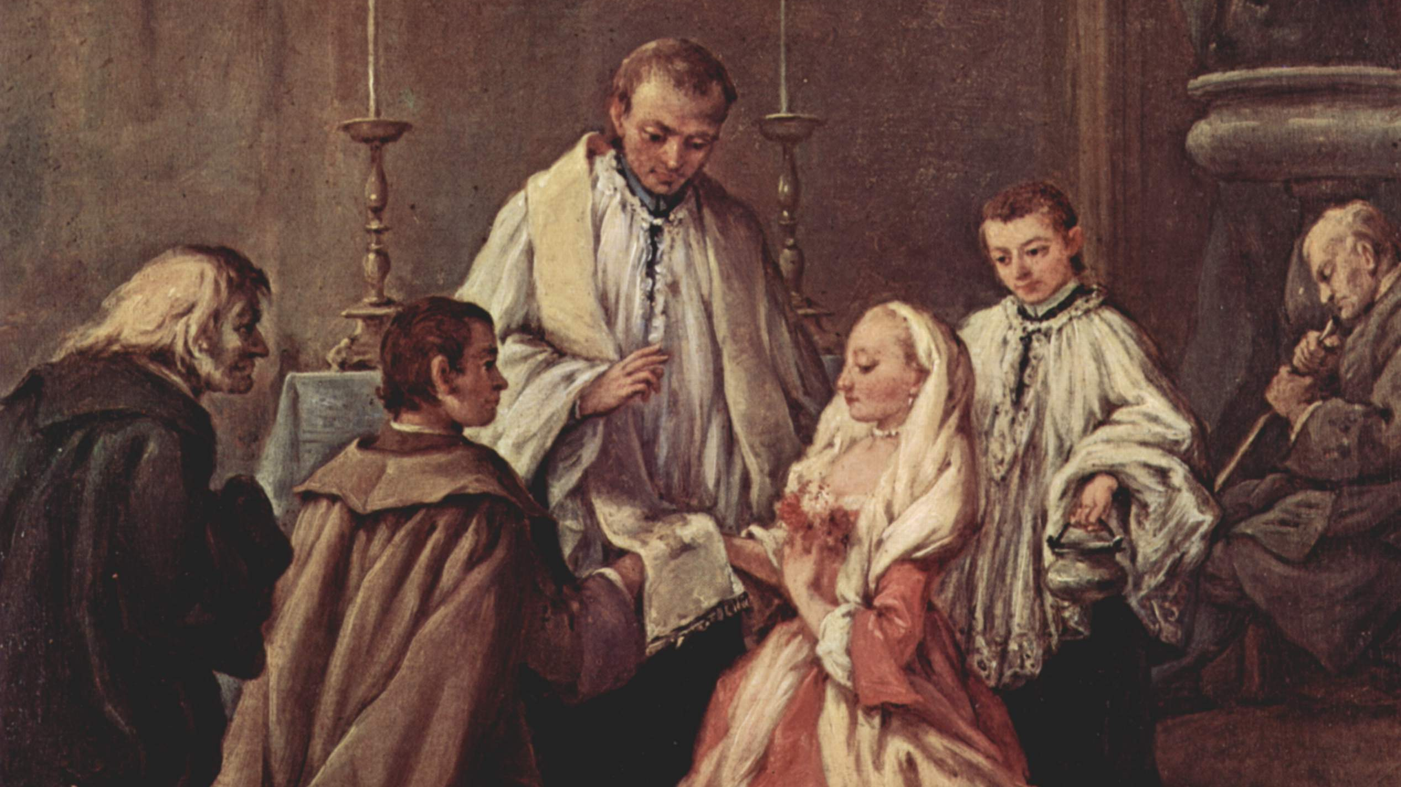
Key points
Marriage as divine institution – must be respected
Calls for human laws that promote marriage, virtue
Church needed to guide people; don’t reduce marriage to human institution
Criticises sex education at odds with Catholic teaching
Procreation as chief good of marriage; contraception frustrates
Abortion as murder
Eugenics, govt sterilisation as violating right to enter marriage, false subordination of family to state, violates body’s dignity
Condemns voluntary sterilisation – principle of totality
Pietro Lonhi, The Sacrament of Marriage (18th Century)

Slide 15
Pius and feminism
The same false teachers who try to dim the luster of conjugal faith and purity do not scruple to do away with the honorable and trusting obedience which the woman owes to the man. Many of them even go further and assert that such a subjection of one party to the other is unworthy of human dignity, that the rights of husband and wife are equal; wherefore, they boldly proclaim the emancipation of women has been or ought to be effected. This emancipation in their ideas must be threefold, in the ruling of the domestic society, in the administration of family affairs and in the rearing of the children. It must be social, economic, physiological: - physiological, that is to say, the woman is to be freed at her own good pleasure from the burdensome duties properly belonging to a wife as companion and mother (We have already said that this is not an emancipation but a crime); social, inasmuch as the wife being freed from the cares of children and family, should, to the neglect of these, be able to follow her own bent and devote herself to business and even public affairs; finally economic, whereby the woman even without the knowledge and against the wish of her husband may be at liberty to conduct and administer her own affairs, giving her attention chiefly to these rather than to children, husband and family.
(no. 74)

Slide 16
Pius and feminism
This, however, is not the true emancipation of woman, nor that rational and exalted liberty which belongs to the noble office of a Christian woman and wife; it is rather the debasing of the womanly character and the dignity of motherhood, and indeed of the whole family, as a result of which the husband suffers the loss of his wife, the children of their mother, and the home and the whole family of an ever watchful guardian. More than this, this false liberty and unnatural equality with the husband is to the detriment of the woman herself, for if the woman descends from her truly regal throne to which she has been raised within the walls of the home by means of the Gospel, she will soon be reduced to the old state of slavery (if not in appearance, certainly in reality) and become as amongst the pagans the mere instrument of man.
(no. 75)

Slide 17
Pius’ legacy
Gradual development around human rights, freedom of conscience (albeit for Catholics)
Marriage vs feminism, contraception, abortion, sterilisation (linked)
Principle of totality – mutilation hermeneutic
Edvard Munsch, Adam and Eve (1909)

