Slide 1
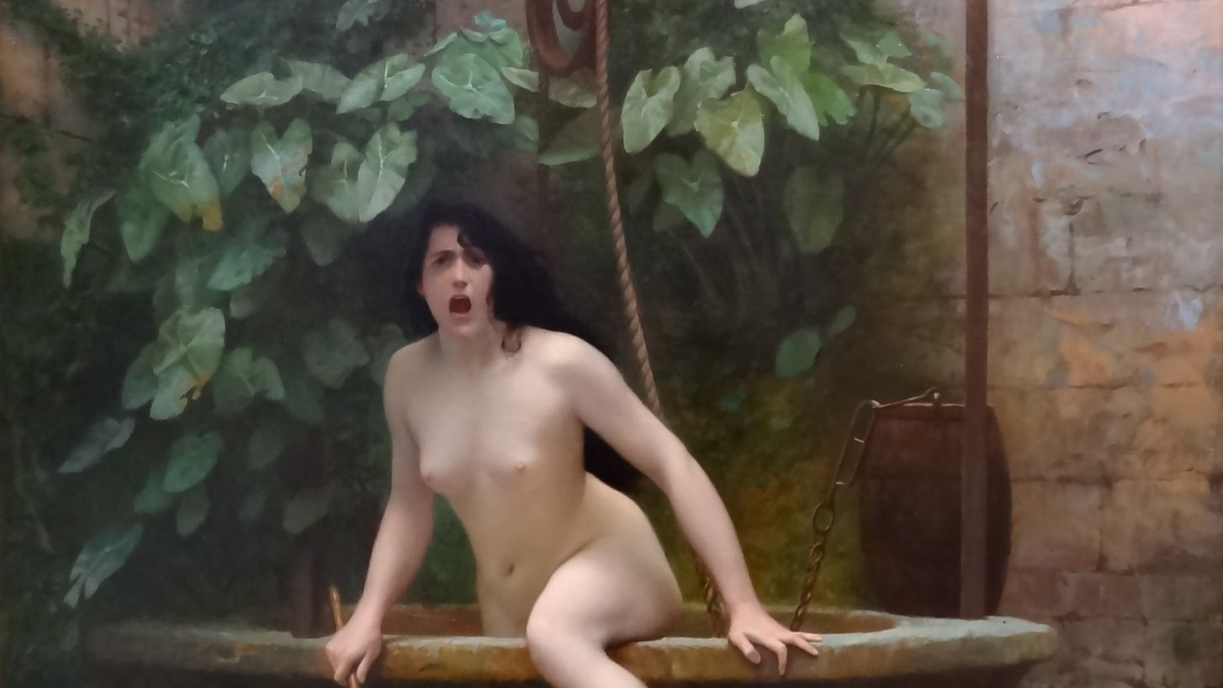
Catholicism and the Culture Wars
Week 3 – Vatican II
Jean-Léon Gérôme, Truth coming from the well armed with her whip to chastise mankind (1896)

Slide 2
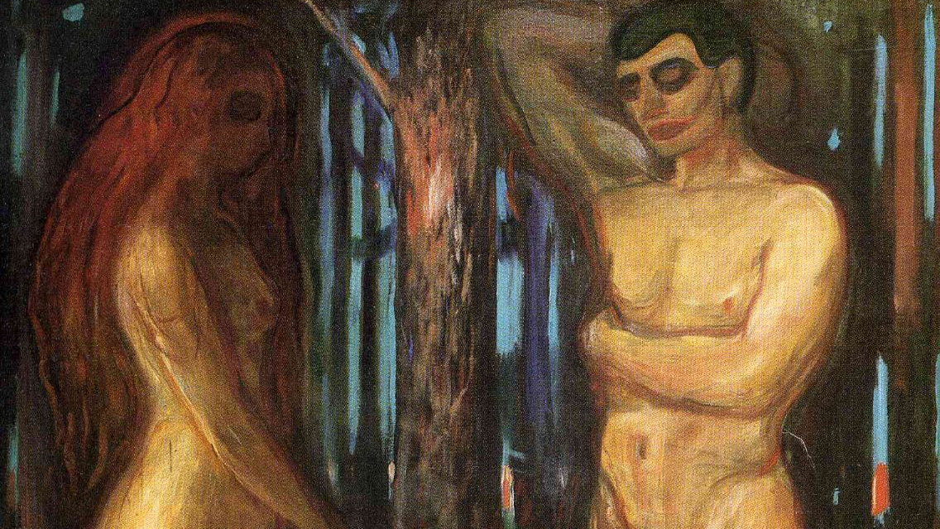
This week
Week 1 – worries about modernity, license; marriage as battleground
Week 2 – early freedom of conscience, religious freedom language (for Catholics); feminism, contraception, abortion, sterilisation
This week – Vatican II
Renegotiating stance towards modern world after WWII
Edvard Munsch, Adam and Eve (1909)

Slide 3
Part 1
The challenge of the 20th Century
Jean-Léon Gérôme, Truth coming from the well armed with her whip to chastise mankind (1896)

Slide 4
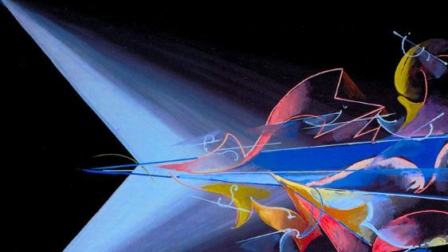
Challenge 1: Totalitarianism
Catholicism as totalitarianism – seeking total dominance
Italy – using totalitarian governments to promote Catholicism
No freedom of conscience, religion, ambivalence re democracy
(at least for non-Catholics)
Horrors of fascism, Communism
Post-war turn to Liberal democracy
Catholic authoritarianism seems problematic!
Giacomo Balla, Science Banishes Obscurantism (1920)

Slide 5
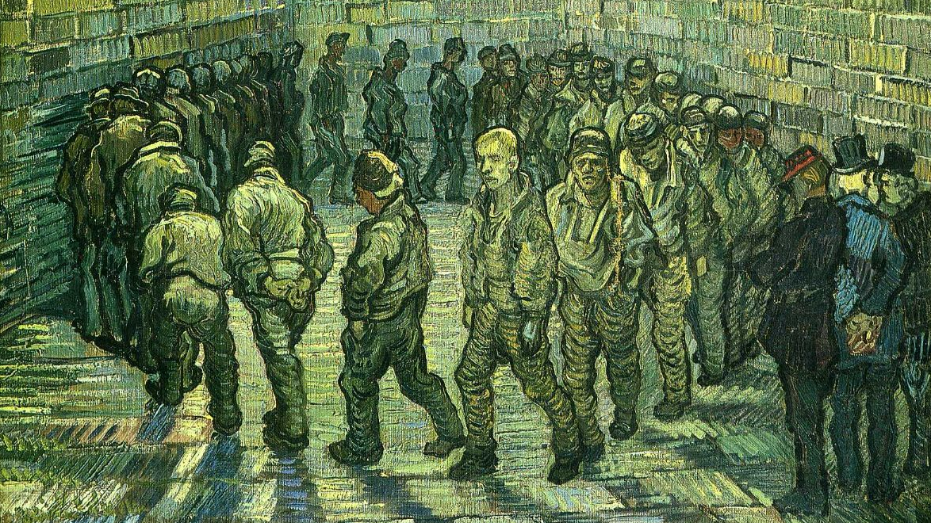
Challenge 2: Cultural shifts
Destruction of old order, widespread experience of mortal danger
Experience of unfreedom – camps, danger etc
Turn towards subjectivity
Vincent van Gogh, Prisoners Exercising (Prisoners Round) (1890)

Slide 6
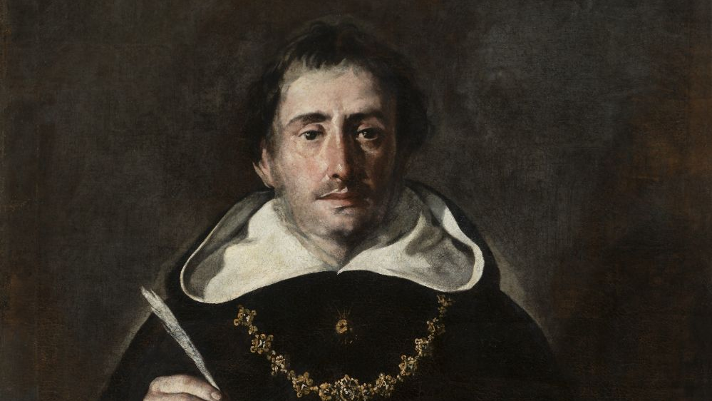
Challenge 3: The need for a new theology
Neo-Thomism – recovery of (a particular reading of) Aquinas
Focus on objectivity – at odds with interest in subjective
Authoritarian policing – opposed to “Modernism”
Manualisation – fragments, limits discipline
Antonio del Castillo Saavedra,St Thomas Aquinas (c.1600-1649)

Slide 7
Part II
A new theology
Jean-Léon Gérôme, Truth coming from the well armed with her whip to chastise mankind (1896)

Slide 8
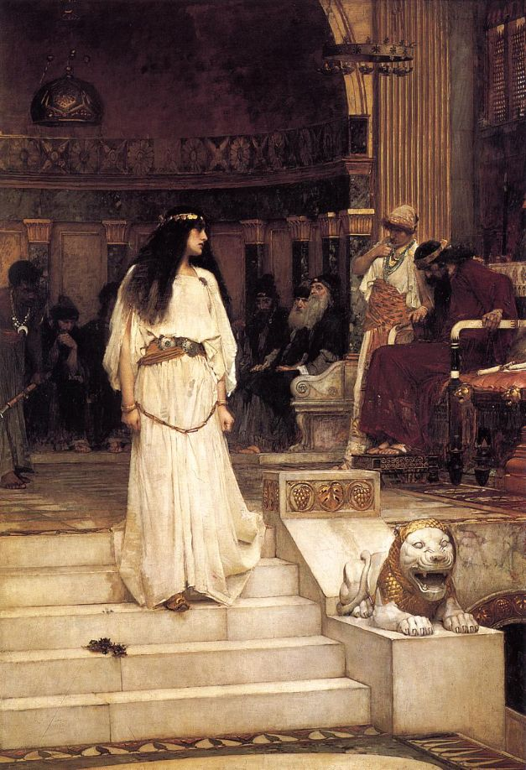
Neo-Thomist “voluntarism”
Worry about “license” – subjecting human freedom to God’s will
Voluntarism – God rules like a lawmaker, imposing will on creation
Christian life = subjecting self to these laws
Based on particular reading of Thomas Aquinas (Neo-Thomist)
John William Waterhouse, Mariamne Leaving the Judgment Seat of Herod (1887)

Slide 9
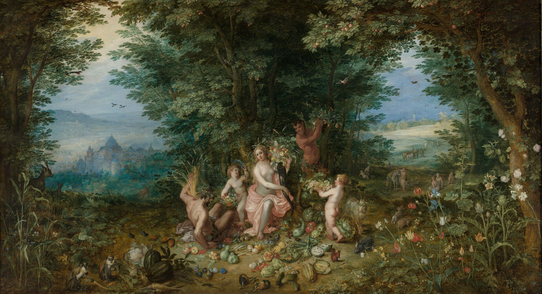
Sacramental ontology
Theologians once censured, later shaped council
Recovery of other readings of Thomas Aquinas, earlier Christian sources
God acts on world at level of creation
Gives it a nature that expresses itself according to divine plan (except sin!)
Christian life – co-operating with grace working in nature
Jan Brueghel the Younger and Hendrik van Balen, Landscape with Ceres (Allegory of Earth) (16th Century)

Slide 10
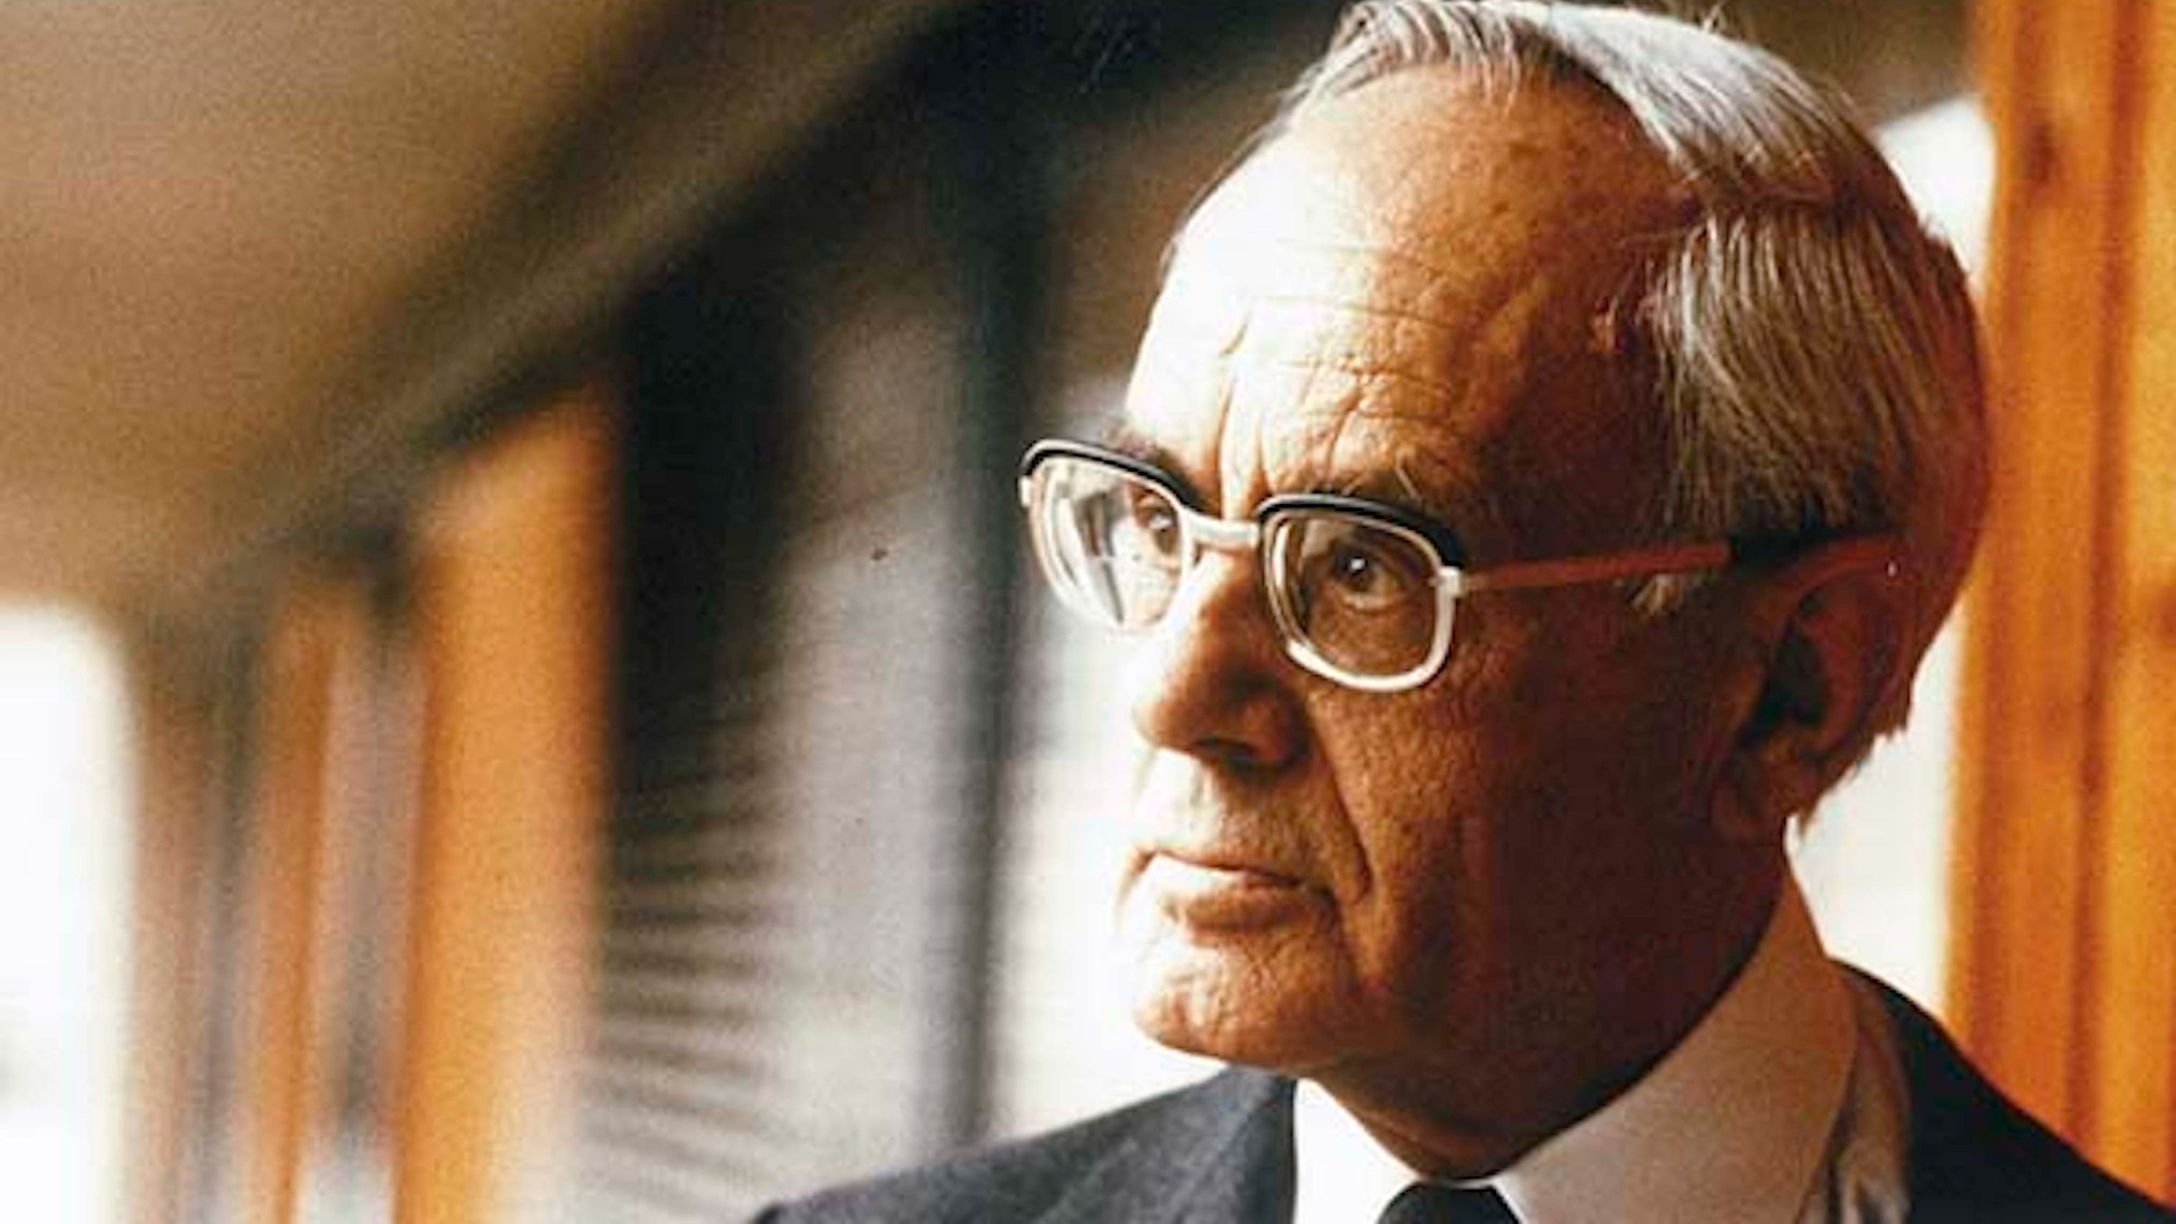
The Nouvelle théologie
God working in creation – can trust in world?
Faith is not about subjecting oneself, society to divine lawmaker
(there is still a moral law; just not an imposition to surrender to)
Less authoritarian vision for society
Grace working in all spheres of human life (subjectivity)
Karl Rahner, SJ

Slide 11
The Nouvelle théologie
Mystical dimension of Church prior to juridical
Reintegration of theology around fundamental theology
Mystical Body: laity are as much part of Church as priests
Less authoritarian vision of Church governance - raising up the bottom of the hierarchy?
Karl Rahner, SJ

Slide 12
Part III
The politics of Vatican II
Jean-Léon Gérôme, Truth coming from the well armed with her whip to chastise mankind (1896)

Slide 13
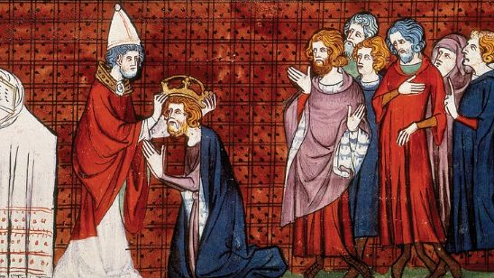
The Church and the world – Gaudium et spes
Church is journeying through world – People of God (no. 11; ch. 4)
Sharing in world’s “joys and the hopes, the griefs and the anxieties” (no. 1)
Even atheism: recognises failures of religion, “protest against the evil in this world, or from the absolute character with which certain human values are unduly invested, and which thereby already accords them the stature of God” (no. 20)
Pope Leo III crowning Charlemagne (14th Century)

Slide 14
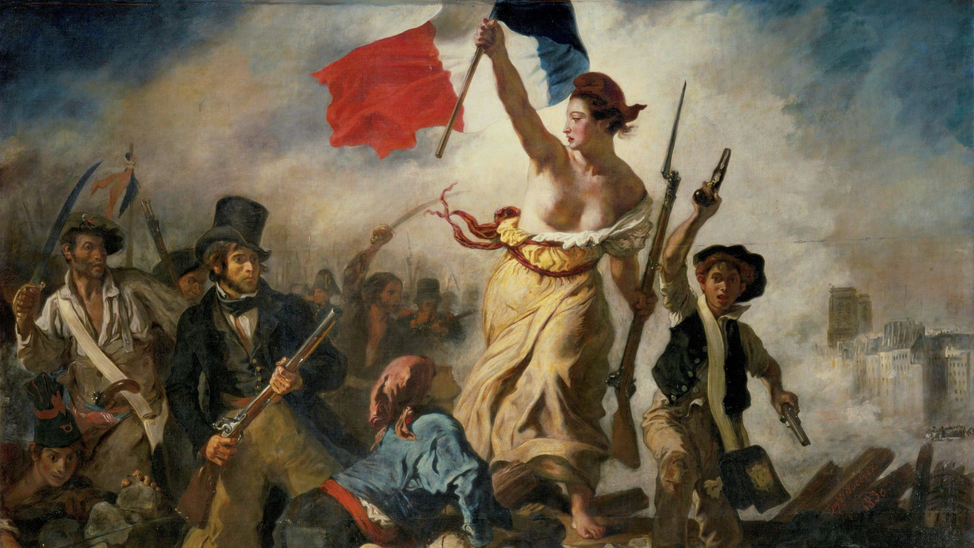
But still worries about license (Gaudium et spesno. 20)
“systematic form” of “modern atheism”: “stretches the desires for human independence to such a point that it poses difficulties against any kind of dependence on God”.
bolstered by “the sense of power which modern technical progress generates in man”, leads to secularisation.
“anticipates the liberation of man especially through his economic and social emancipation”, and views religion as an obstacle to this.
Promoted “by using, especially in the education of youth, those means of pressure which public power has at its disposal”.
Eugene Delacroix, La Liberté guidant le peuple (1830)

Slide 15

Freedom of conscience – Gaudium et spes
In the depths of his conscience, man detects a law which he does not impose upon himself, but which holds him to obedience… For man has in his heart a law written by God; to obey it is the very dignity of man; according to it he will be judged.(9) Conscience is the most secret core and sanctuary of a man. There he is alone with God, Whose voice echoes in his depths.(10)… In fidelity to conscience, Christians are joined with the rest of men in the search for truth, and for the genuine solution to the numerous problems which arise in the life of individuals from social relationships… Conscience frequently errs from invincible ignorance without losing its dignity. The same cannot be said for a man who cares but little for truth and goodness, or for a conscience which by degrees grows practically sightless as a result of habitual sin.
(no. 17)
Renee Magritte, Freedom of Mind (1948)

Slide 16
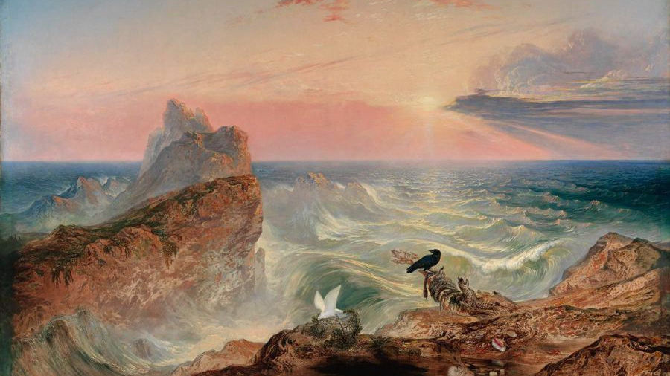
Religious freedom – Dignitatis Humanae
This Vatican Council declares that the human person has a right to religious freedom…
It is in accordance with their dignity as persons-that is, beings endowed with reason and free will and therefore privileged to bear personal responsibility-that all men should be at once impelled by nature and also bound by a moral obligation to seek the truth, especially religious truth. They are also bound to adhere to the truth, once it is known, and to order their whole lives in accord with the demands of truth. However, men cannot discharge these obligations in a manner in keeping with their own nature unless they enjoy immunity from external coercion as well as psychological freedom.
(No. 2)
John Marton, The Assuaging of the Waters (1840)

Slide 17
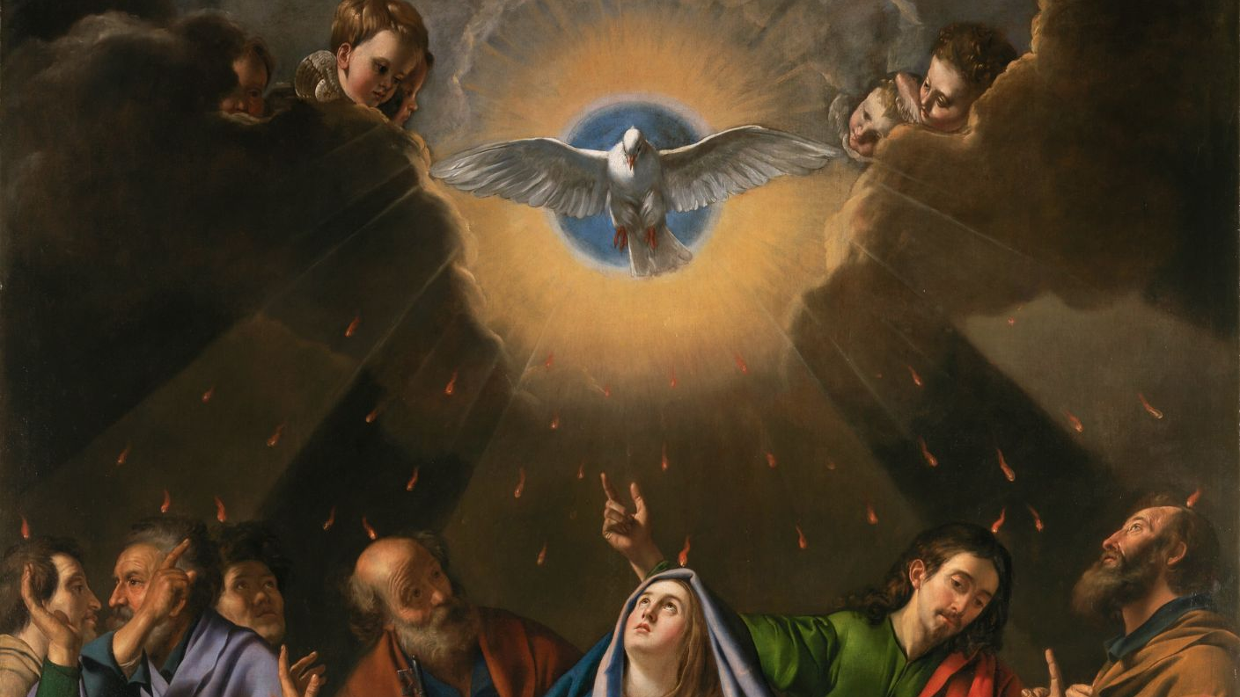
But also
Emphasis on right of religious communities to govern own religious life, practice publicly, own buildings and property, teach and evangelise responsibly and non-coercively
Governments shouldn’t legislate against these things
“not a few can be found who seem inclined to use the name of freedom as the pretext for refusing to submit to authority and for making light of the duty of obedience” (no.8)
Extensive focus on this freedom for the Church specifically
i.e. same contentions, identification with other faiths vs secular
Maino, Pentecostés (1620-1625)

Slide 18
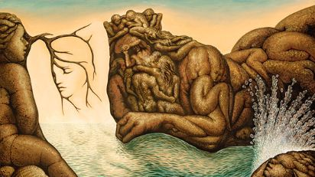
Ambivalence about feminism (Gaudium et spes)
Approvingly recognises a range of struggles for justice, including feminism
“Women now work in almost all spheres. It is fitting that they are able to assume their proper role in accordance with their own nature. It will belong to all to acknowledge and favor the proper and necessary participation of women in the cultural life.” (no. 60)
Emphasises importance of marriage, restates rejection of contraception, abortion
“The family is a kind of school of deeper humanity... The active presence of the father is highly beneficial to their formation. The children, especially the younger among them, need the care of their mother at home. This domestic role of hers must be safely preserved, though the legitimate social progress of women should not be underrated on that account.” (no. 52)
Octavia Ocampo, Absents of the Mermaid (1943)

