Slide 1
Death, finitude and meaning
Philosophy Through the Year: Meaning
London Jesuit Centre

Slide 2
Nihilism and the ‘death of God’
Through a number of published and unpublished texts, Nietzsche tells a story about the history of Western thought, so as to better understand the contemporary cultural situation. Something like:
The Judeo-Christian tradition, combined with Platonism ‘shifted the centre of gravity’ out of life into the ‘Beyond’ (God; Forms; the ‘transcendental subject’);
  i.e. the question of the meaning and value of temporal life is answered with reference to transcendence, or to something not subject to change;
  the ‘true world’ is conceived in terms of contrast with, opposition to, the earthly, empirical world: it is changeless, perfect, undying, etc.
This shift emerged from a basic dissatisfaction with life as it is – a ‘hostility’ towards life;

Slide 3
Nihilism and the ‘death of God’
This means that temporal life in itself is judged to be without meaning;
But the morality of the Judeo-Christian world gives rise to forces that eventually destroy it;
  Especially the ‘will to truth’:
  truth is valued unconditionally (because truth is divine); everything must be sacrificed to truth;
  but eventually, the Christian west ‘murders God’ in the name of truth;
  but if there is no God, there is no longer any truth (nothing stable and unchanging, outside of appearances);
  and so the ‘highest values devalue themselves’

Slide 4
Nihilism and the ‘death of God’
This leads to emptiness, disorientation and meaninglessness (‘passive nihilism’):
  the question ‘why?’ no longer has any answer;
  we have murdered God, but ‘the deed is too great for us’ (‘Parable of the madman’);
  people cling onto the ‘shadows’ of God
OR: it can be taken as an opportunity for ‘the revaluation of all values’, embracing values that remain ‘true to the earth’ (active nihilism)
But the troubling question remains of the value of the ‘will to truth’; as it is this will that drives the whole process…
(see especially: Nietzsche 2006: 219; 223-4; 362-4; 385-389; 464-5; 516)

Slide 5
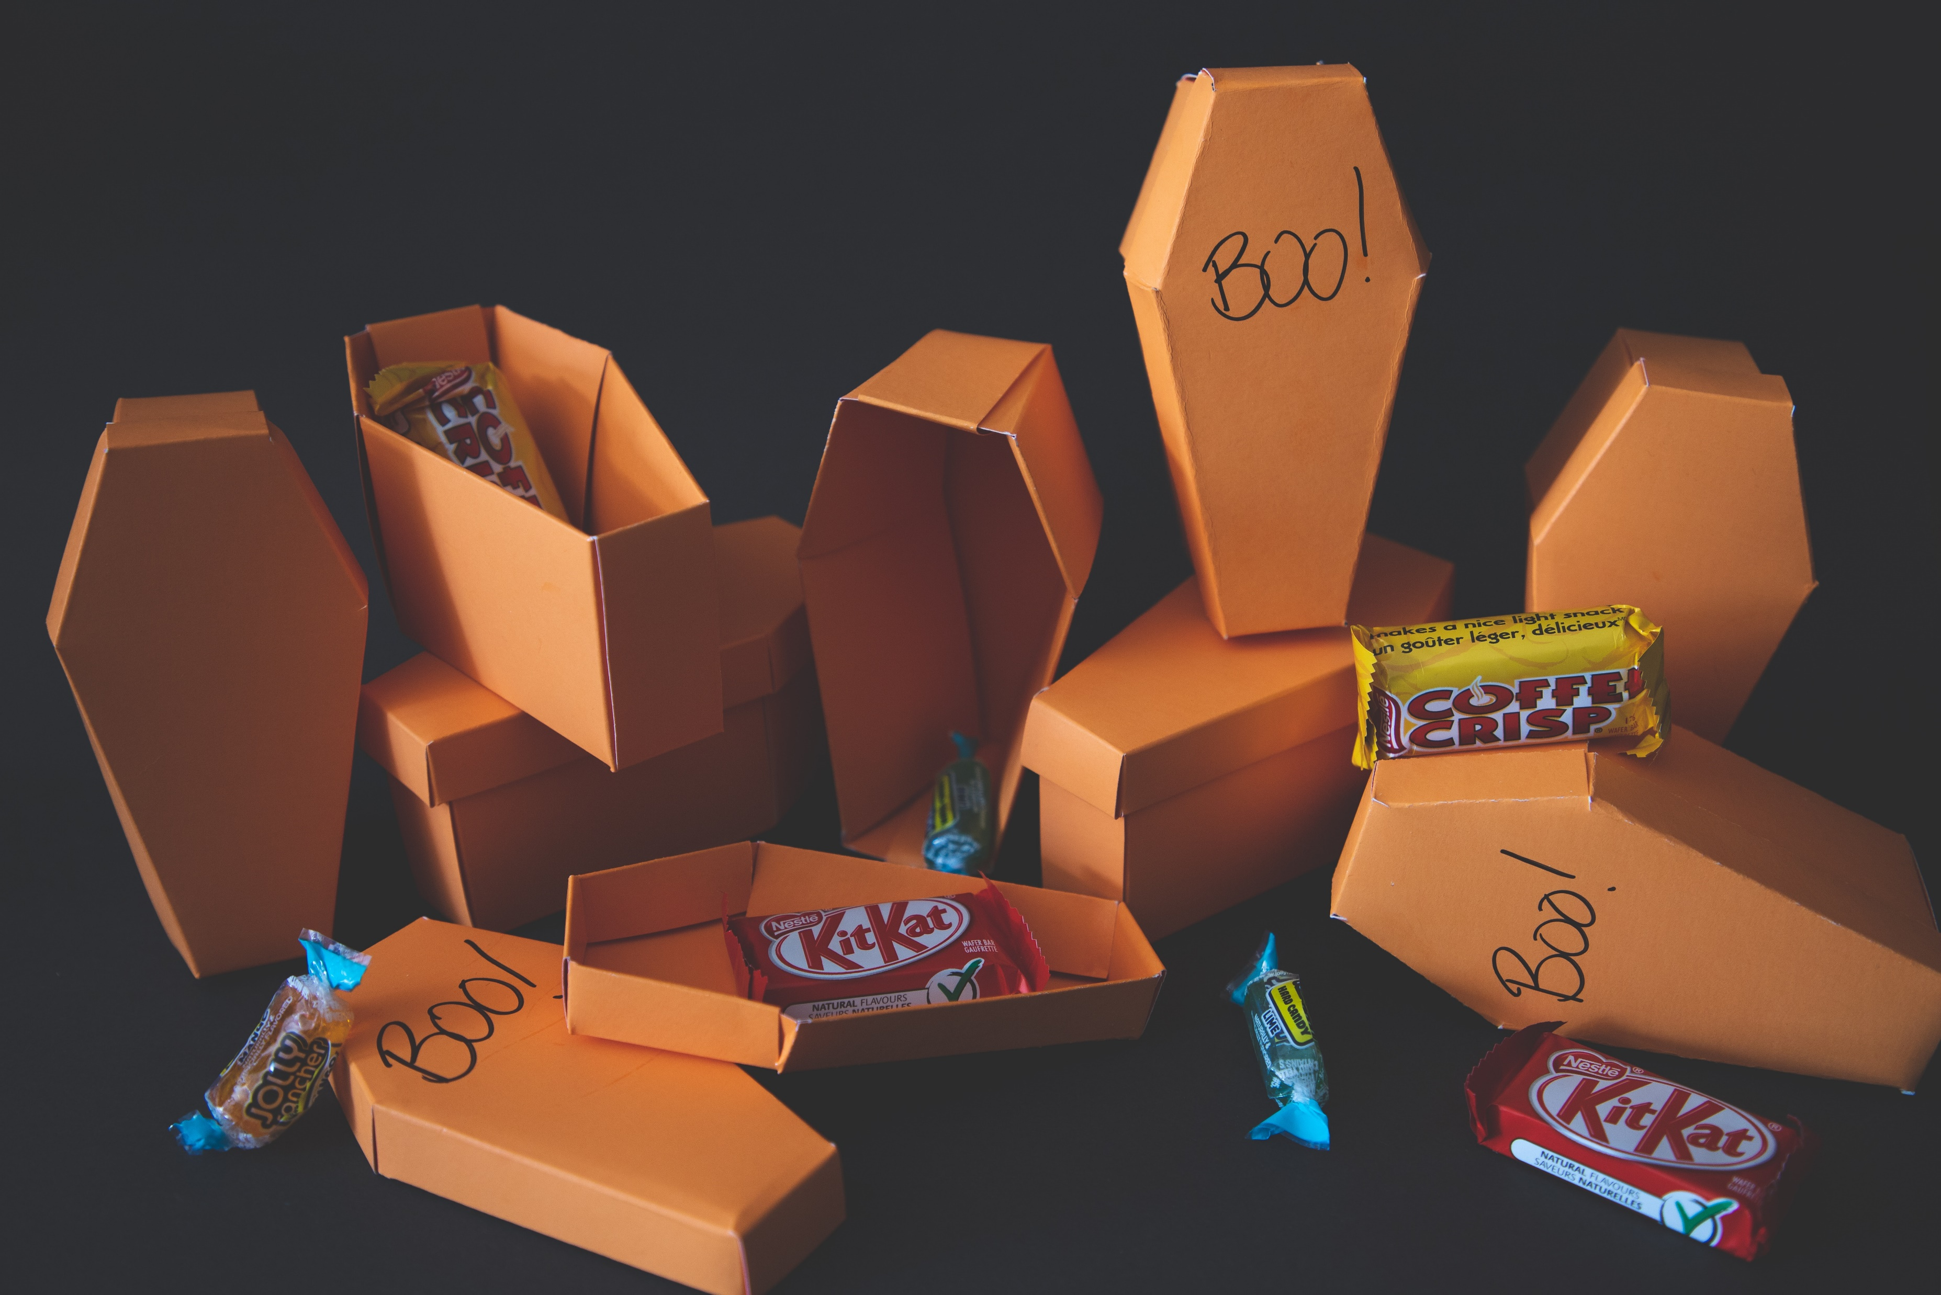
Epicurus’ puzzle
How can death be of any concern to us; why should it mean anything at all?
Death is nothing to us, since while we exist, we are not dead, and when our death occurs, we do not exist.

Slide 6
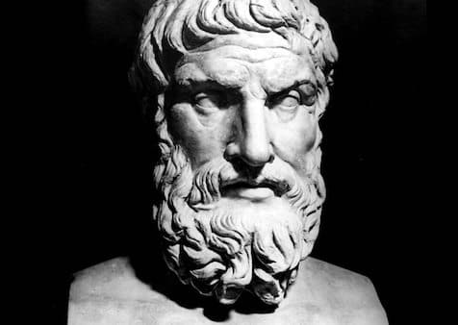
Stoic acceptance?
Since death is natural, and is something over which one has no ultimate control, perhaps it should simply be accepted…
But oddly, the acceptance of death does not seem to be natural…
‘There is only one problematical aspect about [the Stoic acceptance of death], one aspect that arouses our distrust: its secret strain, its tenseness. For at bottom it is after all an attitude directed against nature’ (Joseph Pieper)
This Photo by Unknown Author is licensed under CC BY-NC-ND

Slide 7
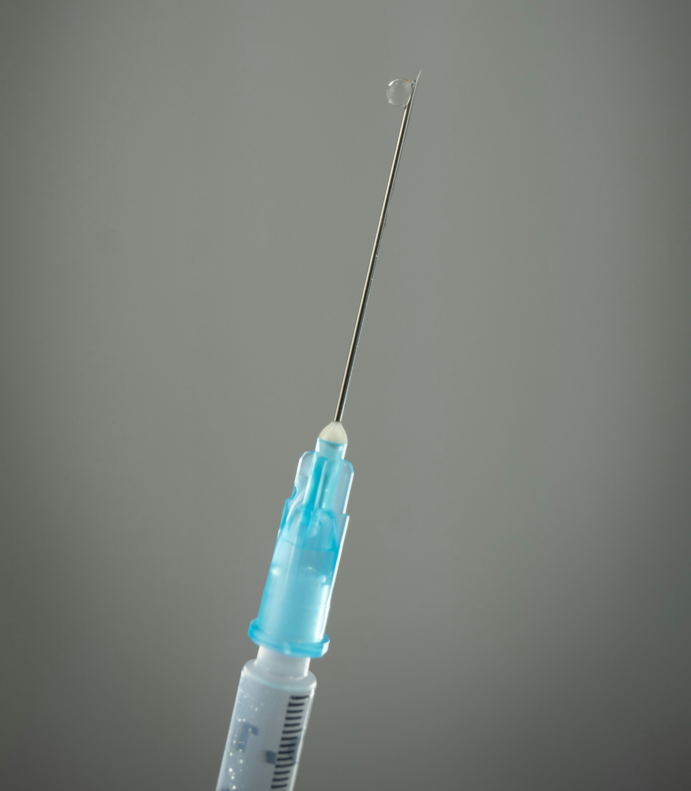
Death as extinction
The mind blanks at the glare. Not in remorse
—The good not done, the love not given, time
Torn off unused—nor wretchedly because
An only life can take so long to climb
Clear of its wrong beginnings, and may never;
But at the total emptiness for ever,
The sure extinction that we travel to
And shall be lost in always. Not to be here,
Not to be anywhere,
And soon; nothing more terrible, nothing more true.
This is a special way of being afraid
No trick dispels. Religion used to try,
That vast moth-eaten musical brocade
Created to pretend we never die,
And specious stuff that says No rational being
Can fear a thing it will not feel, not seeing
That this is what we fear—no sight, no sound,
No touch or taste or smell, nothing to think with,
Nothing to love or link with,
The anaesthetic from which none come round.
(from Phillip Larkin’s ‘Aubade’)

Slide 8
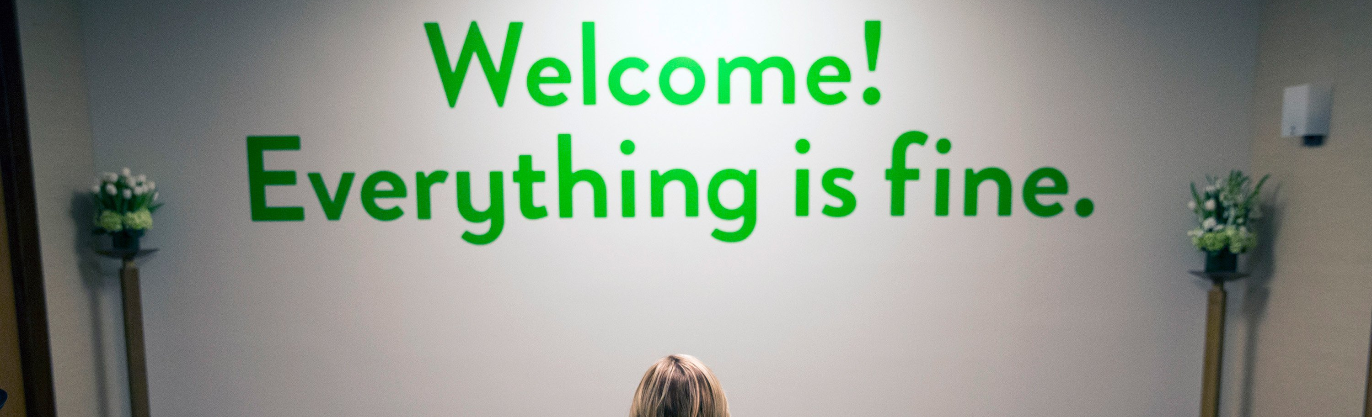
Morality, desire and boredom
But just because we fear death, it doesn’t follow that we actually desire immortality…
‘If all wishes came true no sooner than they were made, then what would occupy human life and on what would time be spent? Suppose this race were transported to a fools paradise, where everything grew on its own and pidgeons flew around already roasted, and everyone found his dearly beloved and held on to her without difficulty. There some would die of boredom, or hang themselves, but some would assault, throttle and murder each other, and thus cause more suffering for themselves than nature now places on them. Thus for such a race no other venue, no other existence is suitable.’ (Schopenhauer)
This Photo by Unknown Author is licensed under CC BY-NC

Slide 9
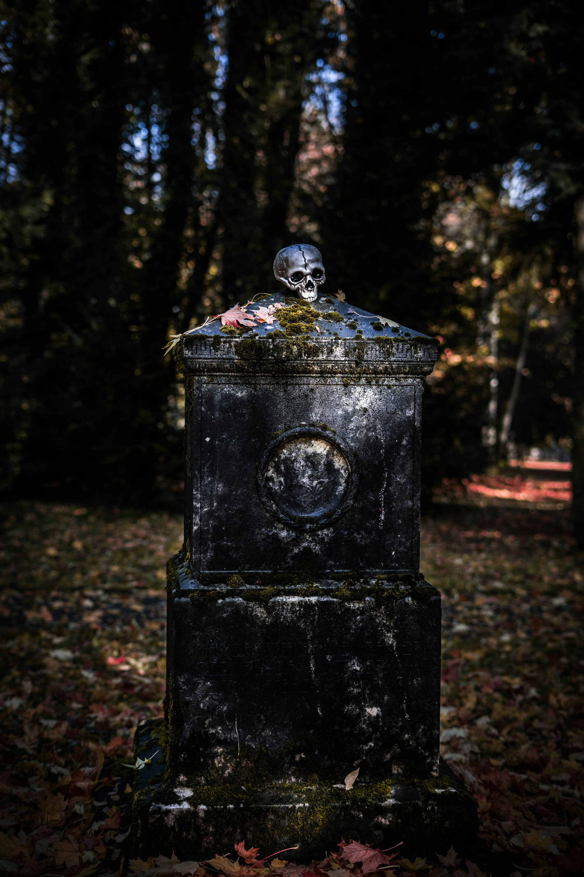
Morality, desire and boredom
Perhaps there is something paradoxical about the relationship between desire and death, e.g.:
‘If we go down into ourselves we find that we possess exactly what we desire. If we long for a certain being (who is dead), we desire a particular, limited being; therefore, necessarily, a mortal, and we long for that special being ‘who’ . . . ‘to whom’ . . ., etc., in short that being who died at such and such a time on such and such a day. And we have that being—dead.
(Simone Weil, Notebooks)

Slide 10
Hagglund on ‘chronophilia’/ ‘chronophobia’
Martin Hagglund explores the nature of the fear of the passage of time, and has tried to show that we cannot separate our love of temporal experiences and beings from our aversion, or fear, of the passing of time:
it could be suggested that we fear the passage of time because we desire something immune to the passage of time: perhaps we ‘want to be timeless but are condemned to a temporal existence’.
instead, Hagglund argues the opposite: ‘We fear time because we want to live on in time. The fear of time (chronophobia) is generated by the love of temporal life (chronophilia), and one cannot even in principle disentangle the two. Rather, the fear of time is part of what animates the desire to hold onto and prolong temporal life.’

Slide 11
Hagglund on ‘chronophilia’/ ‘chronophobia’
For Hagglund, the experience of time is always an experience of loss, in some sense, because in order for any moment to be present, it must be passing. So our desires, and our sense of the meaningfulness of what we desire, is animated by the sense of this passing, and its precariousness
‘The sense of something being valuable or significant is inseparable from the sense that it can be lost. Far from devaluing temporal life, the dimension of loss is part of what makes it emerge as valuable.’
‘The passing away of the moment is thus an inseparable part of what animates the passion for the moment. Furthermore, this passing away is inscribed in the constitution of the moment itself. Time does not overtake a present moment that is first given in itself and then ceases to be. Rather, for time to pass, the present moment must begin to pass away as soon as it comes to be.’

Slide 12
Hagglund on ‘chronophilia’/ ‘chronophobia’
So finitude – especially temporal finitude – actually precedes and grounds the possibility of meaning:
‘If the moment did not negate itself, it could never give way to another moment and there would be no time, only a presence forever remaining the same. This precarious experience of time (of ceasing to be) is not only a negative peril but also the positive possibility of coming into being. Whether in bliss or in mourning, in joy or in pain, we live on after a past that has ceased to be and before a future that may not come to be.’
‘Rather, temporality is intrinsic to the fulfillment of pleasure itself. We do not want to simply “be” in a state of pleasure that is exempt from loss; we want to “linger” in a state of pleasure that is animated by the resistance to its own passing away. This is why the experience of the beautiful—with the pleasure that attends it— increases what Kant calls the “feeling of life” (Lebensgefühl). We are captivated, not by the tranquility of timeless possession but by the feeling of life—of animation—that emerges from trying to retain what is passing away. If you removed this passing away and the attendant relation to loss—in short, if you removed time—you would remove the vitality itself. This is why beauty, as Keats said, is always a “Beauty that must die.” If the experience of beauty and pleasure could not be lost, there would be no “vital interest” in maintaining it

Slide 13
Hagglund on ‘chronophilia’/ ‘chronophobia’
Hagglund sees this at work in our experience of beauty, especially the pleasure of contemplation:
‘According to Kant, when we experience something beautiful the pleasure we feel makes us want to prolong the experience, to maintain ourselves in the state of pleasure. [. . .] What is truly remarkable here is that Kant does not say that we want to overcome the state of lingering in favor of an absolute, timeless fulfillment. Rather, temporality is intrinsic to the fulfillment of pleasure itself. We do not want to simply “be” in a state of pleasure that is exempt from loss; we want to “linger” in a state of pleasure that is animated by the resistance to its own passing away. This is why the experience of the beautiful—with the pleasure that attends it— increases what Kant calls the “feeling of life” (Lebensgefühl). We are captivated, not by the tranquility of timeless possession but by the feeling of life—of animation—that emerges from trying to retain what is passing away. If you removed this passing away and the attendant relation to loss—in short, if you removed time—you would remove the vitality itself. This is why beauty, as Keats said, is always a “Beauty that must die.” If the experience of beauty and pleasure could not be lost, there would be no “vital interest” in maintaining it.’

Slide 14
Hagglund on ‘chronophilia’/ ‘chronophobia’
Hagglund frames his work as a ‘radical atheism’.
some ‘tragic’ atheisms are suppose that we despairingly desire and value that which does not exist (God, immortality, perfection, etc.)
instead, our desires are dependent upon finitude, death, temporal passage, etc.
Our lives are meaningful because we want to survive: to live on
The thought of God, as eternal, perfect, immortal is really the thought of absolute death.

Slide 15
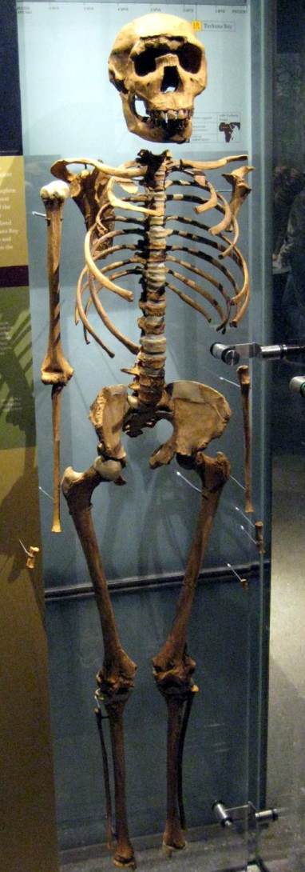
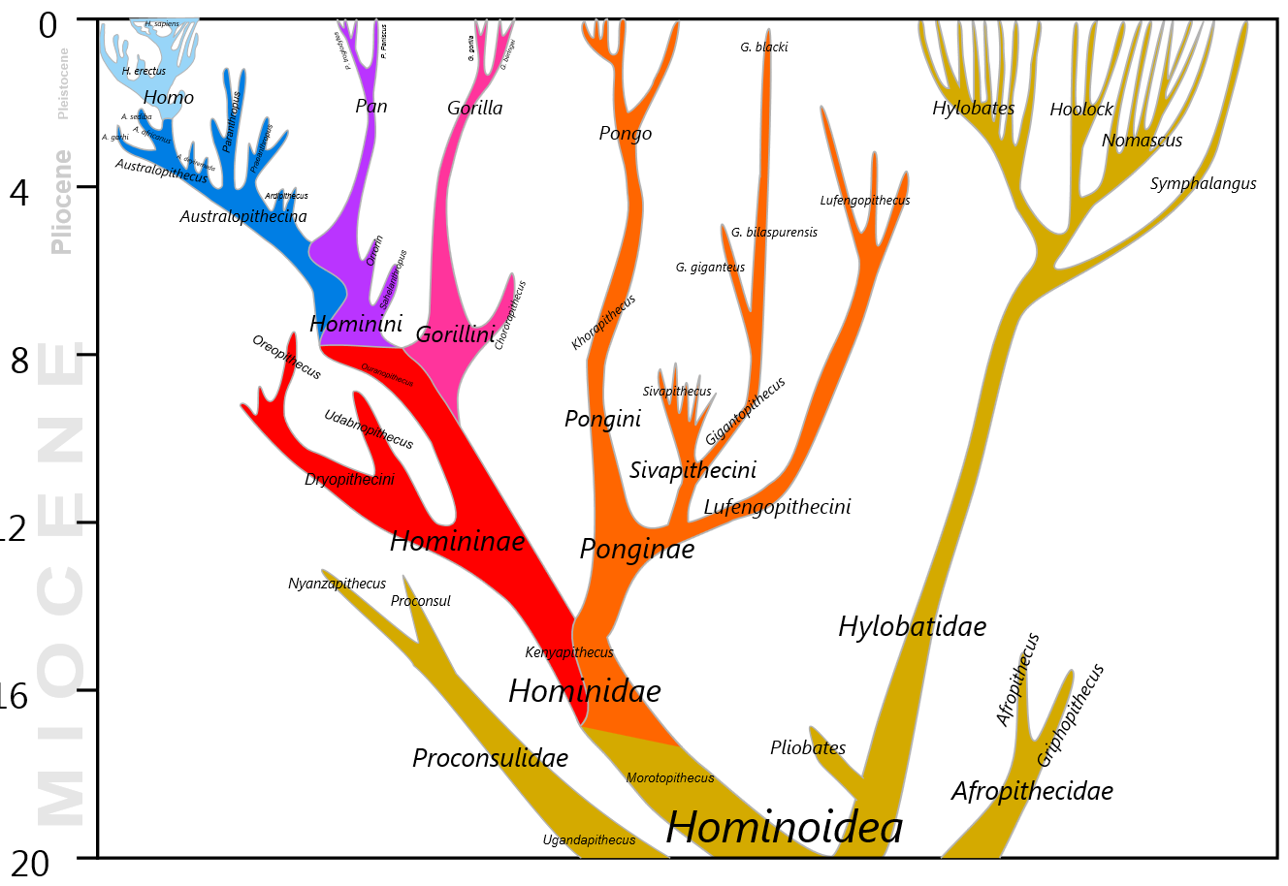

Slide 16
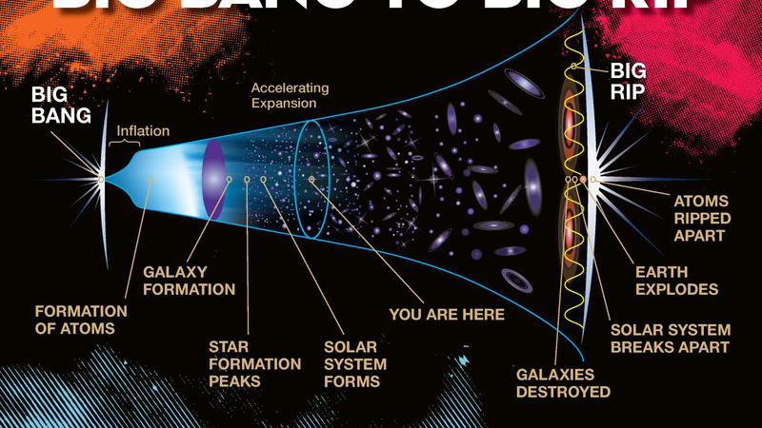
This Photo by Unknown Author is licensed under CC BY

