Slide 1
Meaning and purpose
Philosophy Through the Year: Meaning

Slide 2
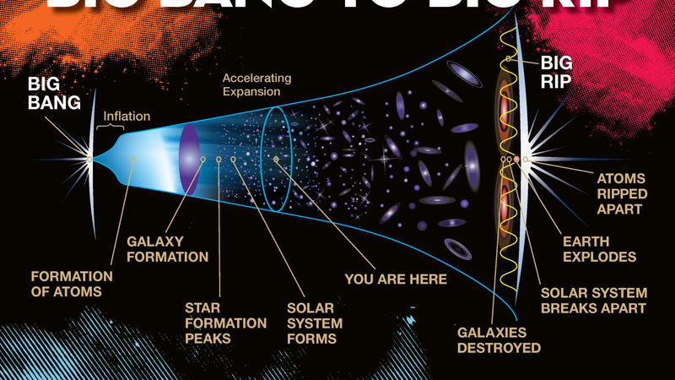
This Photo by Unknown Author is licensed under CC BY

Slide 3
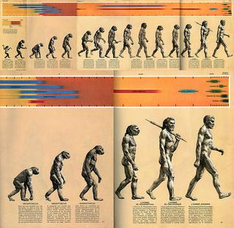
evolution, purpose and progress
This Photo by Unknown Author is licensed under CC BY-SA

Slide 4
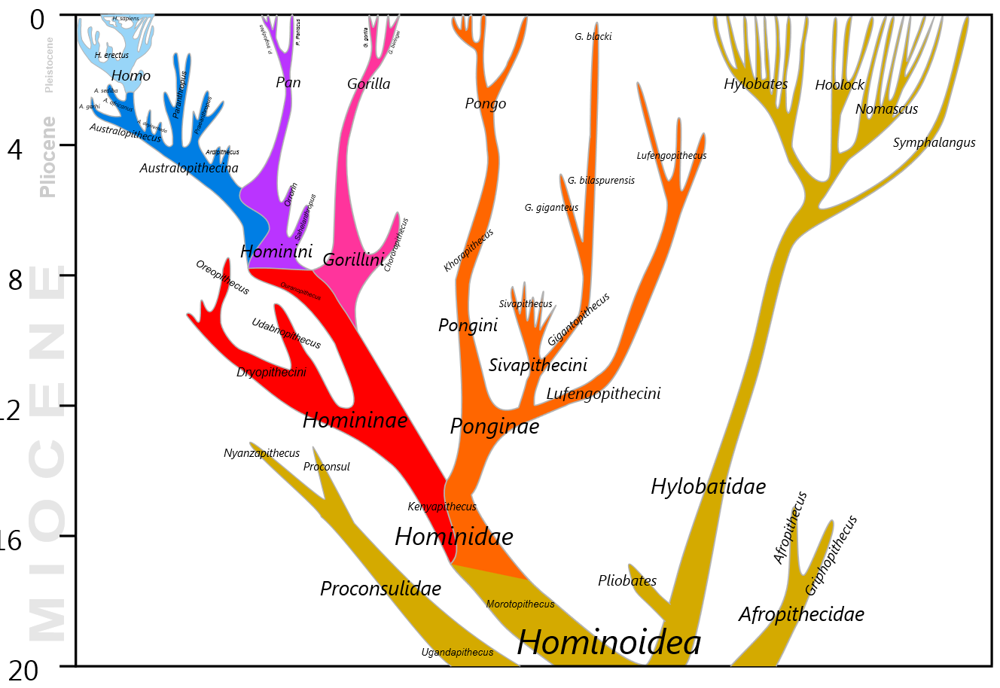
Notes:
Ape family tree: each existent species is equally ‘evolved’; nothing suggests that humans are the goal or purpose or pinnacle of the process

Slide 5
Eternal recurrence (The Gay Science – 1882)
‘The greatest weight. – What, if some day or night a demon were to steal after you into your loneliest loneliness and say to you: “This life as you now live it and have lived it, you will have to live once more and innumerable times more; and there will be nothing new in it, but every pain and every joy and every thought and sigh and everything unutterably small or great in your life will have to return to you, all in the same succession and sequence – even this spider and this moonlight between the trees, and even this moment and I myself. The eternal hourglass of existence is turned upside down again and again, and you with it, speck of dust!”’

Slide 6
Eternal recurrence (The Gay Science – 1882)
‘Would you not throw yourself down and gnash your teeth and curse the demon who spoke thus? Or have you once experienced a tremendous moment when you would have answered him: “You are a god and never have I heard anything more divine.” If this thought gained possession of you, it would change you as you are or perhaps crush you. The question in each and every thing, “Do you desire this once more and innumerable times more?” would lie upon your actions as the greatest weight. Or how well disposed would you have to become to yourself and to life to crave nothing more fervently than this ultimate eternal confirmation and seal? –’ (236 -7)

Slide 7

causes, purposes and reasons
Notes:
Consider this: you have two younger siblings….
“it’s a reaction to distress, designed to attract the attention of a primary care-giver”

Slide 8
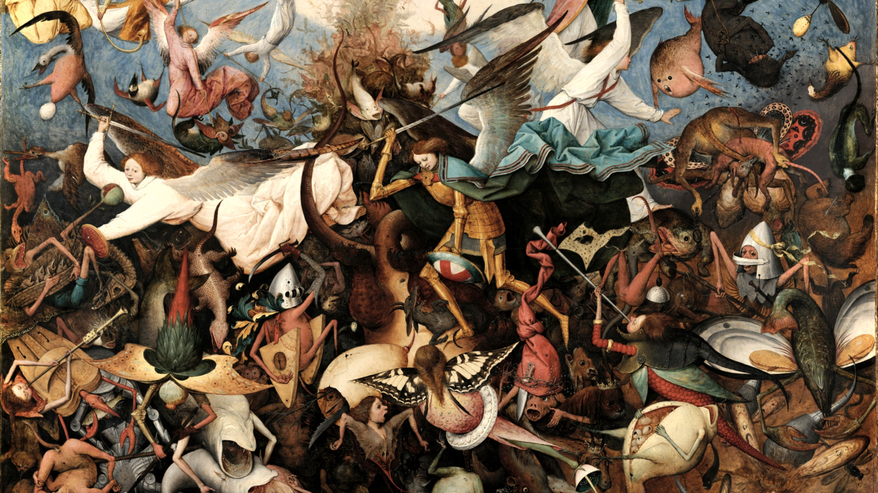
purpose, meaning and desire

Slide 9
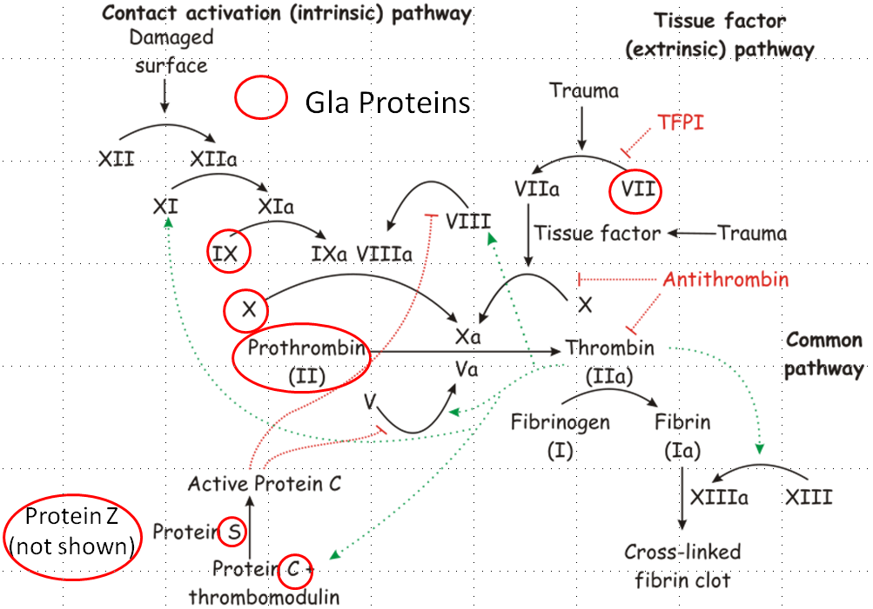
Design and purpose
Complexity with purpose is suggestive of design…
This Photo by Unknown Author is licensed under CC BY

Slide 10
Design/teleological arguments
ordered complexity in nature
(existence of goal-oriented things)
(analogy)
(causal reasoning/inference to best explanation - abduction)
Human artifacts (e.g. a watch)
Human designer
Cosmic designer (= ‘God’)
(analogy)

Slide 11
Design/teleological arguments
Ordered complexity in nature
(existence of goal-oriented things)
(causal reasoning/inference to best explanation - abduction)
The existence of rdered complexity in nature is exceedingly unlikely;
Given the existence of God, biological complexity is (much) less unlikely;
Therefore it is (very?) likely that God exists.
Cosmic designer (= ‘God’)

Slide 12
Design/teleological arguments
The ‘fine-tuning’ of physical constants for life
(causal reasoning/inference to best explanation - abduction)
The ‘fine-tuning’ of the universe for life is exceedingly unlikely;
Given the existence of God, fine-tuning of the universe for life is (much) less unlikely;
Therefore it is (very?) likely that God exists.
Cosmic designer (= ‘God’)

Slide 13
Design/teleological arguments
ordered complexity in nature
(existence of goal-oriented things)
(causal reasoning/inference to best explanation - abduction)
Evil, suffering, misery?
(evil would be unlikely on theistic hypothesis)
Cosmic designer (= ‘God’)
So now theism is more complicated, in explanatory terms.

Slide 14
Design/teleological arguments
ordered complexity in nature
(existence of goal-oriented things)
(causal reasoning/inference to best explanation - abduction)
Evil, suffering, misery?
Well-meaning but incompetent cosmic designer?

Slide 15
Design/teleological arguments
ordered complexity in nature
(existence of goal-oriented things)
(causal reasoning/inference to best explanation - abduction)
Evil, suffering, misery?
Cosmic designer and torturer?

Slide 16
Design/teleological arguments
existence of goal-oriented things
e.g. blood coagulation
where purpose of blood-coagulation = swift healing after injury
where purpose of blood-coagulation = strokes and heart-attacks
Utilitarian population controller?
Benevolent cosmic designer?
Purpose of blood-clotting is healing after injury, when seen from point of view of individual organism. But if we involve a cosmic designer, how should we assess the purpose of something that has mixed results?

