Slide 1
LJC Philosophy through the year
The philosophy of love
Week 3: philia
DR SARAH PAWLETT JACKSON

Slide 2
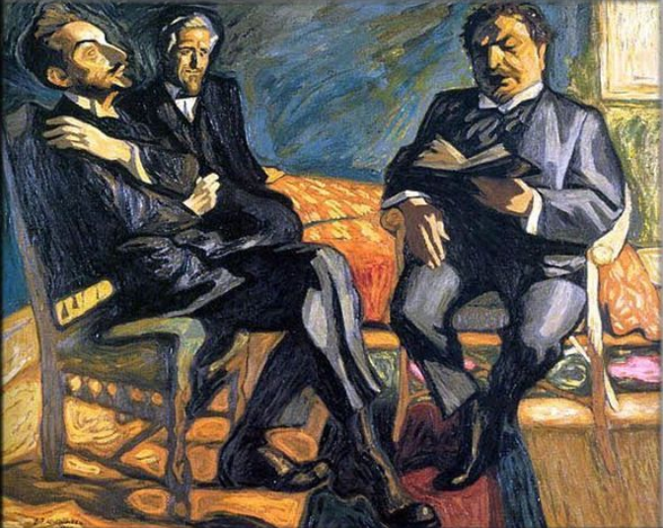
Defining Friendship
Possible characteristic features of friendship:
Enjoying the other’s company
Reciprocity
Similarity/equality
Having shared interests
Involving particularity, partiality and exclusivity
Involving choice
Sophus Claussen reading his poem Imperia for Helge Rode & JF Willumsen, Jens Ferdinand Willumsen, 1915

Slide 3
Defining Friendship
Enjoying the other’s company
  We want to spend time with our friends, to be in their presence
  We find being with them pleasant – or at least don’t not want to spend time with them
‘Friends enjoy each other’s company’ (Aristotle, Nicomachean Ethics, 214)
‘Accepting each other without living together is more like good will than friendship. For nothing is so characteristic of friends as living together.’ (NE 213)
Reciprocity
  Reciprocity is a necessary feature of friendship, unlike eros and agape. Where the latter two can involve one-sidedness or asymmetry, this is not possible with friendship. An unrequited ‘friendship’ isn’t a friendship.
‘If there is to be friendship, the parties must have good will towards each other , i.e. wish good things for each other, and be aware of the other’s doing so.’ (NE 210)

Slide 4
Defining Friendship
Similarity/equality
In friendship there is ‘resemblance between the parties.’ (NE 212)
‘In all aspects each party gets the same or similar things from the other, which is an attribute friendship should have.’ (NE 212)
‘Equality…is something that is thought to be characteristic of friendship.’ (NE 216)
Having shared interests
‘The proverb says, ‘What belongs to friends is shared in common’, and correctly so; for friendship depends upon sharing.’ (NE 218)
‘But it is not possible for people to spend their time with each other if they are not pleasant, and if they do not enjoy the same things, which seems to be characteristic of comradely friendship.’ (NE 214)

Slide 5

Defining Friendship
Involving particularity, partiality and exclusivity
‘It is not possible to be a friend to many in the case of the complete kind of friendship’ (NE 214)
‘Friendships are particular and partial…You cannot be friend with everyone without evacuating ‘friendship’ of all meaning.’ (Soskice, 2007, p160)
Involving choice
‘…for one can feel love no less to towards inanimate than towards animate objects , but reciprocal loving involves decision’ (NE 214)
Two Girls, August Macke, 1913

Slide 6

Aristotle’s three types of Friendship
The useful: relationships based upon mutual advantage
The pleasant: relationships based upon mutual pleasure
The good: relationships based upon mutual admiration

Slide 7
Friendship & ethics
Is the particularity and partiality of friendship a danger to ethics?
Is friendship a means to virtue?
‘ …there is no need for rules of justice between people who are friends, whereas if they are just they still need friendship – and of what is just, the most just is thought to be what belongs to friendship.’ (NE 209)

Slide 8

Friendship with God?
Aristotle: ‘Now there is no precise way of determining in such cases up to what point people can still be friends, for many things can be taken away, and friendship still remains. But if the separation is wide, as between man and god, that is no longer possible.’ (NE 216)
By contrast, Soskice emphasises ways that humanity and divinity shares things as ‘of the same kind’ or as ‘kin’, which makes philia an appropriate way of understanding human-divine relationships:
‘Because friendship is not based on shared perfection in virtue, and is not static, within this way of thinking there is room to say that we might become friends of God.’ (Soskice, 2007, p176)

Slide 9
Slide Tite
References and Further Reading
Aelred of Rievaulx (1979) Spiritual Friendship, trans. Mary Eugenia Laker, Cistercian Publications)
Aristotle, Nicomachean Ethics, trans. Sarah Broadie and C.J. Lowe, (2002) Oxford University Press
Chappell, Sophie Grace (2024) A Philosopher Looks at Friendship, Cambridge University Press
Lewis, C.S (1963) The Four Loves, Collins.
Soskice, Janet (2007) The Kindness of God: Metaphor, Gender and Religious Language, Oxford University Press)

