Slide 1
Incarnation: God with us
Stuart Jesson
London Jesuit Centre

Slide 2

Incarnation
If a child asked you to explain the meaning of the Christian idea of incarnation, what would you say? What images, or analogies, would seem helpful?
What further questions might be raised?
What are the problems, or shortcomings, of this explanation?

Slide 3
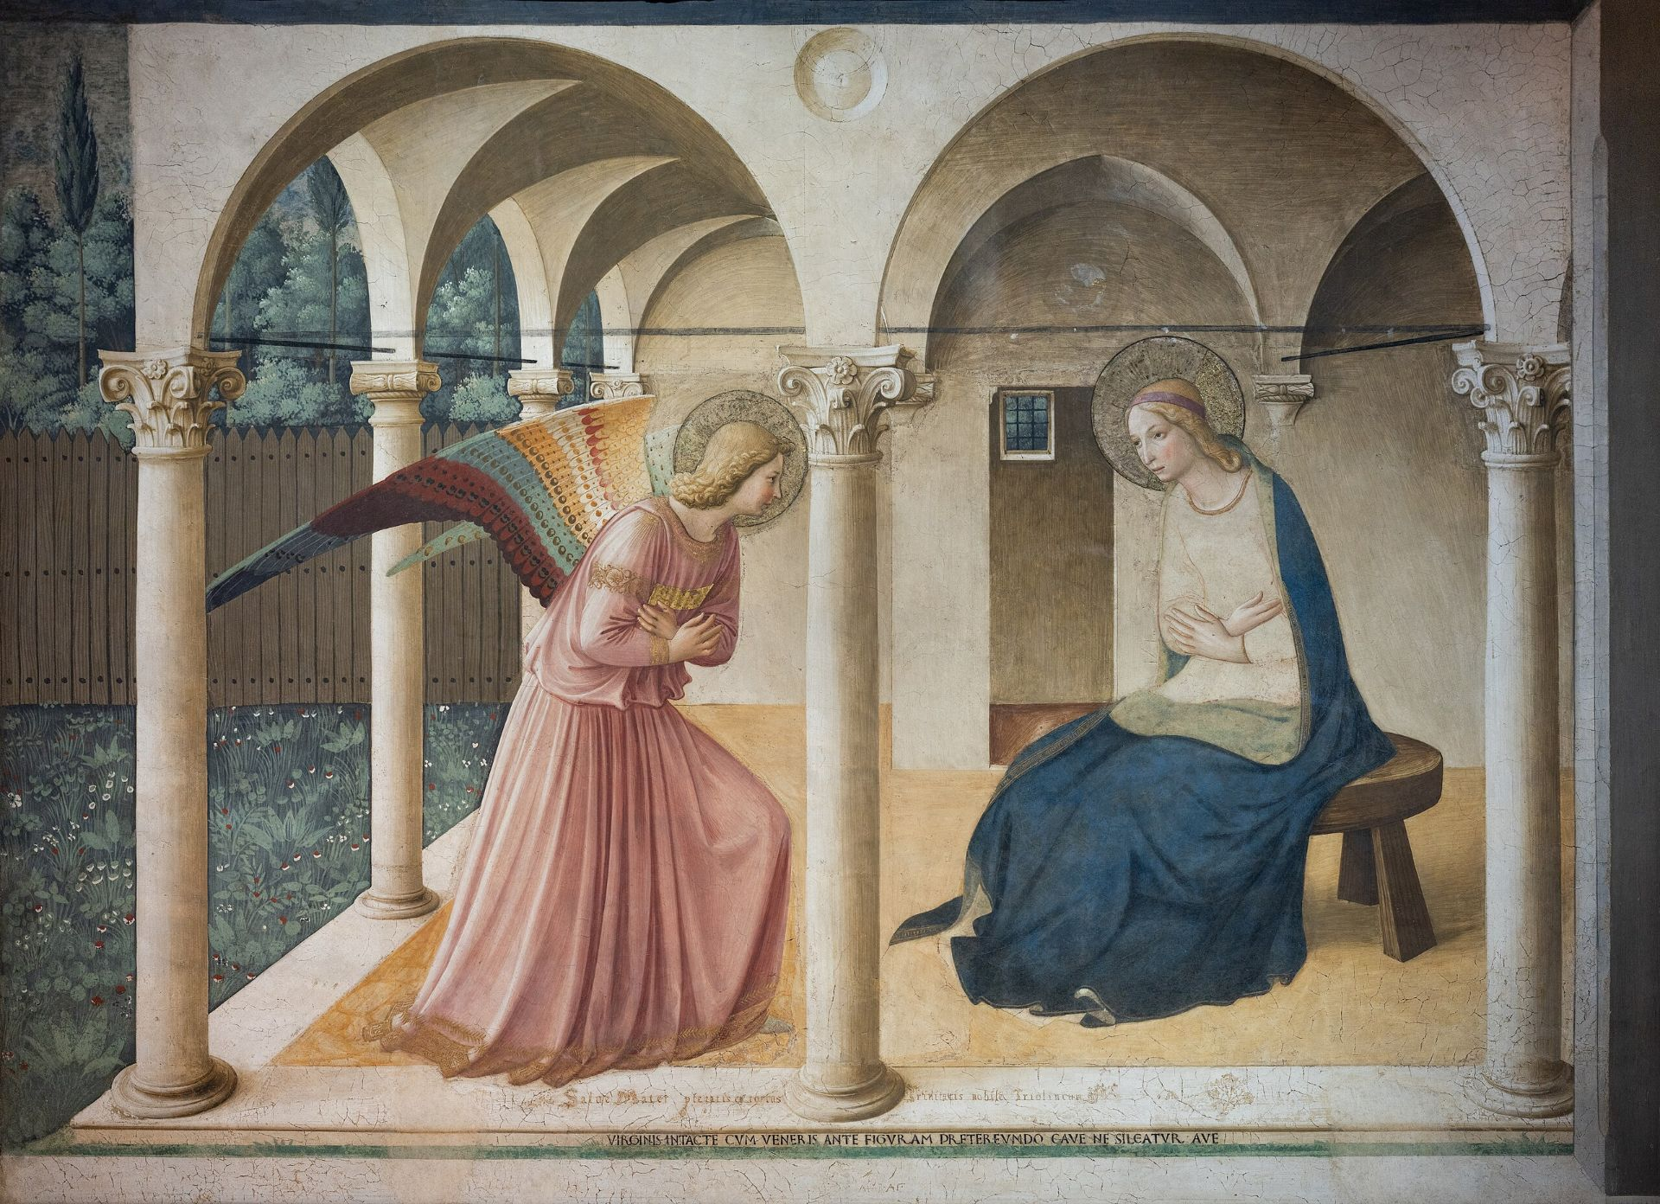
Incarnation – the basic idea
‘For us men and for our salvation, he came down from heaven, and by the Holy Spirit was incarnate of the Virgin Mary, and was made man.’
from the Latin verb ‘incarno’, meaning ‘to make flesh’, or ‘to be made flesh’

Slide 4

Incarnation – the basic idea
‘The Church calls “Incarnation” the fact that the Son of God assumed a human nature, in order to accomplish our salvation in it.
‘assume’ means something like to take up, take on, or adopt; and it is ‘a human nature’ that is adopted, or assumed.

Slide 5

Incarnation – the basic idea
‘For us men and for our salvation, he came down from heaven, and by the Holy Spirit was incarnate of the Virgin Mary, and was made man.’
on the surface of things, at least, it seems like something is changing on the side of God: but does God change?
how can Jesus have been made man, ‘Jesus of Nazareth’ is the name of a man….
or is there a part of God called ‘Jesus’? And would this mean that this Jesus existed before his birth? And if he did, doesn’t that make him very much unlike every other human being who has ever existed?
Etc….
This Photo by Unknown Author is licensed under CC BY-SA

Slide 6
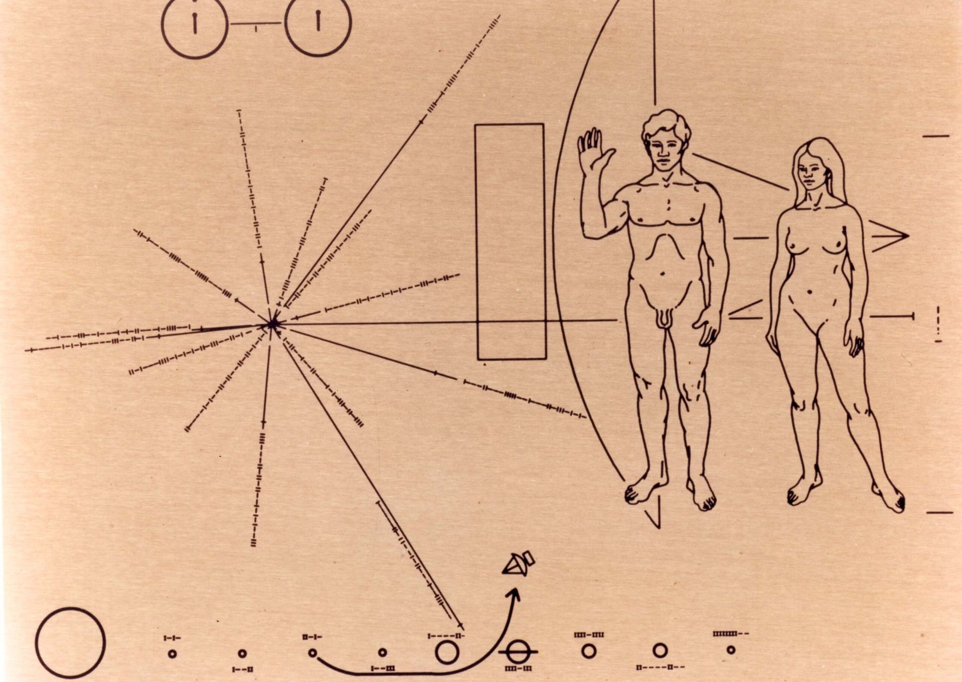
Incarnation – the basic idea
‘The Church calls “Incarnation” the fact that the Son of God assumed a human nature, in order to accomplish our salvation in it.
what does it mean to ‘assume’ a human nature? Isn’t a nature just what something is; what sort of thing it is, at all?
and does it make sense to speak of ‘a’ human nature?
how is our salvation accomplished in the Son of God’s ‘human nature’?
does the Son of God still ‘have’ a human nature?
Etc…

Slide 7
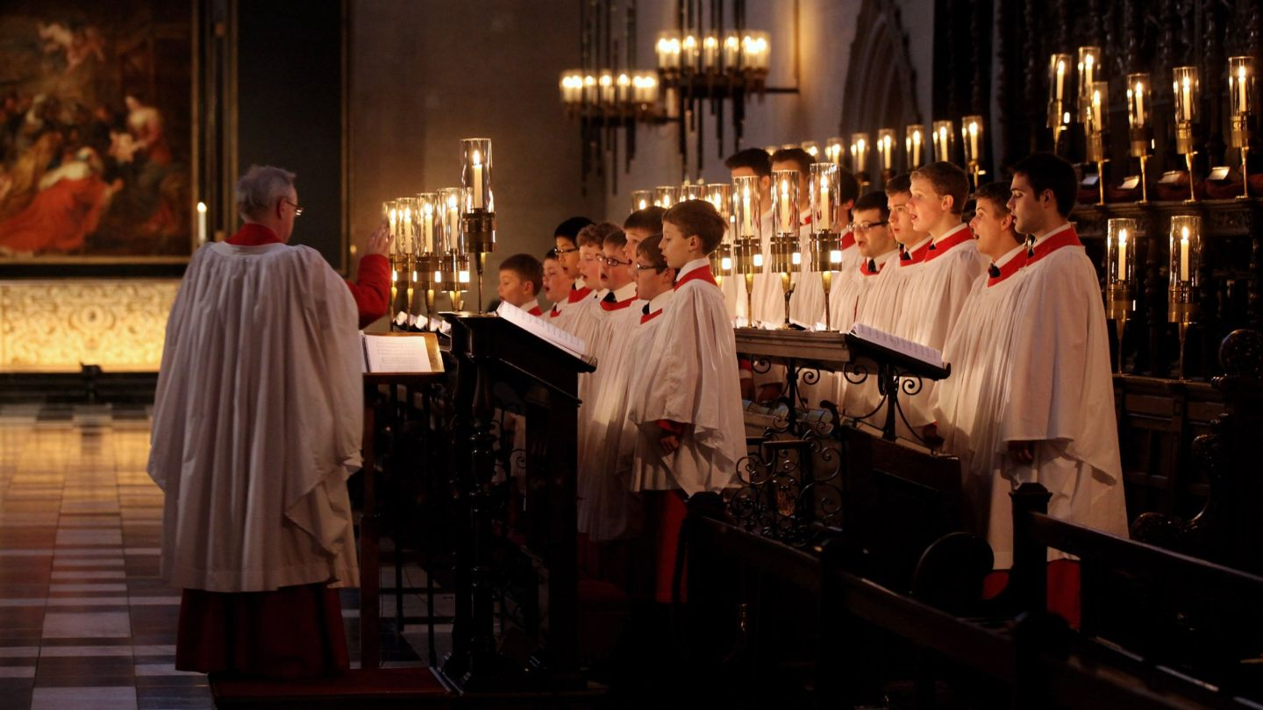
Incarnation in the NT
John 1:
‘And the Word became flesh and lived among us, and we have seen his glory, the glory as of a father’s only son, full of grace and truth. (John testified to him and cried out, ‘This was he of whom I said, “He who comes after me ranks ahead of me because he was before me.”’) From his fullness we have all received, grace upon grace. The law indeed was given through Moses; grace and truth came through Jesus Christ. No one has ever seen God. It is God the only Son, who is close to the Father’s heart, who has made him known.’

Slide 8
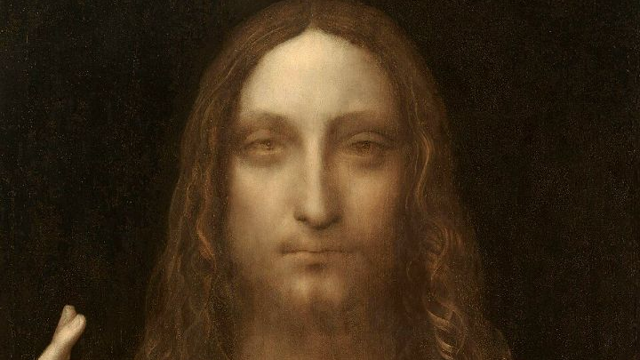
Incarnation in the NT
Hebrews 1
'Long ago God spoke to our ancestors in many and various ways by the prophets, but in these last days he has spoken to us by a Son, whom he appointed heir of all things, through whom he also created the worlds. He is the reflection of God’s glory and the exact imprint of God’s very being, and he sustains all things by his powerful word. When he had made purification for sins, he sat down at the right hand of the Majesty on high, having become as much superior to angels as the name he has inherited is more excellent than theirs.’

Slide 9
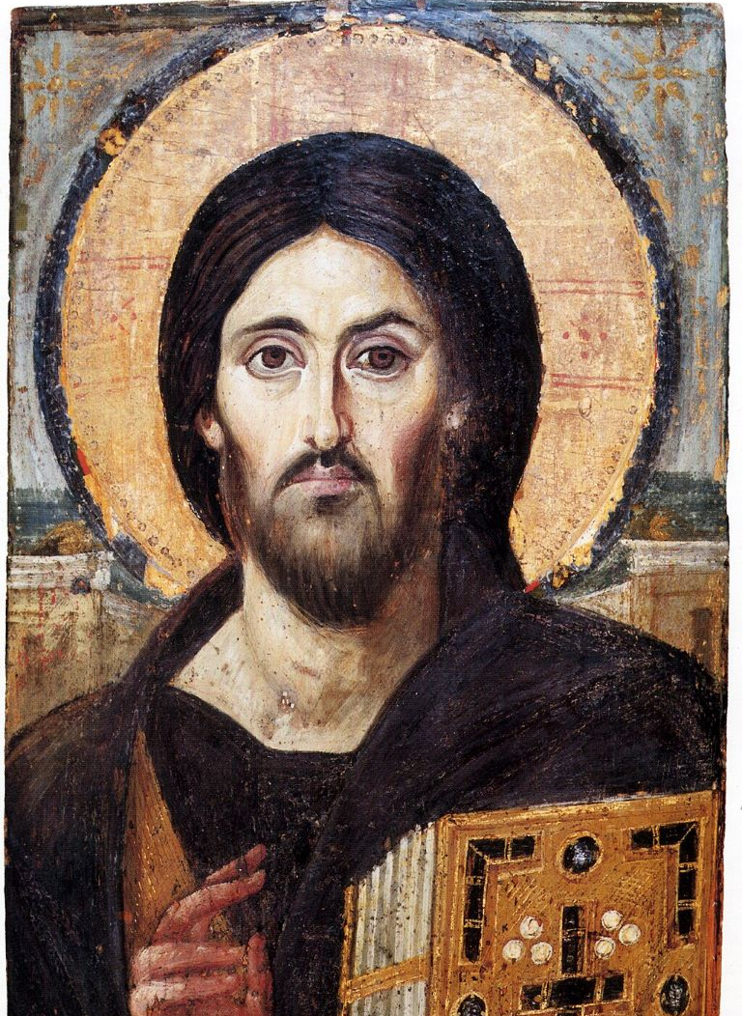
Incarnation in the NT
Colossians 1
‘He is the image of the invisible God, the firstborn of all creation; for in him all things in heaven and on earth were created, things visible and invisible, whether thrones or dominions or rulers or powers—all things have been created through him and for him. He himself is before all things, and in him all things hold together. He is the head of the body, the church; he is the beginning, the firstborn from the dead, so that he might come to have first place in everything. For in him all the fullness of God was pleased to dwell, and through him God was pleased to reconcile to himself all things, whether on earth or in heaven, by making peace through the blood of his cross.’

Slide 10
Incarnation in the NT
1 Timothy 3: 16
‘Without any doubt, the mystery of our religion is great:
He was revealed in flesh,
vindicated in spirit,
seen by angels,
proclaimed among Gentiles,
believed in throughout the world,
taken up in glory.’

Slide 11
Incarnation in the NT
Philippians 2
Let the same mind be in you that was in Christ Jesus,
who, though he was in the form of God,
did not regard equality with God
as something to be exploited,
but emptied himself,
taking the form of a slave,
being born in human likeness.
And being found in human form,
he humbled himself
and became obedient to the point of death—
even death on a cross.
Therefore God also highly exalted him
and gave him the name
that is above every name,
so that at the name of Jesus
every knee should bend,
in heaven and on earth and under the earth,
and every tongue should confess
that Jesus Christ is Lord,
to the glory of God the Father.

Slide 12
Incarnation, mystery and paradox
‘Whether from 'above' or 'below' the tension is always between the appropriating and reducing of revelation to the 'given' world of our understanding or, on the other hand, working through the full implications of its challenge. The Incarnation is fundamentally unthinkable within our existing categories of 'God', 'man', 'time' and 'eternity’. [. . .]
‘Whether we start from above or below, the question is whether the Incarnation is conceiveable. It is experienced as a problem because of what is thinkable and unthinkable according to the canons of our age. Every Christology which takes revelation seriously is driven to speak in apparent paradox as it comes up against the boundaries of thought.’ (Hanvey 1985)

Slide 13
Incarnation, mystery and paradox
Hanvey is suggesting that thinking incarnation demands a re-thinking, or metanoia (repentance) in our understanding of God and humanity:
God can be 'made human'; what, then, does it mean for God to be God?
Human nature has been 'assumed' by God; what, then, does it mean to be human?
Jesus Christ is 'God with us'; what, then, does it mean for God to be 'with' us?
  (John 3: 16: 'It was in this way that God loved the world: that he gave his only son...')

Slide 14
Incarnation connections
If the doctrine of incarnation is at the centre of Christian thought, then how we understand it will influence all other areas (and vice-versa). E.g.
Salvation;
Trinity;
Ecclesiology;
Eschatology;
Anthropology;
Sacraments

Slide 15
Incarnation and salvation
In the early centuries, the doctrine of incarnation was very heavily contested and debated, and so carefully elaborated and developed. Why? Primarily because of the connection between incarnation and salvation:
‘It can be shown that there are soteriological motives behind all the Christological pronouncements of the early church. Both the defence of the true divinity and that of the true humanity are intended to ensure the reality of Redemption.’ (Kasper, 2011: 10).
The seven ecumenical councils ‘presumed and prescribed a conception of salvation as the deification of human beings through their graced inclusion into trinitarian life’ (Anatolios 2020: 168).

Slide 16
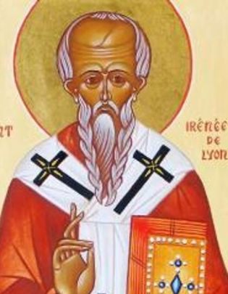
Incarnation and salvation
E.g. Irenaeus of Lyon:
'For it was for this end that the Word of God was made man, and He who was the Son of God became the Son of man, that man, having been taken into the Word, and receiving the adoption, might become the son of God. For by no other means could we have attained to incorruptibility and immortality, unless we had been united to incorruptibility and immortality. But how could we be joined to incorruptibility and immortality, unless, first, incorruptibility and immortality had become that which we also are, so that the corruptible might be swallowed up by incorruptibility, and the mortal by immortality, that we might receive the adoption of sons?' (AH. III. 19. 1)

Slide 17
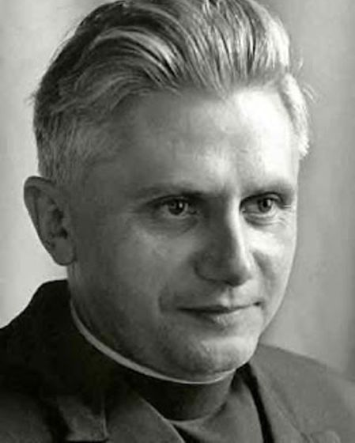
Incarnation and ecclesiology
Catechism, para. 770/Lumen gentium para. 8
‘The Church is in history, but at the same time she transcends it. It is only "with the eyes of faith“ that one can see her in her visible reality and at the same time in her spiritual reality as bearer of divine life.’
So, it is as if the Church has ‘two natures’…
But is still ‘one holy catholic and apostolic church’
So in some sense, the paradoxical language of incarnation is carried over into ecclesiology, precisely because the Church is understood in terms of the Body of Christ, the presence of God, etc.
'Is the Church not simply the continuation of God’s deliberate plunge into human wretchedness?’ (Joseph Cardinal Ratzinger)

Slide 18
Incarnation and ecclesiology
'Christ, the one Mediator, established and continually sustains here on earth His holy Church, the community of faith, hope and charity, as an entity with visible delineation through which He communicated truth and grace to all. But, the society structured with hierarchical organs and the Mystical Body of Christ, are not to be considered as two realities, nor are the visible assembly and the spiritual community, nor the earthly Church and the Church enriched with heavenly things; rather they form one complex reality which coalesces from a divine and a human element. For this reason, by no weak analogy, it is compared to the mystery of the incarnate Word. As the assumed nature inseparably united to Him, serves the divine Word as a living organ of salvation, so, in a similar way, does the visible social structure of the Church serve the Spirit of Christ, who vivifies it, in the building up of the body.'

Slide 19
Incarnation and divine purpose
For some Church Fathers, incarnation has been understood as the ultimate goal of creation, prior to sin. E.g. Maximus Confessor (580-662):
‘This is the great and hidden mystery, at once the blessed end for which all things are ordained. It is the divine purpose conceived before the beginning of created beings. In defining it we would say that this mystery is the preconceived goal for which everything exists, but which itself exists on account of nothing. With a clear view to this end, God created the essences of created beings, and such is, properly speaking, the terminus of His providence and of the things under His providential care. Inasmuch as it leads to God, it is the recapitulation of the things he has created. It is the mystery which circumscribes all the ages, and which reveals the grand plan of God (cf. Eph 1:10-11), a super-infinite plan infinitely preexisting the ages. The Logos, by essence God, became a messenger of this plan (cf. Is 9:5) when He became a man and, if I may rightly say so, established Himself as the innermost depth of the Father’s goodness while also displaying in Himself the very goal for which His creatures manifestly received the beginning of their existence.’
Some recent theologians (e.g. Sam Wells, Edwin Van Driel), we should adopt an ‘incarnation anyway’ view of God’s purposes: incarnation is not primarily aimed, or motivated by, sin.

